Slide 1
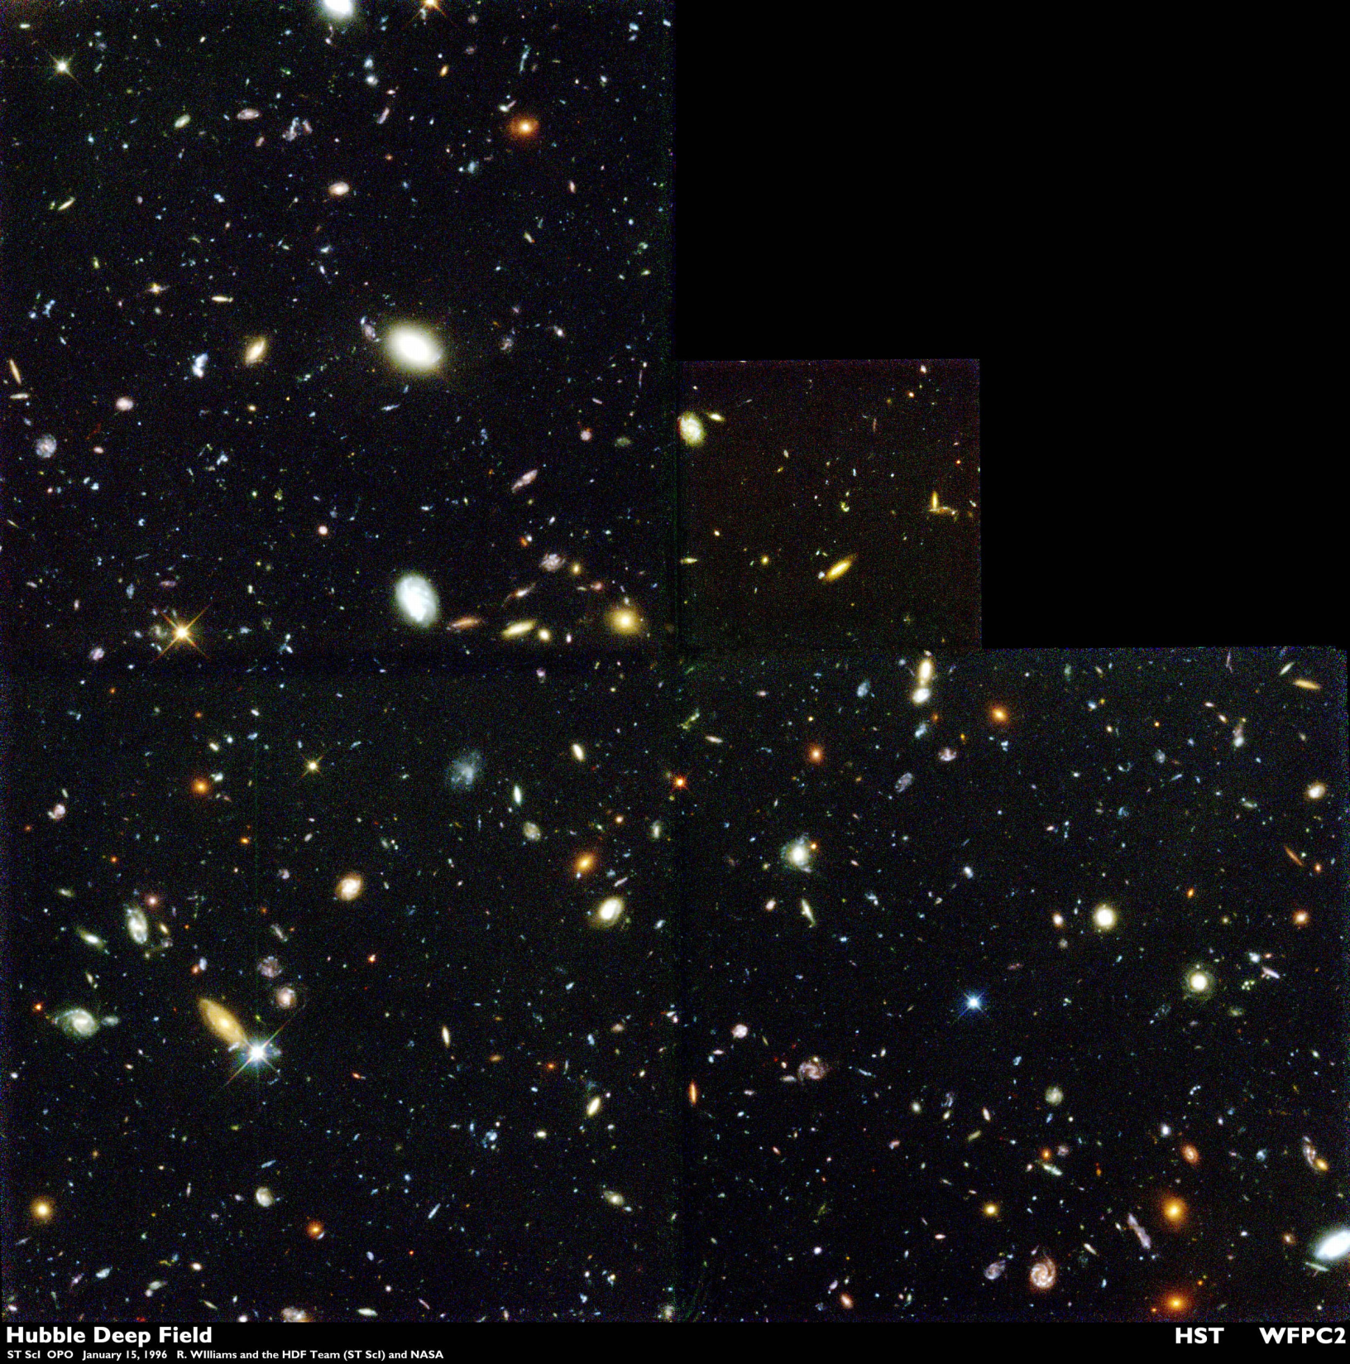
The
Universe

Slide 2
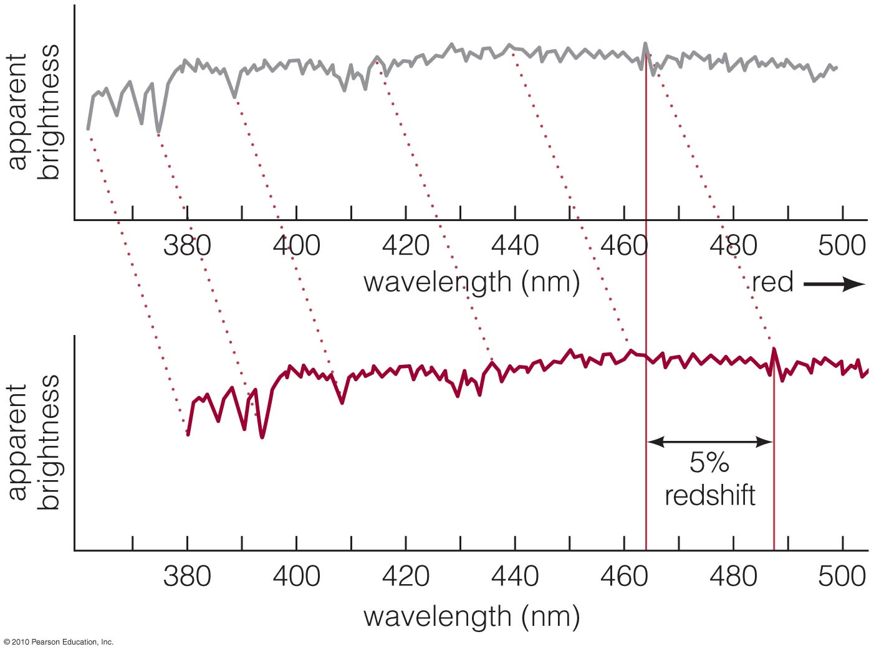
Observations: Galaxy Spectra
Spectral features of almost all galaxies are redshifted
Notes:
The only ones that are not are close enough to be gravitationally bound to us.

Slide 3
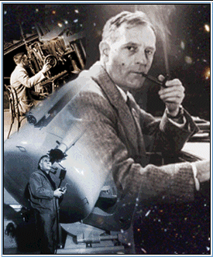
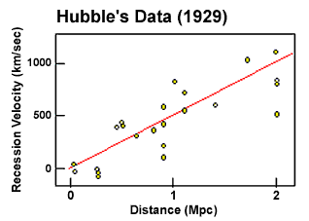
Galactic Red Shift
Everything is moving away!
Notes:
After determining that the distance to M31 (Andromeda) is about 3 million light years, Edwin Hubble went on to survey many other galaxies.
Hubble noticed that all of the galaxies he was measuring were red shifted…
In fact there was a correlation between distance and recessional velocity.
More distant galaxies were moving away FASTER than nearby galaxies.
This relationship is called Hubble’s Law.
The slope of the line (H₀) is Hubble’s Constant.

Slide 4
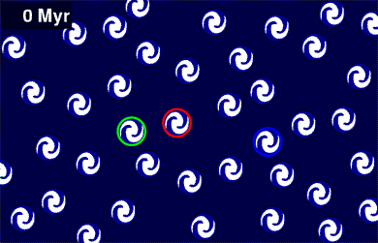
The Universe is Expanding
The space between galaxies must be increasing
Notes:
ANIMATED GIF WAIT FOR IT TO PLAY
Hubble observed that all galaxies have red shift.
More distant galaxies have larger red shifts.
Like raisins in a cake, the cake stuff expands and the space between raisins gets larger.
Hubble’s Law arises naturally from a uniformly expanding universe. (uniform means that the expansion appears to be the same everywhere!)
Einstein was very embarrassed when Hubble demonstrated that the universe is expanding.
He called the cosmological constant his greatest folly.

Slide 5
Hubble’s Law
Galaxies are moving away from us
V
=
H
D
0
Large distances are quoted in redshift
Farther = Faster
Notes:
Hubble, after his success with M31, was measuring distances to a whole bunch of galaxies.
He noticed something peculiar. The more distant a galaxy is, the more it is red shifted.
In fact, there is a linear relationship between velocity and distance.
The slope of the line is H₀. The measurements of H₀ tell us the age of the universe…
We measure velocity by measuring doppler shift.
Since all distant galaxies appear to be moving away from us, all distant galaxies are red shifted.
More distant objects have a greater redshift, so you will often hear distances quoted as redshifts.
H0 (pronounced H naught) is measured in km per second per Mpc. (kilometers per second per mega parsec) mega = million

Slide 6
Q: How could you find the age of the universe from Hubble’s Law?
velocity = distance time
velocity = H_{o} D
H_{o} = 1/time
Notes:
Useful lecture tutorials: p. 155 etc.

Slide 7
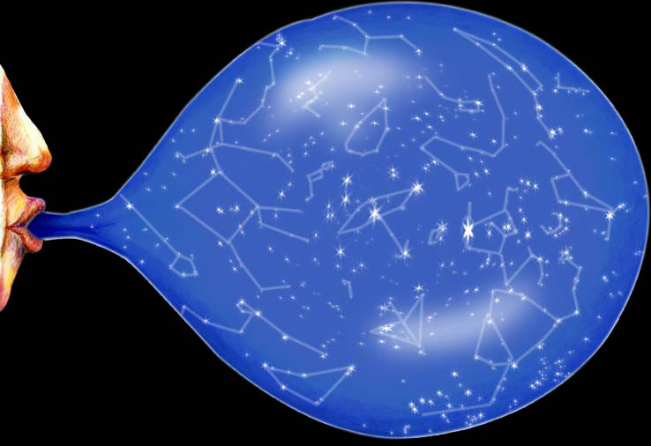
Expanding Universe
Are we at the center?
Is the answer ever yes?
Notes:
Although everything appears to be moving away from us, and the farther away it is, the faster its moving…
We are NOT at the center.
Everything is moving away from everything else. The space between all galaxies is getting larger.
For nearby galaxies, like those in the local group such as M31, the peculiar velocity dominates.
Hubble flow dominates at large distances. Like halfway across the observable universe.

Slide 8
Expanding Universe
Lecture Tutorial p. 155
Notes:
Although everything appears to be moving away from us, and the farther away it is, the faster its moving…
We are NOT at the center.
Everything is moving away from everything else. The space between all galaxies is getting larger.
For nearby galaxies, like those in the local group such as M31, the peculiar velocity dominates.
Hubble flow dominates at large distances. Like halfway across the observable universe.

Slide 9
Remember:
No Lab this week!
Office hours
Tues: by appointment
Weds: 1pm - 4pm
Thurs: 9:30 - 11am
Fri: 9:30 - noon
Mon: 9:30 - noon
Tuesday: you’re on your own if you haven’t come in by now!
Notes:
In our modern conception of the universe, time is simply another dimension.
Space and time itself came into existence at the Big Bang.
Let your philosophical side run wild.

Slide 10
Cosmological Principle
The Universe looks about the same no matter where you are within it
Matter is evenly distributed on very large scales within the universe
It has no center or edges
The cosmological principle is consistent with all observations to date
Notes:
In our modern conception of the universe, time is simply another dimension.
Space and time itself came into existence at the Big Bang.
Let your philosophical side run wild.

Slide 11
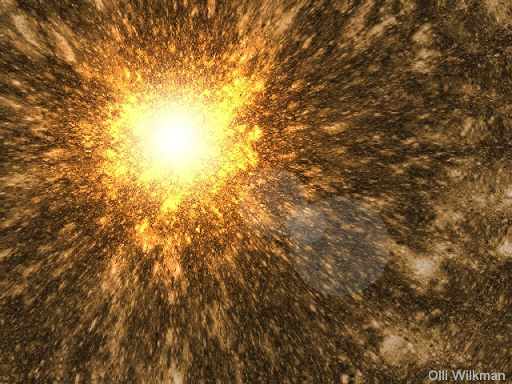
Let’s start at the beginning…

Slide 12
The Age of the Universe
Everything is moving apart.
In the past, things were closer together.
A long time ago, they must have all been in the same place!
The ENTIRE universe occupied a single point
Notes:
We just have to run the movie backwards to find out what happened at the beginning
It turns out that 1/H0 = the age of the universe…
About 13.7 billion years.
At the beginning, the universe is infinitesimally small.
It is a singularity, like a black hole.

Slide 13
Bang!
The moment of creation
It makes no sense to ask what happened before the Big Bang
It makes no sense to ask what is outside the Universe
Space and Time came into existence at the Big Bang
Notes:
In our modern conception of the universe, time is simply another dimension.
Space and time itself came into existence at the Big Bang.
The universe has been expanding ever since.
Let your philosophical side run wild.

Slide 14
Everything that we know before 10⁻⁴³ seconds.
We think the four fundamental forces were unified during this time
Notes:
Before 10⁻⁴³ seconds, our current theories of physics fail.
We need to merge together Quantum Mechanics and General Relativity.

Slide 15
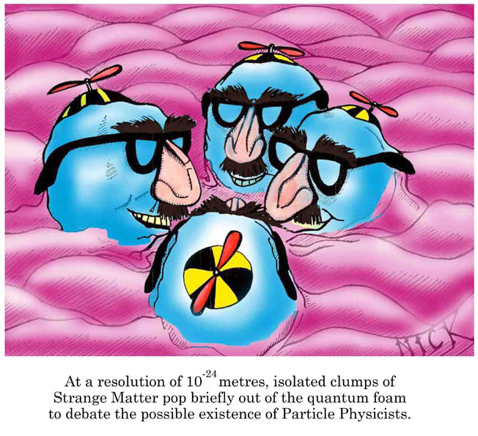
Quantum Fluctuations
The very early universe is ruled by quantum effects
Notes:
Gravity splits from the 4 forces.
Quantum mechanics is not deterministic- You can’t always predict future events based on current conditions.
It’s probabilistic- You CAN predict the probability of a particular outcome.
When the universe was 10⁻⁴³ seconds old, the indeterminate effects of quantum mechanics ruled.
There were large random energy fluctuations.
Particles were literally popping into and out of existence.
BUT! The energy density of the universe is VERY large. As soon a particle is created, it is destroyed by the energy field.
So- there are really no particles in this universe.
These initial quantum fluctuations become important again later.

Slide 16
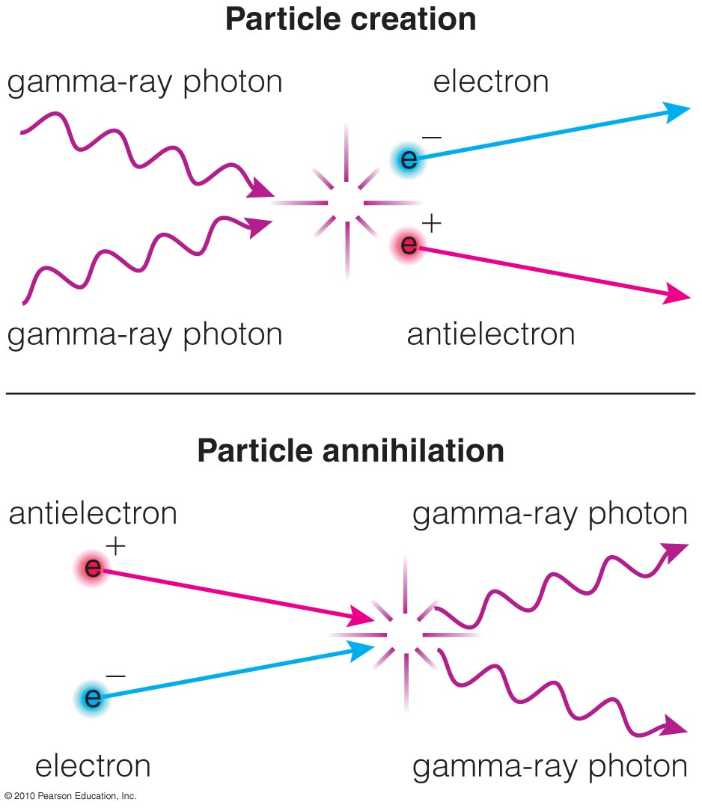
Photons converted into particle–antiparticle pairs and vice versa.
E = mc²
The early universe was full of particles and radiation because of its high temperature.

Slide 17
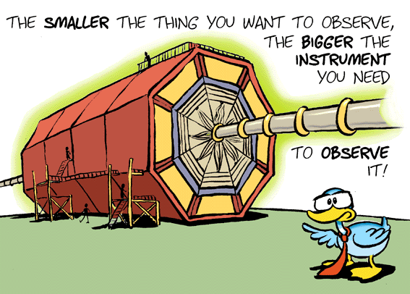
A Brief History
At first, there was no matter
We use particle accelerators to study the very beginning
Notes:
Particle accelerators don’t throw bits of stuff together and watch the parts fly out
They annihilate matter and antimatter and get out a blob of pure energy.
From the blob of pure energy, elementary particles are created.
Just like at the beginning of the big bang.
The more kinetic energy we put into the accelerator, the closer we get to the conditions at the Big Bang.
Modern accelerators create conditions similar to 10⁻⁴³ seconds after the big bang.

Slide 18
Inflationary Period
The GUT (grand unified theory) force splits into the strong and electroweak forces. Now there are 3 forces.
This split releases LOTS of energy causing the universe to expand RAPIDLY

Slide 19
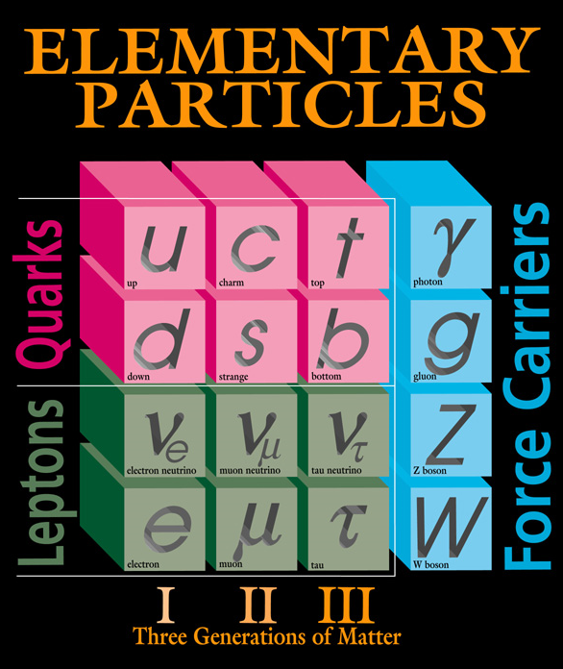
Particles at Last
The energy density drops so that particles can form
The era of particle physics begins at 10⁻¹⁰ seconds
This is the quark soup era
Notes:
The electroweak force splits into electromagnetic and weak forces
It is finally cool enough for particles to form.
Electrons, neutrinos, and quarks exist at this time.
The energies are still too high for protons and neutrons (which are made up of quarks) to exist.
If a proton or neutron forms, it is still quickly torn apart.

Slide 20
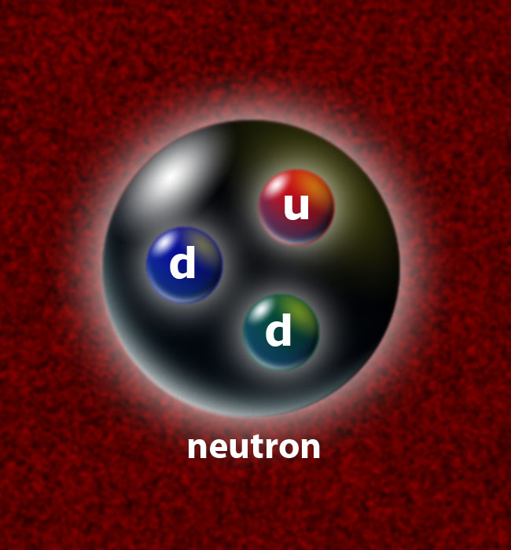
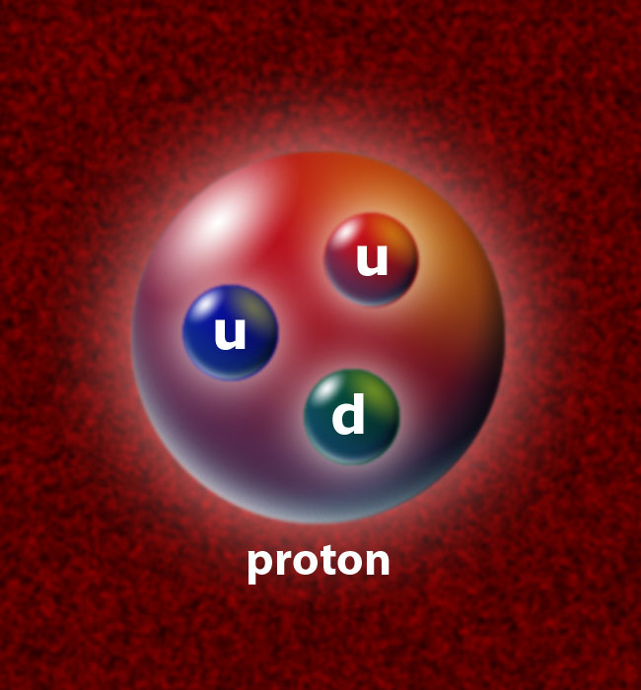
Nucleosynthesis
The Universe is about 1 second old
Quarks combine to form protons and neutrons
Notes:
Conditions are right for fusion to occur, but the energies are still so high that helium nuclei are quickly torn apart again.
Shortly thereafter, for a short time, about 3 minutes, fusion occurs without tearing the helium apart.
After about 3 minutes, things cool down enough and the density drops enough that fusion stops and the nuclei ‘freeze out’.
We end up with about 75% hydrogen and 25% helium. (and a bit of lithium)

Slide 21
The Dark Ages
The Universe is opaque for a long time.
Densities are too high for photons to go very far
Notes:
The universe is a dense mix of protons, neutrons, electrons, AND photons.
An observer in the universe at this time wouldn’t be able to see very far.
It would be much like being in a very thick fog. Photons just scatter all over the place and/or get absorbed.

Slide 22
Looking back…
We cannot directly observe this far back in time because after nucleosynthesis:
A) Fusion stopped so no light was being produced
B) The universe was too dense to produce light
C) There was plenty of light, it just couldn’t get very far

Slide 23
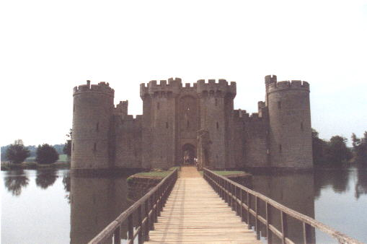
The Fog Lifts
After 380,000 years, the photons are free
Notes:
Eventually… the density drops enough that the electrons are able to hook up with a hydrogen or helium nucleus.
Photons are at last released and allowed to stream free.

Slide 24
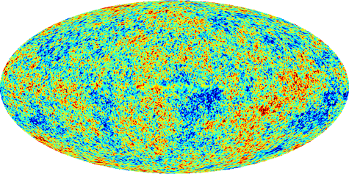
Evidence
Where are the first free photons?
Cosmic
Microwave
Background
Notes:
In 1965 Arno Penzias and Robert Wilson had some noise in their new antenna that they couldn’t figure out.
David Wilkinson and Robert Dicke were building their own instrument at the time to detect the CMB.
Penzias and Wilson scooped them.
The photons from when the fog lifted for the first time should travel mostly unhindered to us from the edge of the universe
They will be severely red shifted, but we should be able to see them (and we do).
The other evidence is the overall composition of the universe.
Models predict 75% H and 25% He. That is what we see.
Stars have not contributed a large amount of helium to the Universe at large.
The universe is really, really uniform. The small variations you see in the picture above are really really small. But, we had a period of rapid inflation (the universe expanded really super fast) and that made all the small variations much larger. These small variations were the seeds that eventually formed into galaxies and clusters of galaxies.

Slide 25
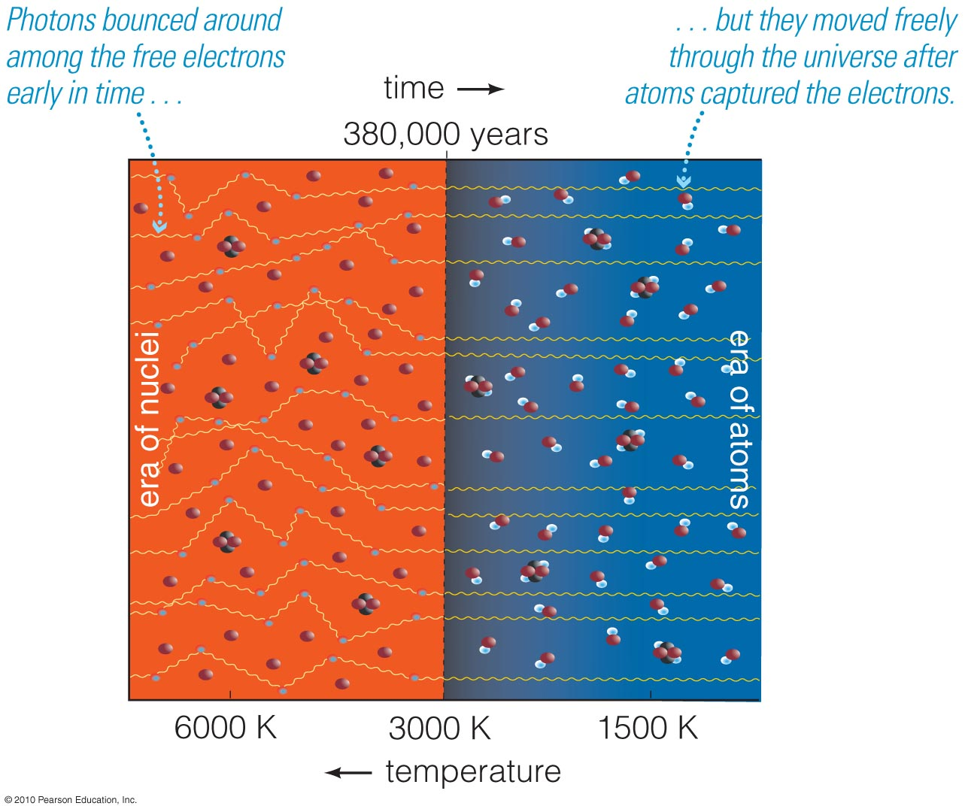
Background radiation from Big Bang has been freely streaming across universe since atoms formed at temperature ~ 3000 K: visible/IR.

Slide 26
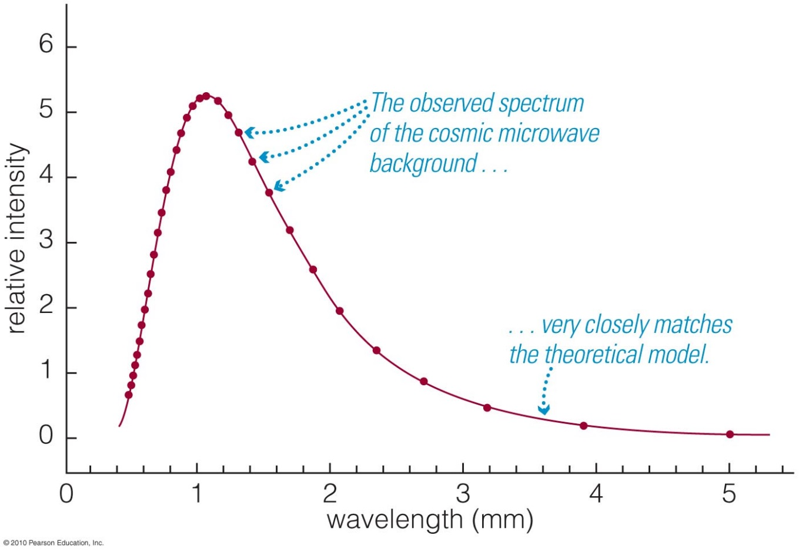
The background has perfect thermal radiation spectrum at temperature 2.73 K
Expansion of universe has redshifted this radiation to ~1000 times longer wavelength: microwaves.

Slide 27
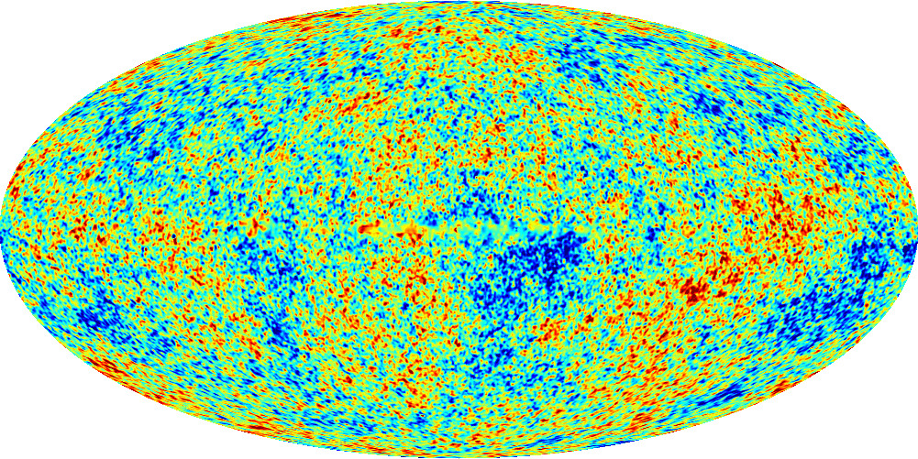
The Seeds of Structure
A period of rapid inflation magnified the early quantum fluctuations
On large scales, the Universe is quite uniform
Notes:
Before inflation, the universe was uniform except for the quantum fluctuations.
After inflation, the small scale fluctuations were frozen in.

Slide 28
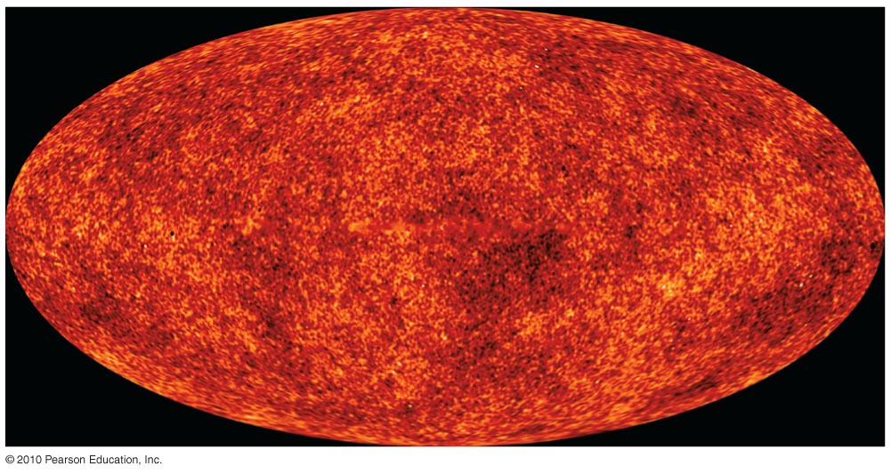
WMAP gives us detailed baby pictures of structure in the universe.

Slide 29
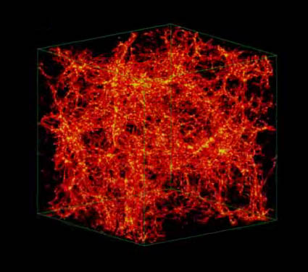
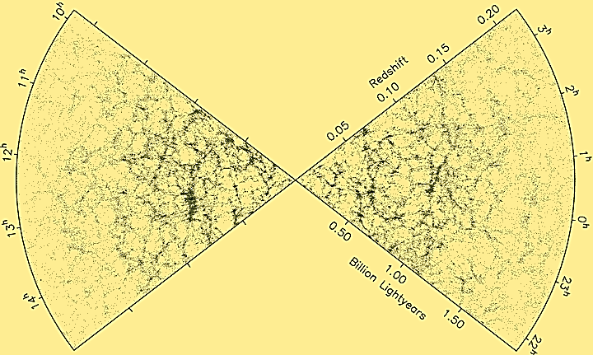
How to Build a Universe
The original over-densities eventually grew…
Notes:
When we start counting galaxies and plotting them in 3-D on the sky, we see that they tend to fall in filaments and cluster together. The spaces between the filaments where few galaxies are located are called voids. These voids aren’t completely empty; there are a few faint galaxies in them. However most galaxies lie along the filamentary structure.
So how does this all form?
The original Small over densities caused by the quantum fluctuations grew through self gravity
Gravitational collapse must overcome the expansion.
Small clumps draw material in and become larger clumps.
The matter in the universe eventually organized itself into filaments with voids in between them.
Where filaments meet we find galaxy clusters.
We can see the distribution of mass by looking at light from galaxies.
The picture on the left is actual data from many many galaxies.
The picture on the right is a computer simulation showing the growth of structure.
These simulations include, and indeed would not work, without a key ingredient… Dark Matter.
To make these simulations work, we use Cold Dark Matter (WIMPS)
WIMPS, although they are weird, are the best current explanation.
Show APOD: http://apod.nasa.gov/apod/ap120813.html

Slide 30
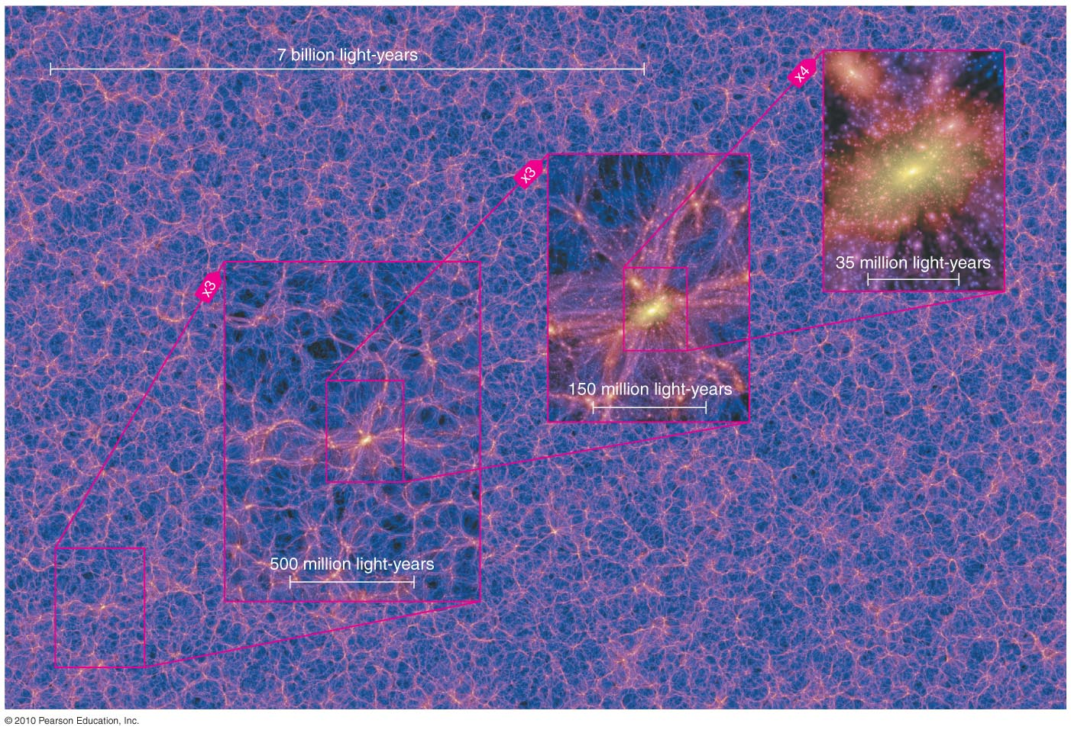
The largest structures in the universe
Notes:
When we start counting galaxies and plotting them in 3-D on the sky, we see that they tend to fall in filaments and cluster together. The spaces between the filaments where few galaxies are located are called voids. These voids aren’t completely empty; there are a few faint galaxies in them. However most galaxies lie along the filamentary structure.
So how does this all form?
The original Small over densities caused by the quantum fluctuations grew through self gravity
Gravitational collapse must overcome the expansion.
Small clumps draw material in and become larger clumps.
The matter in the universe eventually organized itself into filaments with voids in between them.
Where filaments meet we find galaxy clusters.
We can see the distribution of mass by looking at light from galaxies.
The picture on the left is actual data from many many galaxies.
The picture on the right is a computer simulation showing the growth of structure.
These simulations include, and indeed would not work, without a key ingredient… Dark Matter.
To make these simulations work, we use Cold Dark Matter (WIMPS)
WIMPS, although they are weird, are the best current explanation.
Show APOD: http://apod.nasa.gov/apod/ap120813.html

Slide 31
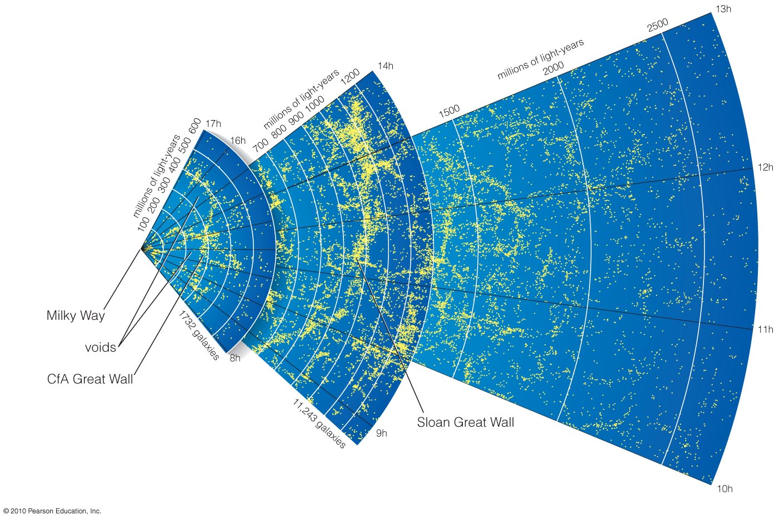
Maps of galaxy positions reveal superclusters and voids
Notes:
The voids are not completely empty but there isn’t much there.

Slide 32
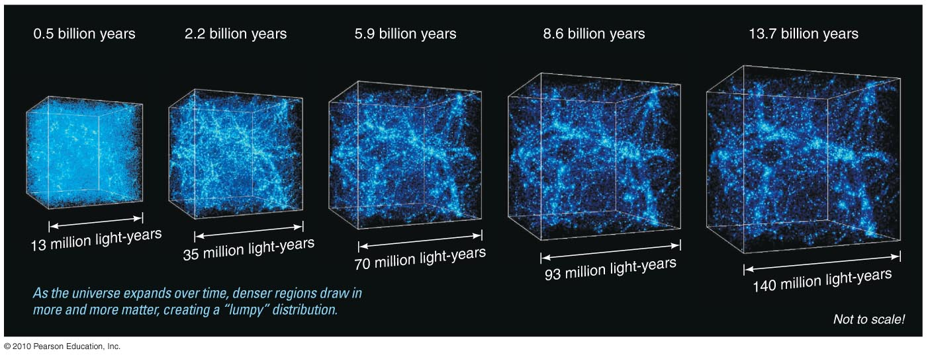
Time in billions of years
(now)
13.7
0.5
2.2
5.9
8.6
13
35
70
93
140
Size of expanding box in millions of light-years
Notes:
Our best models for galaxy formation assume:
Matter originally filled all of space almost uniformly. Gravity of denser regions pulled in surrounding matter.

Slide 33
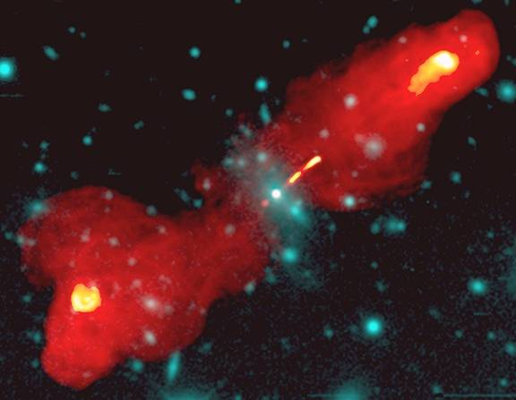
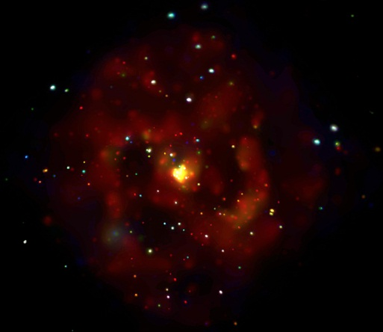
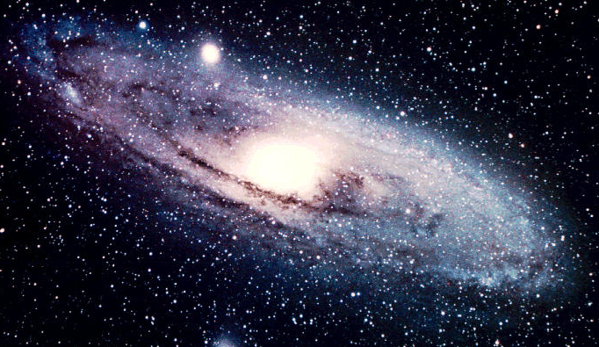
Big Bang
Primordial H, D, He, Li
DM Halo
DM Halo
DM Halo
shocked
DM Halo
shocked
DM Halo
Notes:
“Bottom up” model for cluster formation: we call this “hierarchical cluster formation”
Dark matter halos are over-dense regions in the primordial soup after the big bang. The Dark Matter is most of the mass – and we’ll talk about that more later in the next lecture. But each place which is a little more dense starts to gather up the stuff around it (through gravity) and collapses down into galaxies, quasars, etc. Each over-dense region gathers more stuff to it, eventually becoming groups and then clusters of galaxies.
Groups and clusters continue to gather together even today – clusters are still in the process of forming.
Groups even form today, now from the areas that were less dense originally, as matter moves together along “filaments” due to gravitational attraction.

Slide 34
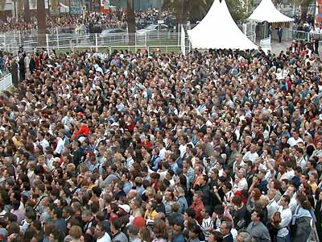
The Fate of the Universe
An escape velocity question on a grand scale
It the Universe has Critical Density it will re-collapse
If it doesn’t, it won’t
Notes:
Critical density refers to the energy balance question.
Is there enough mass to eventually halt the expansion.
The amount of mass required is called the critical density.

Slide 35
The Big Crunch
The Universe is above critical density and re-collapses
Perhaps there is another Big Bang and the whole thing just keeps happening over and over

Slide 36
Heat Death
The Universe is at or below critical density
It will expand forever
Eventually all of the stars will burn out
Notes:
At critical density, the expansion will continue to slow down but the deceleration will become less and less never quite reaching zero
Like Zeno’s paradox. Walk half way towards a tree. Now walk halfway again. Again. Again. You never reach the tree.
Less than critical density and the universe just coasts.
At any rate, it eventually becomes a cold lifeless place. How sad.

Slide 37
The Big Rip
Eventually the expansion will be so fast that gravity won’t hold it together
Eventually NOTHING will hold it together!

Slide 38
Observations & Theory
The expansion appears to be accelerating
Notes:
Einstein’s repulsive force is back!
We call the carrier of the repulsive force “Dark Energy”… Spooky.

Slide 39
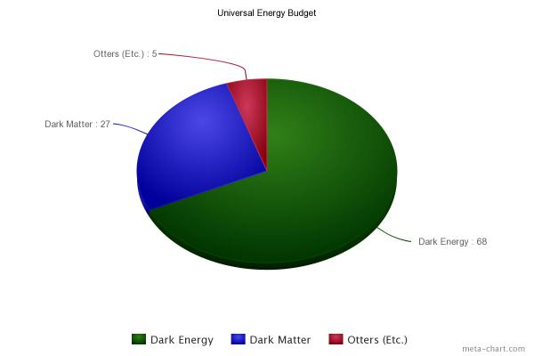
Universal Energy Budget
Otters (etc.)
5%
Dark Matter
27%
Dark Energy
68%
Credit: Sarah Tuttle
Notes:
Otters and other normal matter…. ;)

Slide 40
The End?
Current models
32% matter
68% dark energy
While there is still some doubt about this, observations and theory are getting better.
Notes:
So long, and thanks for all the fish!

