Slide 1
Distances: Pulling it Together
What are ways that we know distance?
How are the measures related?
What is the difference between a direct and an indirect measure?
What is a standard candle? What are some examples?
For what distance scale does each measurement work best?

Slide 2
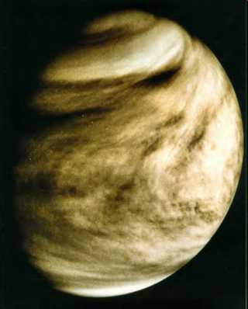
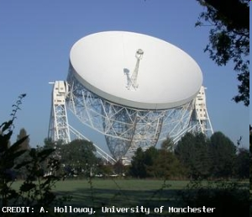
Distances
Radar measurements are DIRCECT measurement.
P² = a³
Notes:
We bounce radar signals off of Venus to measure our precise distance from it.
Remember Kepler’s Laws?
The third law relates orbital period to distance.
So, we have distances in terms of the AU, or the average Earth/Sun distance.
Once we know the distance between us and one other planet, we can calculate
the exact value of the AU and get the distance to the Sun

Slide 3
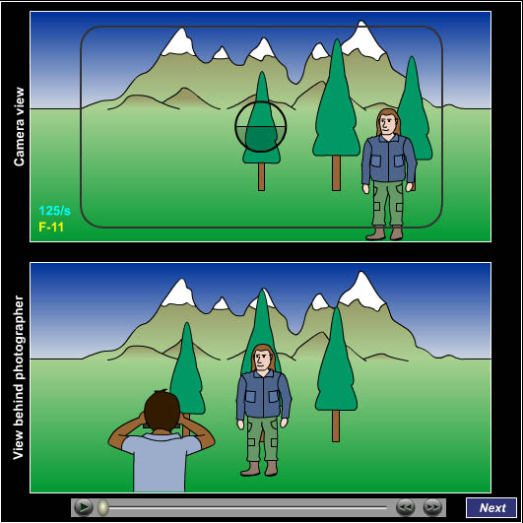
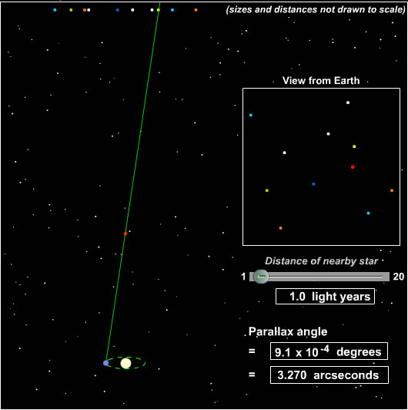
Distances
We use parallax to get distances to nearby stars.
Notes:
Parallax is purely a geometric measurement! Accurate to within detection limits (how well we can resolve the motion). In the late 90’s Hipparcos satellite recalibrated all our distance measurements.
Note: This depends on having an accurate measurement of the A.U. – which we got from radar measurements!

Slide 4
The Shape of the Universe
We need to measure distances!
L
F_{E}
=
4
π
d
2
Notes:
We will get the distances to objects by “knowing” their Luminosity and solving this equation

Slide 5
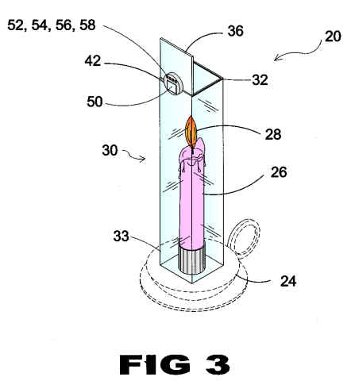
Distances: Standard Candles
Objects of known luminosity
Main Sequence Stars
Cepheid Variables
Novae
Supernovae
Spiral Galaxies

Slide 6
Spectroscopic Parallax
Recall Lecture Tutorial p. 45
Notes:
Lecture Tutorial: Spectroscopic Parallax, p 45
The technique of using spectroscopic sequence to determine actual luminosity is based on understanding the HR diagram. You get the spectral type of the star in question (take its temperature) and look up what its luminosity should be. Note that the main sequence on the HR diagram has some thickness. (recall that main sequence stars get more luminous as they age)
This causes the distance measurement using a single star to be somewhat inaccurate. This has nothing to do with geometric parallax. It’s just another stupid name astronomers use.

Slide 7
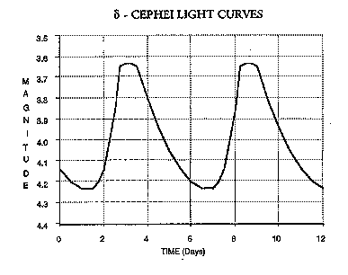
Cepheid Variables
Cepheids have a luminosity-period relationship
Notes:
Cepheids have a period luminosity relationship. We measure the period and derive the luminosity.
We them measure the flux and calculate the distance.
Measure the period, look up the luminosity, calculate the distance.
Cepheids are bright enough to see in other galaxies.

Slide 8
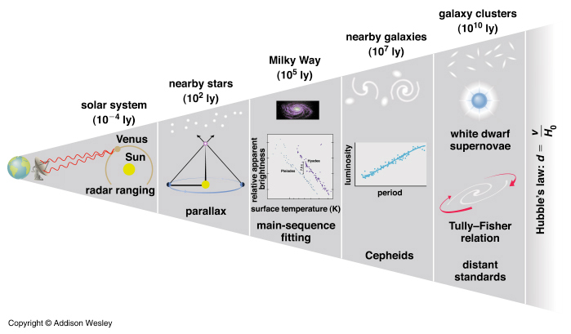
The Distance Ladder
Each ‘rung’ on the ladder depends on the previous rung
Notes:
Our first distances were ratios: the ratio of the different planets distance from the Sun.
When we developed radar we could bounce signals off Venus. Since we know the speed of light, we could figure out far away Venus is. With that, and the ratios of all the planets, we could figure out those distances.
Parallax is using geometry to find distances to the nearest stars. It still depends on the distance from the Earth to the Sun (that we determined with ratios & radar)
With enough near stars we can calibrate our distances to clusters using main-sequence fitting and then us that to find distances to clusters throughout our Galaxy.
Some of those clusters have special stars called Cepheid variable stars. These have a relationship between their luminosity (brightness) and the period of their pulsations. We use the calibration from the clusters to figure out how far Cepheids in other galaxies are.
But even Cepheids are not bright enough to see in far away galaxies. For that, we need to use white dwarf supernovae (Type Ia) and a few other methods. We calibrate those with Cepheid variable stars.
Lastly, we use Hubble’s Law: distance = v / Ho where v = speed a galaxy is going away from us (as measured by Doppler shift) and Ho is Hubble’s constant.
Since each level depends on the calibration from the closer method, uncertainties get bigger the farther we are out. And if we mess up one calibration (due to dust or whatever) it affects everything else.

Slide 9
The Distance Ladder
If the real speed of light was slightly faster than we think
A) our distances derived from Cepheids would be too small.
B) our distances derived from Cepheids would be too large.
C) only our Earth-Venus distance would be affected.
D) No distances would be affected.

Slide 10
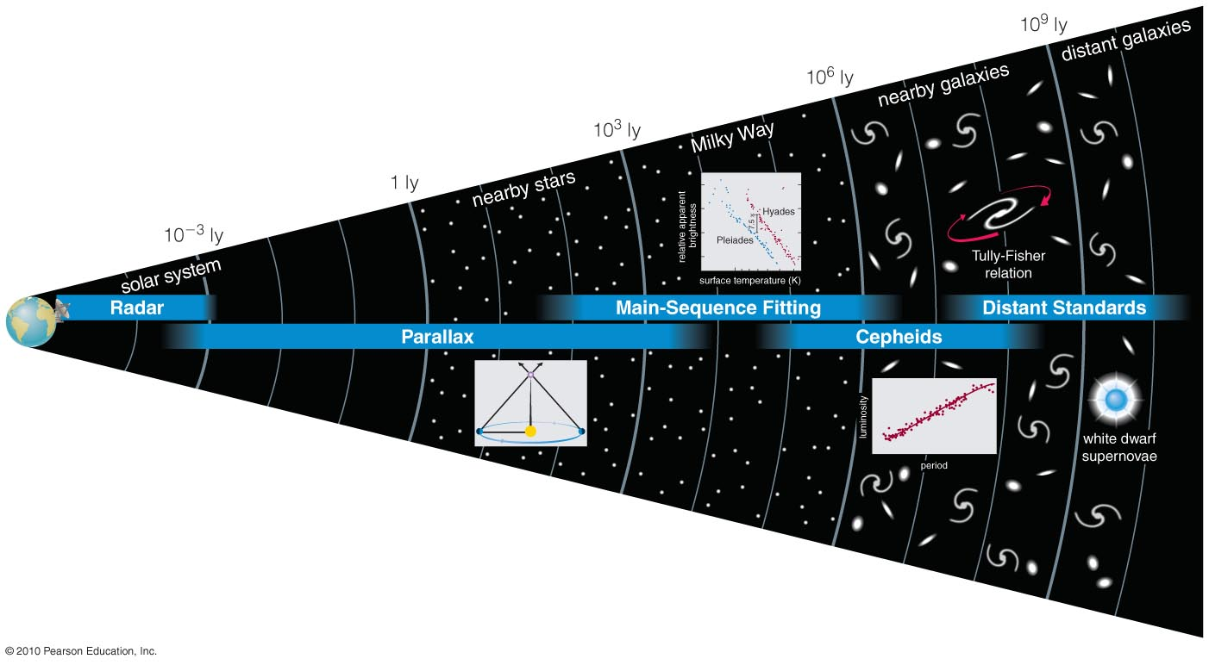
How do we measure the distances to galaxies?

Slide 11
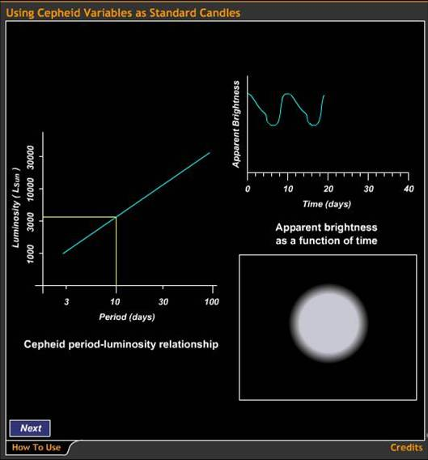
Cepheids
Because the period of Cepheid variable stars tells us their luminosities, we can use them as standard candles.

Slide 12
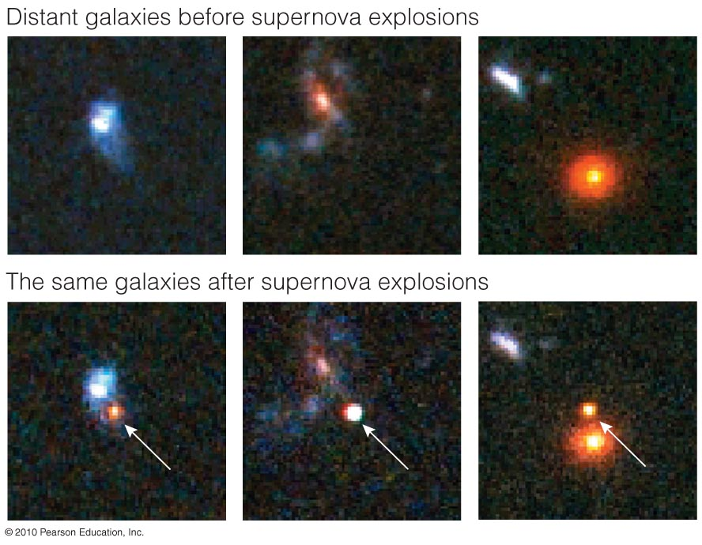
Type I SN
The apparent brightness of a white dwarf supernova tells us the distance to its galaxy (up to 10 billion light-years).

Slide 13
How do we measure the distances to galaxies?

Slide 14
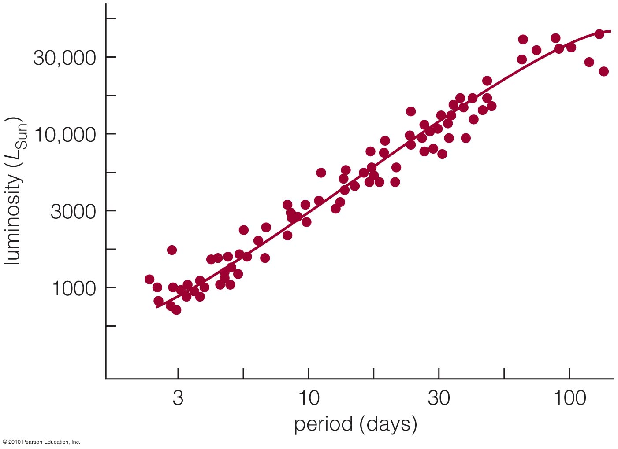
Standard Candle: Cepheid
Cepheid variable stars with longer periods have greater luminosities.

Slide 15
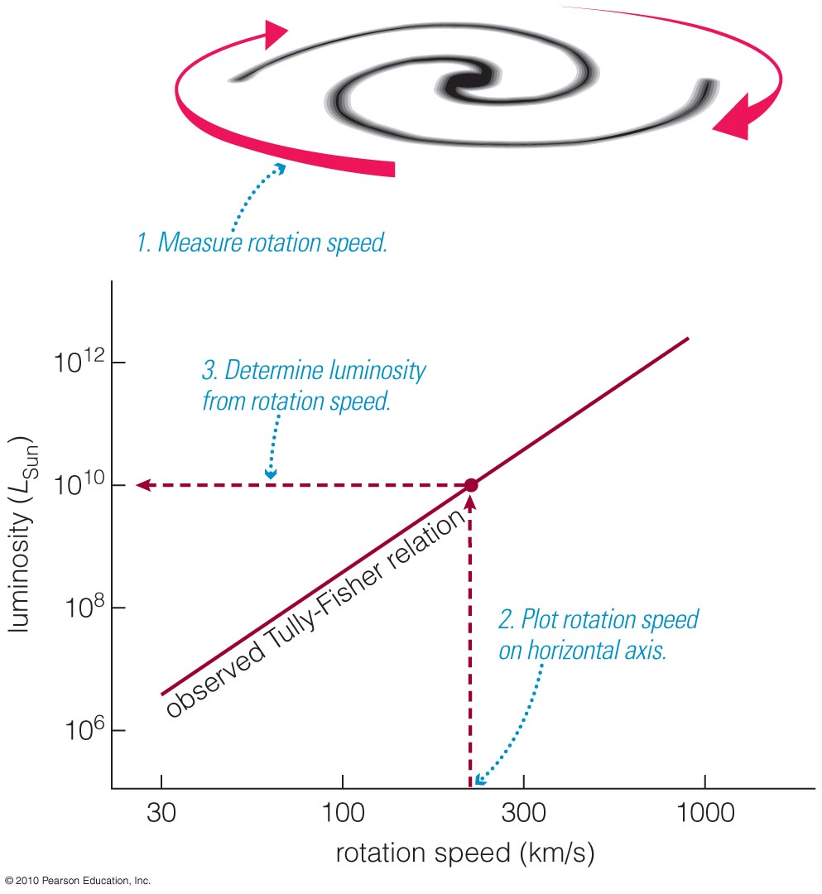
Tully-Fisher Relation
Entire galaxies can also be used as standard candles because a galaxy’s luminosity is related to its rotation speed.
Notes:
This is an empirical relationship!

Slide 16
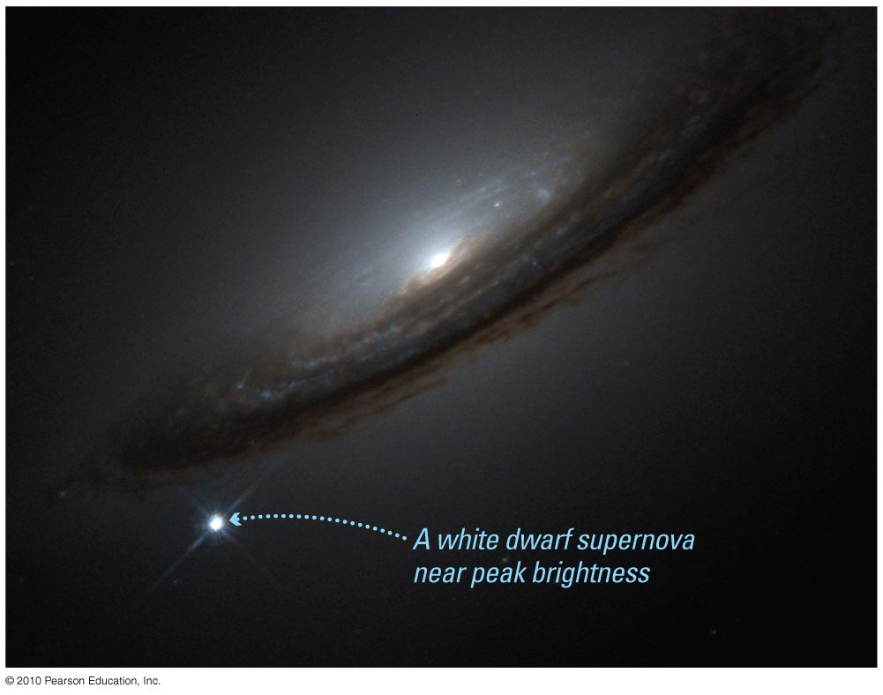
Standard Candle: Type I SN
White-dwarf supernovae can also be used as standard candles.
Notes:
Type Ia supernova are the result of a white dwarf collapse and detonation.
A white dwarf in a binary system goes nova nova nova nova
Each time a little more material is left behind until the Chandrasekhar limit is reached.
And then KABOOM!
The peak luminosity is the same for all Type Ia SN.
They are 500 times brighter than Cepheids
Have to catch one as it’s happening.

Slide 17
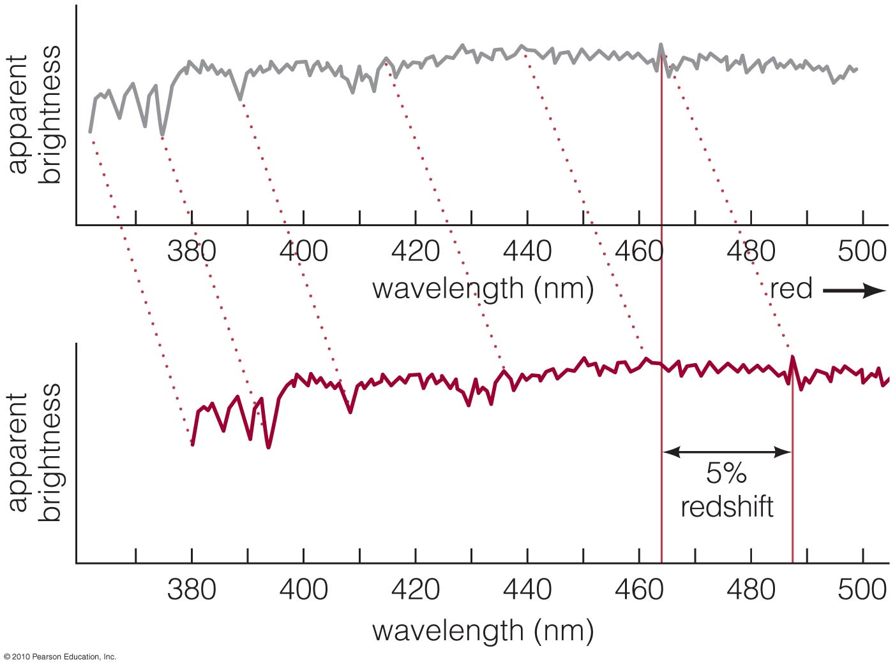
Redshifted Galaxy Spectra
Spectral features of virtually all galaxies are redshifted

Slide 18
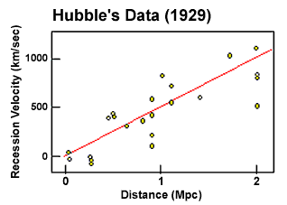
Galactic Red Shift
Everything is moving away!
Notes:
After determining that the distance to M31 (Andromeda) is about 3 million light years, Edwin Hubble went on to survey many other galaxies.
Hubble noticed that all of the galaxies he was measuring were red shifted…
In fact there was a correlation between distance and recessional velocity.
More distant galaxies were moving away FASTER than nearby galaxies.
This relationship is called Hubble’s Law.
The slope of the line (H₀) is Hubble’s Constant.

Slide 19
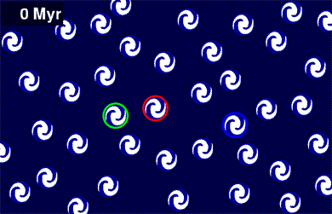
The Universe is Expanding
The space between galaxies must be increasing
Notes:
ANIMATED GIF WAIT FOR IT TO PLAY
Hubble observed that all galaxies have red shift.
More distant galaxies have larger red shifts.
Like raisins in a cake, the cake stuff expands and the space between raisins gets larger.
Hubble’s Law arises naturally from a uniformly expanding universe. (uniform means that the expansion appears to be the same everywhere!)
Einstein was very embarrassed when Hubble demonstrated that the universe is expanding.
He called the cosmological constant his greatest folly.

Slide 20
Hubble’s Law
Galaxies are moving away from us
V
=
H
D
0
Large distances are quoted in redshift
Farther = Faster
Notes:
Hubble, after his success with M31, was measuring distances to a whole bunch of galaxies.
He noticed something peculiar. The more distant a galaxy is, the more it is red shifted.
In fact, there is a linear relationship between velocity and distance.
The slope of the line is H₀. The measurements of H₀ tell us the age of the universe…
We measure velocity by measuring doppler shift.
Since all distant galaxies appear to be moving away from us, all distant galaxies are red shifted.
More distant objects have a greater redshift, so you will often hear distances quoted as redshifts.
H0 (pronounced H naught) is measured in km per second per Mpc. (kilometers per second per mega parsec) mega = million

Slide 21
Q: How could you find the age of the universe from Hubble’s Law?
velocity = distance time
velocity = H_{o} D
H_{o} = 1/time

Slide 22
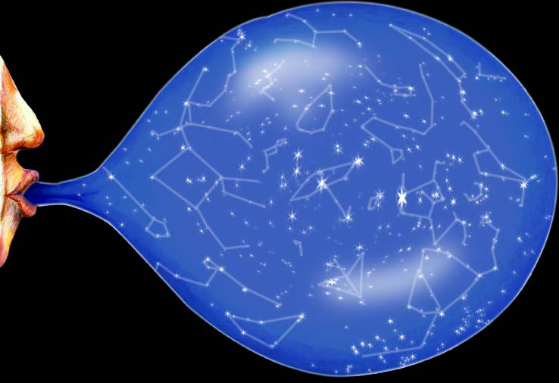
Expanding Universe
Are we at the center?
Is the answer ever yes?
Notes:
Although everything appears to be moving away from us, and the farther away it is, the faster its moving…
We are NOT at the center.
Everything is moving away from everything else. The space between all galaxies is getting larger.
For nearby galaxies, like those in the local group such as M31, the peculiar velocity dominates.
Hubble flow dominates at large distances. Like halfway across the observable universe.

Slide 23
Light
A light year is a unit of:
A) Distance
B) Time
C) Velocity
D) Acceleration
A) Distance. It’s the distance that light can go in one year.

Slide 24
Age
Romulus lives 5 lyr from you.
Remus lives 10 lyr from you.
They each transmit a picture to you on the day of their 21st birthday.
You receive both pictures at the same time. Who is older?
A) Romulus
B) Remus

Slide 25
Age
You observe a galaxy moving away from you at 0.1 light-years per year
It is now 1.4 billion light-years away from you. How long has it taken to get there?
A. 1 million years
B. 14 million years
C. 10 billion years
D. 14 billion years

