Slide 1
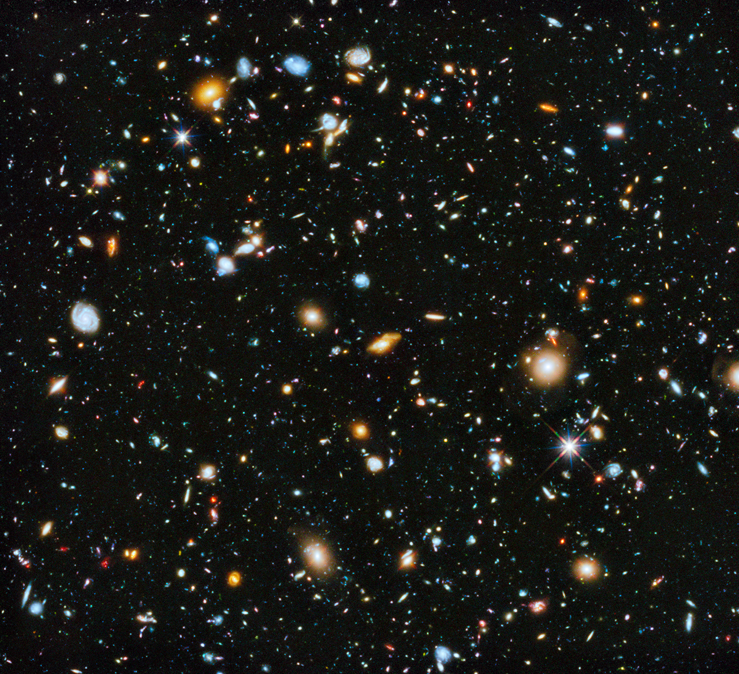
Galaxies!
Notes:
Hubble Ultra Deep Field, revised (2014)

Slide 2
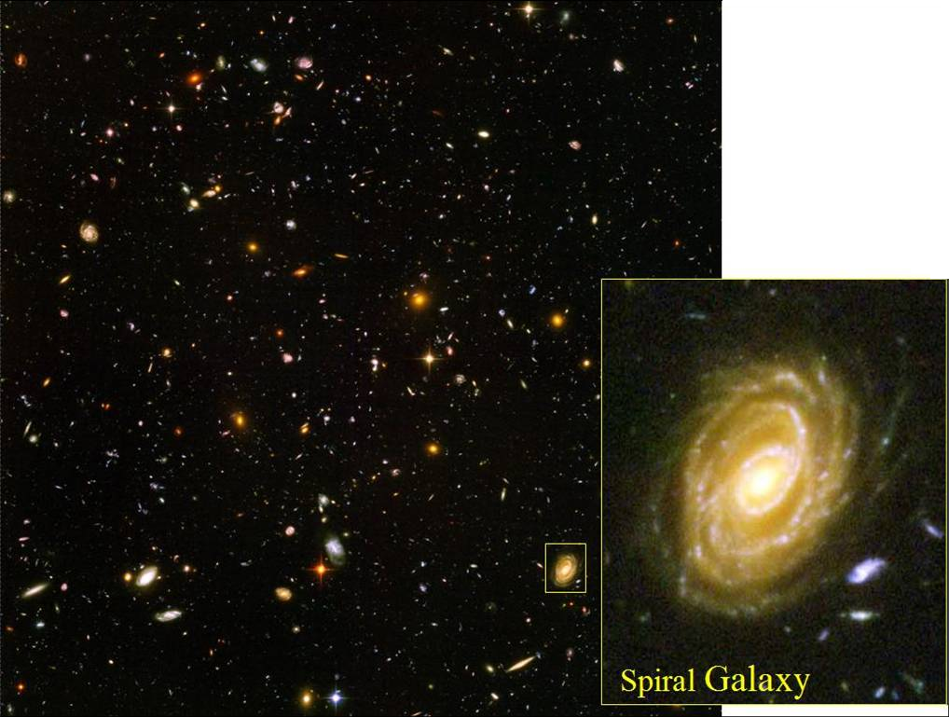
Hubble Ultra Deep Field

Slide 3
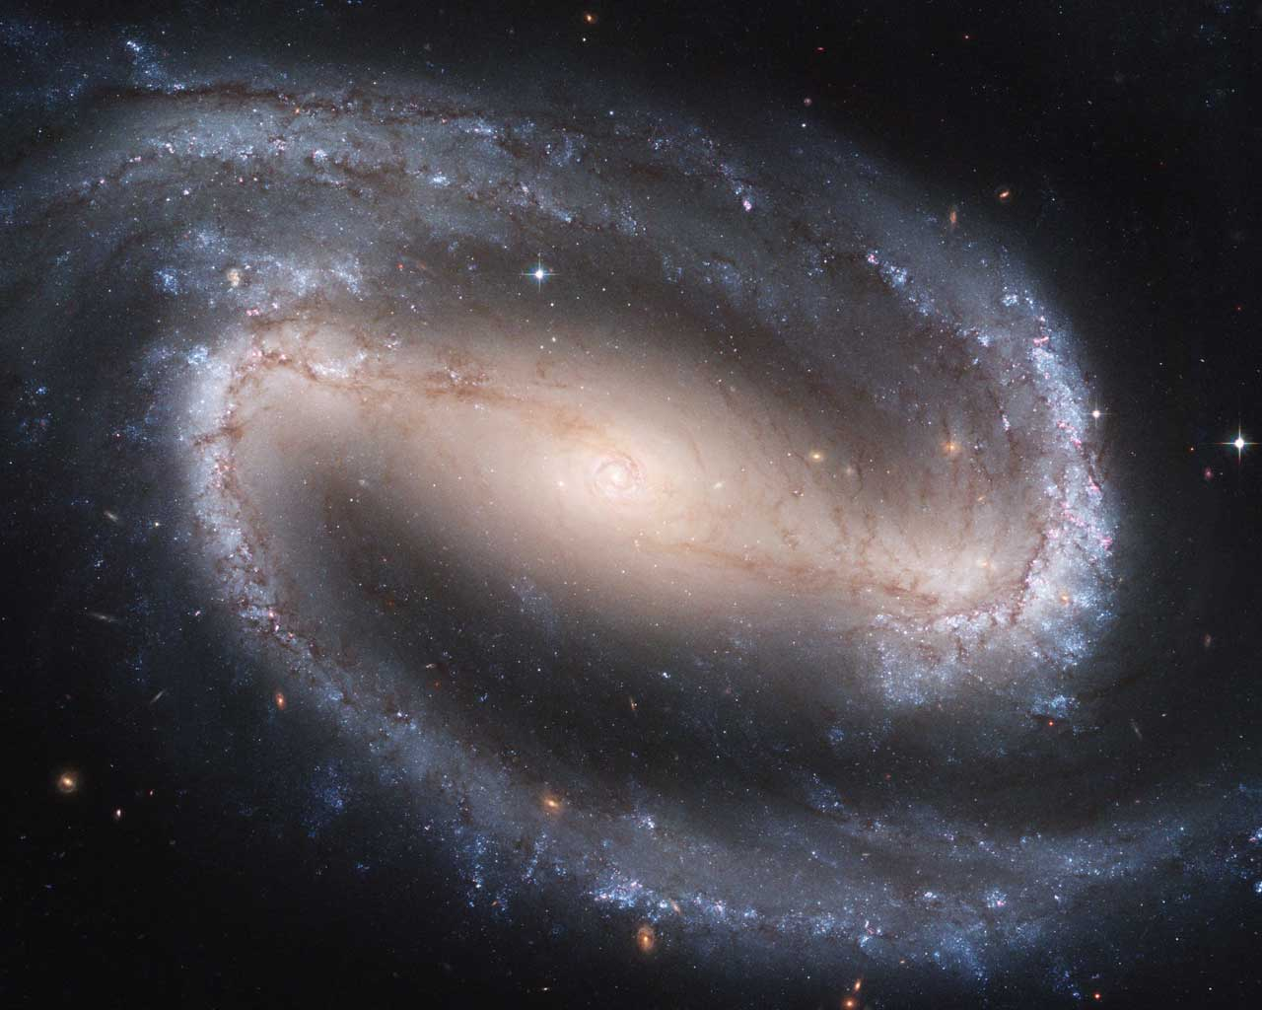
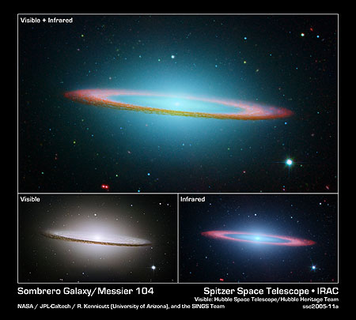
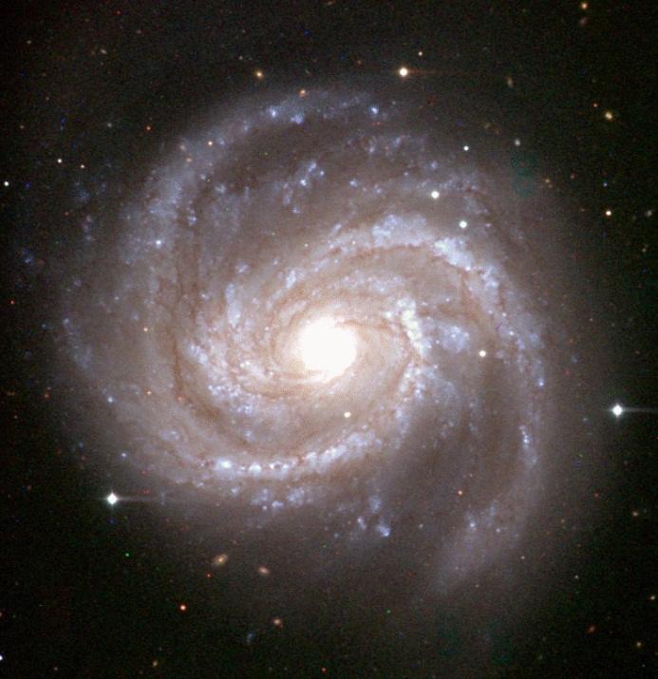
Spirals
Notes:
Spirals have a three component structure:
There is a thin disk composed of gas, dust, and stars.
In the center there is a bulge.
They are surrounded by a ellipsoidal halo.
Some spirals contain a bar that rotates like a rigid body
The arms are connected to the ends of the bar.
What a spiral galaxy looks like from out perspective depends on its inclination.
Some are face on, some are edge on, most are somewhere in between
The Sombrero Galaxy is nearly edge on. Above is a really cool image of it combining the visible image from HST with the infrared image from Spitzer.
In the infrared image, the dust in the disk pops out and looks really nifty.

Slide 4
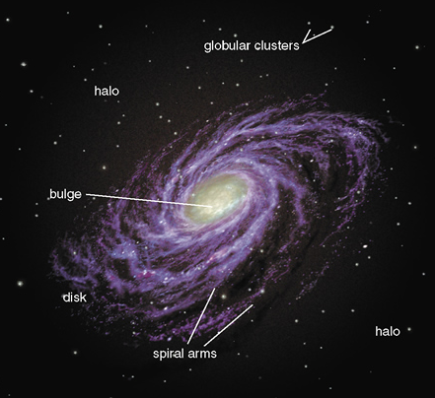
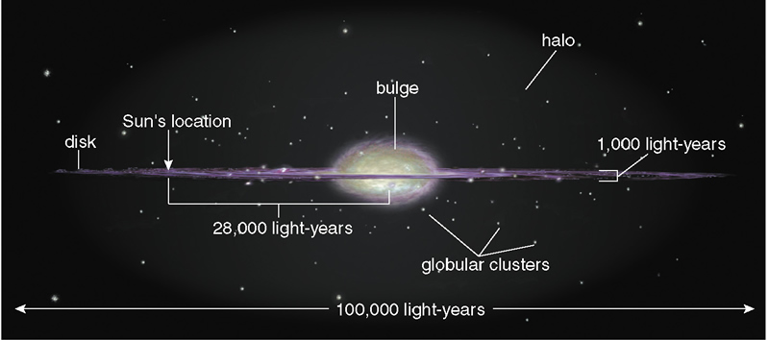
Spirals: Basic Structure
Bulge: Mix of old and new stars; some gas and dust
Disk: Young stars live here; lots of gas and dust
Halo: Old stars, globular clusters
Notes:
Disk
A flat disk with a thickness that is 1/100th the length of the disk
Most of the younger stars lie in the disk
Open clusters, for example
Composed of stars, gas, and dust
Spiral arms are in the disk
Bulge
Central region of the galaxy
Contains a mixture of old and new stars
More tightly packed; higher densities
Halo
A sphere/ellipsoid that surrounds the disk and bulge of the galaxy
Contains older stars
Globular clusters
No gas and no dust, just stars
No star formation going on in the halo

Slide 5
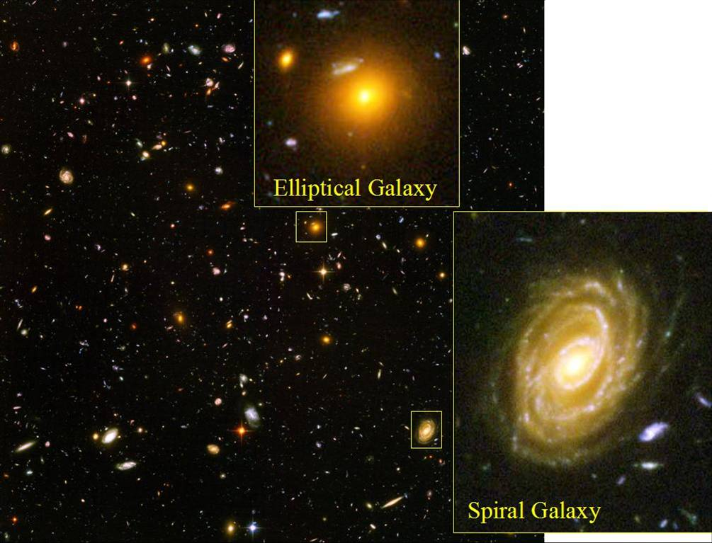
Hubble Ultra Deep Field

Slide 6
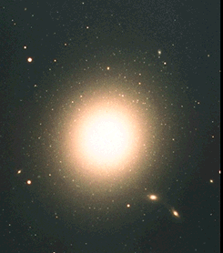
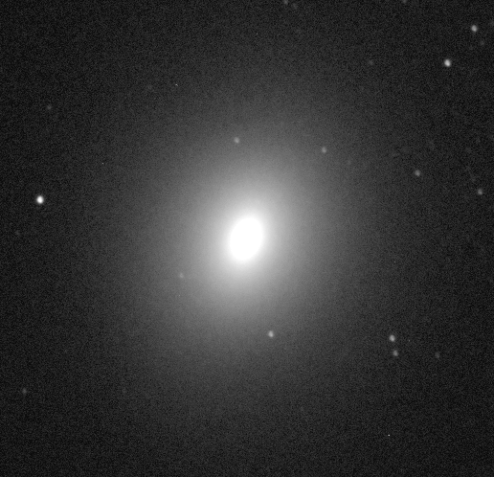
Elliptical
Somewhat like diskless bulges
Very little interstellar medium (ISM – gas & dust) and thus no star formation
Notes:
They have no disk.
About 10 percent of observed galaxies are ellipticals
The ISM consists mostly of low density very hot gas that emits in X-rays.
Since there is no ISM, there is no star formation so the stellar population tends to be lower mass redder stars.
Huge range of sizes.
Dwarf ellipticals can be as small as 10 million solar masses, on the order of the globular clusters.
Giant ellipticals, like M87 can be as large as 10¹³ solar masses, among the largest galaxies in the universe.
Orbital motions are like those in the Bulge or Halo of the Milky Way… Highly elliptical orbits, no orderly motion like in a spiral.

Slide 7
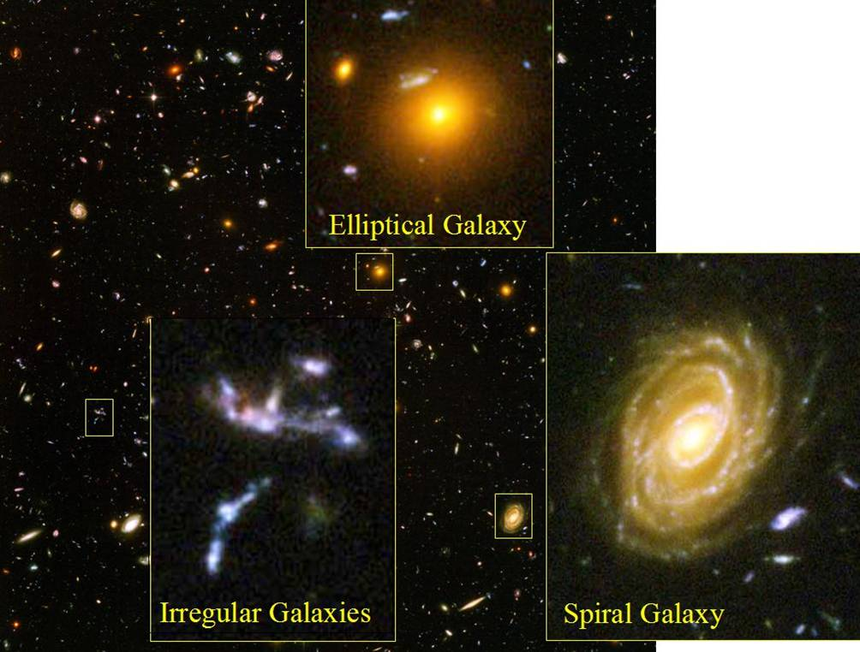
Hubble Ultra Deep Field

Slide 8
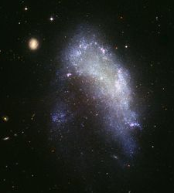
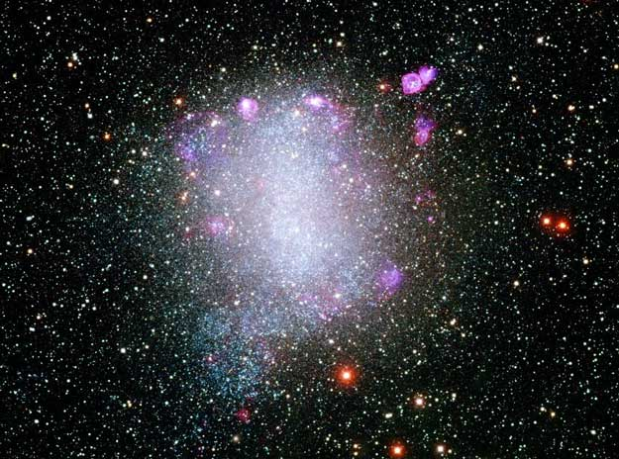
Irregulars
They don’t seem to fit in
Notes:
Neither spiral or elliptical… They tend to have a mix of young and old stars
Generally have some gas and dust component.
They have more in common with spiral disks than with ellipticals.

Slide 9
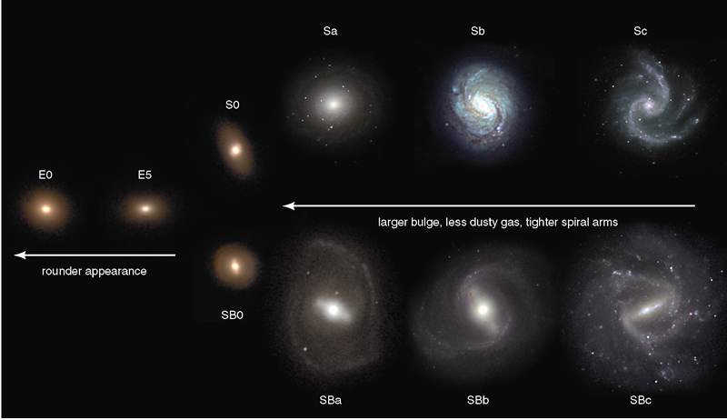
Galaxies
The “Tuning Fork” Diagram
Notes:
The galaxy classification scheme was developed by Edwin Hubble in the 1920’s
Elliptical galaxies are … well … elliptical.
The E0 types are more spherical.
The E5 types are more elliptical.
Then the diagram splits into S and SB
S type galaxies are spirals characterized by a bulge, disk, and spiral arms.
SB galaxies are barred spirals. They have a bar in the center that appears to rotate like a rigid body.
The S0 and SB0 are intermediate objects. Not quite elliptical and not quite spiral
Sa and SBa have loose spiral arms, large bulge to disk ratio, and low dust to gas ratio
Sc and SBc are the opposite. Tightly wound arms, small bulge to disk ratio, high dust to gas ratio
Irregular galaxies are not represented on the diagram. They don’t fit well into any of the classifications.
All galaxy types come in a wide variety of sizes, from 100 million stars to more than a trillion.

Slide 10
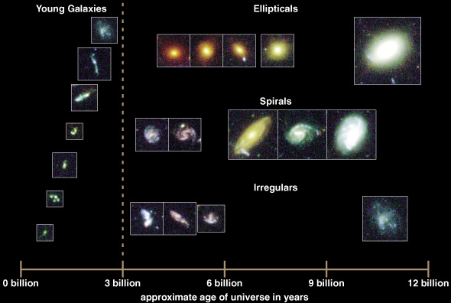
Galaxy Evolution
Observing galaxies at different distances shows us how they age.
Notes:
The study of how galaxies change over time.
Of course galaxies evolve over long periods of time, so we can’t watch a single galaxy evolve.
We CAN see galaxies at various stages of evolution since looking out means looking back in time.
Greater distances or redshifts means that the galaxy was younger when it emitted its light.
The galaxy images above were taken from the Hubble Deep Field. Ages are based on redshift.
They only go back to about 2 billion years. We can’t see what the galaxies looked like when the universe very young.

Slide 11
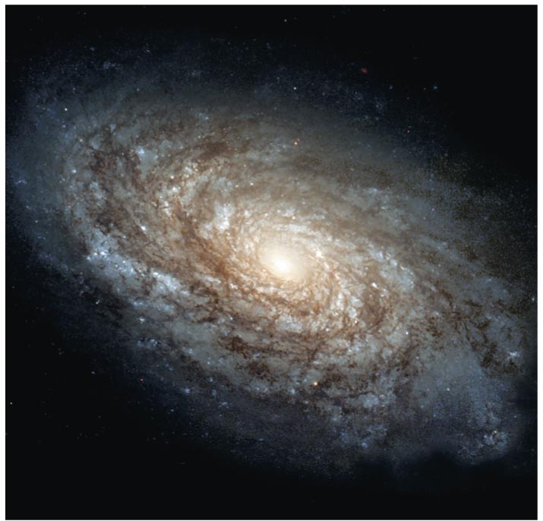
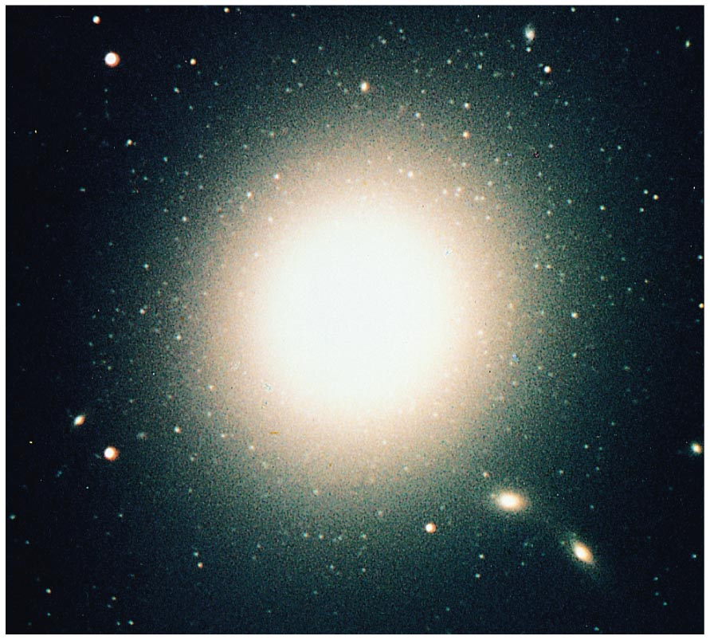
Galaxy Formation
NGC 4414
M87
But why do some galaxies end up looking so different?

Slide 12
Galaxy Formation
The early universe was uniformly filled with hydrogen and helium
Well… Mostly uniform
Notes:
We make our assumptions, plug everything that we know about physics into the computer and turn the thing loose.
The slight over densities of the early universe eventually condensed into proto-galactic clouds.
The proto-galactic cloud contains only hydrogen and helium and a non-uniform density structure.
As the cloud collapses, halo stars begin to form.
The cloud had angular momentum, and as in the proto-planetary disk scenario, the disk of gas flattens.
Star formation is ongoing in the disk of the galaxy. The gas that used to be in the halo is now in the disk and star formation there ceases.

Slide 13
Galaxy Formation:Top Down
“Top down” model: similar to how protoplanetary disks form
Denser regions contracted, forming protogalactic clouds.
Hydrogen and helium gas in these clouds formed the first stars.
Notes:
We make our assumptions, plug everything that we know about physics into the computer and turn the thing loose.
The slight over densities of the early universe eventually condensed into proto-galactic clouds.
The proto-galactic cloud contains only hydrogen and helium and a non-uniform density structure.
As the cloud collapses, halo stars begin to form.
The cloud had angular momentum. If it has a lot, it flattens into a disk like the proto-planetary disk scenario. Star formation is ongoing in the disk of the galaxy. The gas that used to be in the halo is now in the disk and star formation there ceases.
If it doesn’t have much angular momentum, it may turn into an elliptical, forming all its stars before it collapses into a disk.
Ellipticals tend to form in tight clusters, so they most likely formed from areas of high density.
There are some giant ellipticals observed at high redshifts that have a red population of stars suggesting no ongoing star formation.

Slide 14
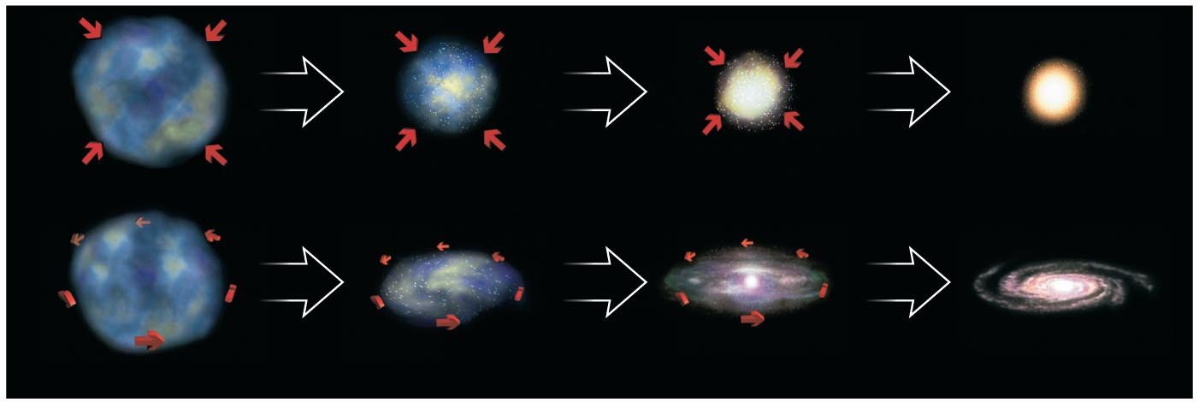
Conditions in the Protogalactic Cloud?
Spin: The initial angular momentum of the protogalactic cloud could determine the size of the resulting disk.
Density: Elliptical galaxies could come from dense protogalactic clouds that were able to cool and form stars before gas settled into a disk.
Notes:
Low angular momentum versus high angular momentum cloud.
Low angular momentum cloud turns into an elliptical
High angular momentum cloud turns into a spiral.
Remember that ellipticals tend to form in tight clusters, so they most likely formed from areas of high density.
There are some giant ellipticals observed at high redshifts that have a red population of stars suggesting no ongoing star formation.
We expect high density clouds to cool more efficiently.
Stars formed before viscosity in the gas could spin the disk out.
The star formation rate was high enough that all the gas was used up.

Slide 15
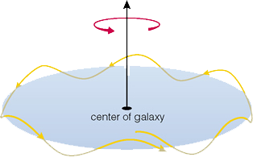
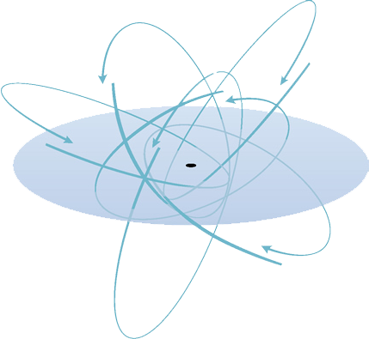
Supporting Evidence
Orbits
Colors
Metallicity?
C3
Notes:
Are our models correct?
The components of the various components of spiral galaxies provide clues.
The disks appear white with bits of blue. There must be ongoing star formation there.
The spheroidal component appears reddish suggesting an older population of stars. (remember that hot young blue stars die quickly)
It appears that the spheroidal component formed before the disk.
The orbits AND colors of milky way halo stars suggest that these stars formed before the proto-galactic cloud spun out into a disk OR were integrated into
the galaxy during mergers with other galaxies.
The disk stars orbit in circles around the galactic center, just like planets.

Slide 16
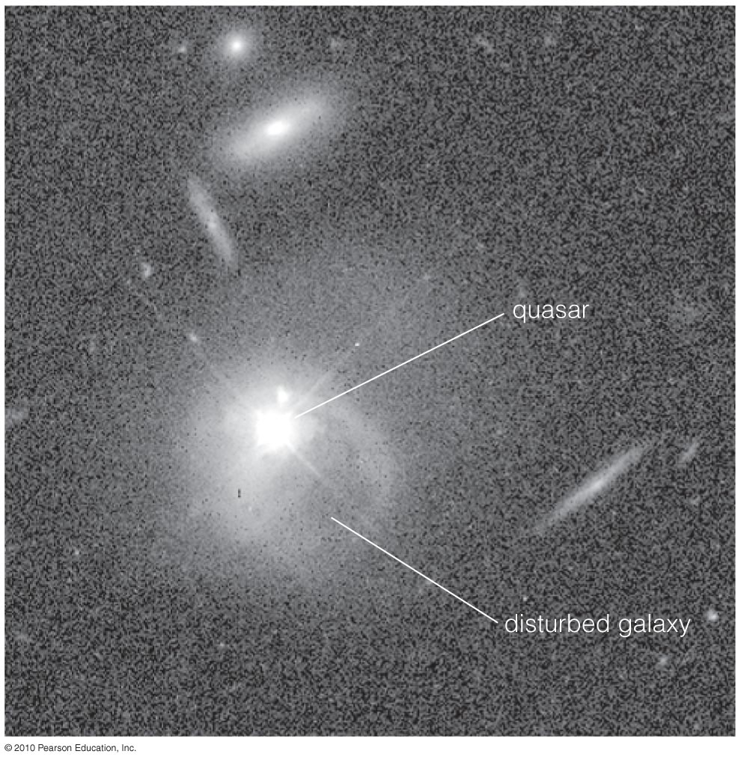
Distant Red Ellipticals
Observations of some distant red elliptical galaxies support the idea that most of their stars formed very early in the history of the universe.

Slide 17
Formation Scenarios
Or…..

Slide 18
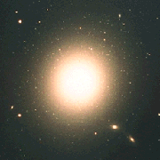
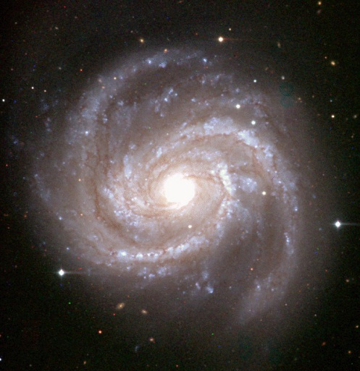
Galaxy Formation: Bottom Up
Spirals merge into ellipticals
Irregulars merge into spirals
Notes:
Irregulars form before the potentials get too large. Then they merge and form spirals – the stars become the halo and bulge while the gas settles down into a disk in the higher potential of the new galaxy, forming the disk. Shocks and density waves cause a new burst of star formation. If the irregulars don’t have as much gas/dust they might form small ellipticals instead.
Spirals then merge to form large ellipticals. Much of the remaining gas/dust is stripped during the merging process, and you’re left with a population of stars which then ages without new star formation (hot blue stars explode quickly, leaving the elliptical as a redder, old set of stars).
SHOW SIMULATIONs: https://www.youtube.com/watch?v=D-0GaBQ494E
http://apod.nasa.gov/apod/ap120717.html gas in filaments (large N-body sim) showing gas-rich mergers & Disk formation
https://www.youtube.com/watch?v=HP3x7TgvgR8 Andromeda vs. Milky Way -> elliptical

Slide 19
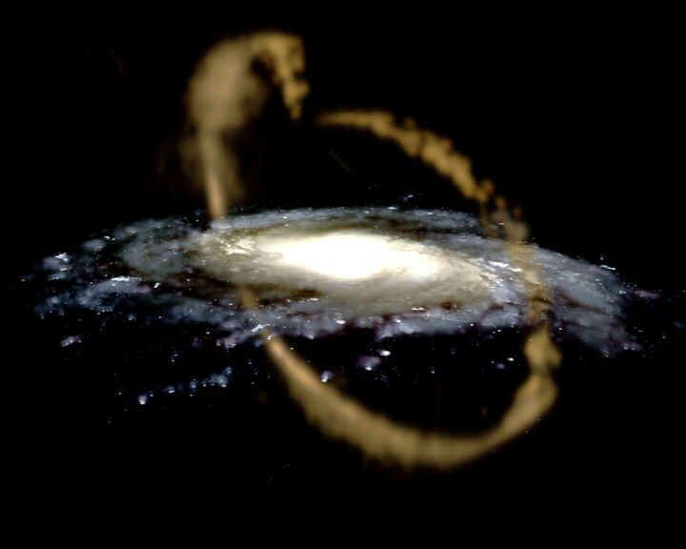
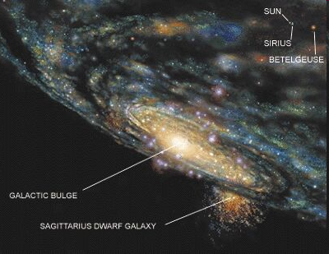
Heirarchical Formation- Bottom Up
Our halo does not appear to have formed from a single proto-galactic cloud
C2,C3
Notes:
Above is an artists misconception of the Sagittarius dwarf
Halo stars are at least 12 billion years as told by the main sequence turnoff on the HR diagram.
Halo stars are metal deficient compared to the Sun, so they must have formed from metal poor gas.
BUT, the halo stars do not have consistent metalicities, suggesting that they did not form from the same gas cloud.
The answer is not clear. It is likely that both the initial conditions of galaxy formation AND galaxy interactions are important.
The metal content does not simply decrease with distance from the galactic center.
So… It appears that mergers may be the answer.

Slide 20
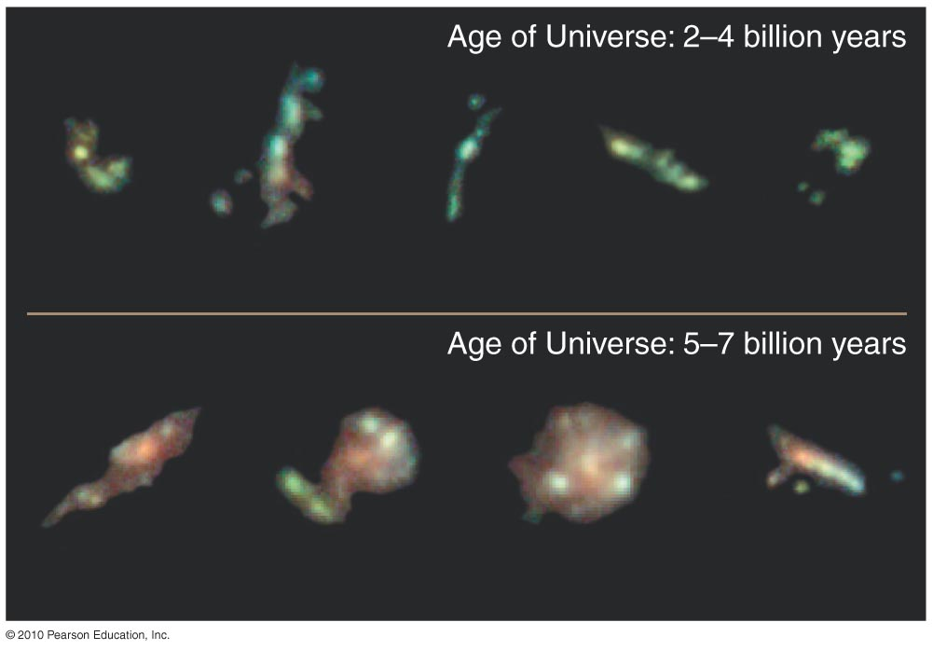
Many of the galaxies we see at great distances (and early times) do look violently disturbed.

Slide 21
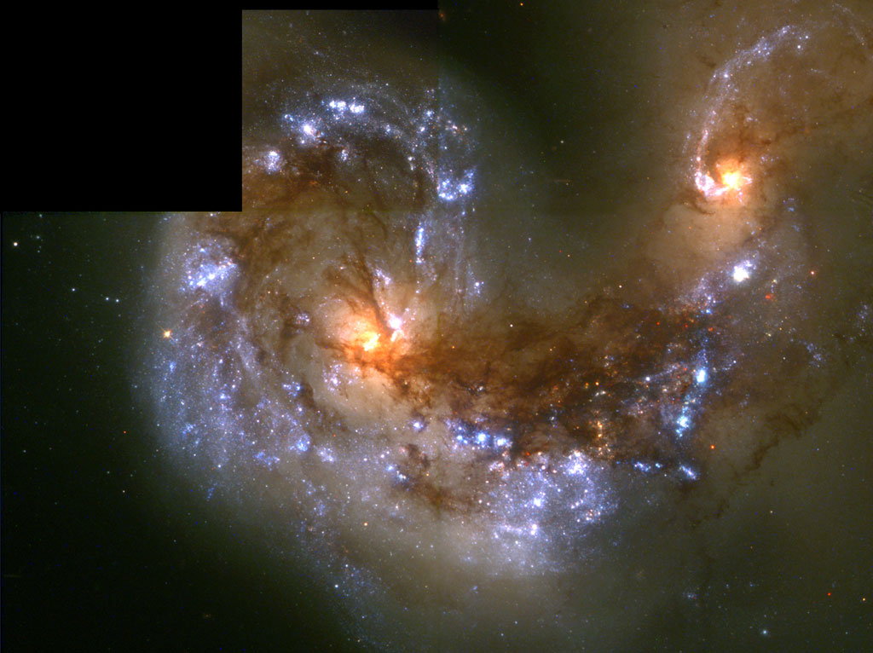
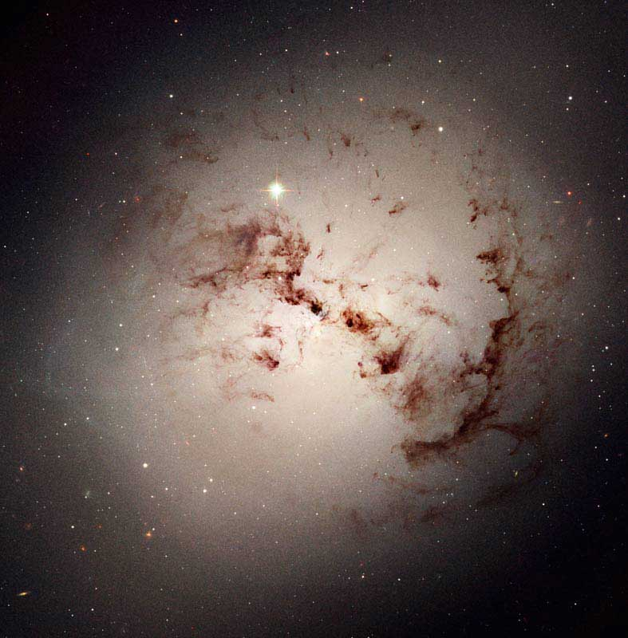
Collisions
When Spirals Collide
C3
Notes:
Stellar orbits get all bungled up and chaotic.
Star formation rate is so high that the gas gets blown out of the galaxy and becomes part of the ICM (intercluster medium).
What is left is an elliptical galaxy which has lost its gas. No new star formation means that it appears red.

Slide 22
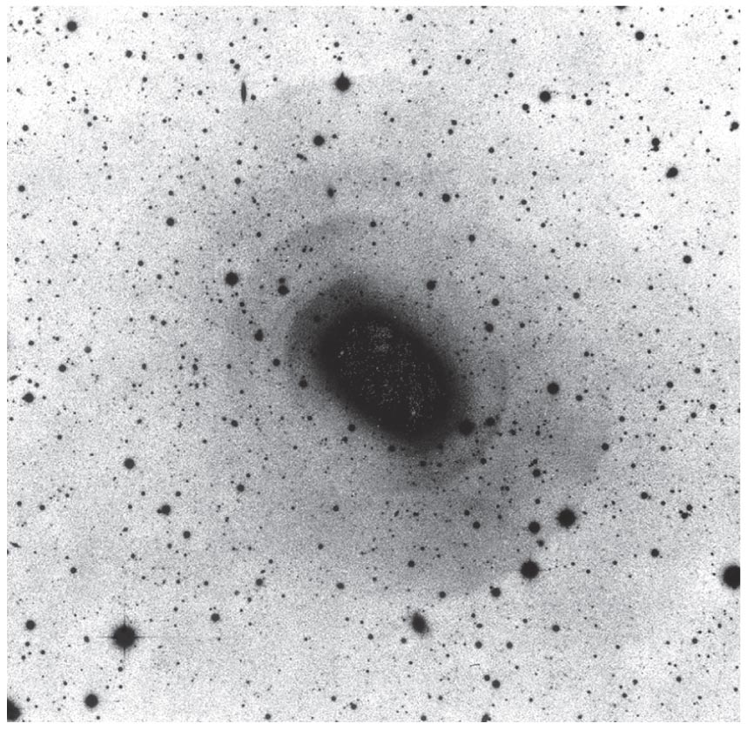
Shells of stars observed around some elliptical galaxies are probably the remains of past collisions.

Slide 23
Formation Differences
Which is correct?
The “bottom up” model?
The “top down” model?
To some extent,
probably both!!

Slide 24
Top-Down model
According to the top-down model, an Elliptical Galaxy would form if it had:
A) High Angular Momentum, Low Density
B) High Angular Momentum, High Density
C) Low Angular Momentum, Low Density
D) Low Angular Momentum, High Density

Slide 25
Top-Down model
According to the top-down model, a Spiral Galaxy would form if it had:
A) High Angular Momentum, Low Density
B) High Angular Momentum, High Density
C) Low Angular Momentum, Low Density
D) Low Angular Momentum, High Density

Slide 26
Bottom-Up model
According to the bottom-up model, a Spiral Galaxy would form if galaxy collisions had little gas
A) True
B) False

Slide 27
Bottom-Up model
According to the bottom-up model, an Elliptical Galaxy could form if two spiral galaxies collided
A) True
B) False
Q: Where would the gas go?

Slide 28
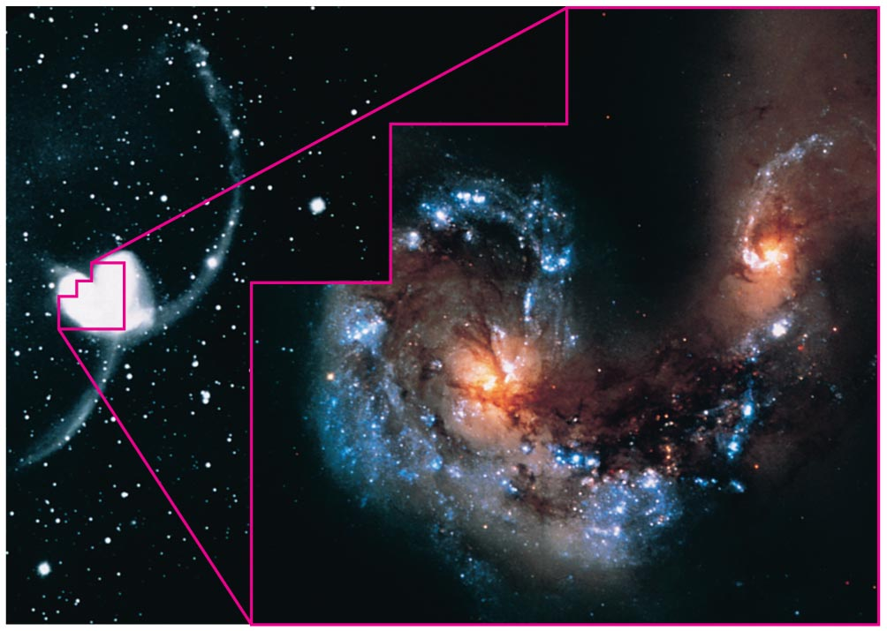
Starbursts
The collisions we observe nearby trigger bursts of star formation.

Slide 29
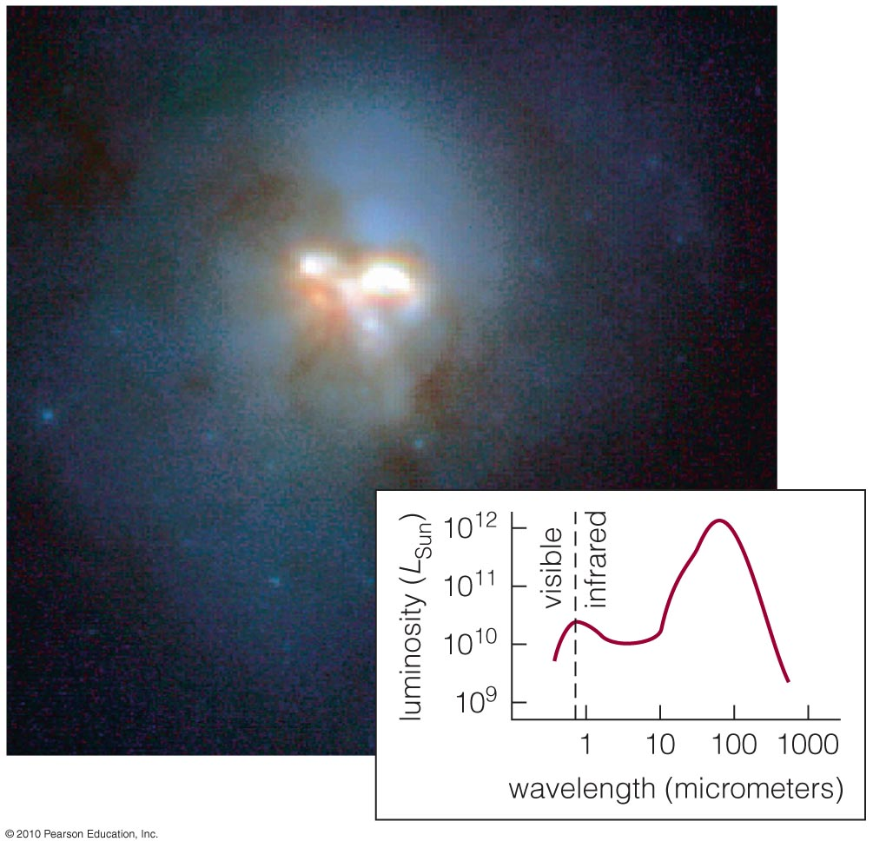
Starburst galaxies are forming stars so quickly that they would use up all their gas in less than a billion years.

Slide 30
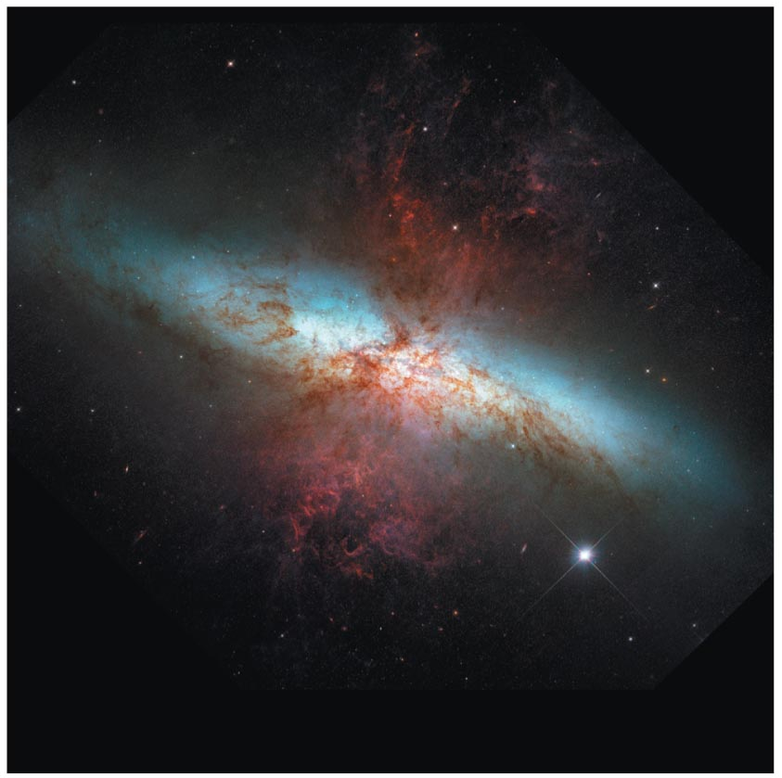
Visible-light
image
Intensity of supernova explosions in starburst galaxies can drive galactic winds.

Slide 31
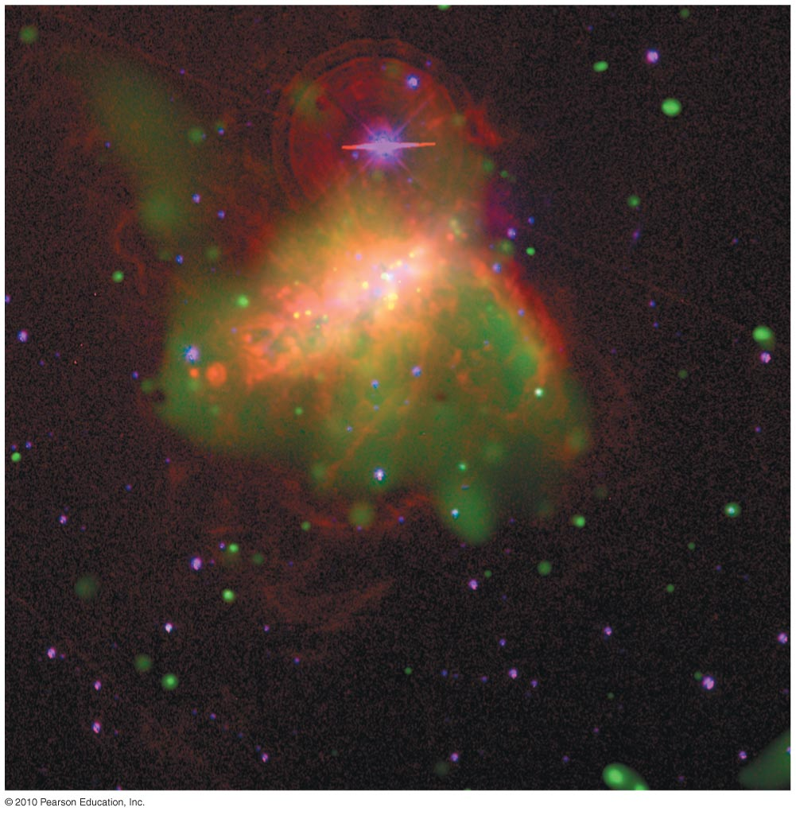
A galactic wind in a small galaxy can drive away most of its gas.

Slide 32
Exam Information
Where do I find the exam?
Mastering Astronomy
When will it be available?
Thursday 12/17 from 8am to Tuesday 12/22 12pm (start time)
How long do I have to take it?
2 hours
How many questions?
Approximately 60
Half similar to previous exams, half from this unit

Slide 33
Exam Information
What type of questions?
All Multiple choice
No sorting/etc.
What about notes? Can I use those?
You may use: Notes, book
You may NOT use: other people
*bear in mind time limit!*
Make sure you have a stable internet connection!!!
Notes:
It is surprisingly easy to catch people cheating online.
I will post office hours but not be available for email questions re: the exam.

Slide 34
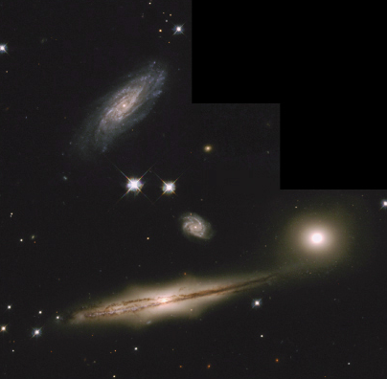
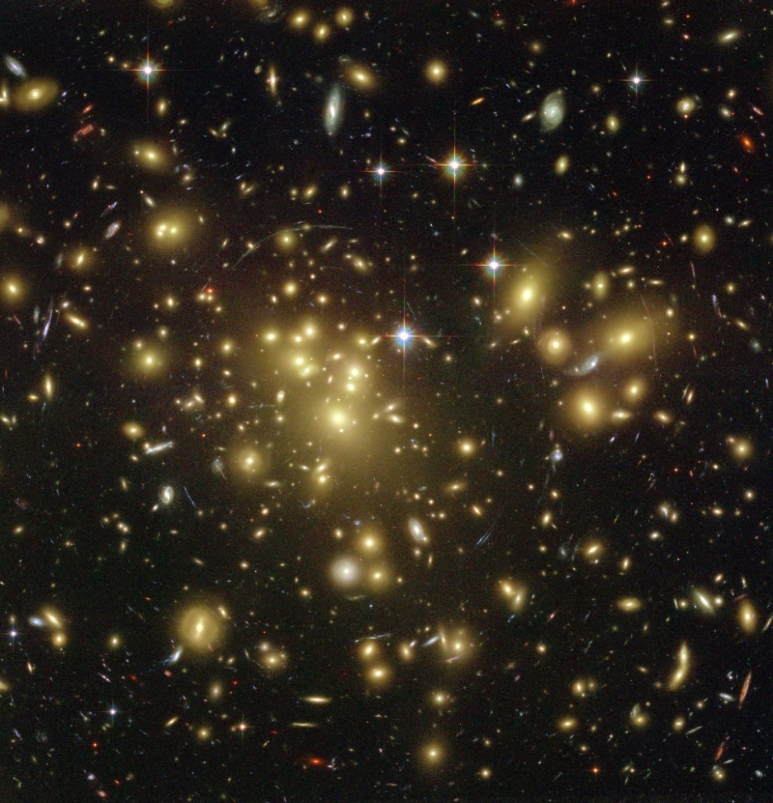
Groups and Clusters
Galaxies like company
B5
Notes:
About 75% of large galaxies are spirals. They tend to hand out in loose groups of several galaxies
Our local group of galaxies contains two large spirals, the Milky Way and Andromeda as well as over 30 smaller galaxies.
Clusters are larger than groups and tend to contain hundreds of galaxies.
Elliptical galaxies tend to hang out in large clusters.
Large elliptical galaxies are rare outside of clusters.

Slide 35
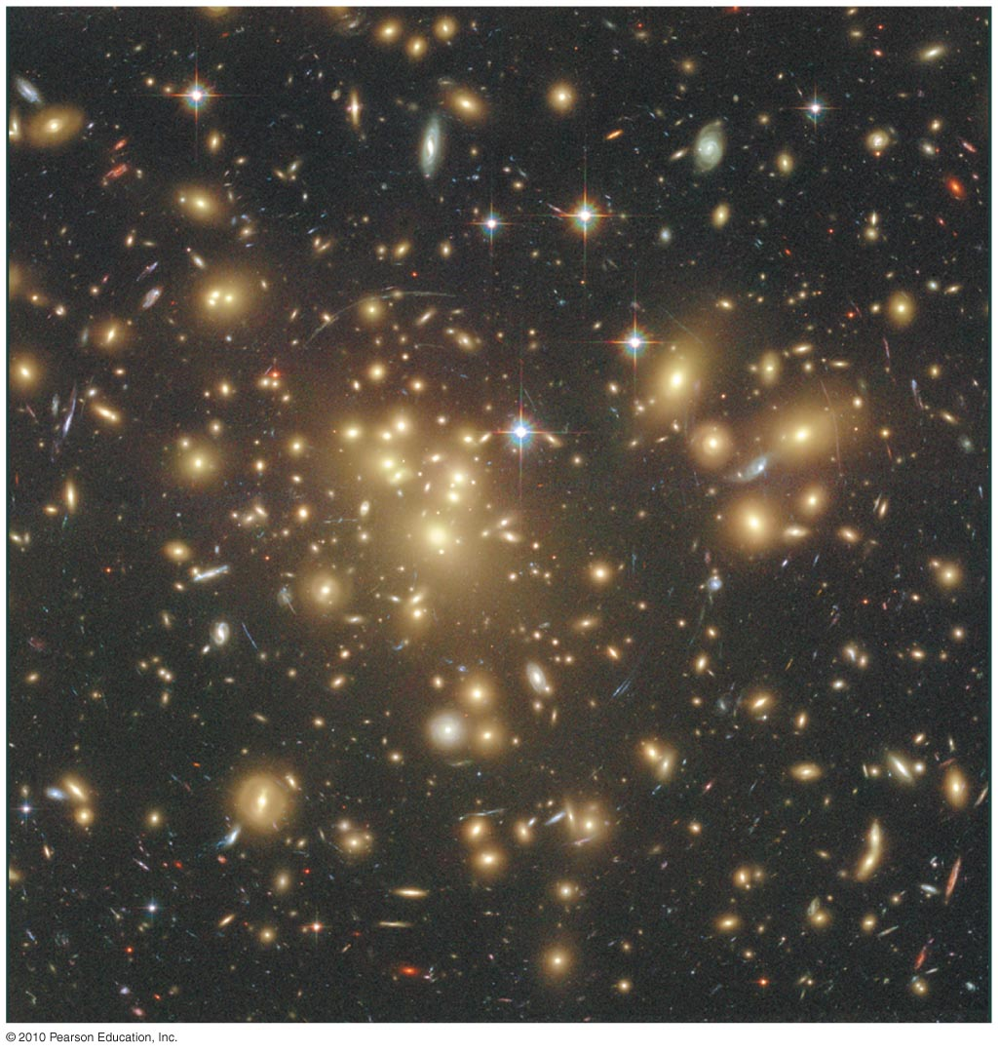
Collisions may explain why elliptical galaxies tend to be found where galaxies are closer together.

Slide 36
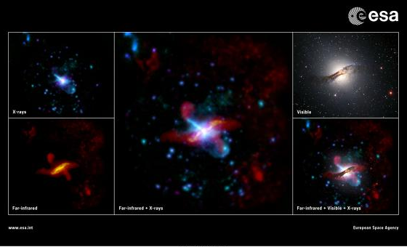
Active Galactic Nuclei (AGN)
Notes:
“The iconic Centaurus A galaxy, also known as NGC 5128, is the closest giant elliptical galaxy containing a radio-loud Active Galactic Nucleus (AGN). Upper left panel: New view of Centaurus A obtained with the EPIC camera on board ESA's XMM-Newton X-ray Observatory, which studied it in three different X-ray wavebands (in order of increasing energy, data from the three wavebands are shown in cyan, blue and purple, respectively).The X-ray image is available here. Lower left panel: New view of Centaurus A obtained with ESA's Herschel Space Observatory, combining data acquired with the PACS instrument at far-infrared wavelengths (shown in yellow) and with the SPIRE instrument at sub-millimetre wavelengths (shown in red), respectively. Central panel: Combined view of the Herschel and XMM-Newton images from the two panels on the left. Upper right panel: Image of Centaurus A at visible wavelengths, obtained with the MPG/ESO 2.2-metre Telescope at La Silla Observatory, Chile. Lower right panel: Combined view of the Herschel and XMM-Newton images from the two panels on the left and the visible waveband image from the upper right panel.” -ESA
http://xmm2.esac.esa.int/external/xmm_mobi/gallery/agns.html

Slide 37
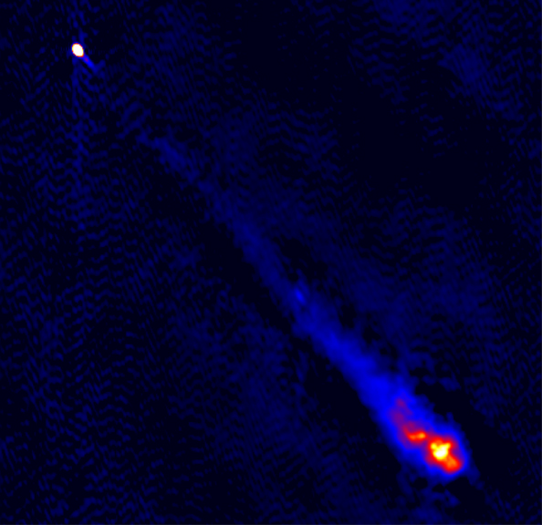
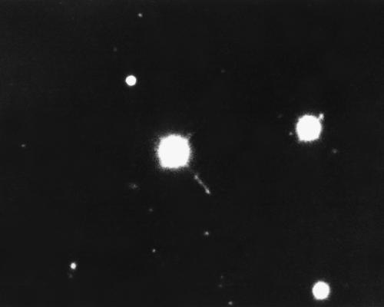
New Kind of Galaxy? 3C273
A radio source with unusual optical emission lines
Notes:
Trying to find optical counterparts of radio sources.
Most of them were galaxies.
This one was a blue star with an odd spectrum.
They soon figured out that the emission lines were highly red shifted hydrogen.
It was receding at 47,000 km/s!
Using Hubble’s Law, that puts it at 2.2 billion light years! Wow!
That means it must have over 1 trillion solar luminosities.
Could there be another explanation for its red shift?

Slide 38
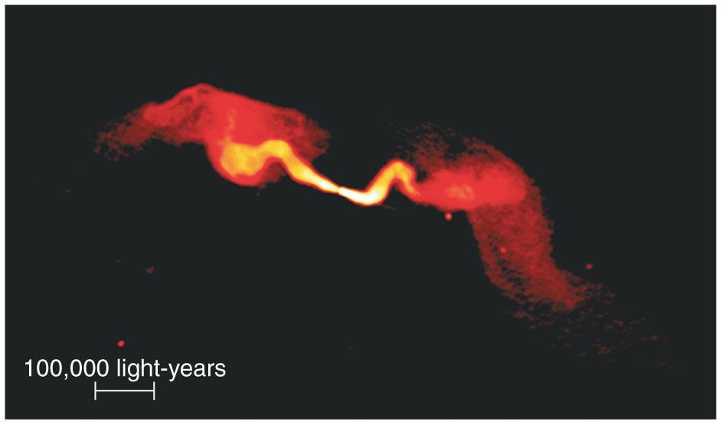
The lobes of radio galaxies can extend over hundreds of thousands of light-years.

Slide 39
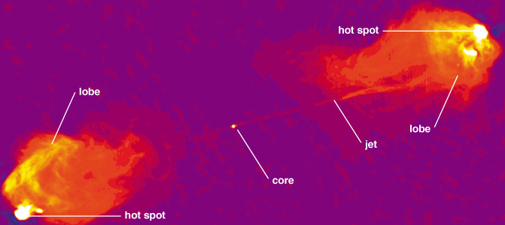
Active Galactic Nuclei (AGN)
The radio emission comes from jets
Notes:
Since their luminosities change on such small time scales, they must be very small.
The size must be on the order of the variability
The radio lobes extend out to enormous distances, much larger than the disk of the galaxy.

Slide 40
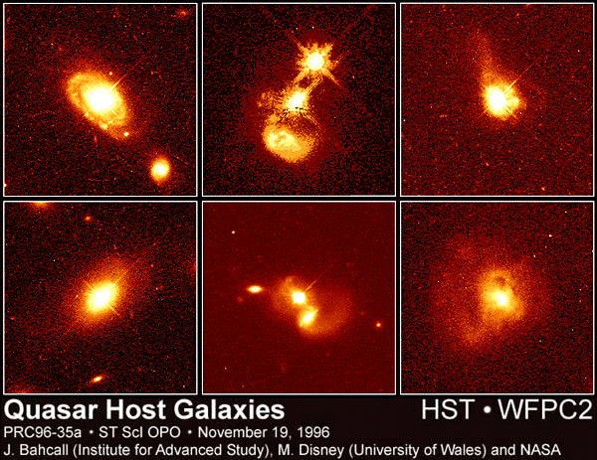
Quasars
They are at the centers of extremely distant galaxies
Notes:
They are called quasars because they are quasi stellar objects.
Their spectrum, instead of looking like a blackbody, is flat, meaning that they have lots of power across the spectrum.
They outshine the entire galaxy. They are about 1000 times brighter than the Milky Way.
Highly variable on very short time scale (about an hour)
They all reside at high redshifts suggesting that they were common billions of years ago but not any more.

Slide 41
Active Galactic Nuclei
Nearby galactic centers with quasar like characteristics
Notes:
Except for their luminosities, AGN look much like quasars.
Its easier to see the host galaxy because it is closer and the central source isn’t swamping the light from the entire galaxy.
The source of the emission is tiny. No telescope can resolve it.

Slide 42
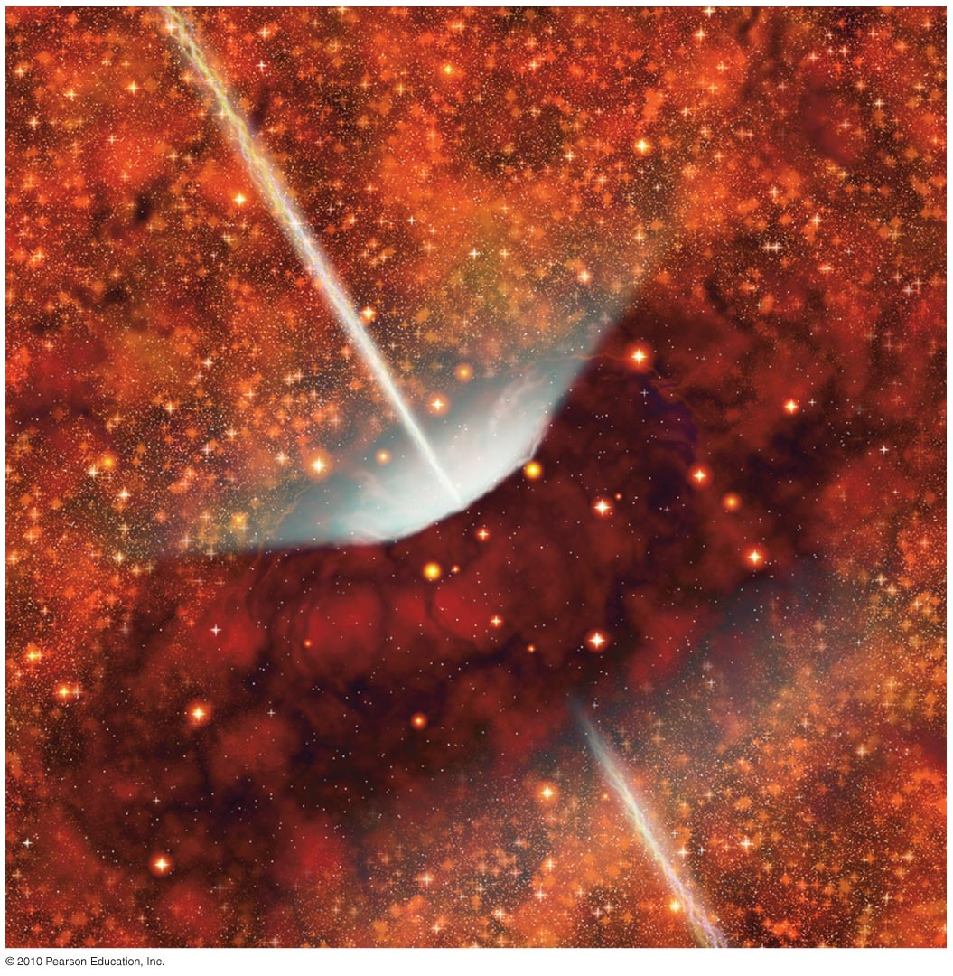
Radio galaxies don’t appear as quasars because dusty gas clouds block our view of the accretion disk.

Slide 43
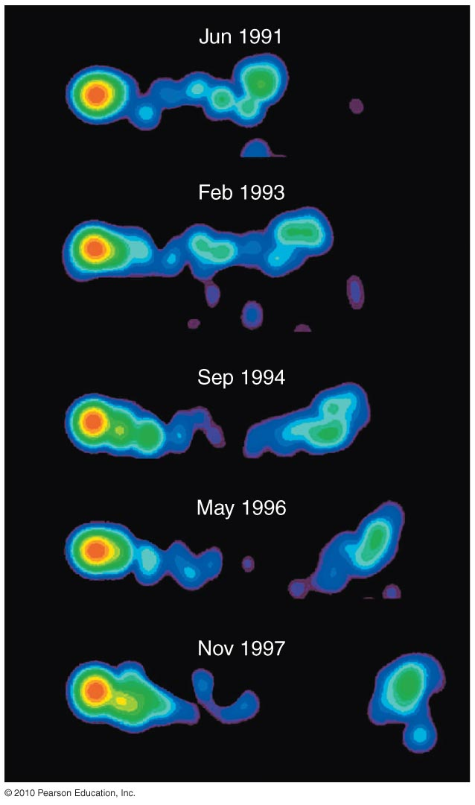
An active galactic nucleus can shoot out blobs of plasma moving at nearly the speed of light.
These ejection speeds suggests the presence of a black hole.

Slide 44
Super Massive Black Holes
Gravitational potential into light
Notes:
An accretion disk forms around the black hole.
It gets really hot and emits at a wide variety of wavelengths.
Twisty magnetic fields collimate the light.
Quasars must consume 17 solar masses per year to be as luminous as they are.

Slide 45
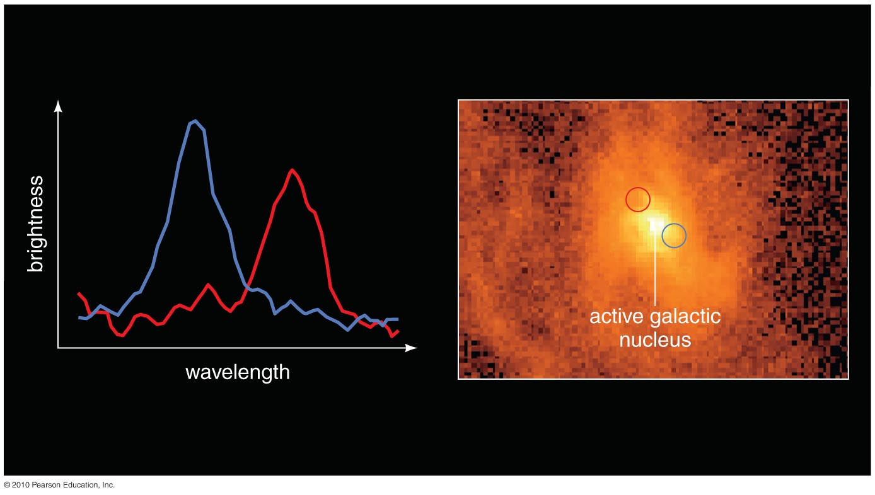
The orbital speed and distance of gas orbiting the center of Galaxy M87 indicate a black hole with mass of 3 billion M_{Sun}.

