Slide 1
Our Galaxy
Image: John P Gleason

Slide 2
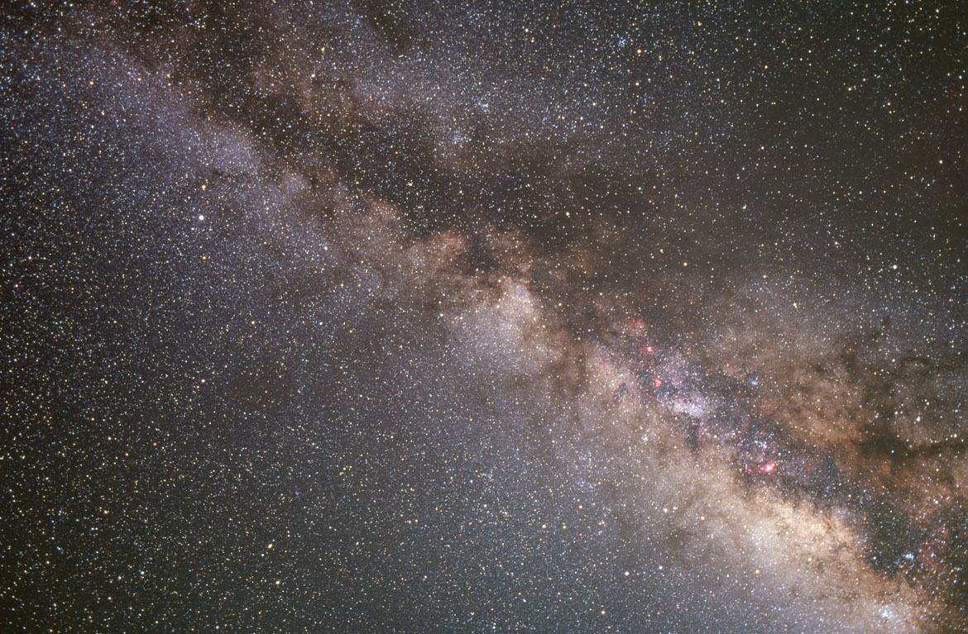
Milky Way Scales
Lecture Tutorial p 135

Slide 3
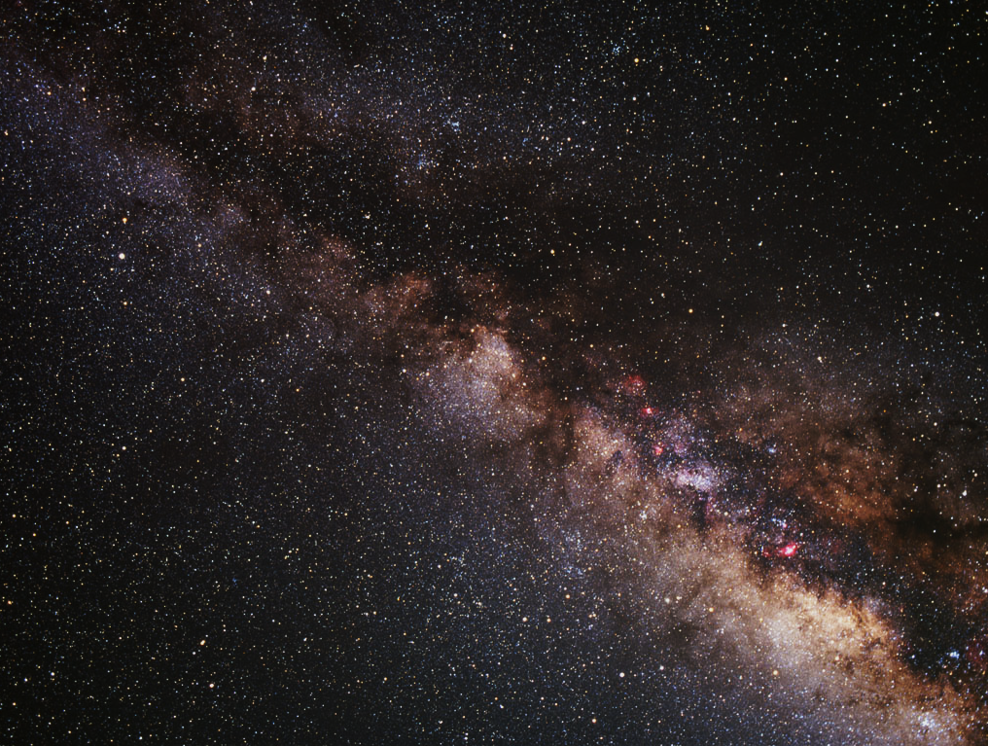
Our Galaxy: Overview
The Milky Way
Basic Structure
Main components?
Composition of components?
Ages of types of stars?
Motion of stellar populations?
Orbital velocities?
What is a rotation curve?
What does the rotation curve
imply about our galaxy?

Slide 4
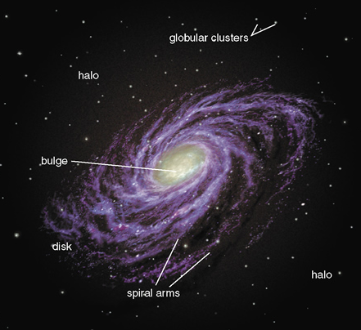
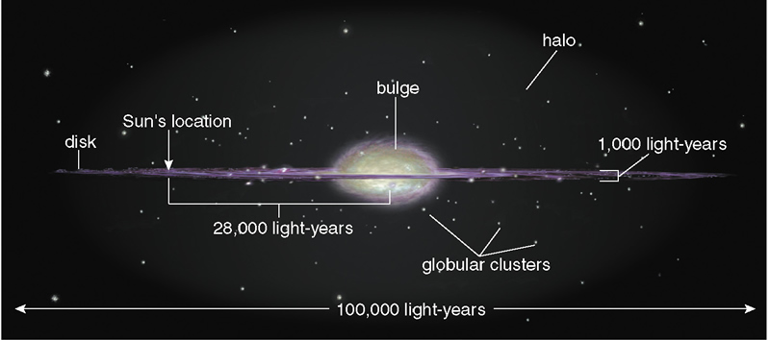
Basic Structure
Disk: Young stars, heavy dust
Bulge: Mixed population, middle aged, some dust
Halo: Old stars, globular clusters, no dust
Notes:
Disk
A flat disk with a thickness that is 1/100th the length of the disk
Most of the younger stars lie in the disk
Composed of stars, gas, and dust
Spiral arms are in the disk
Bulge
Central region of the galaxy
Contains a mixture of old and new stars
More tightly packed; higher densities
Halo
A sphere that surrounds the disk and bulge of the galaxy
Contains older stars
Globular clusters
No gas and no dust, just stars
No star formation going on in the halo

Slide 5
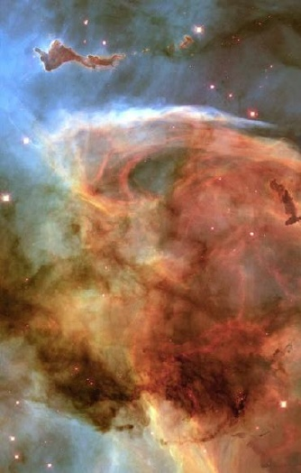
Interstellar Medium
Stuff between stars
90 percent gas
10 percent dust
Obscures much of the galaxy from our view
Mostly in the plane of the galaxy
Notes:
The ISM is the stuff between the stars
Composed of gas and dust
90% gas
10% dust
Very low density of 1 atom/cm⁻³
Yet enough to block light from far away parts of the Galaxy
The ISM effectively absorbs or scatters visible light. (dust, particularly)
it masks most of the Milky Way Galaxy from us
Radio & infrared light does pass through the ISM.
we can study and map the Milk Way Galaxy by making observations at these wavelengths
Hot gas and dust is ionized.
Cooler gas is atomic
Cold gas can form molecules.

Slide 6
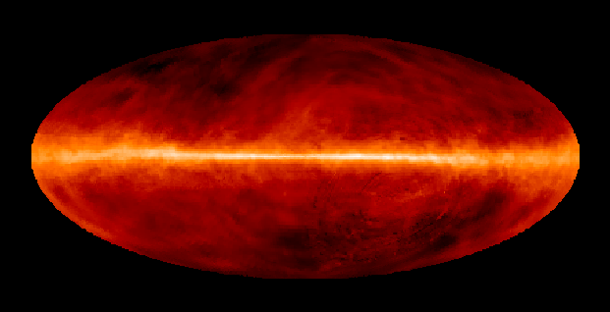
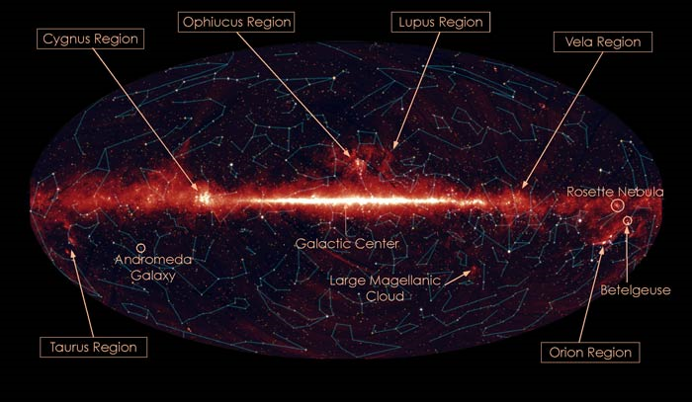
Gas and dust maps
Notes:
In modern times, we have built all sky maps that trace out the dust in the galaxy.

Slide 7
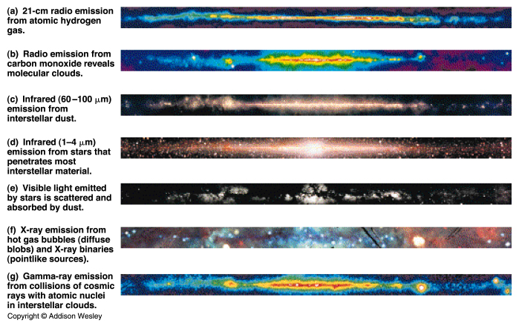
Different Views

Slide 8
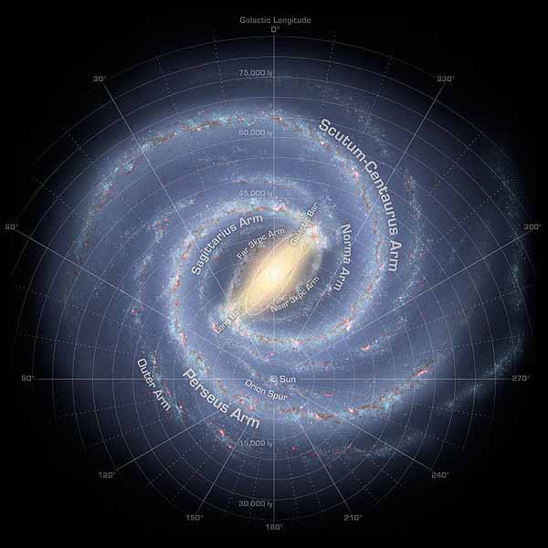
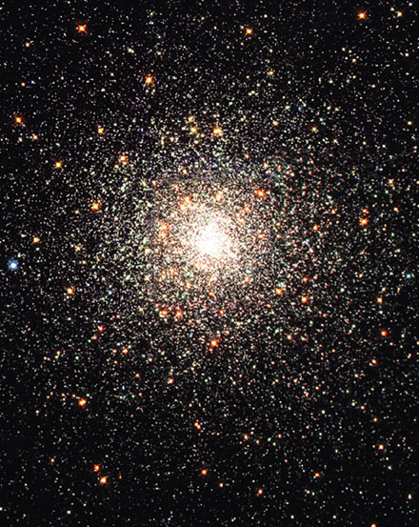
Stellar Populations
Notes:
The galactic center is reddish.
The spiral arms are blue. The pink is glowing hydrogen.
The arms have a young population of stars hot blue stars.
The hot blue stars ionize the hydrogen causing it to glow.
The globular cluster on the right is typical of what is found in the galactic halo.
There is NO dust here and thus NO star formation.

Slide 9
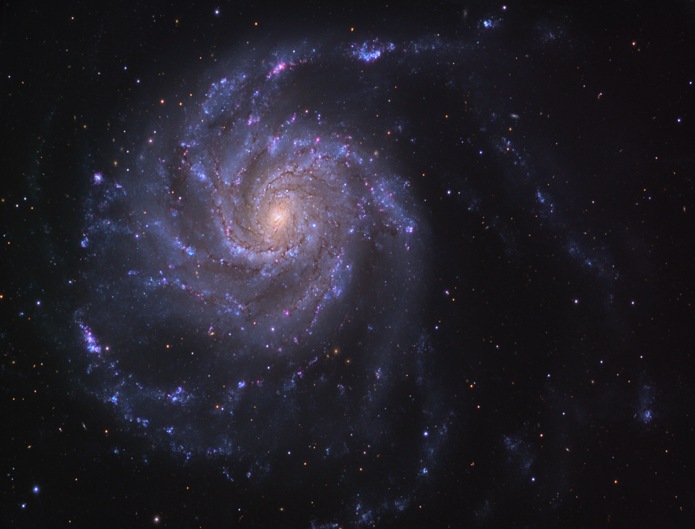
The Galaxy is 10 billion years old but the disk is very Blue. Why?
Notes:
Blue stars are MUCH more luminous than red stars.
They are also short lived.
A young population will have a few blue stars that dominate the output.
These stars die first, leaving behind the cooler red stars.
So young populations tend to appear blue while old populations appear red.

Slide 10
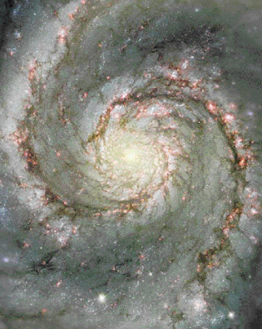
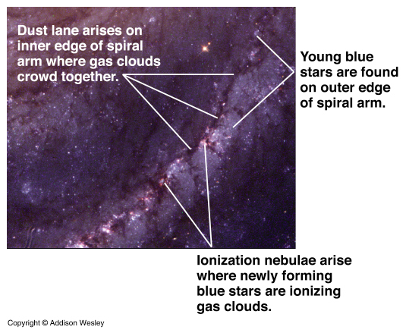
Spiral Arms
Spiral arms are density waves
The density waves move faster than the disk spins
Notes:
Star formation happens in the spiral arms.
Gas and dust piles up just in the wave.
The density wave compresses the ISM triggering star formation.
Hot young stars dominate the area just behind the density wave making the arms blue and bright.
The spiral arms appear much bluer than the bulge, which contains an older population of stars.
The big O and B stars cause ionized nebula to glow in the region of the arms.
The big stars die quickly, long before another wave comes by.
Lower mass stars (the Sun) pass through several density waves in their lifetimes.

Slide 11
Young populations of stars appear blue because
A) Young populations are red, not blue.
B) All stars are born blue and eventually turn red
C) There are a lot more blue (hot) stars than red (cool) stars
D) The blue (hot) stars, although they are rare, are MUCH brighter
Notes:
Blue stars are MUCH more luminous than red stars.
They are also short lived.
A young population will have a few blue stars that dominate the output.
These stars die first, leaving behind the cooler red stars.
So young populations tend to appear blue while old populations appear red.

Slide 12
Galactic Recycling Program
Material gets cooked in stars and ejected back into the ISM
Notes:
Cold molecular clouds collapse and form stars
Stars fuse and make heavy elements.
Big stars explode and enrich the interstellar medium
Smaller stars puff their stuff out in planetary nebula and enrich the interstellar medium
Each new generation of stars contain more ‘metals’ than previous generations.
So, as a galaxy ages, more and more of its material gets processed and the fraction of heavy elements increases.

Slide 13
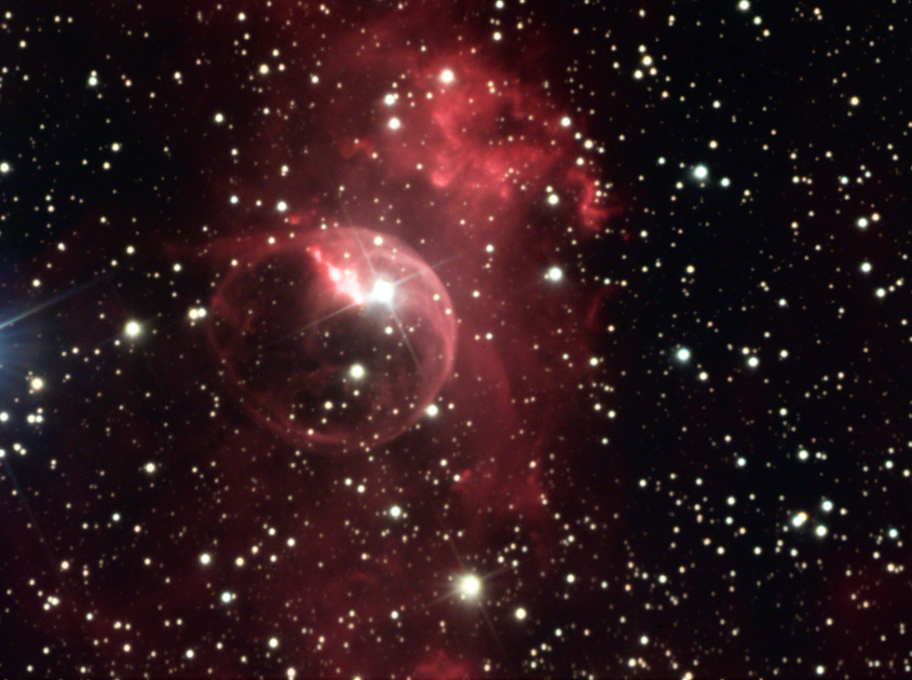
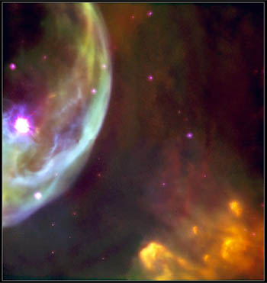
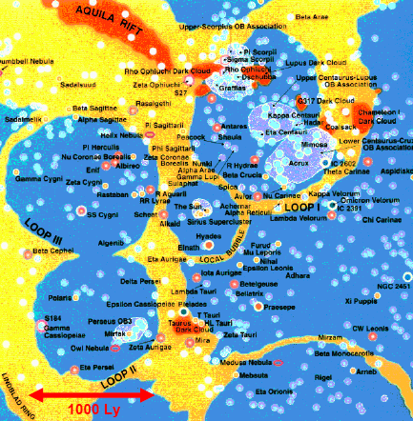
Bubbles
Massive stars blow bubbles in the ISM
Notes:
When a super nova goes off… the velocities of the particles is WAAAAY above the escape velocity of the galaxy.
Stars tend to form in clusters containing some high mass stars and some low mass stars.
When the massive stars explode, the push some of the ISM away.
When a lot of them explode, they blow big bubbles
The Sun resides in a bubble.
Sometimes the bubbles break out of the plane and a chimney forms. The gas then rains back down onto the disk.

Slide 14
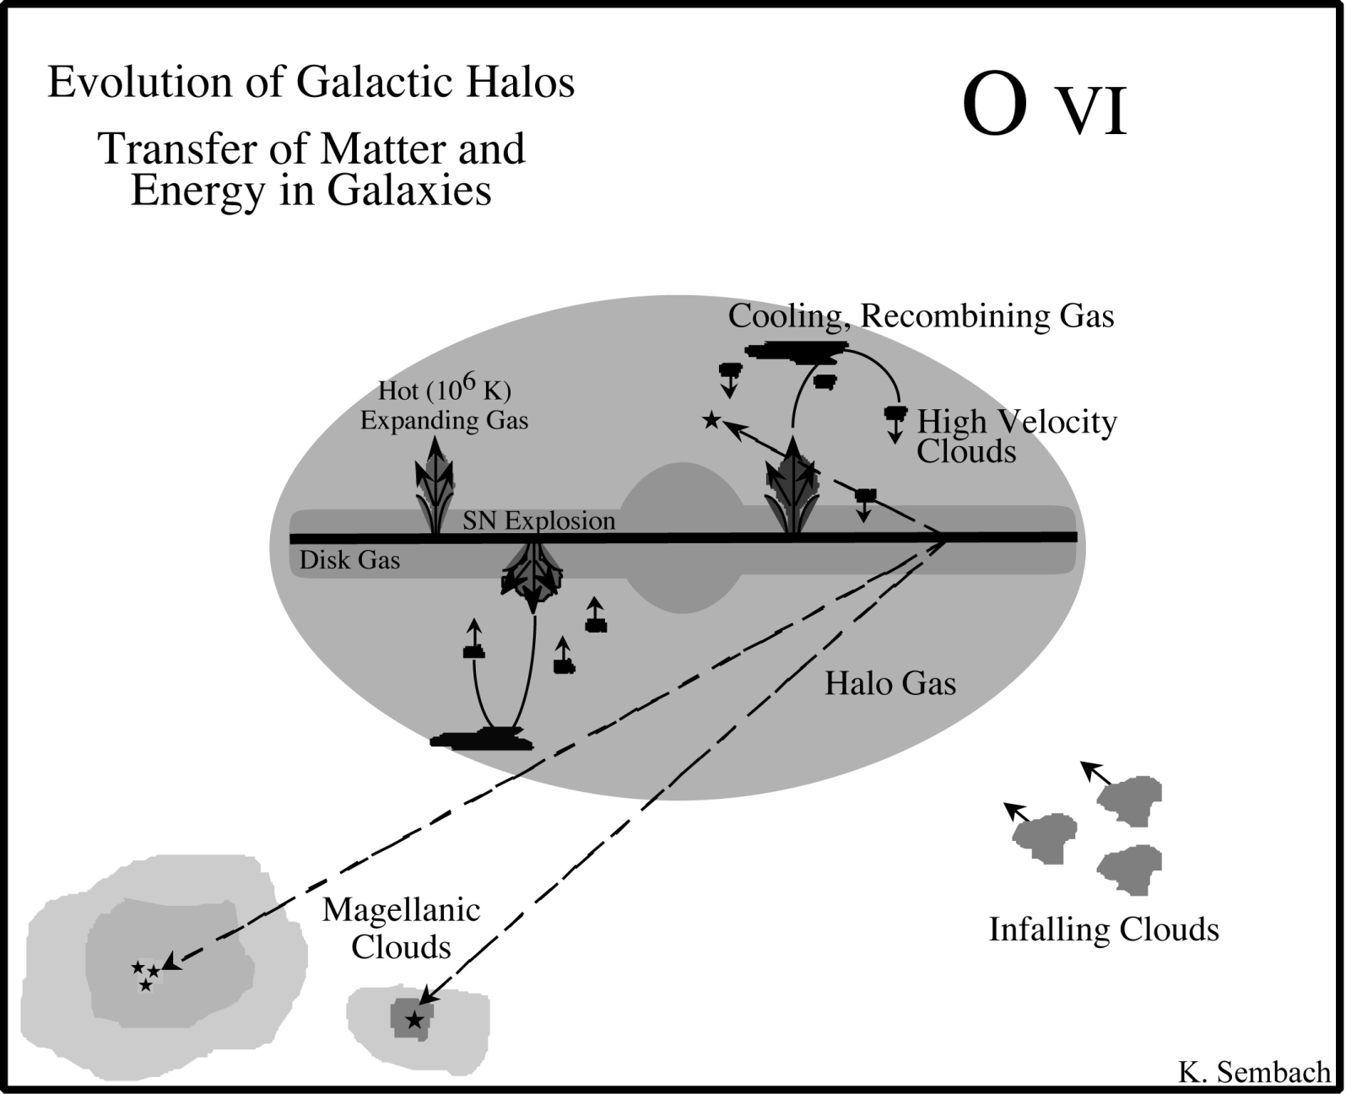
Fountains
Notes:
Sometimes… a LOT of SN go off very close in time to one another.
This can keep blowing the bubble bigger and bigger until the galaxy has a blowout.

Slide 15
History of Matter
The Galaxy’s metal content
A) has been decreasing since its formation
B) has not changed since its formation
C) has been increasing since its formation
D) is not something we can measure

Slide 16
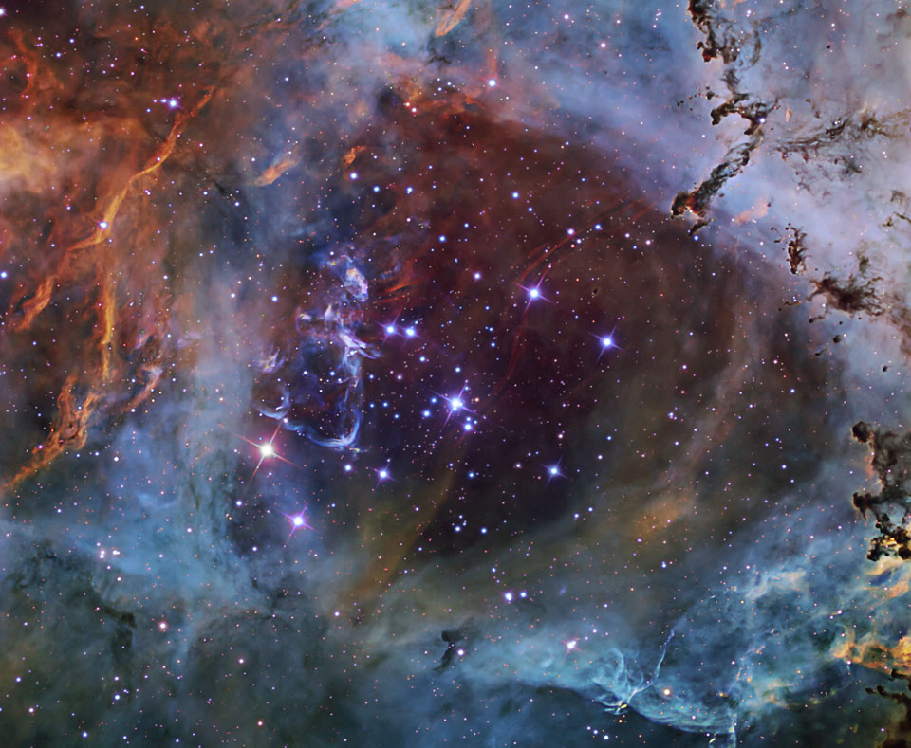
Clusters
Halo: old stars, no dust, globular clusters
Disk: Young stars, heavy dust, open clusters
Notes:
We can get the AGE of glubular clusters by looking at the Main Sequence Turn-off.
Assume that all stars in the cluster have approximately the same birth day.
High mass stars evolve more quickly than low mass stars.
So… The highest mass star STILL ON the main sequence determines the age of the cluster
Because, higher mass stars that WOULD appear just above it are no longer on the main sequence.
Image credit: Right, Rosette Nebula NGC 2244, Don Goldman http://www.astrodonimaging.com/

Slide 17
Halo Stars?
We would expect halo stars to have
A) Higher metal content than the
disk stars
B) Lower metal content than the
disk stars
C) The same metal content than
disk stars
D) There is no way to know.

Slide 18
Orbital Motions
Disk
Mostly circular orbit about the galactic center
Halo and Bulge
Swarming orbits
Not coplanar
Notes:
Orbits in the disk are similar to planetary orbits. They are coplanar and mostly circular
Disk orbits do bob above and below the disk.
If a star is too low, the gravitational force of the disk pulls it back up, but there isn’t enough friction in the disk to stop it from going all the way through.
So… it just oscillates. Add to the oscillating motion the fact that the star is ALSO in orbit around the center.
It looks a bit like the star is riding a circular roller coaster.
Halo and bulge stars (and globular clusters in the halo) are on erratic orbits like a swarm of bees.
Stars don’t interact… meaning there’s no friction between them (star star collisions are very rare)
So.. The orbits never flatten to a disk or circularize.

Slide 19
Kepler’s Second Law
Kepler
Lecture Tutorial
p. 143
p
2
=
a
3
Newton
4
π
2
p
2
a
3
=
(
M
M
)
G
+
1
int
Orbital period depends on the interior mass
Notes:
Don’t mind the exact form of the equation…
The point is that orbital period is dependant on BOTH the mass of the body AND the mass enclosed by the orbit.
Kepler’s third law only works in the solar system.
If we make the Sun more massive, all of the planetary orbital velocities would go up!

Slide 20
If the Sun were 2 solar masses instead of 1 solar mass and the Earth were still in a circular orbit at 1 AU,
A) Our orbital period would be lower
B) Our orbital velocity would be higher
C) Our orbital velocity would be the same
D) Our orbital velocity would be lower

Slide 21
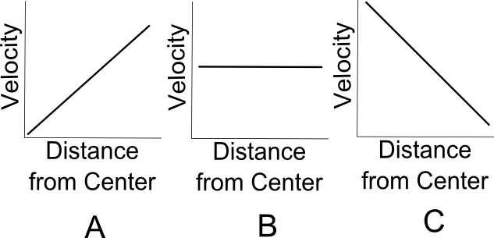
Rotation Curves
Notes:
Rotation Curve: A plot of Orbital Velocity versus Distance from the center of rotation.
Which is the rotation curve for quarters on a turntable?
Which is the rotation curve for Planets in the Solar system?

Slide 22
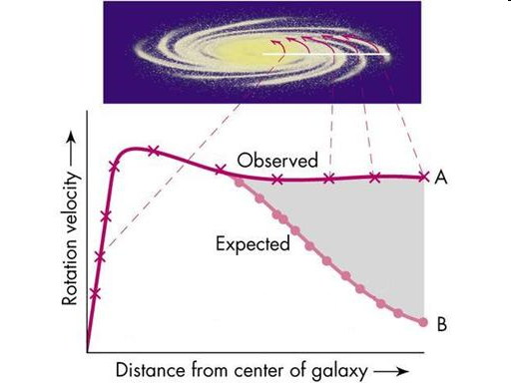
What do we expect?
Hmm…
Notes:
So we measure the mass that we can see (due to the starlight) and predict orbital velocities using Newton’s version of Kepler’s 3rd Law.
In rigid bodies, the velocity is directly proportional to the radius… faster rotation further from the center.
Planetary orbits follow Kepler’s third law, and go slower as you get further from the center.
Galaxies have a rigid section in the middle followed by a flat rotation curve. The velocity doesn’t change as you go out from the center.
We can’t account for all of the mass by considering all of the stars and all of the gas and dust.
Evidence for mass that we can’t see… Dark Matter.

Slide 23
What does it mean?
Gas & Dust
Stars etc.
Dark
Matter
Dark
Energy
Notes:
So we measure the mass that we can see (due to the starlight) and predict orbital velocities using Newton’s version of Kepler’s 3rd Law.
In rigid bodies, the velocity is directly proportional to the radius… faster rotation further from the center.
Planetary orbits follow Kepler’s third law, and go slower as you get further from the center.
Galaxies have a rigid section in the middle followed by a flat rotation curve. The velocity doesn’t change as you go out from the center.
We can’t account for all of the mass by considering all of the stars and all of the gas and dust.
Evidence for mass that we can’t see… Dark Matter.

Slide 24
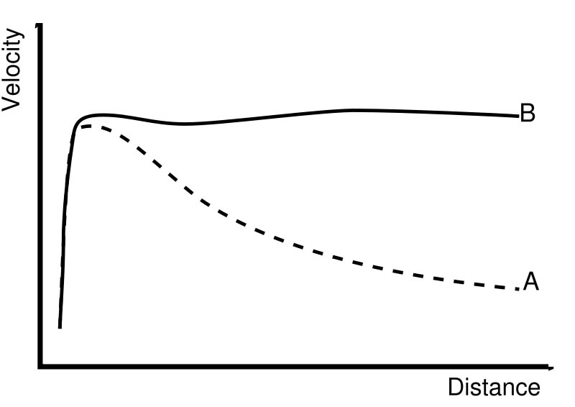
Galactic Rotation Curve
We can’t see all of the Milky Way’s mass
Notes:
According to the orbits of stars in the Milky Way, there should be a LOT more mass than we can see.
We can’t see it though. So, we call it dark.

Slide 25
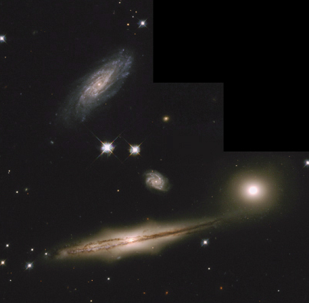
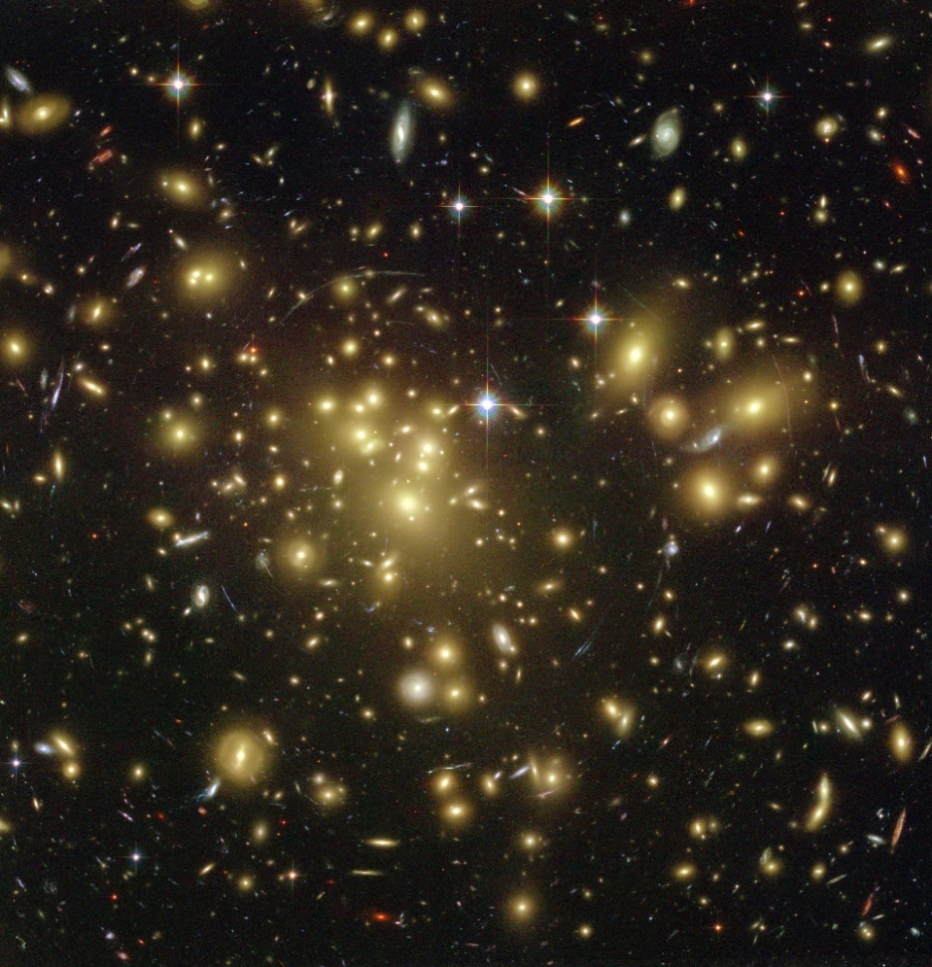
Groups and Clusters
Galaxies like company
…and they too show effects of dark matter
Notes:
About 75% of large galaxies are spirals. They tend to hand out in loose groups of several galaxies
Our local group of galaxies contains two large spirals, the Milky Way and Andromeda as well as over 30 smaller galaxies.
Clusters are larger than groups and tend to contain hundreds of galaxies.
Elliptical galaxies tend to hang out in large clusters.
Large elliptical galaxies are rare outside of clusters.

Slide 26
Galaxy Clusters
Orbital velocities in clusters of galaxies are strange too
We can ‘weigh’ the cluster in two ways:
velocities of the galaxies
X-ray gas emission
Once again, there isn’t enough mass.

Slide 27
Gravitational Lensing
Abell Cluster 1689
Notes:
Gravity bends light.
A ray that was never destined to hit our eyes, ends up hitting our eyes due to a deep gravitational well.
We can ‘weigh’ the cluster.
Again, there is not enough mass. The shortfall is in agreement with the orbital velocity measurements.

Slide 28
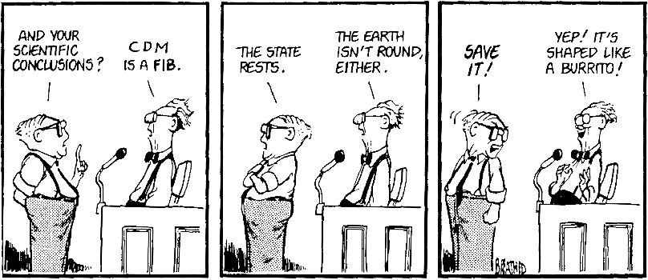
MoND
Modified Newtonian Dynamics
It hasn’t come close to working yet
Notes:
F isn’t quite equal to ma. Maybe we don’t understand gravity?
It can be made to work for galactic rotation curves but then fails everywhere else.
MoND doesn’t work.

Slide 29
Dark Matter
Ok, so what the heck is it?
Could it be ordinary matter?
MACHOs
Massive Compact Halo Objects
Surveys detect a few, but not enough
Notes:
Could it be a lot of compact objects that just aren’t glowing very bright?
Something like lots and lots of low mass objects left over from star formation (brown dwarfs), or stellar-sized black holes?
Alas, we don’t see enough lensing events for normal matter to be much of the “dark matter” out there…

Slide 30
WIMP’s
Or is it extraordinary matter?
Weakly
Interacting
Massive
Particles
They interact gravitationally only
CDM = Cold Dark Matter
Notes:
WIMPS would explain why the apparent distribution of dark matter is spherical.
As globular clusters and elliptical galaxies are spherical since the stars don’t generally collide…
So the dark matter halo around galaxies is spherically distributed since the WIMPS are collisionless.
NEUTRINOS could be part of this – they have small mass, but there are a lot of them! Still… not enough to make up all the dark matter that we observe gravitationally.

Slide 31
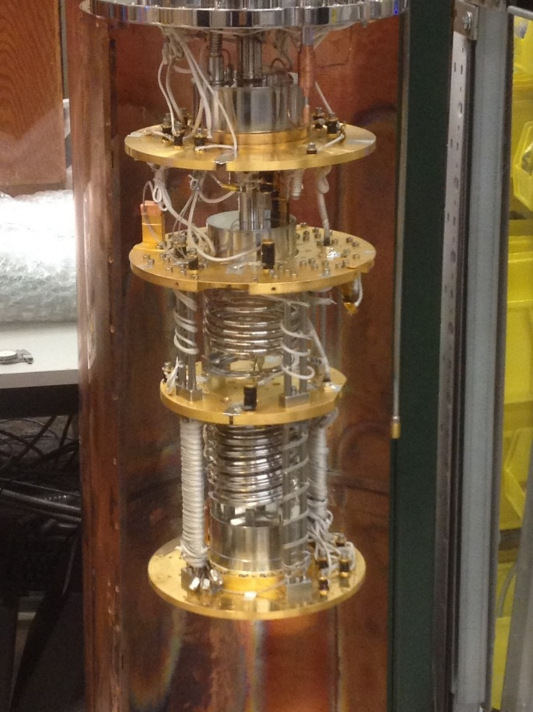
Axions??
“New” Fundamental Particle?
Originally proposed to solve CP violation
Created in the Big Bang!
If low mass could still be around!
Notes:
Theory suggests that axions were created abundantly during the Big Bang… if they have a low mass, and are cold (aka not much kinetic energy) then they should be able to undergo Bose-Einstein condensation. If instead high mass axions are created in the BB, they would decay (and not be around anymore so that would not help the dark matter problem).
CP-symmetry states that the laws of physics should be the same if a particle were interchanged with its antiparticle (C symmetry), and then left and right were swapped (P symmetry). Charge Parity (CP) violation says this doesn’t work that way…
The strong CP problem is one of the most important unsolved questions in physics. Maybe it could also solve our dark matter problem?
Top: Theoretical Particle physicist Dr. Chanda Hsu Prescod-Weinstein, whose theoretical work on axions and dark matter are groundbreaking
To the left, part of the Axion Dark Matter eXperiment (ADMX), almost online to try to detect these critters (U Washington)
This one is looking promising!

