Slide 1
The Shape of the Universe
Questions:
What was different between Herschel’s Kapteyn’s stellar distance measurements?
What was Kapteyn/Shapley debate about?
Who was the “most” correct?
What did they both get wrong?

Slide 2
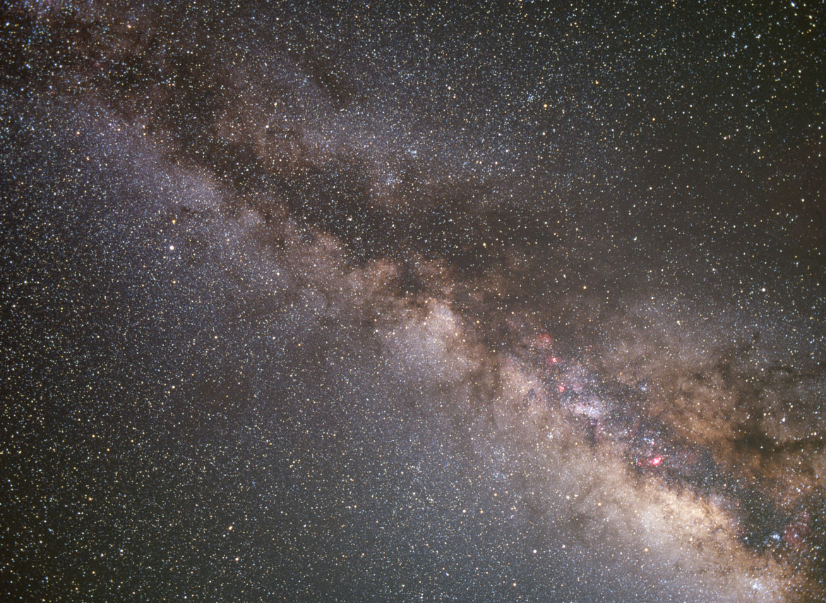
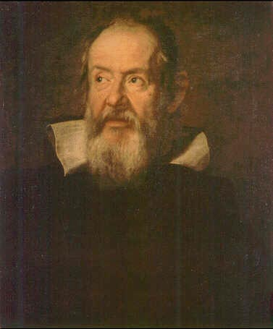
The Shape of the Universe
Gallileo
The Milky Way is composed of innumerable stars

Slide 3
The Shape of the Universe
We need to measure distances!
L
F_{E}
=
4
π
d
2
Notes:
We will get the distances to objects by “knowing” their Luminosity and solving this equation

Slide 4
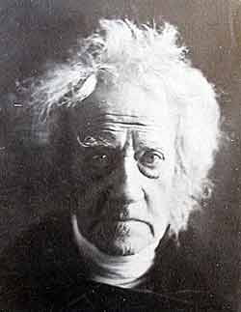
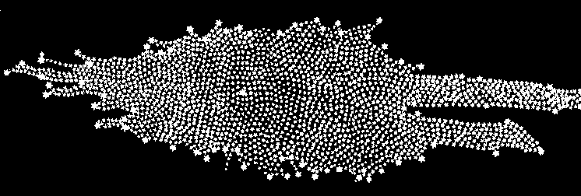
The Shape of the Universe
William Herschel
Assumes L=1 for all stars
The “Universe” is a flat disk 5 times wider than thick

Slide 5
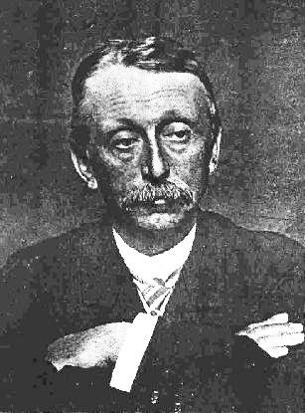
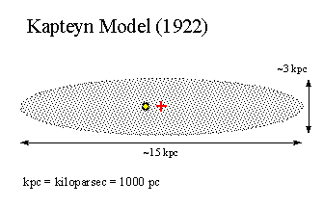
The Shape of the “Universe”
Kapteyn
Short and squat (Lentil)
Sun is near the center
40,000 lyr across
Notes:
Kapteyn measured the distance to stars in many different directions using main sequence stars as standard candles.
Using Newton’s laws, Shapley measured the orbits of globular clusters to find the center of mass of the galaxy.
Kapteyn underestimated the obscuring effects of interstellar dust.
He imagined a lens shaped galaxy.

Slide 6
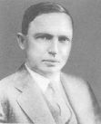
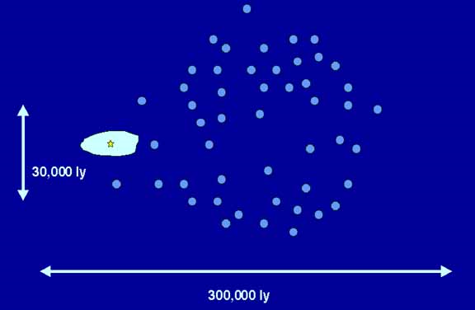
The Shape of the “Universe”
Shapley
Globulars are in a spherical “halo”
Center is 45,000 lyr away
Notes:
Kapteyn measured the distance to stars in many different directions using main sequence stars as standard candles.
Using Newton’s laws, Shapley measured the orbits of globular clusters to find the center of mass of the galaxy.
Kapteyn underestimated the obscuring effects of interstellar dust.
He imagined a lens shaped galaxy.

Slide 7
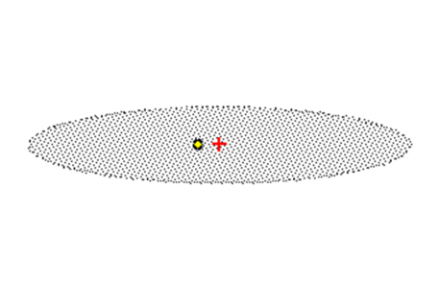
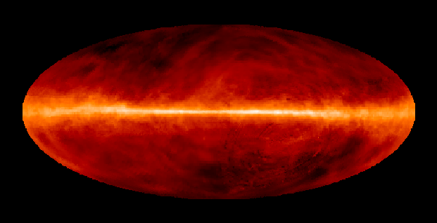
What’s going on?
Notes:
The Kapteyn and Shapley Universes superimposed on one another.
Kapteyn and Shapley disagree about nearly everything…
The overall size.
The shape
The distance to the “center”

Slide 8
What’s going on?
Facts
Kapteyn is looking at resolvable stars.
Shapley is looking at Globular Clusters
They disagree about the size by a factor of 10
They disagree about the location of the Sun
The dust is concentrated in the midplane of both Kapteyn’s and Shapley’s distributions.
Questions
Why is Kapteyn’s Universe so small?
Why can Shapley see so far?
Why is Kapteyn’s disk so thick and why does it extend so far “behind” us?

Slide 9
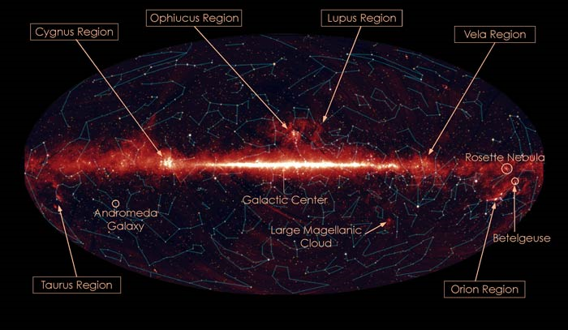
Gas and dust maps
Notes:
In modern times, we have built all sky maps that trace out the dust in the galaxy.
We have noticed that the dust is concentrated in a narrow band and is the most dense towards the constellation of Sagittarius.
Both Kapteyn AND Shapley found that the galactic center lies in the direction of Sagittarius.

Slide 10
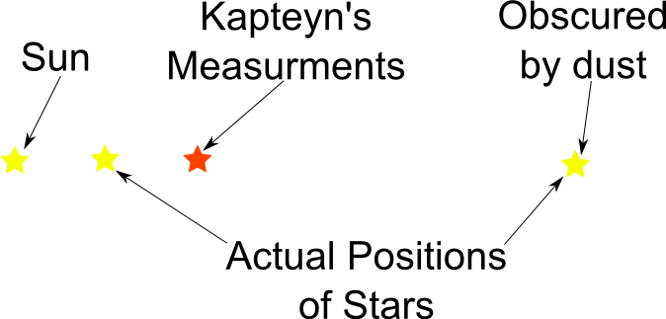
Why so small?
Notes:
Kapteyn couldn’t SEE all of the stars in the galaxy because of dust in the galactic plane.
The most distant star in this image would have been blocked from his view.
The nearby star that he COULD see was dimmed by dust causing him to get the wrong distance.

Slide 11
Why is the disk too thick?
Kapteyn’s Measurements
Actual Positions

Slide 12
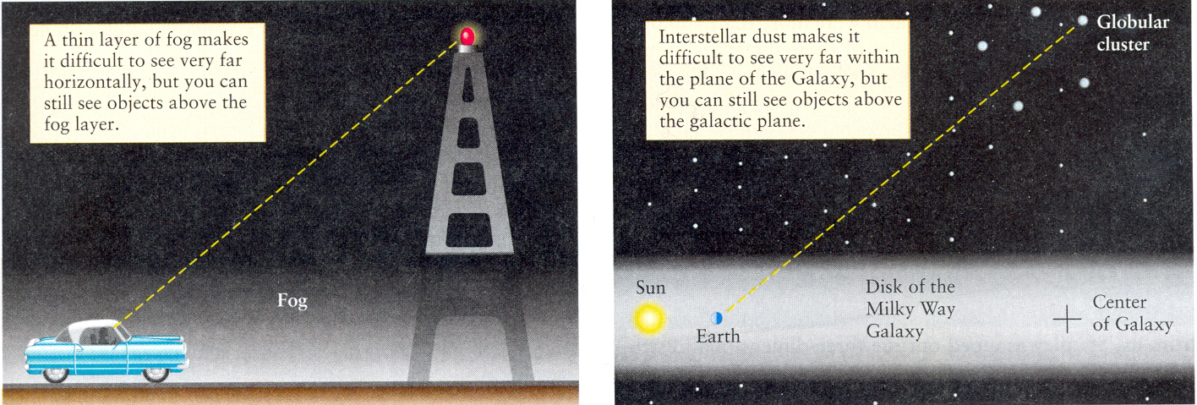
Why can Shapely see further?
Shapely’s distances were ALSO too big because of dust.
But he could see further!
Notes:
He could see further because he was looking through less dust AND the globulars are BRIGHT

Slide 13
Who’s Correct?
They were both wrong, but Shapely was closer.

Slide 14
Milky Way Scales
Lecture Tutorial p 135

Slide 15
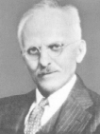
The Great Debate
You wanna fight about it?
Bring it on, whippersnapper
Shapley
Curtis
Shapley: The universe is one big galaxy and the spiral nebula are within it.
Curtis: Galaxies are island universes and the Milky Way is but one of them.
Notes:
Shapley said that the Milky way is very large. In fact the entire universe is taken up by the Milky Way and the ‘spiral nebula’ are nearby gas clouds within the Milky Way.
Curtis said that the Milky Way is smallish and the Sun is nearly in the center (40,000 ly across). The ‘spiral nebula’ are other galaxies like the Milky Way.
Note: They are BOTH wrong about one thing and right about one thing.

Slide 16
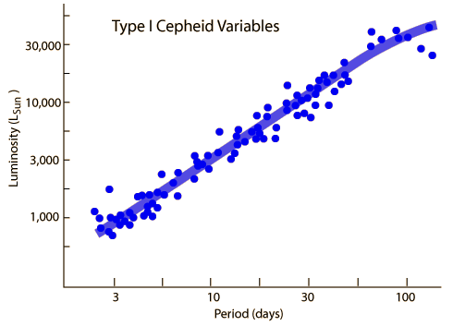
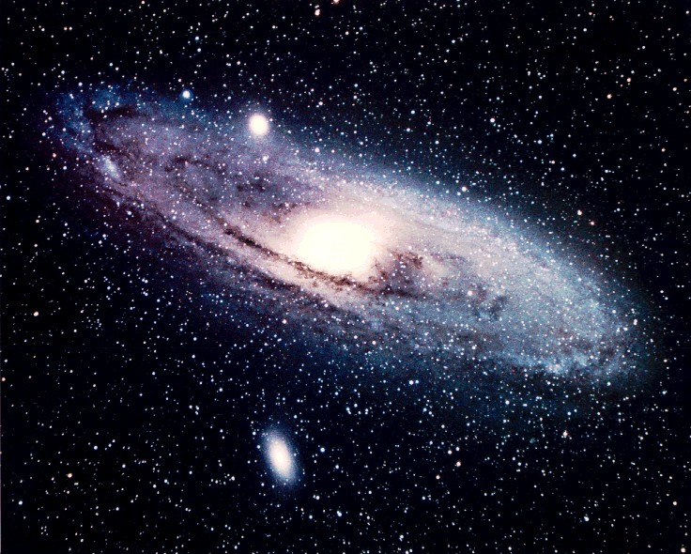
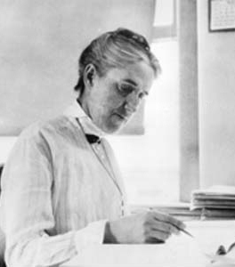
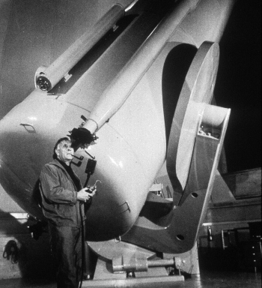
The Great Debate
Henrietta Swan Leavitt Cepheids
1912
Edwin Hubble looks at Cepheids in the Andromeda Galaxy 1924
Notes:
Way farther away than even Shapley’s estimates of the size of the galaxy!
Cepheids have a period luminosity relationship. We measure the period and derive the luminosity.
We them measure the flux and calculate the distance.
Turns out that M31 is 2.9 million light years away. This really blew their minds.
But… Shapley was right about the overall size of the Milky Way. It’s much larger than Kapteyn and Curtis thought. It turns out that the Universe is a lot larger than anyone thought.

Slide 17
The Great Debate
Right: Milky Way is very large & we are not at the center
Wrong: universe is one big galaxy
Shapley
Curtis
Right: Galaxies are island universes and the Milky Way is but one of them.
Wrong: MW is small & sun nearly in the center
Notes:
Shapley said that the Milky way is very large. In fact the entire universe is taken up by the Milky Way and the ‘spiral nebula’ are nearby gas clouds within the Milky Way.
Curtis said that the Milky Way is smallish and the Sun is nearly in the center (40,000 ly across). The ‘spiral nebula’ are other galaxies like the Milky Way.
Note: They are BOTH wrong about one thing and right about one thing.

