Slide 1
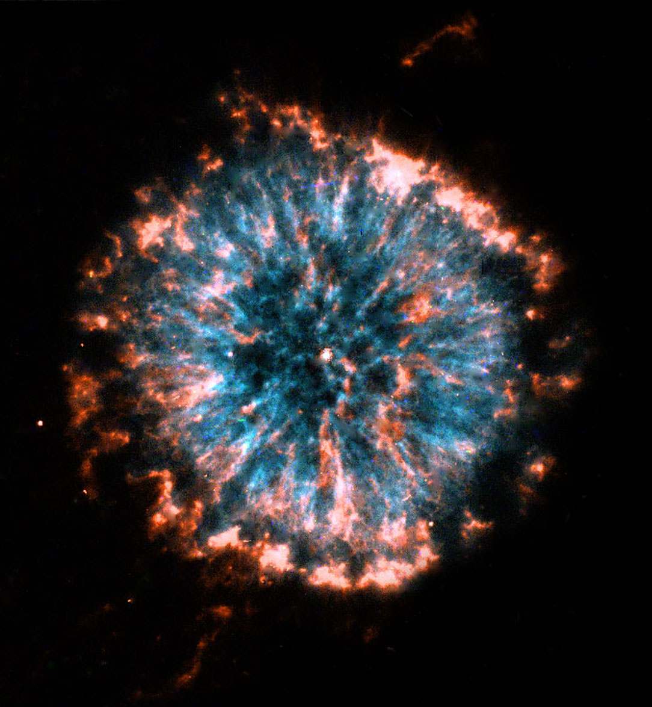
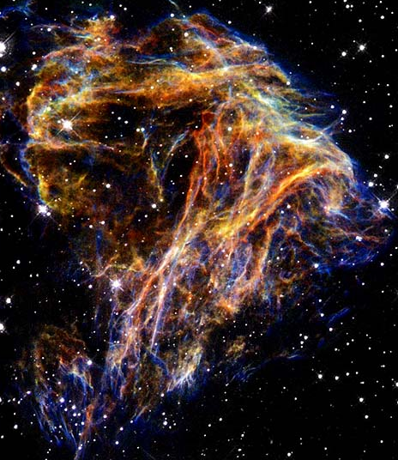
Stellar Evolution: the end
Low Mass Stars
High Mass Stars
Notes:
Left: “Glowing Eye Nebula” HST image, planetary nebula
Right: N49, Type II supernova remnant

Slide 2
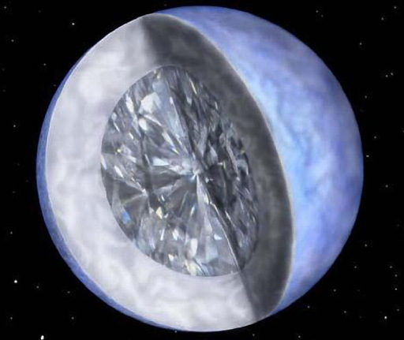
Dead Stars: Low Mass Stars
Leftover core: a white dwarf

Slide 3
Stellar Evolution Clickers
Stars on the Main Sequence:
A) Evolve up the MS towards the hot blue corner.
B) Evolve down the MS towards the cold red corner.
C) Move in along the MS in a direction determined by their mass.
D) Stay in the same place on the MS until they run out of Hydrogen.
Notes:
A

Slide 4
We observe a Main Sequence star that is 10 times more luminous than the Sun.
A) The star is bluer, hotter, and more massive than the Sun.
B) The star is bluer, hotter, and less massive than the Sun.
C) The star is redder, hotter, and more massive than the Sun.
D) The star is redder, colder, and less massive than the Sun.
Notes:
A

Slide 5
Star A and B are the same age. They are 10M_{sun} and 5M_{sun} respectively.
Which of the following is true
A) Star A will die first because it has much less fuel.
B) Star B will die first because it has less fuel to consume
C) Star A will die first because its ratio of fuel consumption to mass is much higher.
D) They will live about the same amount of time.
Notes:
C

Slide 6
During its Main Sequence Lifetime, a star:
A) Evolves up the main sequence towards the upper left of the HR diagram.
B) Remains in roughly the same spot on the HR diagram.
C) Evolves down the main sequence towards the lower right of the HR diagram.
D) has a very complex motion on the HR diagram.
Notes:
B

Slide 7
White Dwarfs
How do they form?
What are they made of?
What stops them from collapsing?
How big are they?
What’s their size/mass relationship?
What is a nova?
What is a type I supernova?

Slide 8
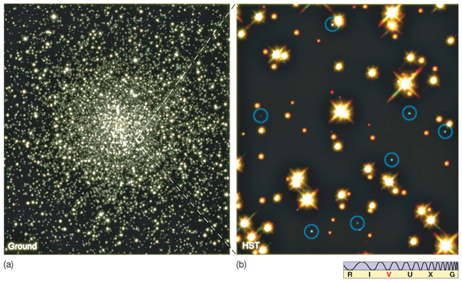
Weird Stuff
White Dwarfs:
the dead stellar core left over after the low mass puff off their outer layers

Slide 9
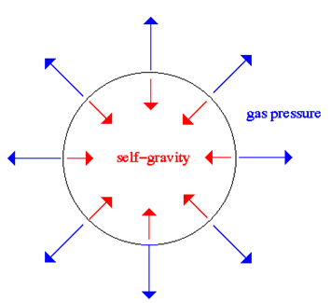
Discussion Question
What happens when gravity wins?
Notes:
What is the “gas” made of?
What determines the size of the ball?

Slide 10
Degeneracy Pressure
Pauli says everyone (electrons) sits in their own chair (is in a different quantum state)
Notes:
The Pauli exclusion principle states that subatomic particles like electrons, neutrons, and protons may not occupy the same quantum state.
When you try to make them, they start to fight.
If you keep packing people in, they will eventually sit on each others laps. Or something…
Pressure no longer depends on temperature. It depends instead on how closely packed the electrons are.
According to the uncertainty principle, if you squish electrons down into a small space, their momentum gets more and more out of control. Thus the ‘pressure’
Degeneracy refers trying to make them occupy the same quantum state. They resist degeneracy.

Slide 11
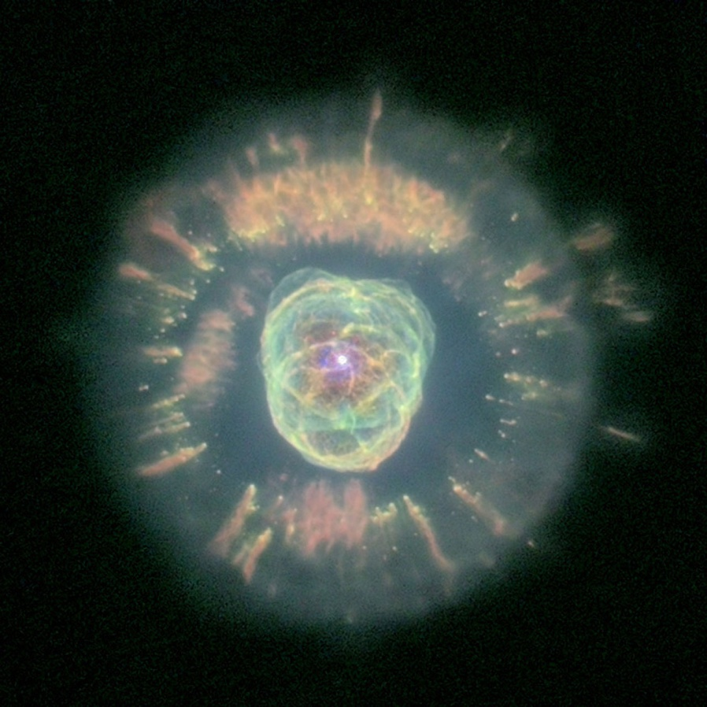
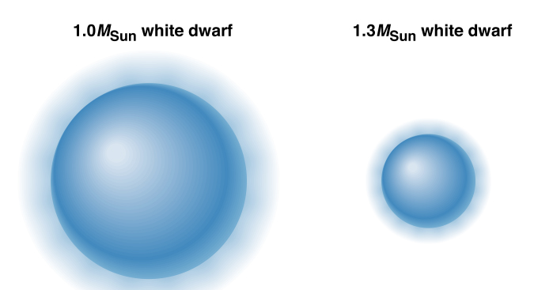
White Dwarfs
Carbon Core- held up by
electron degeneracy pressure
White Dwarf
Notes:
They are not fusing… only cooling off. Verrrrrrrrrry slowly
Since there is no longer an internal energy source, gravity crushes the material down until it is being held up by electron degeneracy pressure.
Since degeneracy pressure doesn’t depend on temperature, white dwarfs never change size once they are created.
In fact, white dwarfs actually get smaller the more massive they are because degeneracy pressure depends on the distance between particles.
On the HR diagram, they follow a line of constant radius, slowly cooling off and getting dimmer.
Degenerate matter is VERY dense. Approximately 10 tons per cubic inch.
They are dead core of a low mass star. When the star dies (creating a planetary nebula), the nebula eventually disperses leaving behind the white dwarf
Therefore, White dwarfs are made up mostly of carbon nuclei and electrons.
In fact, it is believed that there is a layer of crystalline carbon near the surface.
This means that there diamonds beneath the surface of a white dwarf!

Slide 12
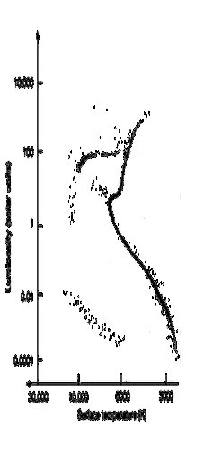
What happens then?
After a white dwarf forms, all it can do is cool…
The vertical spread is radius
Horizontal spread is temperature

Slide 13
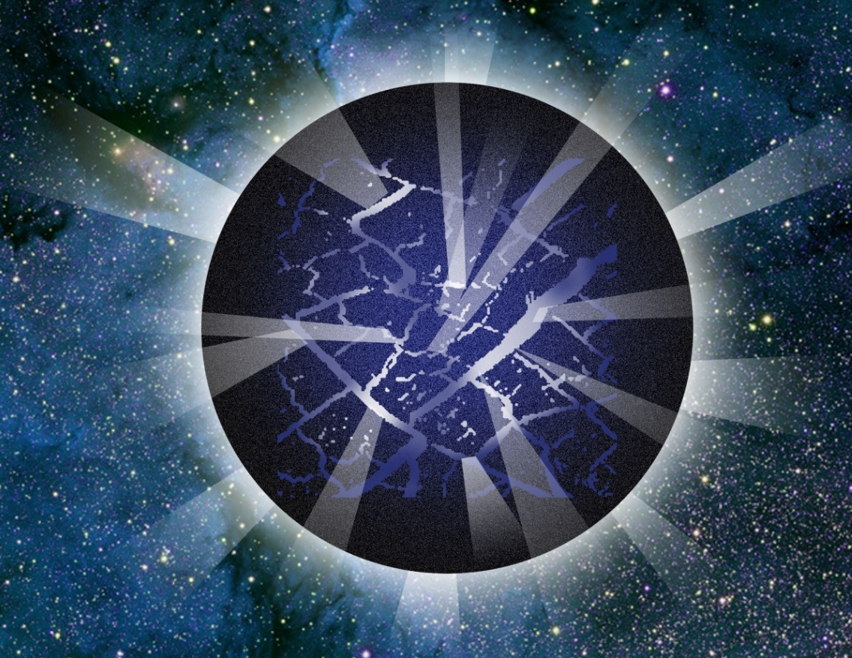
White Dwarf
As it cools, the white dwarf shrinks
Shrinking causes quakes (much like earthquakes)
The white dwarf eventually solidifies completely…
Notes:
The star’s luminosity changes due to the quakes, which we use to figure out the structure of the interior (just like helio-seismology, this is astero-seismology).

Slide 14
White Dwarf
… and crystallizes…
Making the biggest diamonds in the universe!

Slide 15
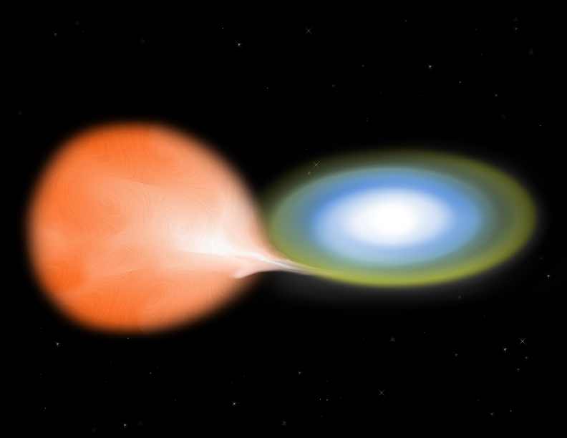
Nova
A binary system can turn into a nova
Notes:
How do we get more mass onto a white dwarf? It’s already dead….
Suppose we have a white dwarf around a red giant.
The giant can feed hydrogen onto the surface of the white dwarf.
Eventually, enough piles up that the hydrogen fuses in a large and sudden detonation (called a nova)
Then the process starts all over again.

Slide 16
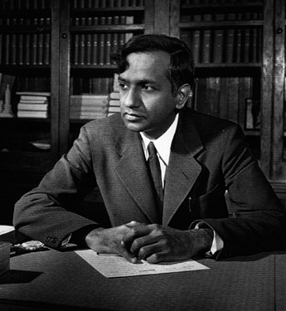
White Dwarf Limit
The Chandrasekhar Limit
White dwarfs can be no more than 1.4 solar masses
Electron degeneracy pressure fails for more massive objects
Notes:
Chandrasekhar did this work between his undergraduate and graduate academic careers.
When he presented the work to the Royal Society, they balked.
Later he won the Nobel Prize in physics for his work on degeneracy.
So… What happens when a white dwarf exceeds the Chandrasekhar Limit?
It turns into a neutron star!

Slide 17
Question
After MANY white dwarf novas, the white dwarf
A. gets more massive and slowly shrinks to a single point
B. uses up the fuel of its red giant companion and becomes a “normal” white dwarf.
C. collapses suddenly and explodes violently
D. The novae keep happening forever

Slide 18
White Dwarf Supernova (Ia)
A WD in a binary will nova many times
Each nova event leaves a little mass behind
Eventually the Chandrasekhar limit is surpassed.
Notes:
Eventually you build up so much material that the white dwarf reaches the Chandrasekhar limit. And THEN a big explosion happens. The WD collapses and detonates, exploding completely.

Slide 19
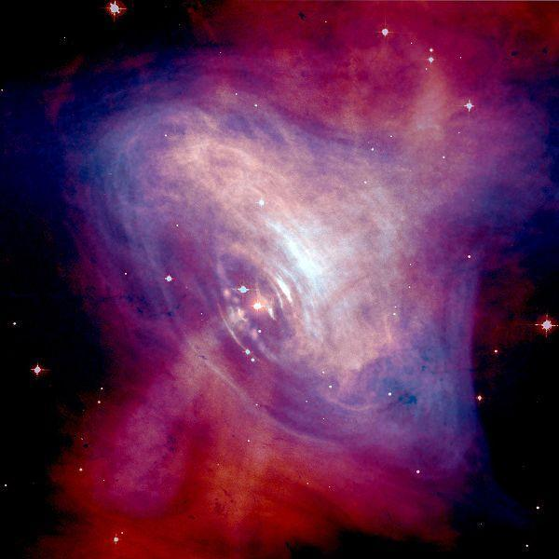
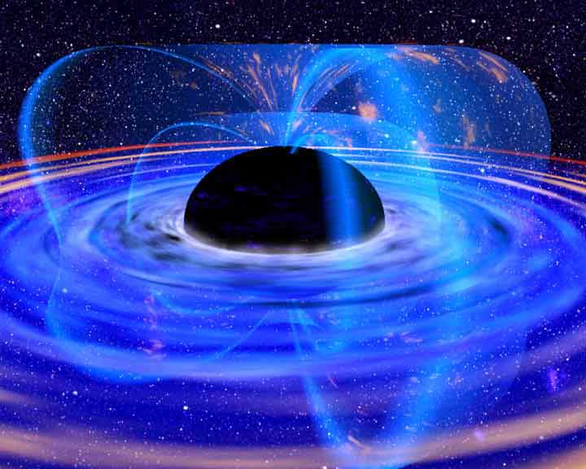
Dead Stars: High Mass Stars
Supernova (Type II) end states
Notes:
In addition to WD novae, Type II supernovae can make neutron stars directly (and also black holes).

Slide 20
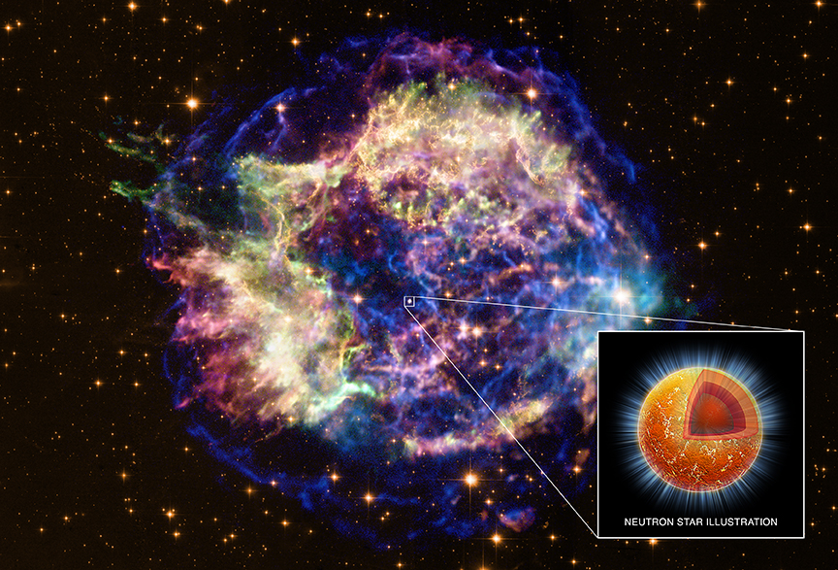
Dead Stars: High Mass Stars
Possibility 1 Leftover core: a neutron star
Notes:
White Dwarf (and planetary nebula) on the left; Type II supernova on the right

Slide 21
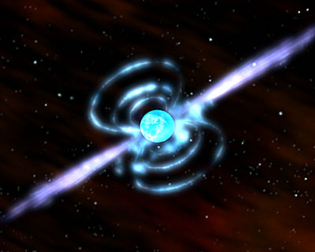
Neutron Stars
The leftover core of a massive star.
Held up by neutron degeneracy pressure
Rotate rapidly
Have very strong magnetic fields!
A GIANT ball of neutrons.
Notes:
About the size of Manhattan Island but more massive than the Sun.
A cubic inch weighs more than Mt. Everest.

Slide 22
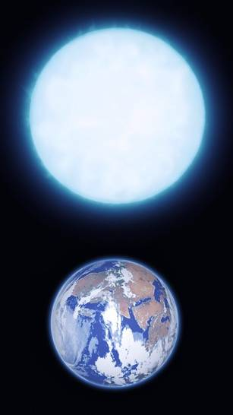
Comparison: WD vs. NS
White
Dwarf
Neutron
Star
City-sized
1 cm³ > Mt Everest
Neutrons only*!
Earth-sized
1cm³ = 1 ton!
Atoms still exist
Notes:
*mostly. Though maybe not entirely.

Slide 23
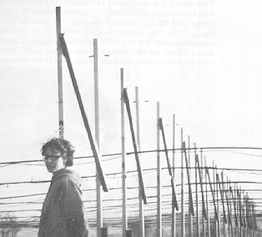
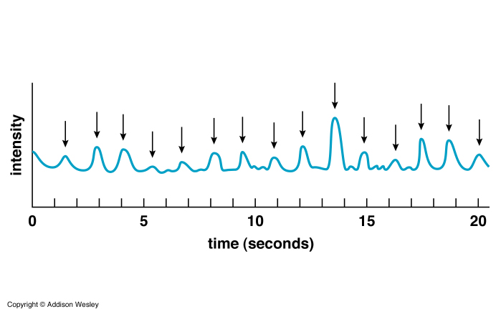
Little Green Men
A 4 ½ acre radio telescope designed to find quasars
Found a very regular radio signal.
Jocelyn Bell- 1967
They called the source LGM-1

Slide 24
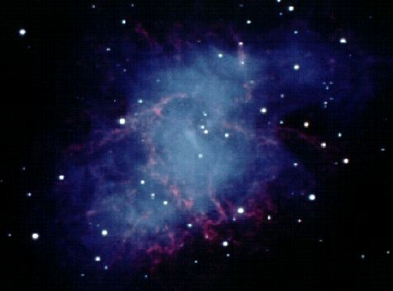
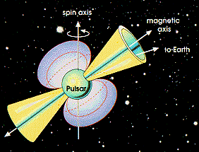
Pulsars
Spinning Neutron Stars
The Crab Nebula
Spinning Neutron Stars
Notes:
After a lot of puzzling, they turned out to be spinning neutron stars.
The magnetic field is offset from the axis of rotation.
Light is being beamed out of the poles of the magnet.
When the light sweeps past us, we see a pulse. The period of the pulsation is the rotation period of the neutron star.
All pulsars are neutron stars. The light is from charged particles (electrons) moving very fast around the magnetic fields. The emission is concentrated into a beam that comes out at the magnetic poles.
We only see the pulse if the beam sweeps past us.

Slide 25
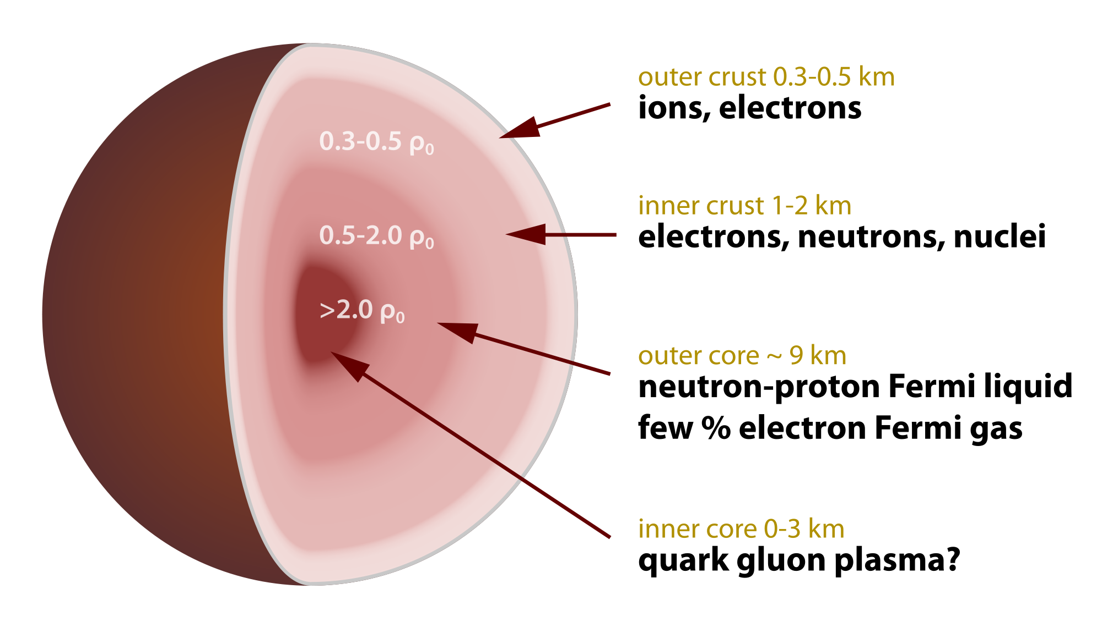
Pulsars
Interior structure???
Notes:
Yeah so like, what even?
Definitely the outside has regular ions. (see spectrum next page)
And certainly inside is a superfluid.
So probably some kind of superconducting superfluid somewhere in there → spinning charges make for magnetic fields
What’s the deal with that quark and gluon plasma? IF it exists, then it will make a really big magnetic field (quarks are charged). This could explain it but we really don’t know.
also: at least some neutron stars have atmospheres made of carbon! Weird! So it’s clear that not all elements get crushed into neutrons. It will be interesting to see how our ideas of neutron stars change over the next 5-10 years.

Slide 26
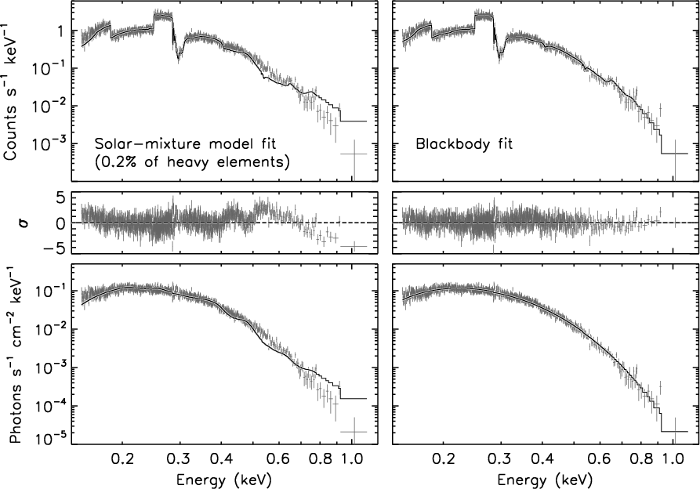
Solitary NS Spectrum…
What would you expect?
Notes:
Mostly a blackbody spectrum. This was 500ks observation (5.78 days staring at the same object in space… that’s a LONG time!!) The odd jumps are due to iron lines, mostly.

Slide 27
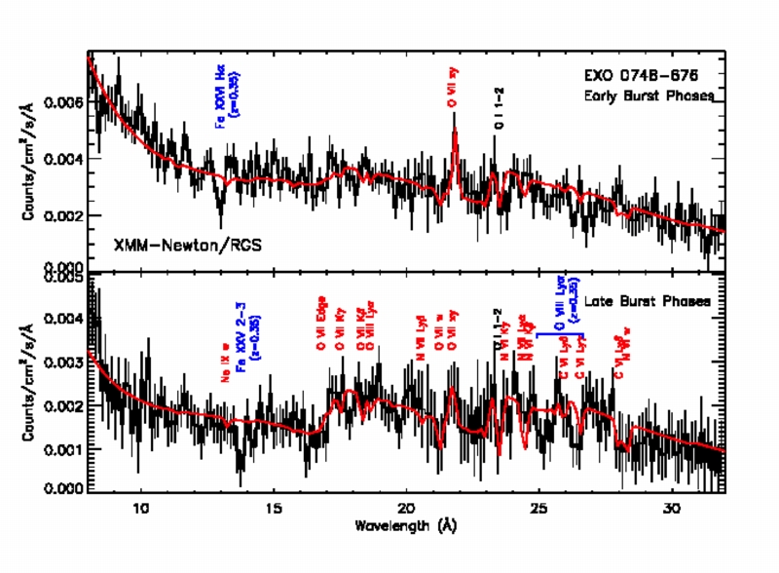
Solitary NS Spectrum…
Notes:
You can observe some leftover bits that aren’t neutrons (after the core collapse and bounce, some of the overlying material falls back to the star). By these lines we can tell the size of the neutron star (since their width depends on the gravity felt by the atom). This neutron star is made of neutrons and not something weirder (like strange quarks)

Slide 28
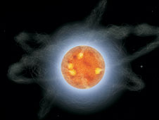
Magnetars
Neutron Stars with extremely strong magnetic fields…
But they rotate slowly.
Notes:
Pulsars with very strong magnetic fields are relatively rare. The magnetic fields can stress the neutron star’s crust and cause it to crack suddenly, causing huge starquakes… and a huge burst of energy.
There are a lot of questions about magnetars…
How do they have such big magnetic fields?
How do they form?
Do all pulsars have a magnetar phase?
We have observed a rapidly spinning pulsar slowing down quickly… and suddenly quaking in a way similar to a magnetar. Is it possibly on its way to turning into one as it loses rotational energy?

Slide 29
Comparison: WD vs. NS
White
Dwarf
Neutron
Star
City-sized
1 cm³ > Mt Everest
Maximum: 3 M_{sun}
Earth-sized
1cm³ = 1 ton!
Maximum: 1.4 M_{sun}
Notes:
*mostly. Though maybe not entirely.

Slide 30
Neutron Stars
The force of gravity 1 AU from a 10 Solar Mass black hole is:
A. The same as the force gravity from a 10 solar mass star.
B. Greater than the force of gravity from a 10 solar mass star
C. Less than the force of gravity from a 10 solar mass star.
D. Infinite

Slide 31
Neutron Stars
The force of gravity 1 AU from a 1 Solar Mass black hole is:
A. The same as the force gravity from a 10 solar mass star.
B. Greater than the force of gravity from a 10 solar mass star
C. Less than the force of gravity from a 10 solar mass star.
D. Infinite

Slide 32
Black Holes
When even neutron degeneracy pressure fails
Notes:
A super massive star goes supernova leaving behind a particularly large core.
The release of gravitational potential energy that used to halt the collapse further strengthens it.
There is no form of pressure that we know of to stop gravity once neutron degeneracy fails.
The star collapses into oblivion. Gravity finally wins once and for all.
The star becomes infinitely small, reduced to a point that mathematicians call a singularity.
These objects are so compact and have such an immense gravitational field that Newton’s gravitational law fails completely and we must turn to Einstein.

Slide 33
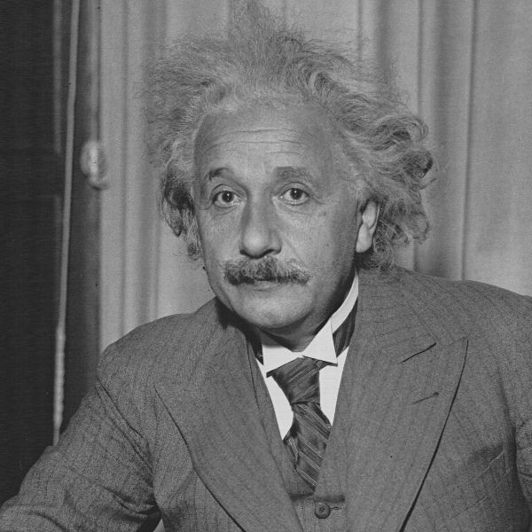
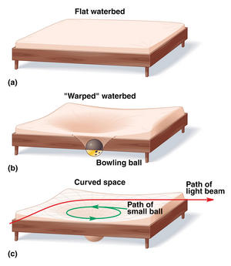
Einstein’s Gravity
Gravity is really curved spacetime
Notes:
Massive objects always take the shortest possible path between point A and point B.
In flat space, the shortest path is a straight line.
Spacetime gets warped by massive objects, so the shortest possible path is curved.
Light follows these curved paths as well. Light is effected by gravity.

Slide 34
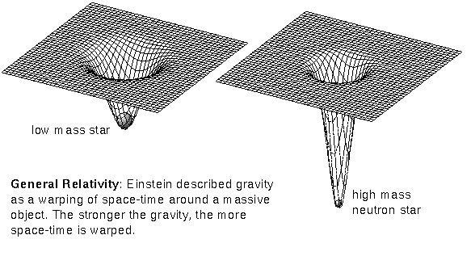
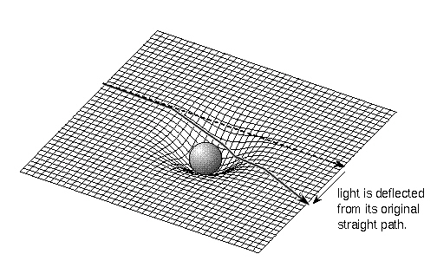
Rubber Space
Notes:
Light itself actually goes into orbit around the black hole at the event horizon.
If you could position yourself there, you could see the back of your own head!
R_{s} = 2Gm/c²

Slide 35
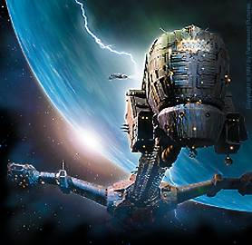
Schwarzschild Radius
When the escape velocity exceeds the speed of light, nothing can escape.
Anything that falls in is gone forever
Event Horizon
R_{s} = 2Gm/c²
Notes:
Light itself actually goes into orbit around the black hole at the event horizon.
If you could position yourself there, you could see the back of your own head!
R_{s} = 2Gm/c²

Slide 36
Schwarzschild Radius
Falling into a black hole would look pretty weird…
Notes:
Light itself actually goes into orbit around the black hole at the event horizon.
If you could position yourself there, you could see the back of your own head!

Slide 37
Black Holes
The force of gravity 1 AU from a 10 Solar Mass black hole is:
A. The same as the force gravity from a 10 solar mass star .
B. Greater than the force of gravity from a 10 solar mass star
C. Less than the force of gravity from a 10 solar mass star.
D. Infinite

Slide 38
Black Holes
If the Sun were replaced by a 1 Solar Mass black hole:
A. The Earth and all the planets would be sucked in.
B. We would get very cold but our orbit would be unaffected.
C. The inner planets would get sucked in.
D. Everything would be exactly the same as now.
B: Because black holes don’t suck!

Slide 39
Tidal Forces are CRAZY
The gravitational force at your head
Is MUCH less than that at your feet
So you get stretched into spaghetti
Notes:
Bigger the black hole, the less tidal force there is at the surface

Slide 40
Tidal Forces are CRAZY
Mass | Rs | Tidal Force (g’s)
10 M_{sun} | 1/200 R_{e} | 10⁹
100 M_{sun} | 1/20 R_{e} | 10⁷
10⁶ M_{sun} | 4 R_{sun} | 0.1
10⁹ M_{sun} | 4,000 R_{sun} | 10⁻⁷
Notes:
Bigger the black hole, the less tidal force there is at the surface

Slide 41
Gravitational Time Dilation
Time slows down on approaching the event horizon
At the event horizon, time stops
Notes:
At least from our perspective. Not from the perspective of the person falling into the black hole.
Light also red shifts and at the event horizon, the wavelength becomes infinite.
Objects become unobservable to us.

Slide 42
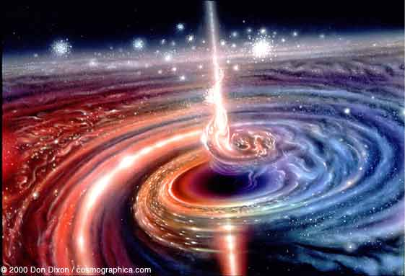
Finding Black Holes
Notes:
Discussion: If we can’t see the black hole itself, how could we find them?
We must look at their effects on other objects:
Binary stars: accretion (like with the novae)
Gravitational lensing
Accretion disks
Infalling material (x-rays from)
Huge jets
Antimatter fountains

Slide 43
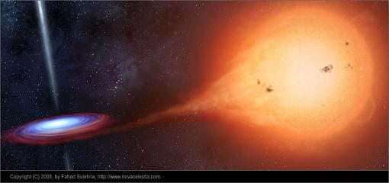
Finding Black Holes
Notes:
Binary stars: accretion (like with the novae)
Hard to see apart from point source X-ray images though, because even the accretion disk around this is so small (the black hole “size” is a city block, maybe”)

Slide 44
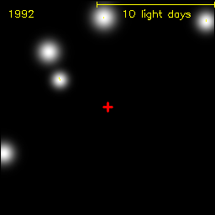
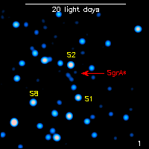
Our Galactic Black Hole
Does a Black Hole exist at the center of the Milky Way?
Most likely!
Notes:
At the center of our galaxy is a 3.6 million solar mass object that is an excellent candidate for a super massive black hole.
It has been observed in the past as a radio source and named Sagittarius A.
Observations of the positions of several stars in the neighborhood suggest something of the correct mass is there. It could be a dense cluster however.
There was a flare observed in 2003 within 10 Schwarzschild of the location of Sgr A. It is characteristic of a flare from an accretion disk.

Slide 45
Finding Black Holes
Notes:
We also see an antimatter fountain from the center of our galaxy, which is fairly typical of supermassive black holes. 511 keV emission is from electron-positron annihilation!

Slide 46
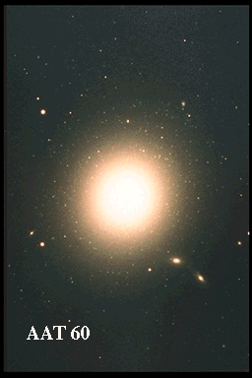
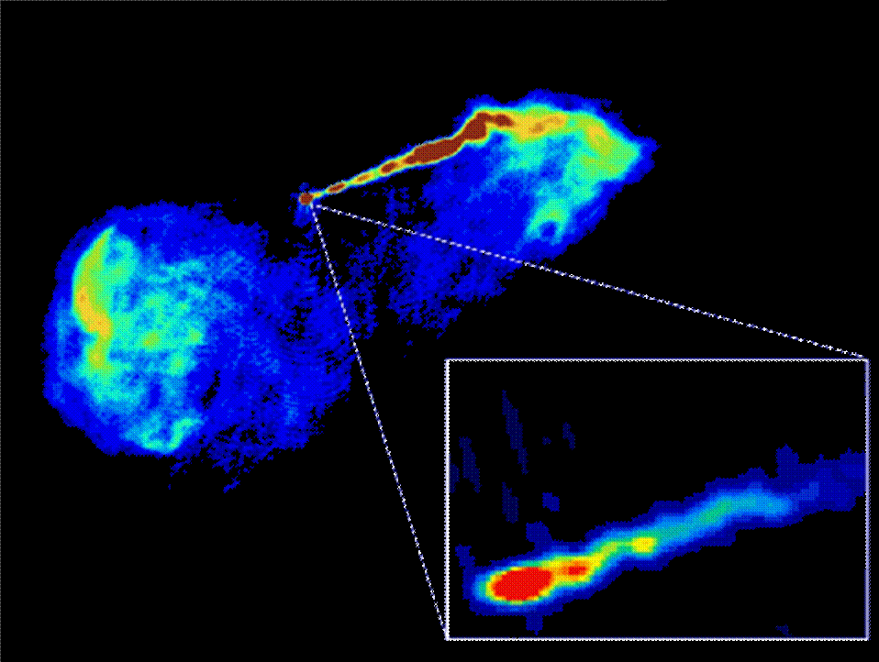
Evidence for Black Holes

Slide 47
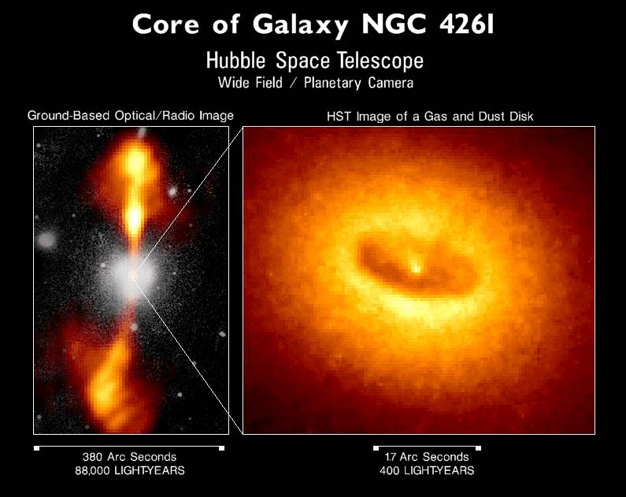
Evidence for Black Holes
Dusty torus
Accretion disk

Slide 48
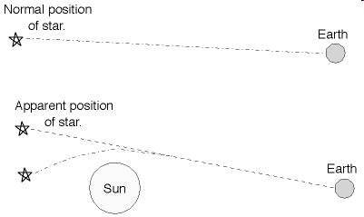
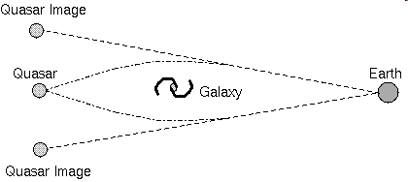
Gravitational Lensing
Notes:
Massive objects bend the light path so that objects apparent position changes.
Just like looking at a pencil in a glass of water, the light bends (refracts) in the water making the pencil appear broken.
Starlight can get bent by the presence of a galaxy or the Sun so that the star appears somewhere else.
We can even see multiple copies of the same object.

Slide 49
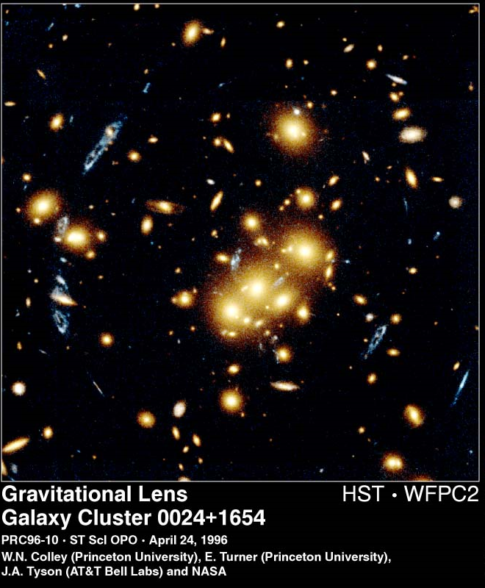
Gravitational Lensing
Notes:
We can see gravitational lensing of background galaxies due to the large cluster of galxies in the foreground.

Slide 50
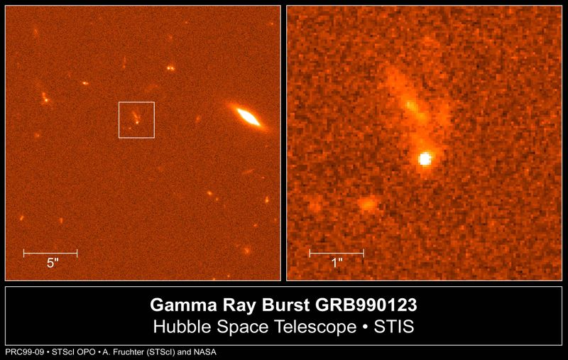
Gamma Ray Bursts
Extremely bright explosions
Notes:
In the 1960s, the US put satellites up to watch for gamma rays due to nuclear detonations.
They saw bursts of gamma rays coming from all over the place.
For a long time, we had no idea what or even where they were. We didn’t know if they came from within the solar system, within the galaxy, or from distant extra-galactic sources.
GRB lasts a few seconds to a few minutes.
They are hundreds of times brighter than a typical supernova explosion.
Gamma rays are hard to focus, so pinpointing their location is difficult.
One has to look for lower energy counterparts, such as in the optical

Slide 51
What are They?
A hypernova explosion
Notes:
They appear to be very far away, some near the edge of the observable universe.
Really big explosions of first or second generation stars.
It is inconceivable, given their distance, that the energy is spherically distributed.
The gamma rays are actually beamed at us. We don’t see the burst unless we are in the beam.

Slide 52
What are They?
Notes:
They appear to be very far away, some near the edge of the observable universe.
Some GRBs last for very short times, and these are due to mergers of neutron stars.
https://www.nasa.gov/topics/universe/features/gamma-ray-engines.html

