Slide 1
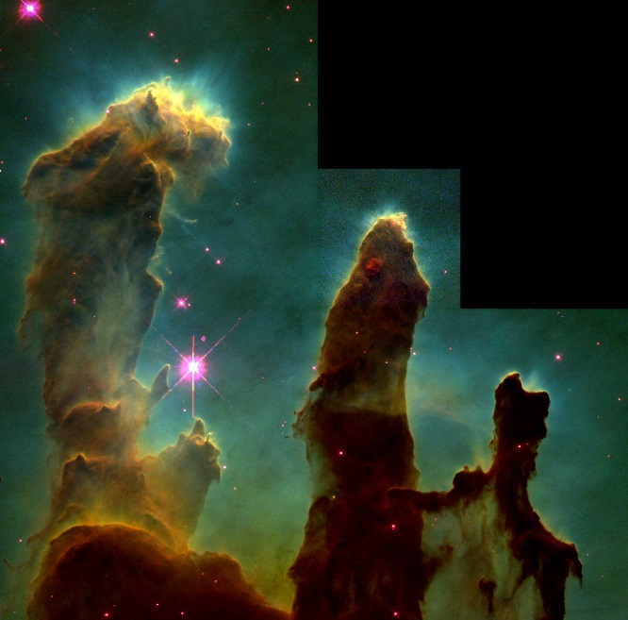
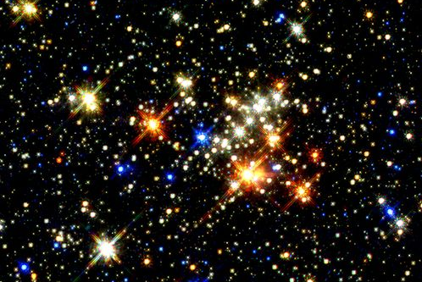
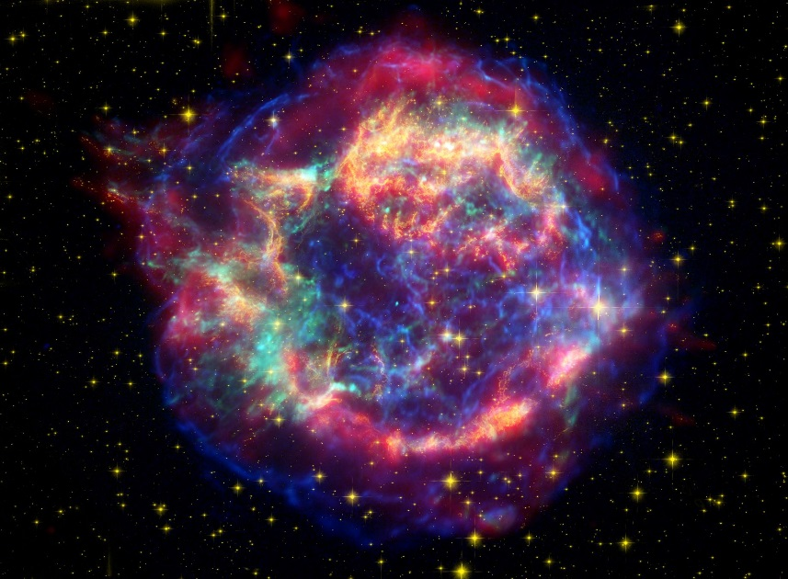
Stars
Birth
Life
Death
Notes:
We are going to talk about
- how stars form
- how stars live and die
- how their mass relates to their temperature and their luminosity (intrinsic brightness).
- fusion of elements (we already covered H -> He)
- creation of elements greater (larger) than iron (Fe)

Slide 2
The H-R Diagram
Lecture Tutorial p. 56 (part 2)
Notes:
Lecture Tutorial: Temp, Luminosity & Size part 2, page 56

Slide 3
Stellar Evolution
Notes:
Clusters of stars can tell us about stellar evolution because the stars in them formed at the same time (within the variance involved with formation times) and from the same cloud of gas. Here are two H-R diagrams from two different clusters; note that they look very different. We will find out what these tell us about the stars in them.

Slide 4
The H-R Diagram
Notes:
We are going to try to explain this diagram.
The H-R diagram (named after Hertzsprung and Russell) is a plot of stellar temperature versus luminosity
It shows some surprising and very useful patterns.
The prominent strip going diagonally up the diagram is the Main Sequence. Most stars lie in this region.
They are stars that are fusing hydrogen into helium in their cores.
The diagram gives us immediate information about the size of a star given the luminosity relationship that we studied earlier.
Cold things that are very bright must be very large.
Very hot things that aren’t very luminous must be very small.
So stars have a spectral type (referring to the temperature) and a luminosity class (referring to the size). As we will find out, stars of different luminosity classes are doing different things in their cores.

Slide 5
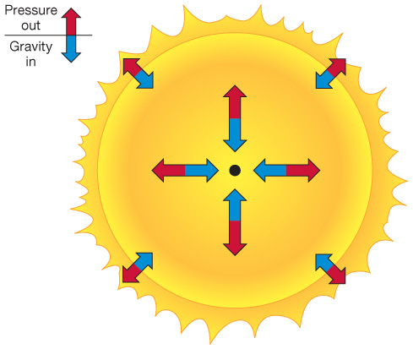
Stars: Hydrostatic Equilibrium
Pressure out = Gravity in
If temperature increases, pressure increases
Stars fusing hydrogen:
Main sequence
➔ Expansion
Notes:
Expansion means that it cools slightly, and so pressure decreases… this is how a star keeps its size, and why it’s stable. Remember that the fusion reactions at the core are very temperature sensitive.

Slide 6
Fusion
For most of their life, stars fuse hydrogen into helium
Notes:
4H -> 1He + neutrinos, gamma rays and positrons (which annihilate with electrons to produce more gamma rays)

Slide 7
The Main Sequence
Bright stars fuse faster than dim stars
Brighter main sequence stars are more massive
Massive stars die more quickly
Main Sequence lifetime depends only on mass
Notes:
Stars spend the majority of their lives on the main sequence fusing hydrogen -> helium.
As we saw in the lecture tutorial, the main sequence lifetime depends solely on mass.
Although there is more mass to fuse, bright stars fuse their hydrogen at a very high rate (remember, fusion is VERY temperature dependent)
**Question: Will a high mass star (30Mo) live longer or shorter than the sun?**
The sun will live for 10 billion years.
A 30 solar mass star will live for a few million years.

Slide 8
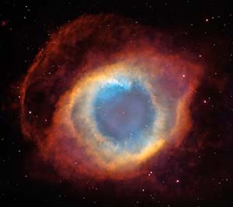
Tutorial: Low Masss
Notes:
By “low” mass I mean things up to 8 times the mass of our sun
Tutorial from PER:
Page 1, then discuss
Page 2, discuss after #10
Answer #10 (2nd one)
Remainder on your own.

Slide 9
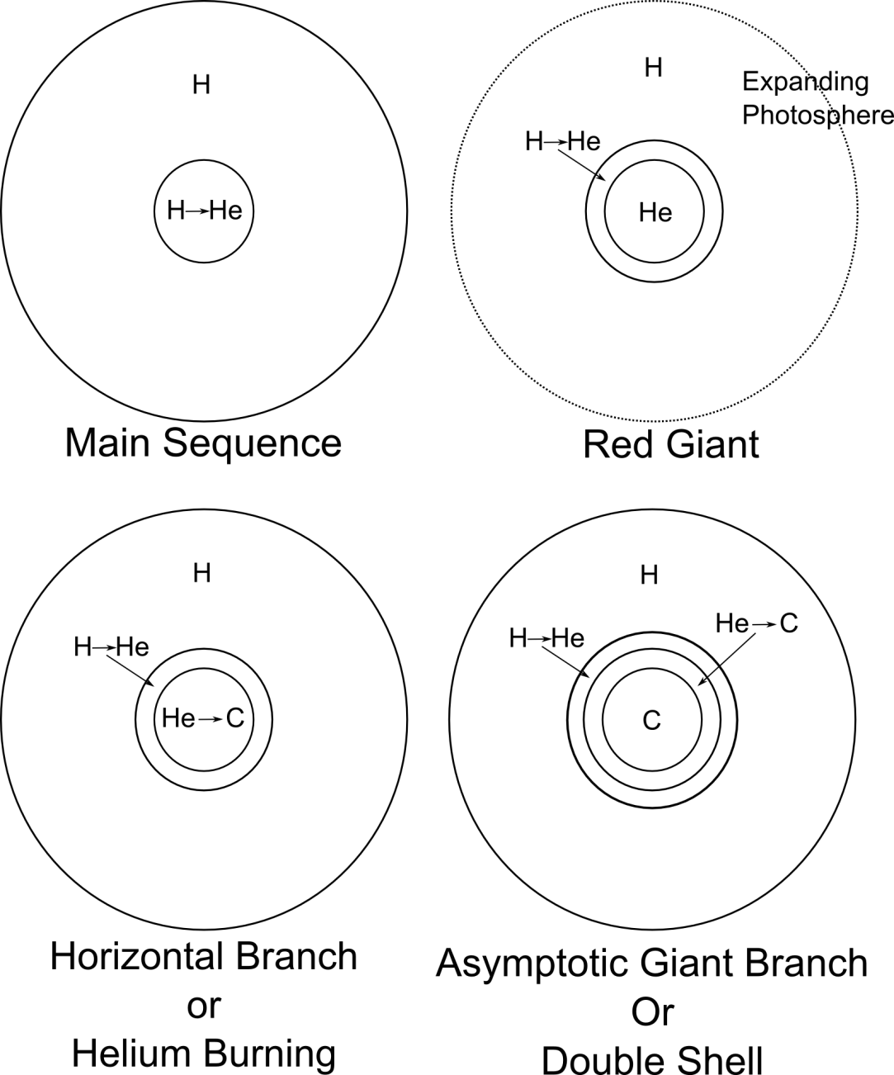
Low Mass Evolution
Notes:
During the MS lifetime, the core gets contaminated with helium slowing the reaction rate.
The star contracts slightly, heating the core and reestablishing equilibrium.
Thus its luminosity slowly increases over its MS lifetime.
Once the hydrogen is used up, core hydrogen fusion stops and the star begins to collapse.
Hydrogen shell burning begins and the star expands to about 100 times it’s previous size, becoming a red giant.
**question: why does the helium core not fuse right away?**
Helium keeps dumping into the core from the shell until… POP!
The helium core ignites. Core expands, helium shell expands, star shrinks slightly.
The star continues to evolve along the HORIZONTAL branch.
Helium fuses into carbon for a while until the star runs out of helium.
The star begins to contract again
A helium shell ignites.
A hydrogen shell ignites.
There’s not enough mass to start carbon fusion, but the shells burn out of control.
The star blows off all of its outer envelope in a beautiful display called a… (next slide)

Slide 10
Low Mass Evolution
Notes:
During the MS lifetime, the core gets contaminated with helium slowing the reaction rate.
The star contracts slightly, heating the core and reestablishing equilibrium.
Thus its luminosity slowly increases over its MS lifetime.
Once the hydrogen is used up, core hydrogen fusion stops and the star begins to collapse.
Hydrogen shell burning begins and the star expands to about 100 times it’s previous size, becoming a red giant.
**question: why does the helium core not fuse right away?**
Helium keeps dumping into the core from the shell until… POP!
The helium core ignites. Core expands, helium shell expands, star shrinks slightly.
The star continues to evolve along the HORIZONTAL branch.
Helium fuses into carbon for a while until the star runs out of helium.
The star begins to contract again
A helium shell ignites.
A hydrogen shell ignites.
There’s not enough mass to start carbon fusion, but the shells burn out of control.
The star blows off all of its outer envelope in a beautiful display called a… (next slide)

Slide 11
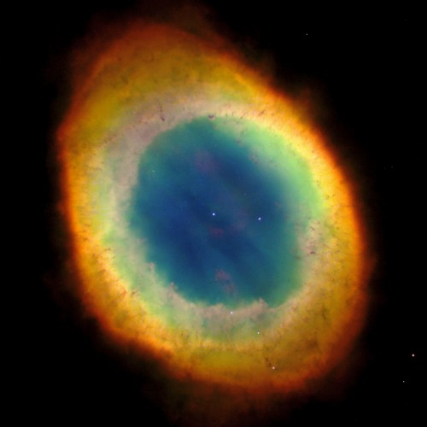
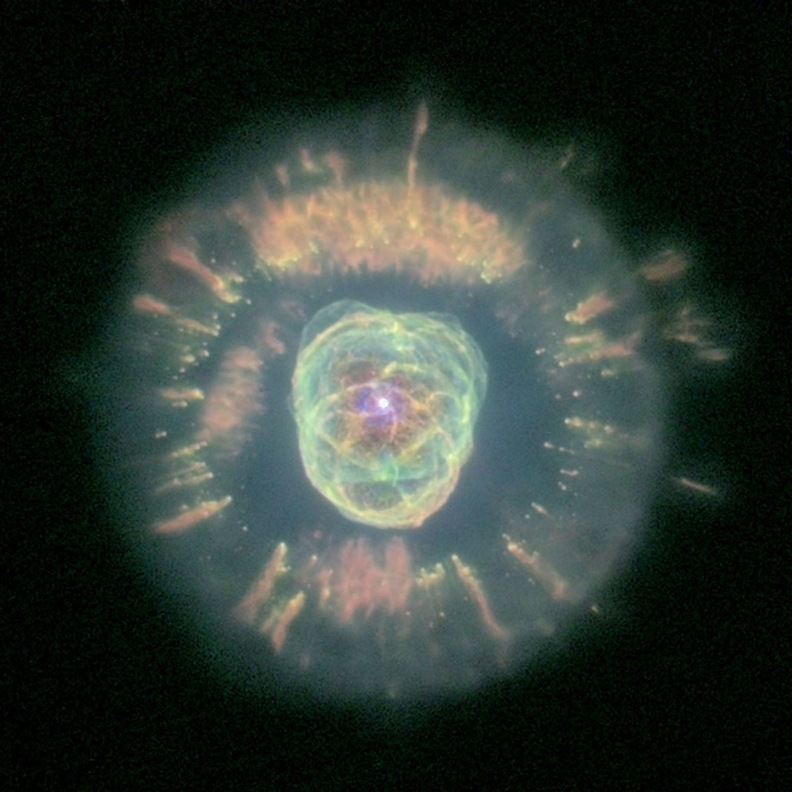
“Planetary” Nebula
Ring Nebula
Eskimo Nebula
Notes:
Not really anything to do with planets. It is a dead/dying low mass star.
In the middle is what is left of the core of the star. It is called a white dwarf.
Heavier elements are being made in the cloud surrounding the dense dying white dwarf core through neutron capture.
Planetary nebula is a vast area of research.

Slide 12
The interior of a Red Giant is
A) An inert helium core surrounded by a shell of fusing hydrogen.
B) A core of fusing helium surrounded by a shell of fusing hydrogen.
C) An inert carbon core surrounded by a shell of fusing helium that is surrounded by a shell of fusing hydrogen.
D) An iron core surrounded by many shells each fusing a different element.
Notes:
Not really anything to do with planets. It is a dead/dying low mass star.
In the middle is what is left of the core of the star. It is called a white dwarf.
Heavier elements are being made in the cloud surrounding the dense dying white dwarf core through neutron capture.
Planetary nebula is a vast area of research.

Slide 13
Star Clusters
Open Clusters: young stars
The main sequence turnoff tells us the age
Notes:
Clusters of stars are all at the same distance from us.
If we assume that they all have the same birthday, we can find the age of the cluster.
The oldest stars will be just leaving the main sequence.
The main sequence turnoff point tells us the age.
This is a young cluster of stars, which still has most of its hot blue stars on the main sequence.

Slide 14
Star Clusters
Globular Clusters: old stars
Notes:
An old cluster has lost all of its hot blue stars, and only has very low mass, cool small stars on the main sequence. There are some mid-size masses still in the red giant branch (like our sun, only another 5 billion years older).
(Cluster on the left is M55; Image credit: Hubble)

Slide 15
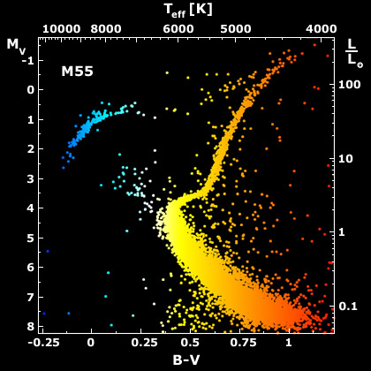
Main Sequence Fitting
The distance is more accurate if we use a bunch of stars
This only works if we can see the main sequence
Most extra-galactic MS stars are too faint
Notes:
Using a bunch of stars in a cluster, we can clearly see the main sequence and more accurately get the distance.
For sources outside of the Milky Way, we must find brighter standard candles.

Slide 16
Massive Stars
High mass stars keep on fusing
The highest mass ones never really make it to the “red giant” branch
Notes:
High mass stars burn up their hydrogen at a FURIOUS rate.
Really high mass stars have so much radiation pressure that they continuously blow gas off of their outer layers.
When the hydrogen runs out, the star turns into a red giant, just like in the low mass case and we get a helium core with a hydrogen shell.
These stars CAN fuse carbon. When they are out of carbon they fuse the next thing building up shell after shell
The reactions are crazy and complex. Lots of stuff is made.
They become red super giants.
Betelgeuse is a red super giant with a radius of 500 solar radii.
Until… there is iron in the core. Then the show is over.
The fact that we see hot massive stars on the main sequence means we must have ongoing star formation!

Slide 17
Massive Stars
Notes:
Massive star fusion shells

Slide 18
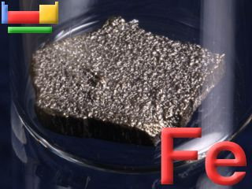
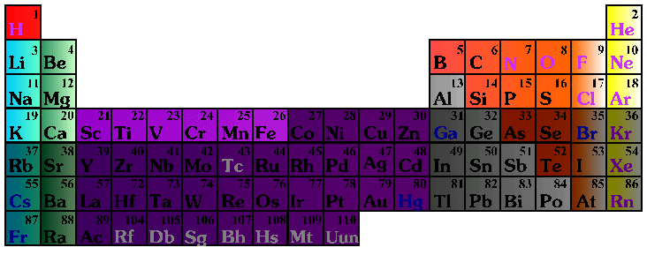
Fusion
Nuclear fusion makes elements all the way up to Iron (Fe)
Notes:
You’ll note there are a lot more elements out there – including some pretty important ones to us – which are NOT made through fusion! Copper, Nickel, Zinc, Silver, Gold… we’ll get to where these come from a little later in the lecture. For now, we are going to focus on the procces of fusion
But first a reminder from last class…

Slide 19
Why Stop?
We can’t get energy out any more
Notes:
We can fuse (smoosh together small atoms) and get energy out until iron.
We can fission (break apart big atoms) and get energy out until iron.
Iron is at the bottom of the well. No energy is available.
Eventually… the star squeezes hard enough that…
The iron core collapses releasing one boat load of energy.

Slide 20
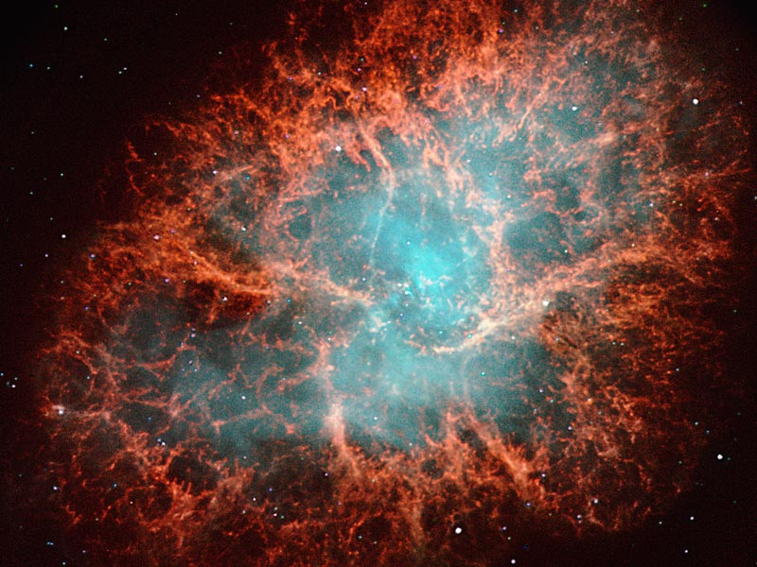
Supernova! KABOOM*!
Notes:
During a supernova explosion, the energy released is on the order of the entire output of the galaxy.
The iron core (which is the mass of the sun and the size of the earth) collapses into a ball a few kilometers across.
The leftover core is a neutron star.
If it was a REALLY big star, the core can collapse further into a black hole.

Slide 21
Supernova: the process…
Fe tries to fuse…. and takes energy
Core collapses
(gravity wins, temperature and density rise)
Photodisintegration destroys elements
(and eats more energy)
Protons and electrons crush together to make neutrons & neutrinos
Infalling stuff hits a wall of neutrinos… and rebounds. Boom!
Notes:
This all takes about a second.
Photodisintigration is the process where an element is torn apart by the photons hitting it.
Neutrinos normally don’t react very much with matter but there are SO MANY of them here that the weak interaction is enough to blow apart the star!

Slide 22
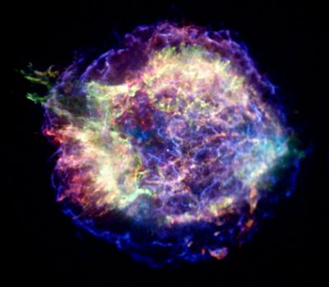
Supernova!
Cassiopeia A SNR

Slide 23
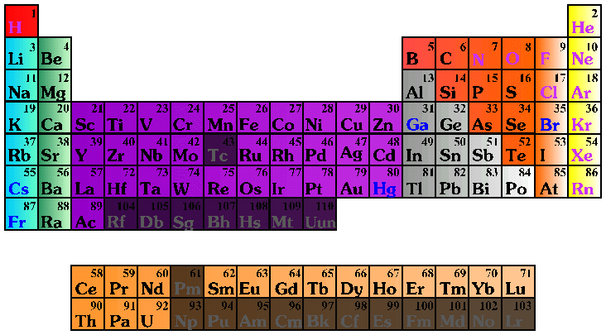
Supernova: the process…
But wait…
If we destroyed all our elements, where did the ones we have here come from?
Notes:
Remember what I said about neutron capture. During this process you’ve got tons of neutrons flying around fast…. And you smack them onto each other, and onto the outer layers…. But neutrons don’t like to be just by themselves so they decay back into protons…building up the elements that we see. This process is called rapid neutron capture and is how we build up all the elements in space beyond H and He! (well except for a few smaller ones built up by slow neutron capture in the outer shells of smaller stars)

Slide 24
Stars
Building HEAVIER Stuff Yet.
As star dies, atoms in the gas capture extra neutrons from the dying core
Neutrons decay to produces the rest of the naturally occurring elements

Slide 25
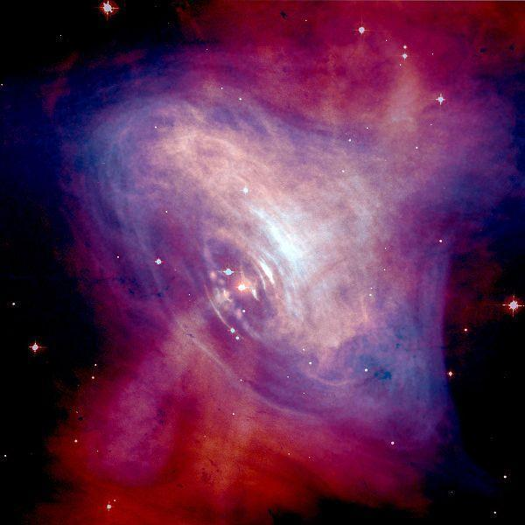
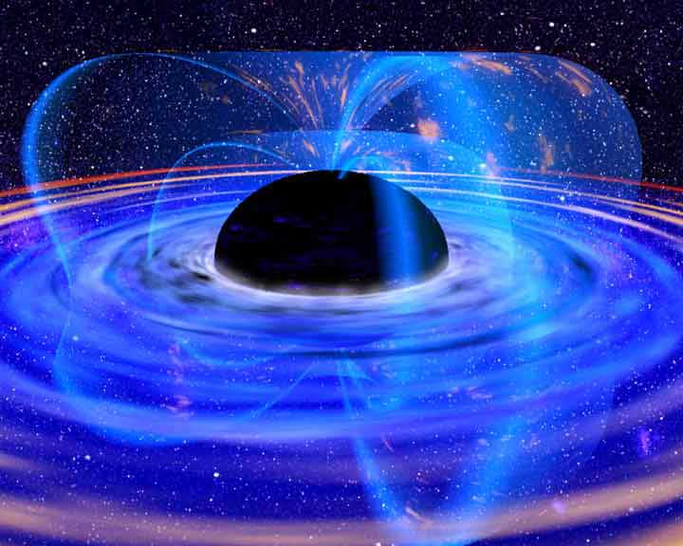
Supernova: end state
So what are we left with after all is said and done?
Notes:
And so… what are we left with? Neutron stars… black holes… or nothing at all!

Slide 26
Tutorial: Stellar Evolution
Red Giant
Planetary
Nebula
Supernova
(Type II)
White
Dwarf
Neutron
Star
Black Hole
Black Dwarf
Notes:
Page 133
First just do question 1)

Slide 27
Tutorial: Stellar Evolution
Red Giant
Supernova
(Type II)
Planetary
Nebula
accretion
Companion
star
Neutron
Star
?
accretion
accretion
Black
Hole
White
Dwarf
SN Ia
X-rays!
NOVA!
Nothing
Left
Notes:
Now add in question 2).

Slide 28
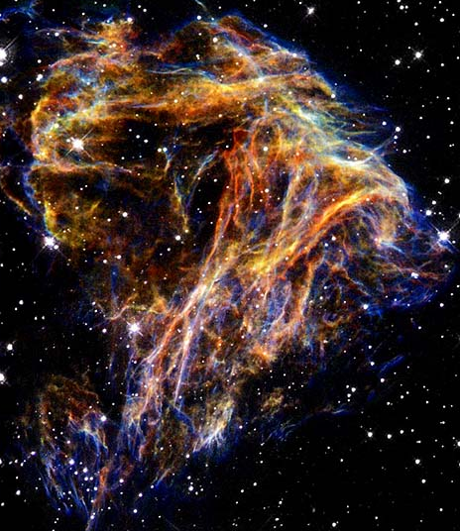
Stellar Evolution: the end
Low Mass Stars
High Mass Stars

Slide 29
Galactic Recycling Program
Material gets cooked in stars and ejected back into the ISM
Notes:
Cold molecular clouds collapse and form stars
Stars fuse and make heavy elements.
Big stars explode and enrich the interstellar medium
Smaller stars puff their stuff out in planetary nebula and enrich the interstellar medium…but not too much, since most of what’s put out is hydrogen (with the exception of carbon stars)
Each new generation of stars contain more ‘metals’ than previous generations.

Slide 30
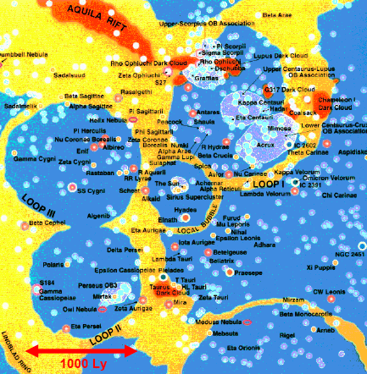
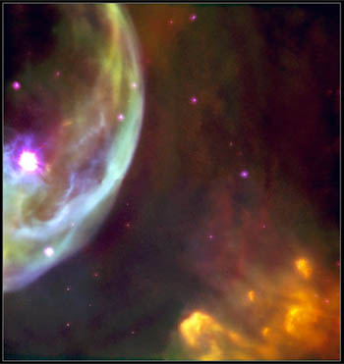
Bubbles
Massive stars blow bubbles in the ISM
Notes:
Stars tend to form in clusters containing some high mass stars and some low mass stars.
When the massive stars explode, the push some of the ISM away.
When a lot of them explode, they blow big bubbles
The Sun resides in a bubble.
Sometimes the bubbles break out of the plane and a chimney forms. The gas then rains back down onto the disk.

