Slide 1
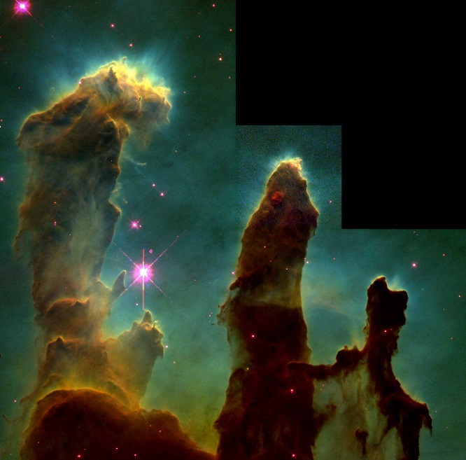
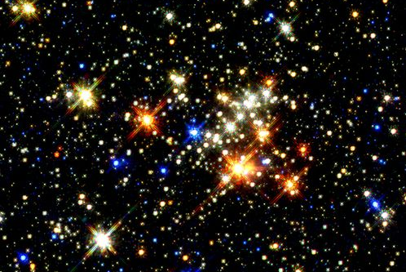
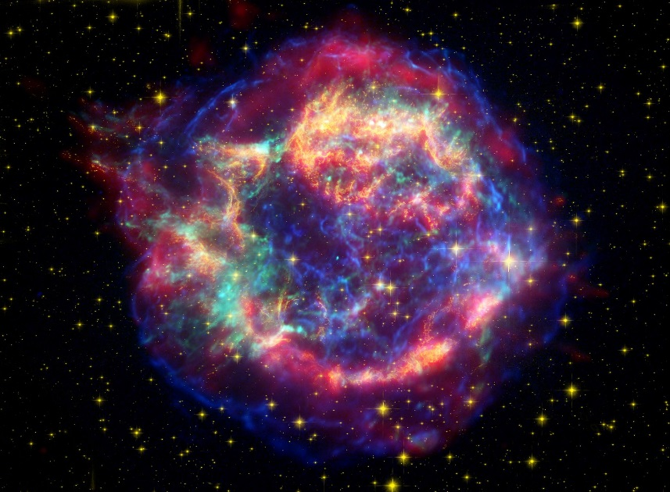
Stars
Birth
Life
Death
Notes:
We are going to talk about
- how stars form
- how stars live and die
- how their mass relates to their temperature and their luminosity (intrinsic brightness).
- fusion of elements (we already covered H -> He)
- creation of elements greater (larger) than iron (Fe)

Slide 2
Clicker Question
I remembered my lecture tutorials today
True
False
Notes:
I did mention we were going to use these extensively in this unit.

Slide 3
Stars
What can we measure about stars?
Brightness (apparent)
Spectrum:
color
absorption/emission lines
blackbody curve
Distance
Motion: apparent and actual
Doppler shift
Notes:
Now wait one minute. We need to talk about this. We’ve been plotting luminosity and temperature. What do we really measure? Here are all the things we can measure about stars. Some of these we don’t need right now but it’s important to keep in mind.
We’ll cover some of how we do this in future slides.

Slide 4
Some Definitions
Luminosity:
Total energy radiated into space by a star per second.
Flux:
Total energy radiated per second per square meter
Notes:
In order to get these we take the apparent brightness and correct for distance.

Slide 5
Some Definitions
Flux Emitted:
Total energy radiated per second per square meter.
4
σ
F
=
T
Notes:
We’ve been talking about intensity so far! Intensity and flux have the same units (energy per area). In fact, they are essentially the same thing – so be careful where you are talking about the flux matters.
This is the flux at the surface of the star.

Slide 6
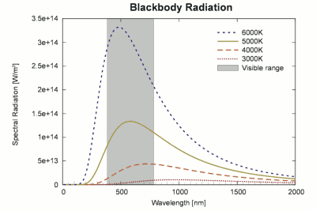
Luminosity of a Star
Depends on Temperature
And on
surface area
Notes:
Luminosity from a star depends on temperature- Hotter objects are brighter
Luminosity from a star depends on surface area- Bigger objects are brighter
Luminosity is INTRINSIC to the star… independent of distance.

Slide 7
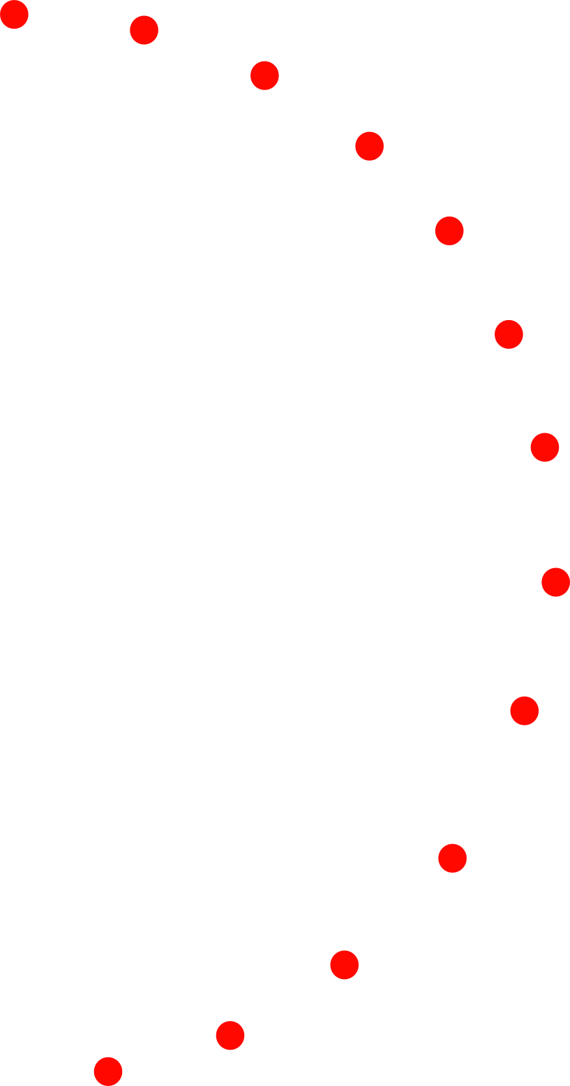
Luminosity versus
Apparent Brightness
Notes:
Imagine the light particles are little ping pong balls called “photons.”
The Sun spits photons in all directions. If you are standing very close, you will intercept many photons
If you are far away, you will intercept fewer photons.

Slide 8
Some Definitions
Apparent Brightness:
Amount of light at a distance?
Closer = Brighter
Bigger = Brighter
Hotter = Brighter
Notes:
Luminosity is the total number of photons leaving a star every second.
Luminosity is an intrinsic property of a star and is INDEPENDENT of its distance from us.
Flux is the number of photons crossing a square meter patch.
From our unit on light, we know that the flux from the surface of a hot object depends on its temperature.
Therefore, the Luminosity of a star depends on its Temperature and its surface area.
A hot bowling ball emits more energy per second than a hot bb
Small hot plates emit less energy per second than a large hotplate.
The flux received by the Earth from a star is the total number of photons per meter at the distance that the Earth is from the star.
A LARGE solar collector collects more energy than a tiny one.

Slide 9
Apparent Brightness
Apparent Brightness
depends on
LUMINOSITY and DISTANCE
Notes:
The apparent brightness of a star depends on its luminosity and its DISTANCE
So if I know the apparent brightness and the luminosity, I can get the distance
For luminosity, we need to know the stellar temperature AND the stellar radius
The temperature I can measure directly.
The radius is near impossible to measure directly.
OR, we can try to find the true luminosity of a star by knowing its distance and measuring its apparent brightness. Unfortunately, distances are hard to figure out. However if we can find distances to some stars, we can figure out characteristics and then make generalizations to stars that are similar*
*we’ll talk about what this means later.

Slide 10
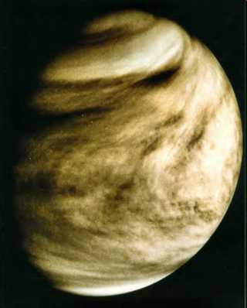
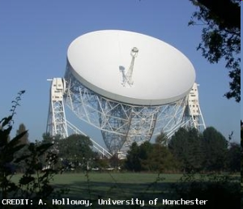
Distances
Radar measurements are DIRCECT measurement.
P² = a³
Notes:
We bounce radar signals off of Venus to measure our precise distance from it.
Remember Kepler’s Laws?
The third law relates orbital period to distance.
So, we have distances in terms of the AU, or the average Earth/Sun distance.
Once we know the distance between us and one other planet, we can calculate
the exact value of the AU and get the distance to the Sun

Slide 11
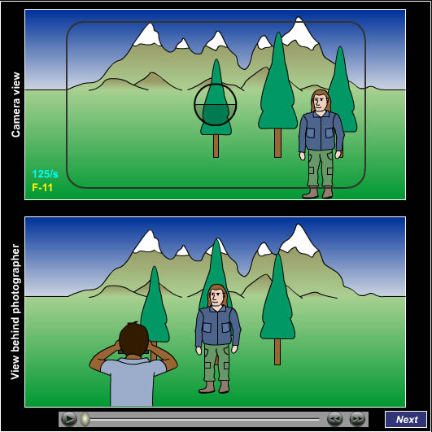
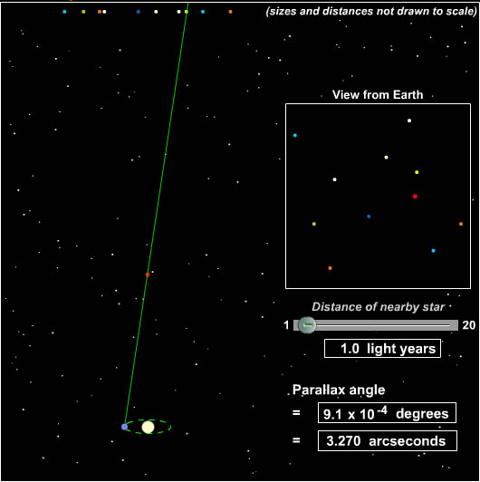
Distances
We use parallax to get distances to nearby stars.
Notes:
Parallax is something the Greeks expected to see, but couldn’t. That’s why (one of the reasons) they decided that the Earth isn’t moving.
But stars are crazy far away, so their parallax is hard to measure.
We are able to detect the parallax of the nearest stars, within a few hundred light years.
Remember that the Milky Way galaxy is 100,000 light years across.
Parallax is a geometric measurement! Accurate to within detection limits (how well we can resolve the motion). In the late 90’s Hipparcos satellite recalibrated all our distance measurements.
Note: This depends on having an accurate measurement of the A.U. – which we got from radar measurements!

Slide 12
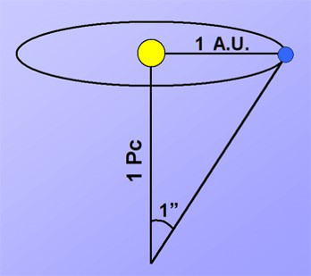
The Parsec
1 AU object subtends an angle of
1 arcsecond at a distance of
1 parsec
1 parsec = 3.26 lyr
Lecture Tutorial p. 37
Notes:
Lecture Tutorial: Parsec p 37 (after talking about below)

Slide 13
Stars
What do we want to know about stars?
Luminosity
Mass
Size (radius)
Temperature (surface, interior)
→ Fusion / physical processes

Slide 14
Magnitudes
Here’s something stupid that astronomers did
Brighter stars have smaller magnitudes
(well ok, it made sense at the time…)
Notes:
The magnitude system dates back to Hipparchus.
The brightest stars were called ‘Stars of the First Magnitude’
Next came stars of the second magnitude and so on.
Our eyes respond logarithmically… So the magnitude system is logarithmic.
It’s also backwards.
It’s also ‘unitless’, It’s based on the log of the ratio of fluxes.
The flux in the bottom is called the ‘zero point’, as it defines where zero is on the scale.
Vega is the zero magnitude star.
Absolute magnitude is the magnitude that a star WOULD have if it were 10 parsecs away. It is a measure of intrinsic brightness.

Slide 15
Brightness: Magnitudes
Absolute vs. Apparent: Tutorial p. 45 part I
Apparent: how bright something is from Earth
Absolute: how bright something is if it were at a distance of 10 parsecs
Notes:
Lecture Tutorial: p45 (questions 1-5 of apparent & abs magnitude of stars)
Absolute is a way to measure how intrinsically bright something is. Why 10 parsecs? Because that’s pretty easy to calculate, since the magnitude scale is a logarithmic scale (base 10). It’s a convenient choice, just as Vega is our convenient choice for an apparent magnitude of zero.

Slide 16
Brightness: Magnitudes
Which appears brighter?
C
D
Neither
Notes:
Lecture Tutorial: p45 (questions 1-5 of apparent & abs magnitude of stars)
Absolute is a way to measure how intrinsically bright something is. Why 10 parsecs? Because that’s pretty easy to calculate, since the magnitude scale is a logarithmic scale (base 10). It’s a convenient choice, just as Vega is our convenient choice for an apparent magnitude of zero.

Slide 17
Brightness: Magnitudes
Which is actually brighter
(more luminous)?
C
D
Neither
Notes:
Lecture Tutorial: p45 (questions 1-5 of apparent & abs magnitude of stars)
Absolute is a way to measure how intrinsically bright something is. Why 10 parsecs? Because that’s pretty easy to calculate, since the magnitude scale is a logarithmic scale (base 10). It’s a convenient choice, just as Vega is our convenient choice for an apparent magnitude of zero.

Slide 18
Brightness: Magnitudes
Star B is:
Closer than 10 pc
Farther than 10 pc
Exactly 10 pc away
Notes:
Lecture Tutorial: p45 (questions 1-5 of apparent & abs magnitude of stars)
Absolute is a way to measure how intrinsically bright something is. Why 10 parsecs? Because that’s pretty easy to calculate, since the magnitude scale is a logarithmic scale (base 10). It’s a convenient choice, just as Vega is our convenient choice for an apparent magnitude of zero.

Slide 19
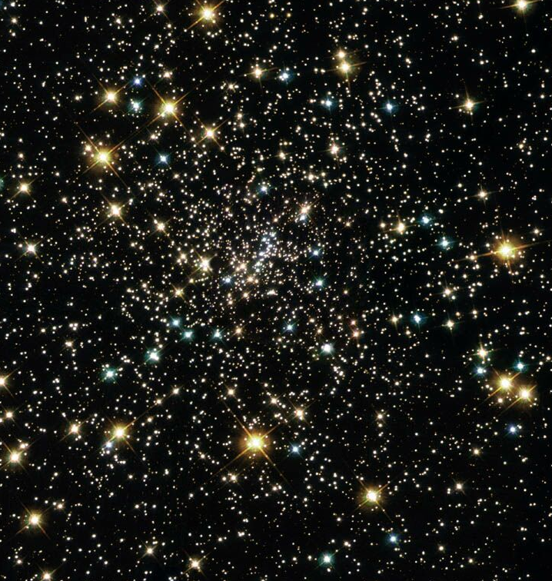
Temperature & Luminosity
Remember: How bright a star appears depends on how bright it really is & its distance.
Notes:
But how do we figure out how bright something really is, if we can’t get actual distances through parallax?

Slide 20
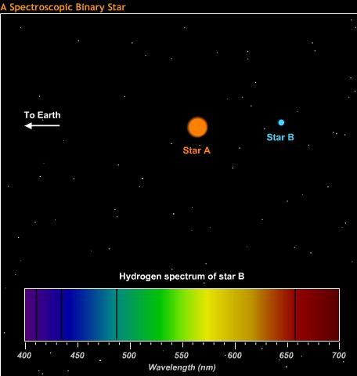
Stellar Mass
In principle this is simple
We only need:
Orbital Period
Orbital velocity
Orbital velocity is difficult
Notes:
With the orbital period and the orbital velocity, we can apply Newton’s version of Kepler’s third law. This is the same thing that we do for the sun, or for determining Jupiter’s mass using its moons. But we have a slight added complication because you can’t ignore one of the star’s masses.
We can get velocity through doppler shift… but that only gets one component of the velocity.
If the orbital plane is parallel to our line of sight, then we have the entire velocity.
Only a few systems are arranged like this. We can use them to calibrate the other stars.

Slide 21
Spectroscopic Sequence
The spectroscopic sequence is a temperature sequence
Notes:
The spectroscopic classification is a temperature sequence. O stars are HOT. M stars are cool.
Why… Bit of history
Edward Pickering was working on stellar spectra. He had an assistant… who didn’t do good work. So, he hired his housekeeper, Williamina Fleming.
Williamina Fleming classified the spectra based on the strength of their hydrogen lines. A being the strongest to O for the weakest.
The hydrogen line classification was inadequate
Annie Jump Cannon realized, by looking at other lines, that the classification scheme actually should be in the order OBAFGKM order, eliminating some classifications.
Many astronomers thought that the different sets of lines were dependent on the composition of the star.
Cecilia Payn-Gaposchkin realized that it’s a temperature sequence.
Hydrogen reaches a maximum and then goes away due to ionization in the hottest stars. This later led to the realization of the meaning of the underlying blackbody curve. Now we have an easy way to determine temperature.

Slide 22
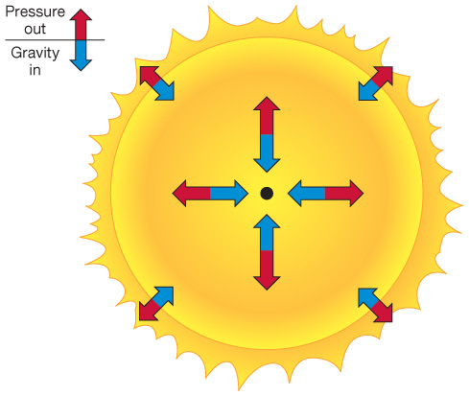
Spectroscopic “Parallax”
Mass
Temperature
Theory
Understanding Luminosity
Special pulsating stars help too
Notes:
Cepheid variables have helped us calibrate star luminosities as well. These stars pulse with a very specific period-luminosity relationship. (This is different from the small pulsations that most stars undergo)

Slide 23
Spectroscopic Parallax
Lecture Tutorial p. 45
Part II
Notes:
Lecture Tutorial: Spectroscopic Parallax, p 45
The technique of using spectroscopic sequence to determine actual luminosity is based on understanding the HR diagram. You get the spectral type of the star in question (take its temperature) and look up what its luminosity should be. Note that the main sequence on the HR diagram has some thickness. (recall that main sequence stars get more luminous as they age)
This causes the distance measurement using a single star to be somewhat inaccurate. This has nothing to do with geometric parallax. It’s just another stupid name astronomers use.

