Slide 1
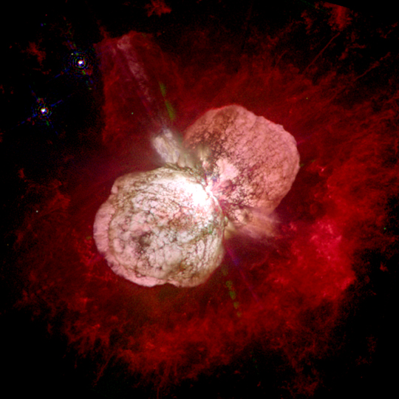
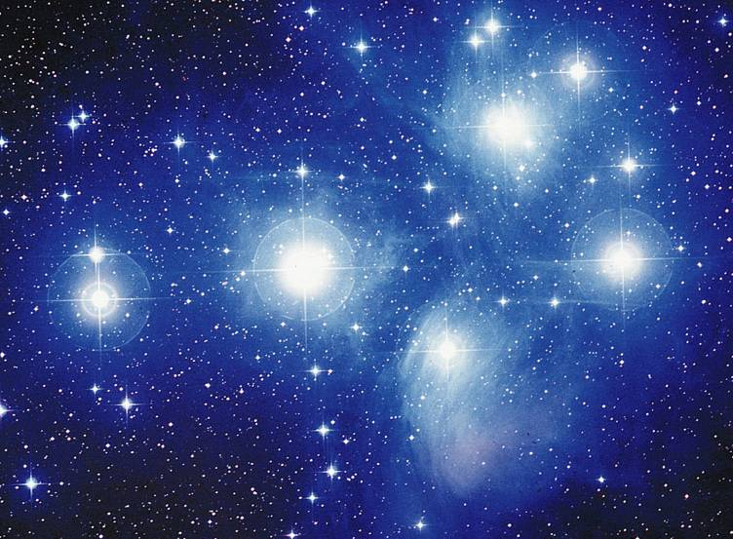
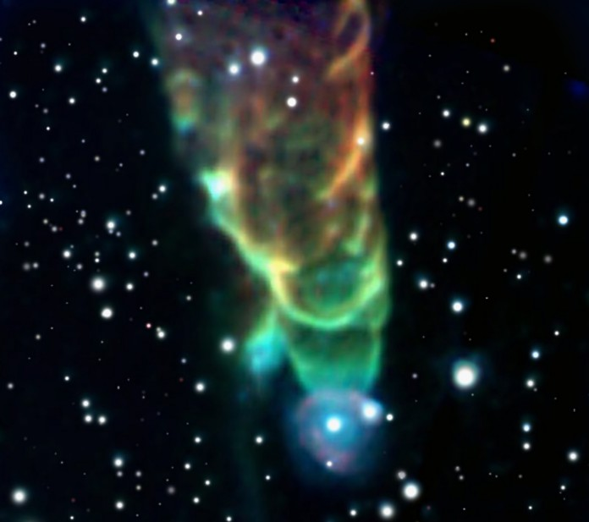
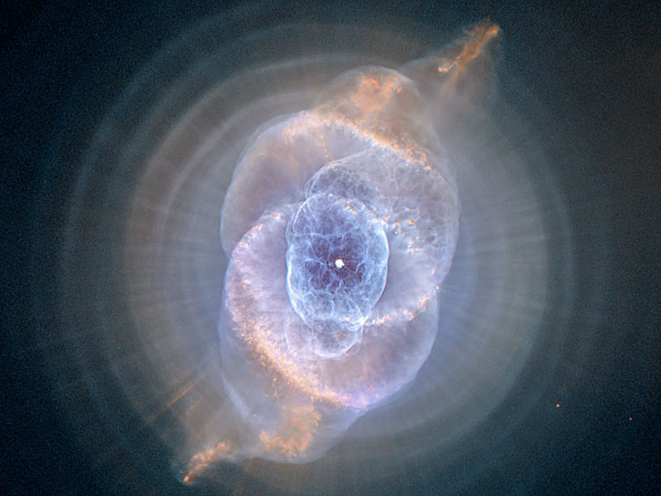
Stars
Notes:
We are going to talk about
-how stars live and die
-how their mass relates to their temperature and their luminosity (intrinsic brightness).
-fusion of elements (we already covered H -> He)
-creation of elements greater (larger) than iron (Fe)

Slide 2
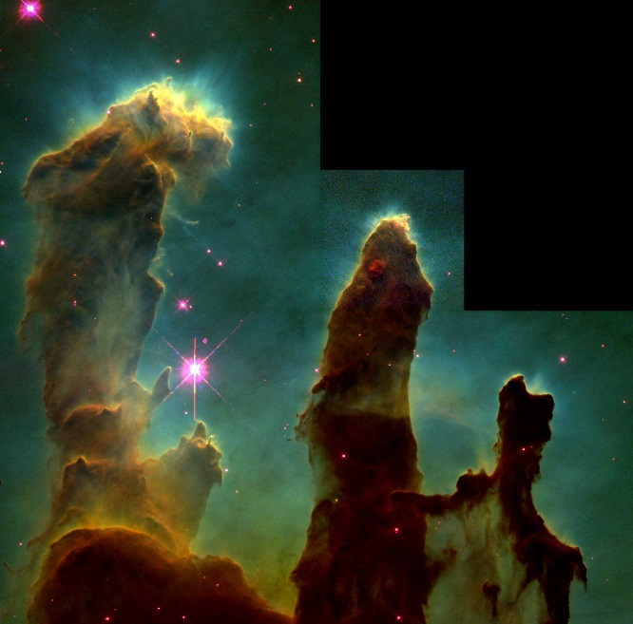
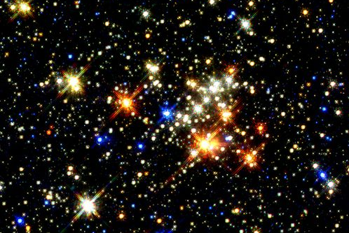
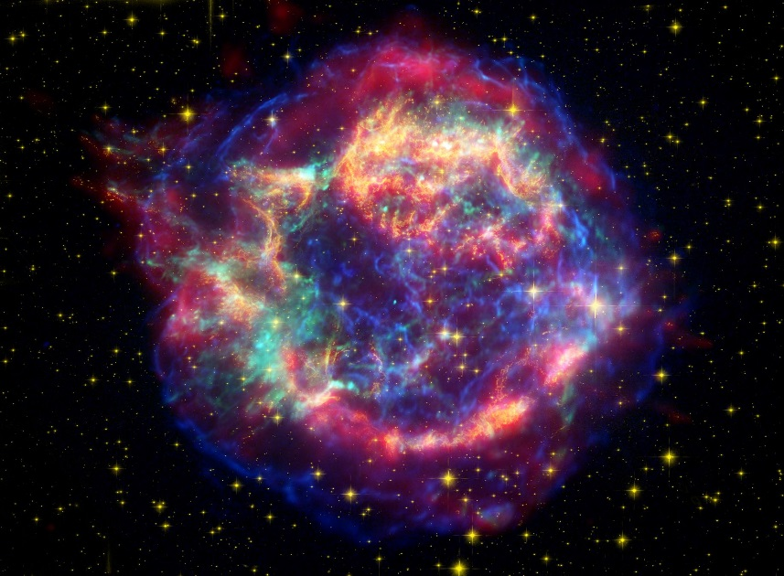
Stars
Birth
Life
Death
Notes:
We are going to talk about
- how stars form
- how stars live and die
- how their mass relates to their temperature and their luminosity (intrinsic brightness).
- fusion of elements (we already covered H -> He)
- creation of elements greater (larger) than iron (Fe)
We will also need to talk a little bit more about what (and how) we directly measure when observing stars.

Slide 3
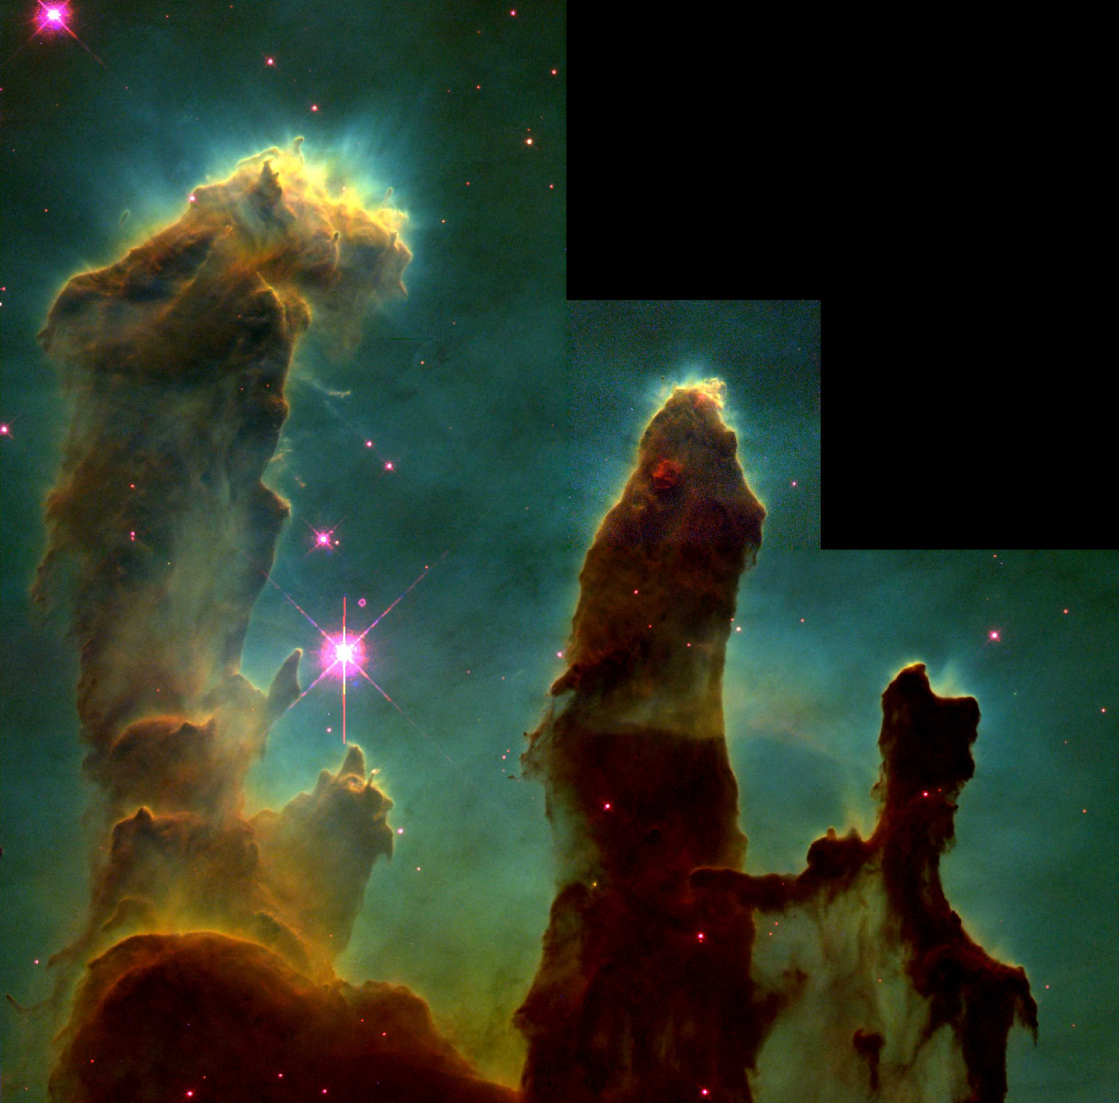
The Birth of Stars

Slide 4
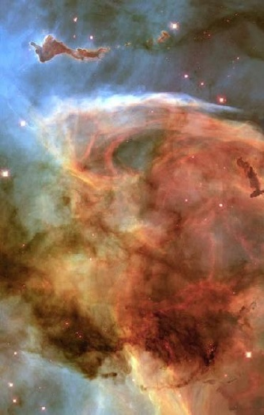
Interstellar Medium
Stuff between stars
90% gas
10% dust
Dust obscures much of the galaxy from our view
Notes:
Stars form in dark clouds of dusty gas in interstellar space. The gas between the stars is called the interstellar medium
The ISM is the stuff between the stars
Composed of gas and dust
90% gas
10% dust
Very low density of 1 atom/cm⁻³
Yet enough to block light from far away parts of the Galaxy
The ISM effectively absorbs or scatters visible light. (dust, particularly)
it masks most of the Milky Way Galaxy from us
Radio & infrared light does pass through the ISM. We can study and map the Milk Way Galaxy by making observations at these wavelengths
Hot gas and dust is ionized.
Cooler gas is atomic
Cold gas can form molecules, and it’s in cold molecular clouds that star formation is easiest to do.

Slide 5
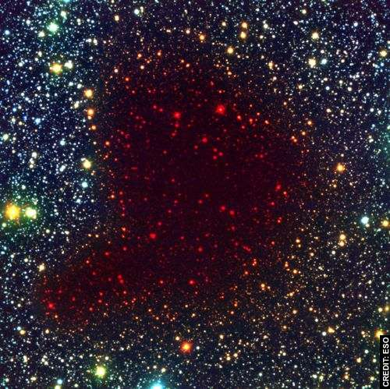
Interstellar Medium
Optical
Infrared
Notes:
Tiny solid particles of interstellar dust block our view of stars on the other side of a cloud.
Particles are < 1 micrometer in size and made of elements like C, O, Si, and Fe.
Observing the infrared light from a cloud can reveal the newborn star embedded inside it.

Slide 6
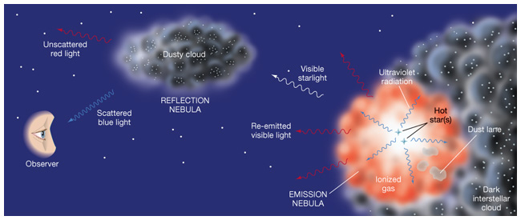
Nebulae: “fuzzy things”
Dust: scatters blue best
Hot H gas: emits mostly red

Slide 7
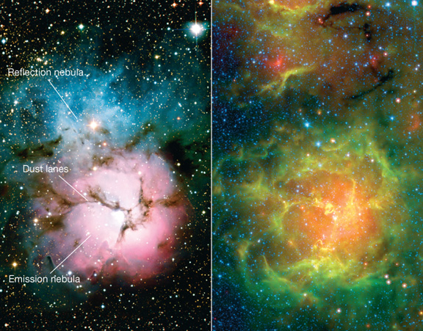
Nebulae: “fuzzy things”
Notes:
Visible on the left; Infrared on the right

Slide 8
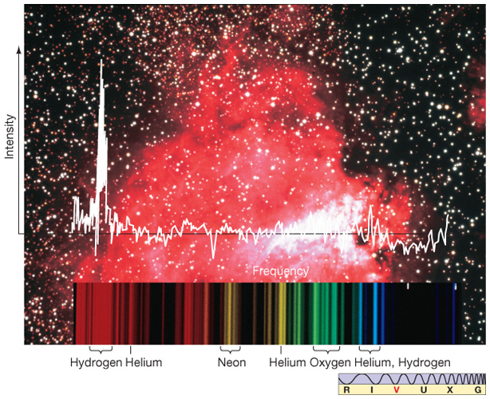
Composition of Nebulae
Notes:
We can tell the elements in a nebula by looking at its spectrum. Not too surprisingly we see similar stuff as our solar system is made of… 70% H, 28% He, 2% heavier elements in our region of Milky Way

Slide 9
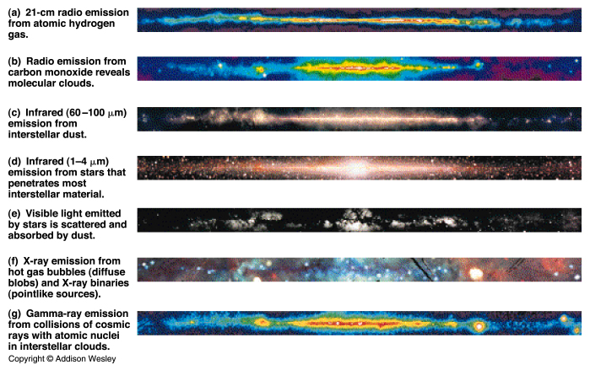
Different Views

Slide 10
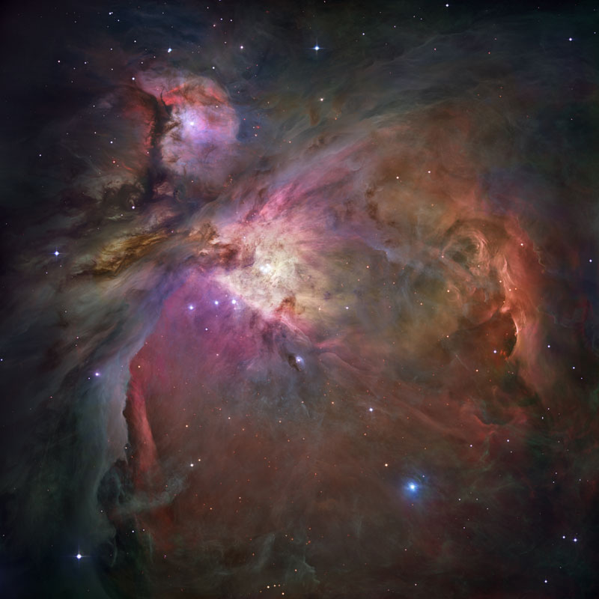
The Making of Stars
So… how do we go about making stars out of all this stuff?
Notes:
The orion nebula is a stellar nursery. Many stars are forming here; it is lit mostly by four very hot stars in the center (putting out most of the light)
A cloud of gas and dust doesn’t just start to collapse for no reason: something has to trigger it. But what?

Slide 11
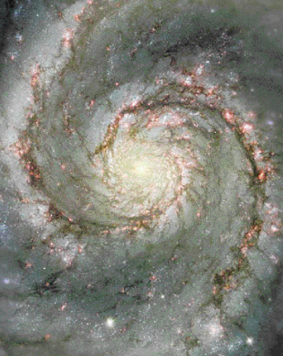
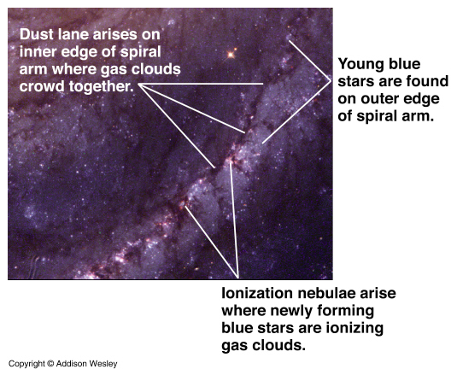
Spiral Arms
Spiral arms are density waves
The density waves compress the gas clouds…
Notes:
Star formation happens in the spiral arms.
Gas and dust piles up just in the wave.
The density wave compresses the ISM triggering star formation.
Hot young stars dominate the area just behind the density wave making the arms blue and bright.
The spiral arms appear much bluer than the bulge, which contains an older population of stars.
The big O and B stars cause ionized nebula to glow in the region of the arms.
The big stars die quickly, long before another wave comes by.
Lower mass stars (the Sun) pass through several density waves in their lifetimes.

Slide 12
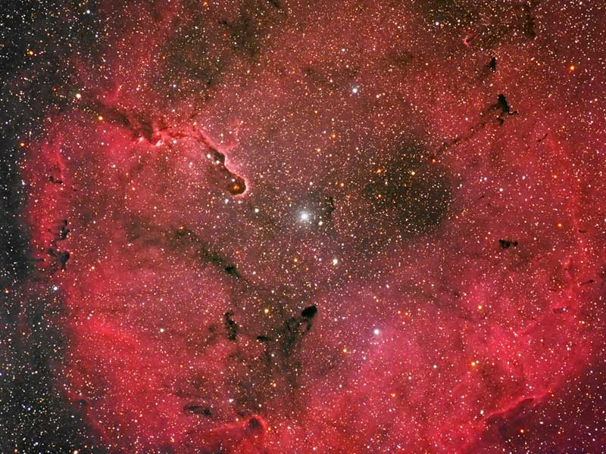
Emission from Near Stars
Once you get some star formation it can trigger other stars to form
Hot emission nebulae
Notes:
Emission nebula compresses at the edges, or even in the inside. This compression can lead to formation of new stars.

Slide 13
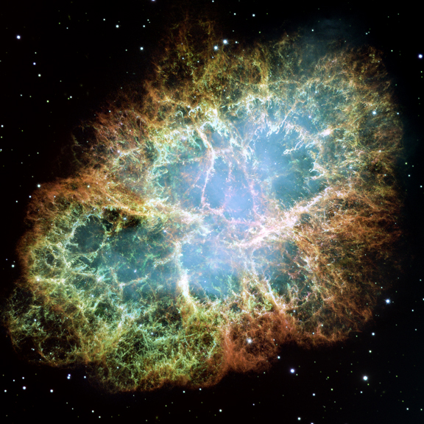
Explosions in Space
Dying stars – especially big ones
Supernovae
Notes:
Shockwaves from an exploding (dying) star nearby going through a nearby cloud of gas can trigger star formation

Slide 14
Low Temperatures
Or maybe the cloud just gets too cold...
Cold molecular cloud
Notes:
Cold… can’t hold up against gravity.

Slide 15
Birth
Stars are born in clusters
Clouds fragment as they collapse
Notes:
In a molecular cloud, it’s a battle between thermal pressure and gravity.
When gravity wins, stars are born. Show cluster formation animation
Clouds tend to fragment in such a way that they make more low mass stars than high mass stars. It’s easier for gravity to overcome pressure in smaller pieces of the cloud, causing it to break apart into multiple fragments, each of which may go on to form a star.
Emission lines from molecules in a cloud can prevent a pressure buildup by converting thermal energy into infrared and radio photons. This radiation cools the cloud, making collapse easier.
A typical molecular cloud (T~ 30 K, n ~ 300 particles/cm³) must contain at least a few hundred solar masses for gravity to overcome pressure, if there are no other forces resisting collapse (such as magnetic fields or turbulence in the gas, both of which are usually present as well).
For every 10 to 100 solar mass star, there 10 stars between 2 and 10 solar masses and 50 between 0.5 and 2 solar masses.
So… there are lots of small stars born.

Slide 16
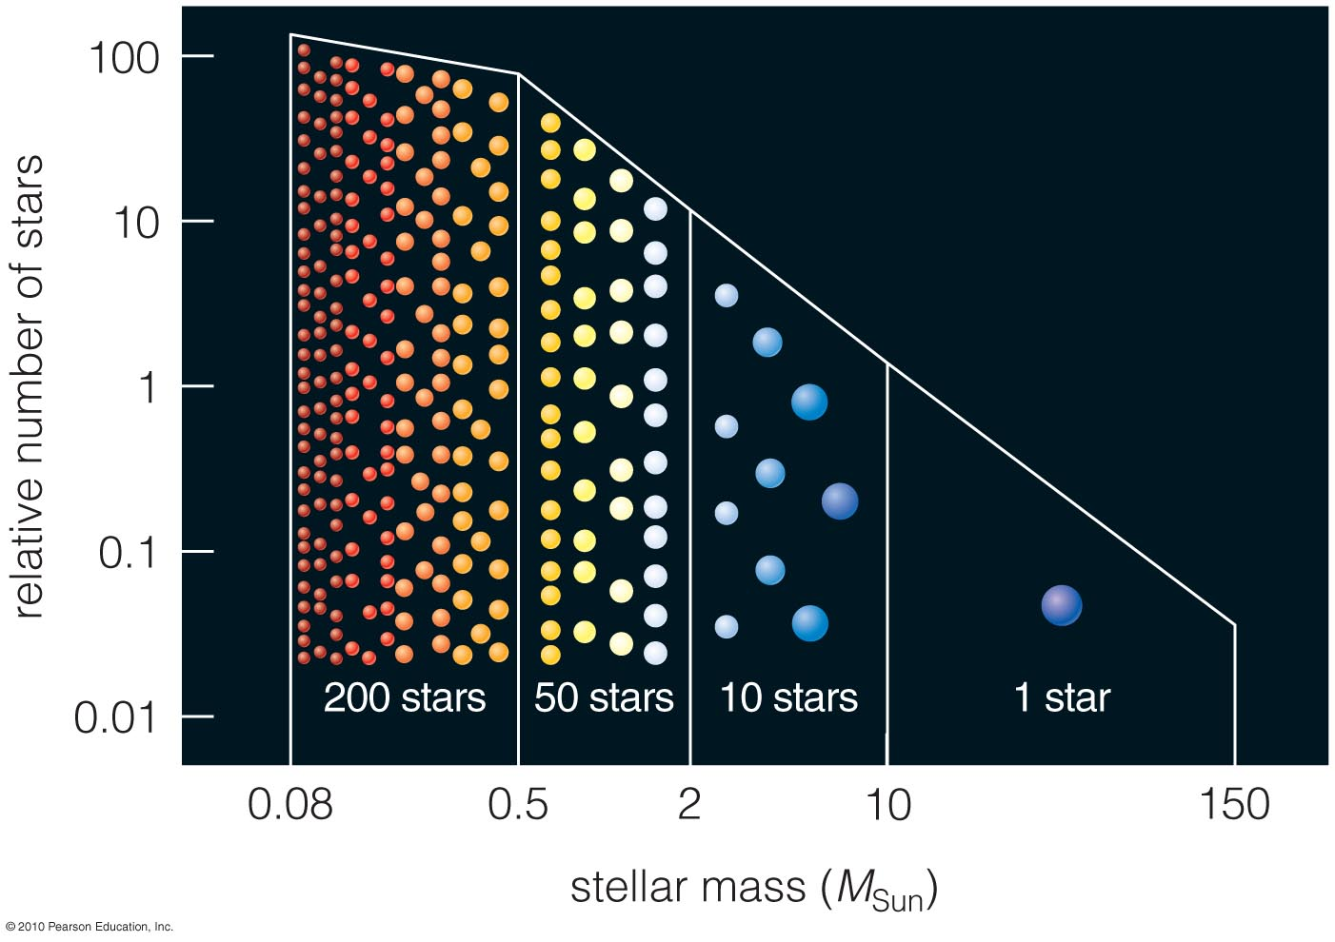
Star Types
LOTS more small stars than big ones!

Slide 17
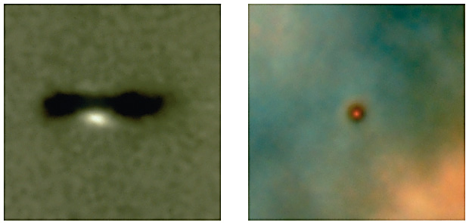
Protostars

Slide 18
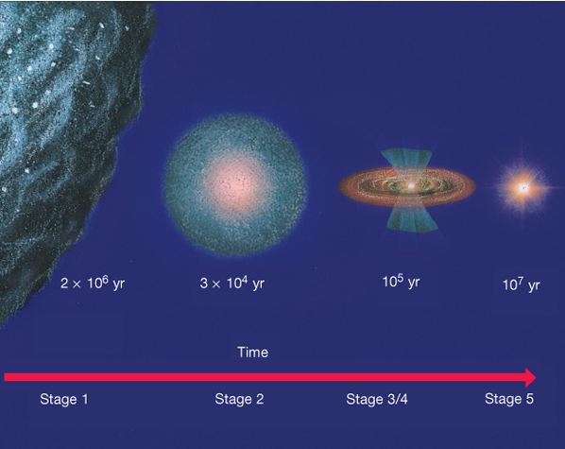
Protostars
Energy is from gravitational potential
Not fusing hydrogen yet!
Notes:
When convection dominates, the star moves almost vertically on the HR diagram.
Once radiative transfer starts, the star moves more horizontally.
Fusion starts, but the star continues to contract until the equilibrium condition is reached.
Then it settles onto the main sequence.
*see interactive figure from masteringastronomy.com*

Slide 19
Protostars
Stars more massive than 150 M_{sun} would blow apart
Main Sequence
Stars less massive than 0.08 M_{sun} can’t sustain fusion
Notes:
Remember Jupiter is 0.001 M_{sun}!
A large solitary failed star is called a brown dwarf. Some more massive ones can fuse deuterium (hydrogen with one neutron in the nucleus in addition to its proton) but it doesn’t last long.

Slide 20
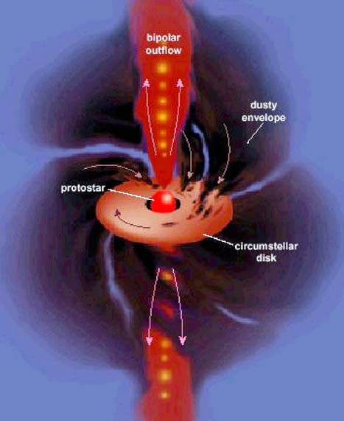
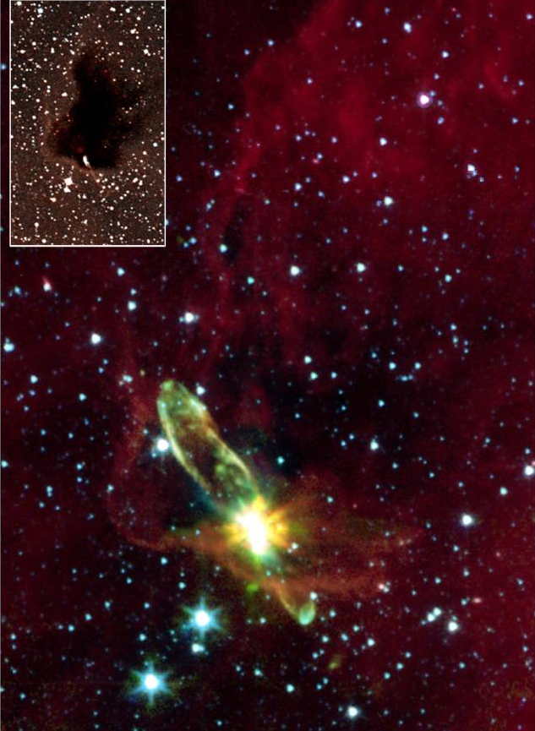
Protostars
Notes:
Jets form… they are pretty ubiquitous in astronomy, any time you have a spinning disk of material you’re likely to get jets. The disk is hot, so has a wind of its own, and the magnetic field from the central object can pick up material from that wind and toss it outwards.

Slide 21
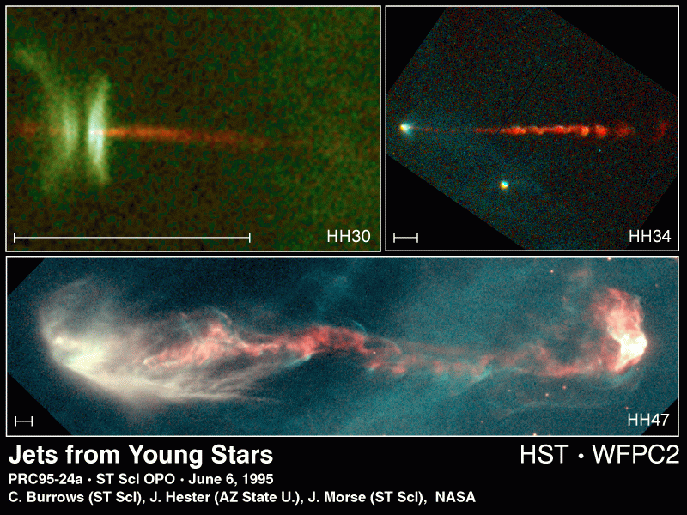
Protostars

Slide 22
Star formation & Lifetimes
Lecture Tutorial p. 119
Notes:
Lecture tutorial P 119

