Slide 1
The Sun

Slide 2
Overview
What is the composition of the Sun?
Why does the Sun shine?
How do we know its temperature?
Why is the Sun hot? (energy source)
Chemical?
Gravitational?
Fusion?
What IS fusion, and why does it release energy?
What is the structure of the Sun?

Slide 3
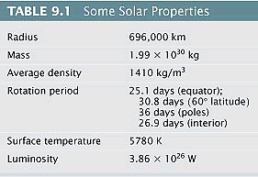
Basic Properties
100 Earths fit across
Peaks at 500nm (blue-green)
Luminosity: how much energy per second an object (a star) gives off (Watts, or erg/s)
Notes:
Re = 6, 378km
Density of earth 5155kg/m3 (water = 1,000kg/m3)

Slide 4
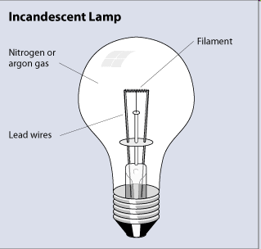
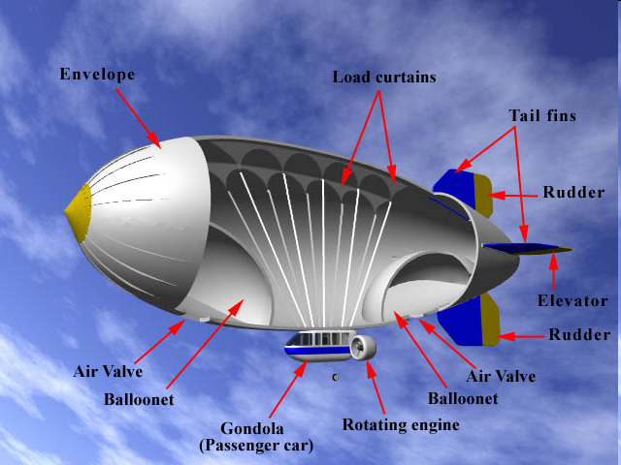
What IS the Sun?
A mass of incandescent gas
Plasma
Primarily Hydrogen
Notes:
The Sun is composed primarily of Hydrogen.
A LOT of hydrogen. It contains 98% of the mass of the solar system.
It has the same abundances as the gasses in the early solar system.
98% hydrogen and helium and around 1% of all of the other stuff on the periodic table.

Slide 5
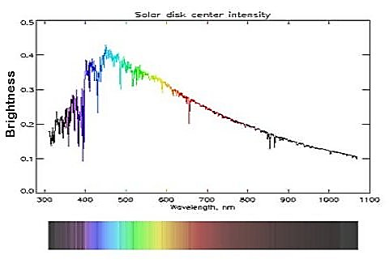
Solar Spectrum
Notes:
Mostly a blackbody…. With lots of absorption lines
Why don’t we see the emission lines from the corona in this plot?

Slide 6
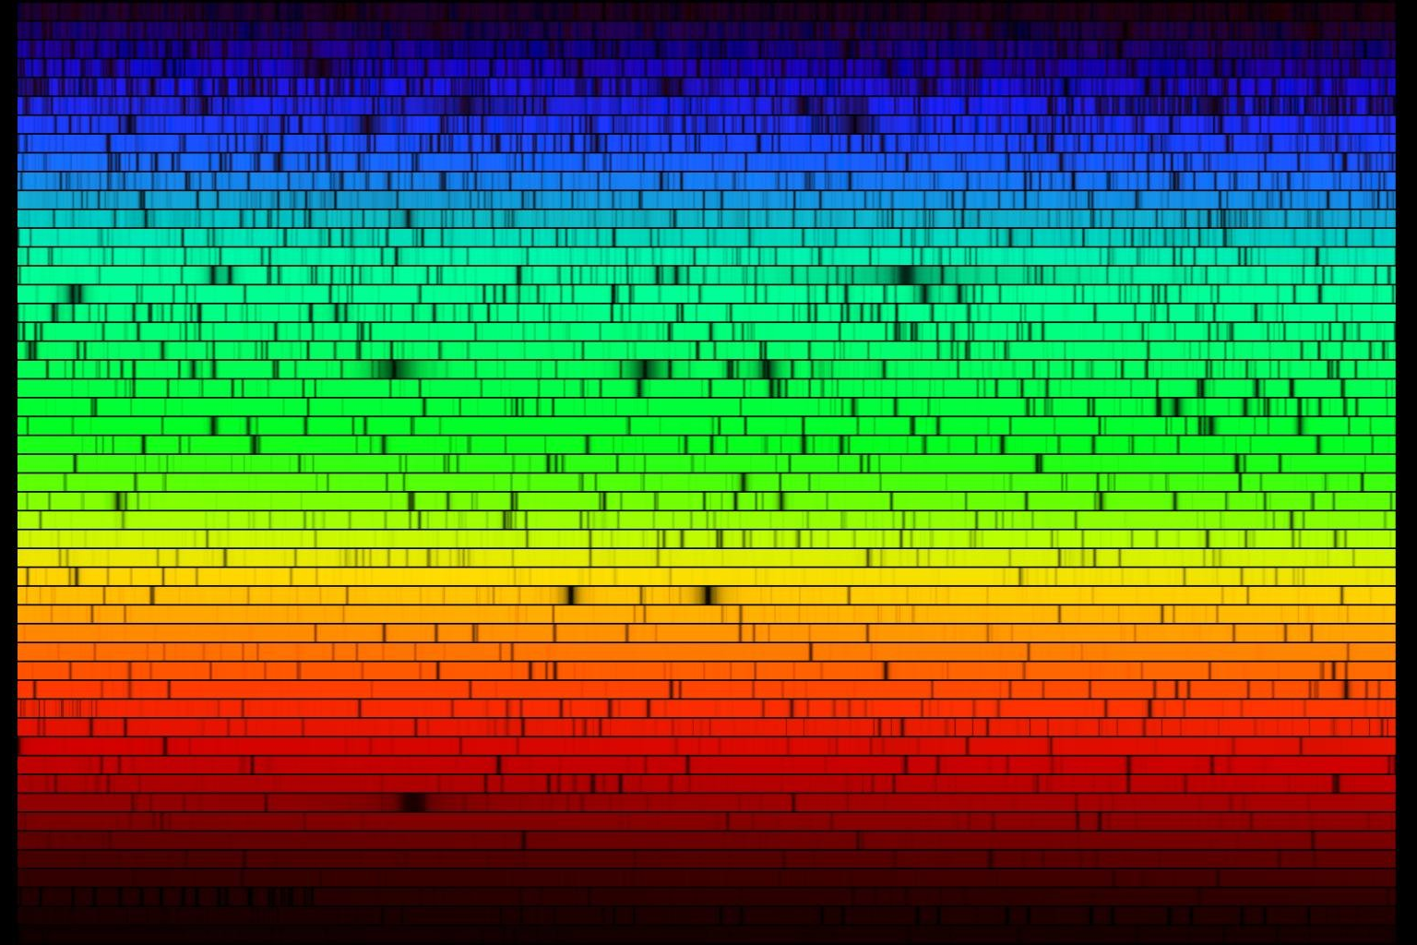
Absorption
Notes:
Black body. A DENSE object that absorbs 100% of incoming photons.
That’s why it’s black… no known objects are perfect bb absorbers.
A DIFFUSE cloud does NOT absorb like a black body. It absorbs discrete little chunks of color.
The individual atoms act like hungry photon monsters that only like certain colors of photons.
The Sun is a DENSE ball of hydrogen that is surrounded by a diffuse atmosphere. Looking at the absorption lines in this atmosphere shows us the composition of the sun.

Slide 7
Why Does the Sun Shine?
Because it’s HOT!
5800 degrees
Notes:
EVERYTHING with a temperature emits light.
What’s that funny plot on the right? It’s called a BLACK BODY curve.
Remember how we get temperature from that?

Slide 8
Overview
What is the composition of the Sun?
Why does the Sun shine?
How do we know its temperature?
Why is the Sun hot? (energy source)
Chemical?
Gravitational?
Fusion?
What IS fusion, and why does it release energy?
What is the structure of the Sun?

Slide 9
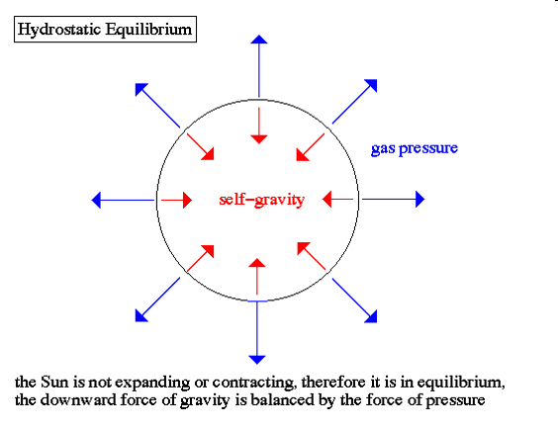
Keeping the Sun Inflated
Notes:
9
First of all, what is a consequence of it being hot?
The Sun is in Hydrostatic Equilibrium, much the same way that the atmosphere holds itself up.
BUT… it’s always losing energy through radiation into space… which means it’s always cooooooling off… because space is cold.
As it cools off, it should keep collapsing.
But… It doesn’t continue to collapse (at least not on short time scales) so it MUST have an energy source that keeps the temperature (and thus the pressure) up. What provides that energy?
The fusion reactions keep adding energy.
The fusion reactions are also temperature sensitive… So the system auto-regulates.
If the core cools down a little… the Sun contracts a little increasing the temp and the density in the core which speeds up the reaction.
If things get too hot, the Sun expands, lowering the temperature and density in the core, slowing the reactions.
In both cases, things return to equilibrium

Slide 10
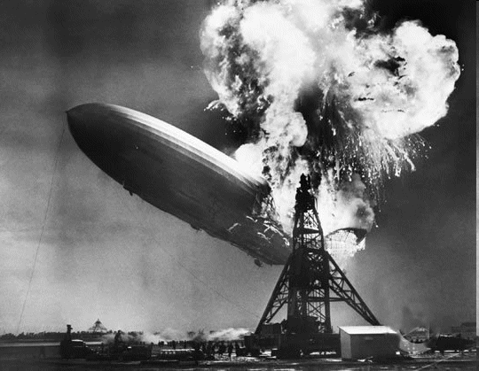
What’s the energy source?
Burning?
It would only last a few thousand years
Lecture Tutorial: Cheerios
Notes:
“burning” is usually a way of saying “oxidation”
Hydrogen Oxide is H2O, or water.
We know how much energy the Sun is throwing off.
We know how much energy a typical chemical reaction gives off.
Based on it’s mass,
If the sun were combusting (or having some other chemical reaction) it would only burn for a few thousand years.
We have good reason to believe that the Sun has been around longer than a few thousand years. (like historical records)

Slide 11
Question:
If the Sun had no internal energy source
A. It would stay the same size
B. It would slowly shrink
C. It would quickly shrink
D. It would grow
Notes:
Discuss with your group and then as a class.

Slide 12
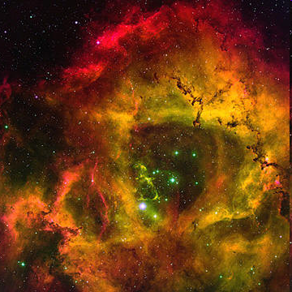
What’s the energy source?
Gravitational Time Scale
(just contracting)
A few tens of millions of years
Notes:
As the cloud collapses, the potential energy is transferred into kinetic energy.
The Sun is very dense, and since it has a temperature (from the kinetic energy gained from the collapse), it radiates like a black body.
But! Only the surface can radiate… It takes the energy a loooooong time to get out.
So… the Sun should be sloooowly shrinking. We don’t observe the Sun shrinking.
Additionally If the sun were releasing gravitational potential energy as heat, it would last a few tens of millions of years.
Geological evidence suggests that the Earth (and rocks from space) are several billion years old
So it’s not likely powered by grav. Potential

Slide 13
Overview
What is the composition of the Sun?
Why does the Sun shine?
How do we know its temperature?
Why is the Sun hot? (energy source)
Chemical?
Gravitational?
Fusion?
What IS fusion, and why does it release energy?
What is the structure of the Sun?

Slide 14
Fusion
The Sun fuses hydrogen into helium releasing energy
Notes:
14
The Sun is fusing hydrogen nuclei into helium nuclei in its core.
A Hydrogen nucleus is composed of a single proton.
A Helium nucleus is composed of two protons and two neutrons.
In order to fuse protons, the electrostatic force must be overcome, which requires very high pressures and temperatures.
Like those found in the center of the Sun
The temperature at the center of the Sun is 12 million degrees Kelvin
The central pressure is 270 billion atmospheres.
Once the protons get close enough together, the strong nuclear force takes over.
We get energy from this reaction via Einstein’s equation: E=mc²
1 helium nucleus is slightly lighter than 4 hydrogen nuclei.
The extra mass was converted into energy

Slide 15
Question
As the core is contaminated with helium, the nuclear reaction rate drops and the Sun
A. stays the same size
B. shrinks (gets smaller)
C. grows (gets bigger)
Notes:
Group discussion

Slide 16
Question
If the Sun were to shrink a little, the core temperature would (increase/decrease) causing:
A. The reaction rate to increase shrinking the sun
B. The reaction rate to decrease shrinking the sun
C. The reaction rate to increase growing the sun
D. The reaction rate to decrease growing the sun
Notes:
Class discussion

Slide 17
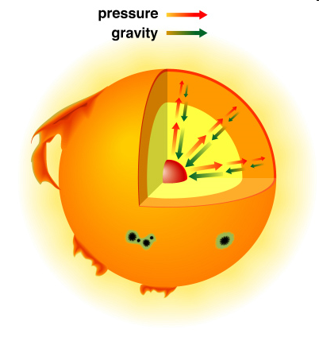
Solar Thermostat
Fusion reaction rate depends on temperature
If temp decreases, pressure decreases
As gravitational potential is released, temperature increases
As temp increases, pressure increases
As helium contaminates the core, fusion rate slows
Notes:
17
As Helium contaminates the core of the star, the hydrogen reaction rate slows.
This causes the Sun to cool, which causes the pressure to drop.
When the pressure drops, gravity causes the star to collapse slightly.
This slight compression (release of grav. Potential energy) causes the temperature to increase slightly.
The increased temperature increases the reaction rate in the core.
The star returns to equilibrium.
If the core cools down a little… the Sun contracts a little increasing the temp and the density in the core which speeds up the reaction.
If things get too hot, the Sun expands, lowering the temperature and density in the core, slowing the reactions.
In both cases, things return to equilibrium

Slide 18
Composition
How is the Sun’s composition different than it was 1 billion years ago?
Where is that helium?
Notes:
Because the sun is fusing hydrogen to helium, the sun has more helium than before. However all of that helium is locked up in the core, so not visible in the spectrum of the star. It will never leave the core of the star. So what we see is the original composition the sun had – and this is the composition of most of our star.

Slide 19
Overview
What is the composition of the Sun?
Why does the Sun shine?
How do we know its temperature?
Why is the Sun hot? (energy source)
Chemical?
Gravitational?
Fusion?
What IS fusion, and why does it release energy?
What is the structure of the Sun?

Slide 20
Structure
Hot Dense Core
Fusion happens here
Radiative Zone
Energy carried by photons
Convective Zone
Energy carried by convection
Notes:
Fusion is ONLY happening in the core of the Sun. Only about 10 percent of the Sun’s mass will be converted to Helium.
Surrounding the core is a RADIATIVE zone.
The core and the radiative zones aren’t good at absorbing photons so the photons randomly bouncing around slowly working their way out.
It will take a photon about a million years to get all the way out.
The convective zone very is good at absorbing photons.
The photons created in the core are absorbed in the radiative zone and heat the gas in this region.
Convection carries the energy out in this region.

Slide 21
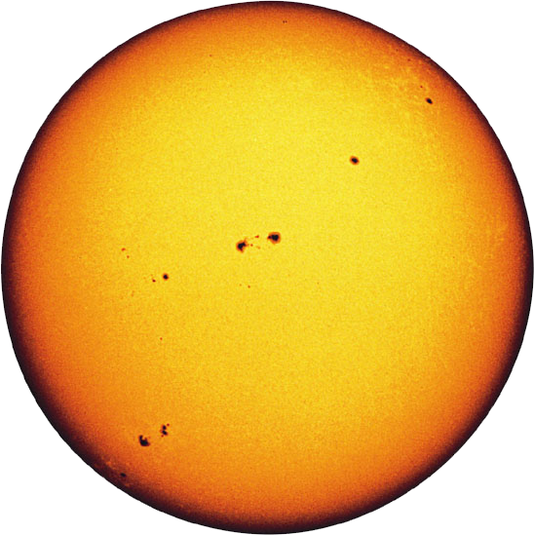
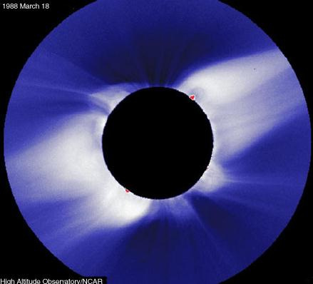
Photosphere and Corona
The visible surface
photons escape
Hot low density atmosphere
chromosphere is in between
photosphere
corona
Notes:
The photosphere is the ‘surface’ of the sun. The radius of the photosphere is 696,000 km
It’s the place where photons finally ‘escape’ into space.
Temperature at the photosphere is 5,800 degrees Kelvin.
The black body peaks in the green.
Just outside of this is the chromosphere. This is a lower density, cooler gas, where the absorption comes from.
The Corona is a very low density, very hot gas, about 1 million degrees.
The heating mechanism is poorly understood. Leading hypothesis is that energy is transported outward by magnetic fields.
It contains relatively little heat due to low densities.

Slide 22
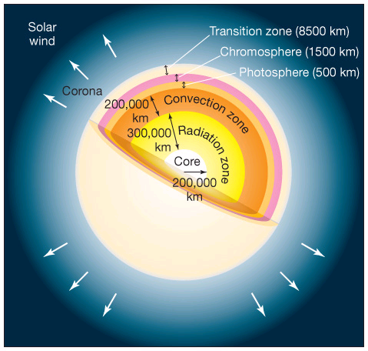
Solar Structure

Slide 23
Outer Structure
Notes:
Remember, the photosphere is what we call the “surface” of the sun. What type of spectrum do we see from the photosphere? Because of the Chromosphere? The Corona? Looking through all at once?
Photosphere: ~5800 K
Chromosphere ~6000-10,000 K
Corona > 1 million K
Image credit: doi:10.1016/j.newar.2010.08.001

Slide 24
Solar Spectrum
Notes:
Mostly a blackbody (generated by the photosphere), with lots of absorption lines (from different layers in the photosphere)
Why don’t we see the emission lines from the corona in this plot? Very low density! (not that many emission photons)

Slide 25
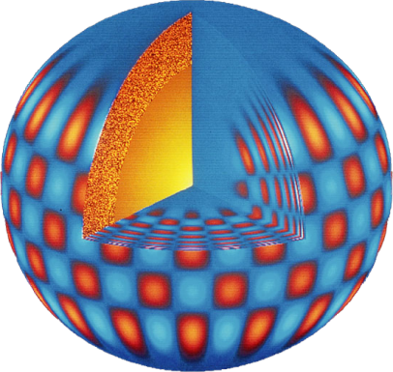
How do We Know?
Mathematical
Models
Helioseismology
Neutrinos
Notes:
By mixing together in a computational model:
The composition of the Sun,
The mass of the Sun,
Basic physics (hydrostatic equilibrium, radiation pressure, etc..),
What we know from the laboratory about fusion
We get out correct luminosity and size of the Sun. This is good!
Similar to determining the structure of the Earth through seismology, we watch the vibrations of the Sun and determine its internal structure.
Results from helioseismology agree well with computer models. (these sound waves are generated in the convection zone)
By counting the neutrinos from the Sun, we verify what we know about the fusion reactions going on.

Slide 26
Convection Granules
Evidence of convection is seen on the solar “surface”
Notes:
Although the surface of the Sun appears smooth evidence of the underlying convection cells can be seen.
These are called granules.
Each one of the granules is about 600 miles across.

Slide 27
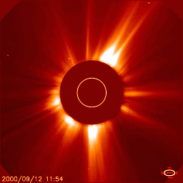
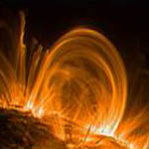
Solar Weather
Notes:
Sunspots are cool places on the photosphere.
They are associated with places where strong magnetic fields are emanating.
Magnetic fields have a loop structure exiting the photosphere and reentering it at another point.
These loops are associated with solar prominances.
When they break, CME (coronal mass ejections occur)
CMEs are the cause of the Aurora

Slide 28
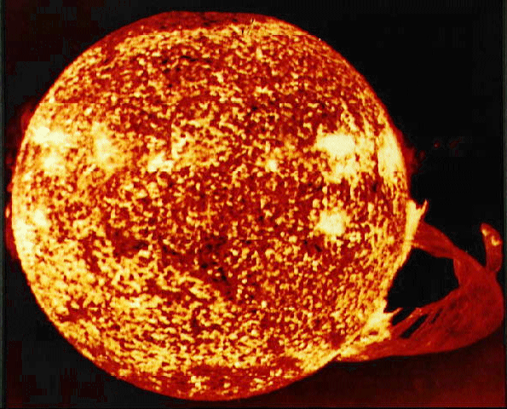
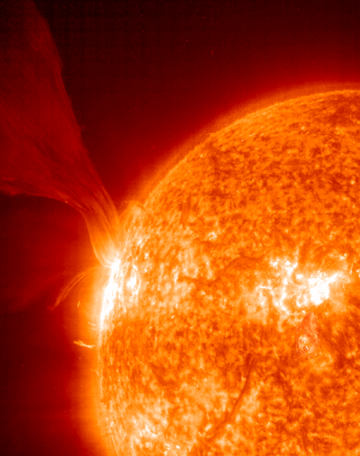
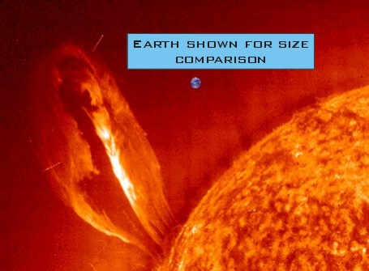
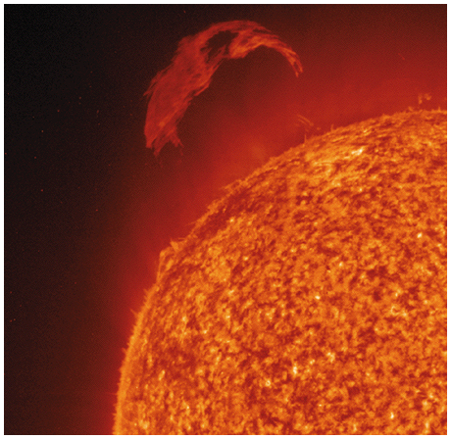
Pretty Pictures

Slide 29
How do we know?
Observations:
Photosphere
Granulations
Sunspots
Pulsations
Flares & CMEs
Helioseismology
Spectroscopy
Solar wind
Neutrinos
Models:
Hydrostatic Equilibrium
Helioseismology
Energy transport
Numerical simulations
Mass-energy equivalence

Slide 30
Overview
What is the composition of the Sun?
Why does the Sun shine?
How do we know its temperature?
Why is the Sun hot? (energy source)
Chemical?
Gravitational?
Fusion?
What IS fusion, and why does it release energy?
What is the structure of the Sun?

