Slide 1
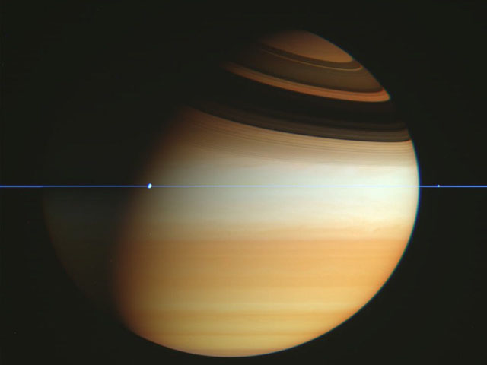
The Jovian Planets

Slide 2
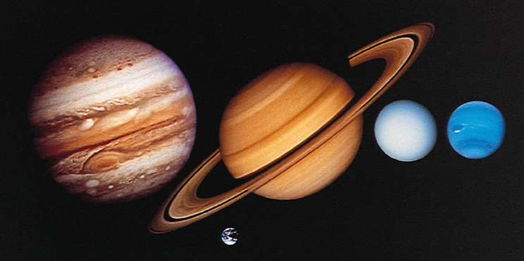
The Jovian (Jupiter-like) Planets
Much larger and more massive than terrestrial planets
Notes:
Much larger and much more massive than the terrestrial planets, although not necessarily as dense
Composed mostly of H, He, and H compounds
No solid surface
Fast rotation rates, therefore Slightly squished in nature
Many moons
Over 100 combined
Captured asteroids and comets
Some similar to terrestrial planets
All have rings

Slide 3
The Jovian Planets
Low density
Composition: H, He, H compounds
No solid surface
Notes:
Though it is possible that the stuff at the center of Uranus & Neptune are solid… hard to say for sure.

Slide 4
Jovian Atmospheres
Colors are caused by different chemicals in the clouds
Notes:
Different colors caused by different chemicals condensing into clouds (these are trace amounts)
White-yellow: Ammonia (NH₃)
Blue-green: Methane (CH₄)
White: Water (H₂O)
Brown-rust: Ammonium Hydrosulfide (NH₄SH)
Atmosphere temperature and condensation points for each chemical explain planet colors
Uranus and Neptune are cold enough to form methane clouds which absorb red light and reflect blue light

Slide 5
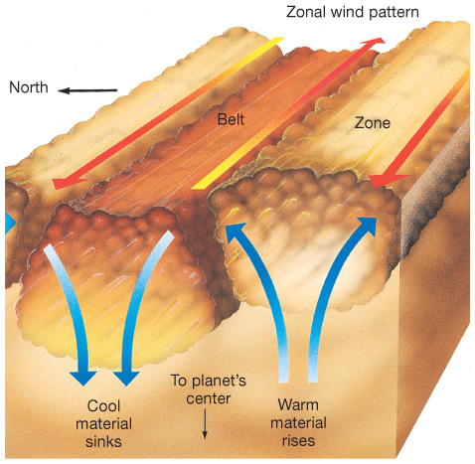
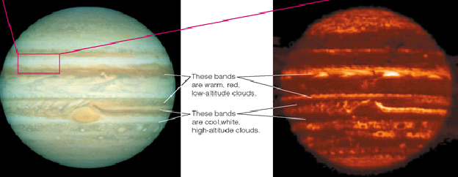
Jupiter’s Atmosphere
Banding is caused by strong convection
Bands alternate hot and cold
Notes:
Severe winds within the troposphere, 300 miles an hour as measured by Galileo probe
Bands and zones created by strong convection
The great red spot is a giant hurricane – 2.5 times the diameter of Earth! It’s been going on for over 400 years now.
Note: Jupiter (and Saturn and Neptune) actually emits more light than it receives!! This is because it’s still undergoing gravitational contraction.

Slide 6
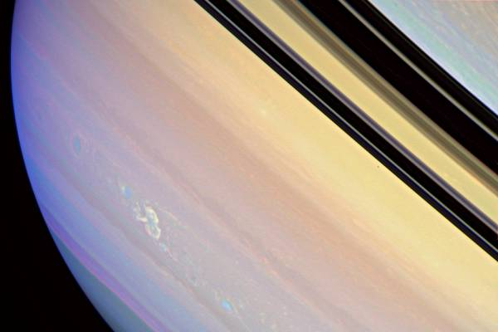
Saturn
Cat the equator are no longer going as fast as they used to; Saturn may lose its place as the windiest in the solar system…
Saturn has intense lightning storms
Notes:
Saturn isn’t as dense as Jupiter because it has less gravity
Also, its clouds are thicker due to less gravity; they get compressed less at the altitude that clouds form.
Like Jupiter, Saturn also emits more light than it receives; probably because He droplets are still condensing and raining down (sort of like differentiation, in a way)
Saturn has powerful lightning storms, ten thousand times stronger than on Earth, that occur in huge, deep thunderstorms columns nearly as large as the entire Earth. The storms occasionally boil up to the planet's visible surface.

Slide 7
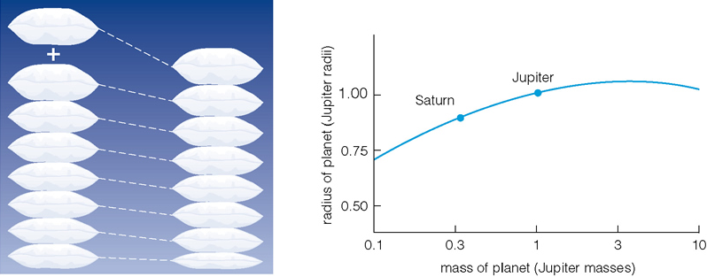
Sizes of the Gas Giants
Jupiter has three times the mass of Saturn
But is only slightly larger
Notes:
Jupiter has 3 times the mass of Saturn but it is not much larger
Increasing the mass doesn’t really increase the size because the added weight compresses the planet more
Jupiter is about as big as planets can get
Increasing Jupiter’s mass would actually shrink the size

Slide 8
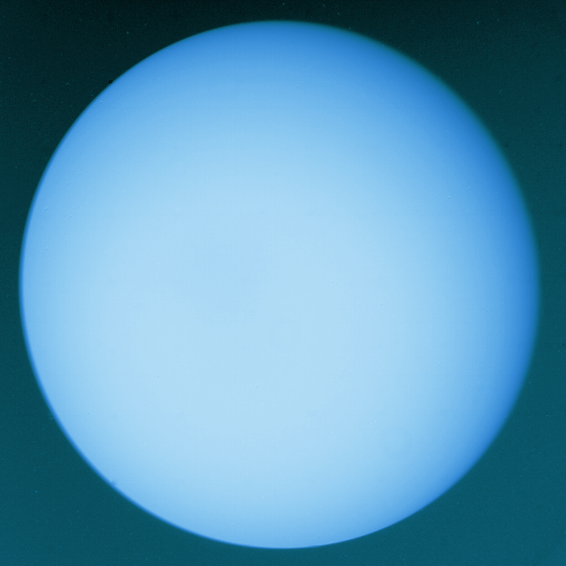
Uranus’ Axis
Polar axis is in the ecliptic
No banding or clouds
Odd weather due to axis tilt
Blue because of methane
Notes:
Uranus’ rotation axis tilt leads to extreme seasons
No storms
No clouds or banded structure seen in 1986 when N pole facing Sun
HST saw storms in 1998, perhaps because the S hemisphere is warming up

Slide 9
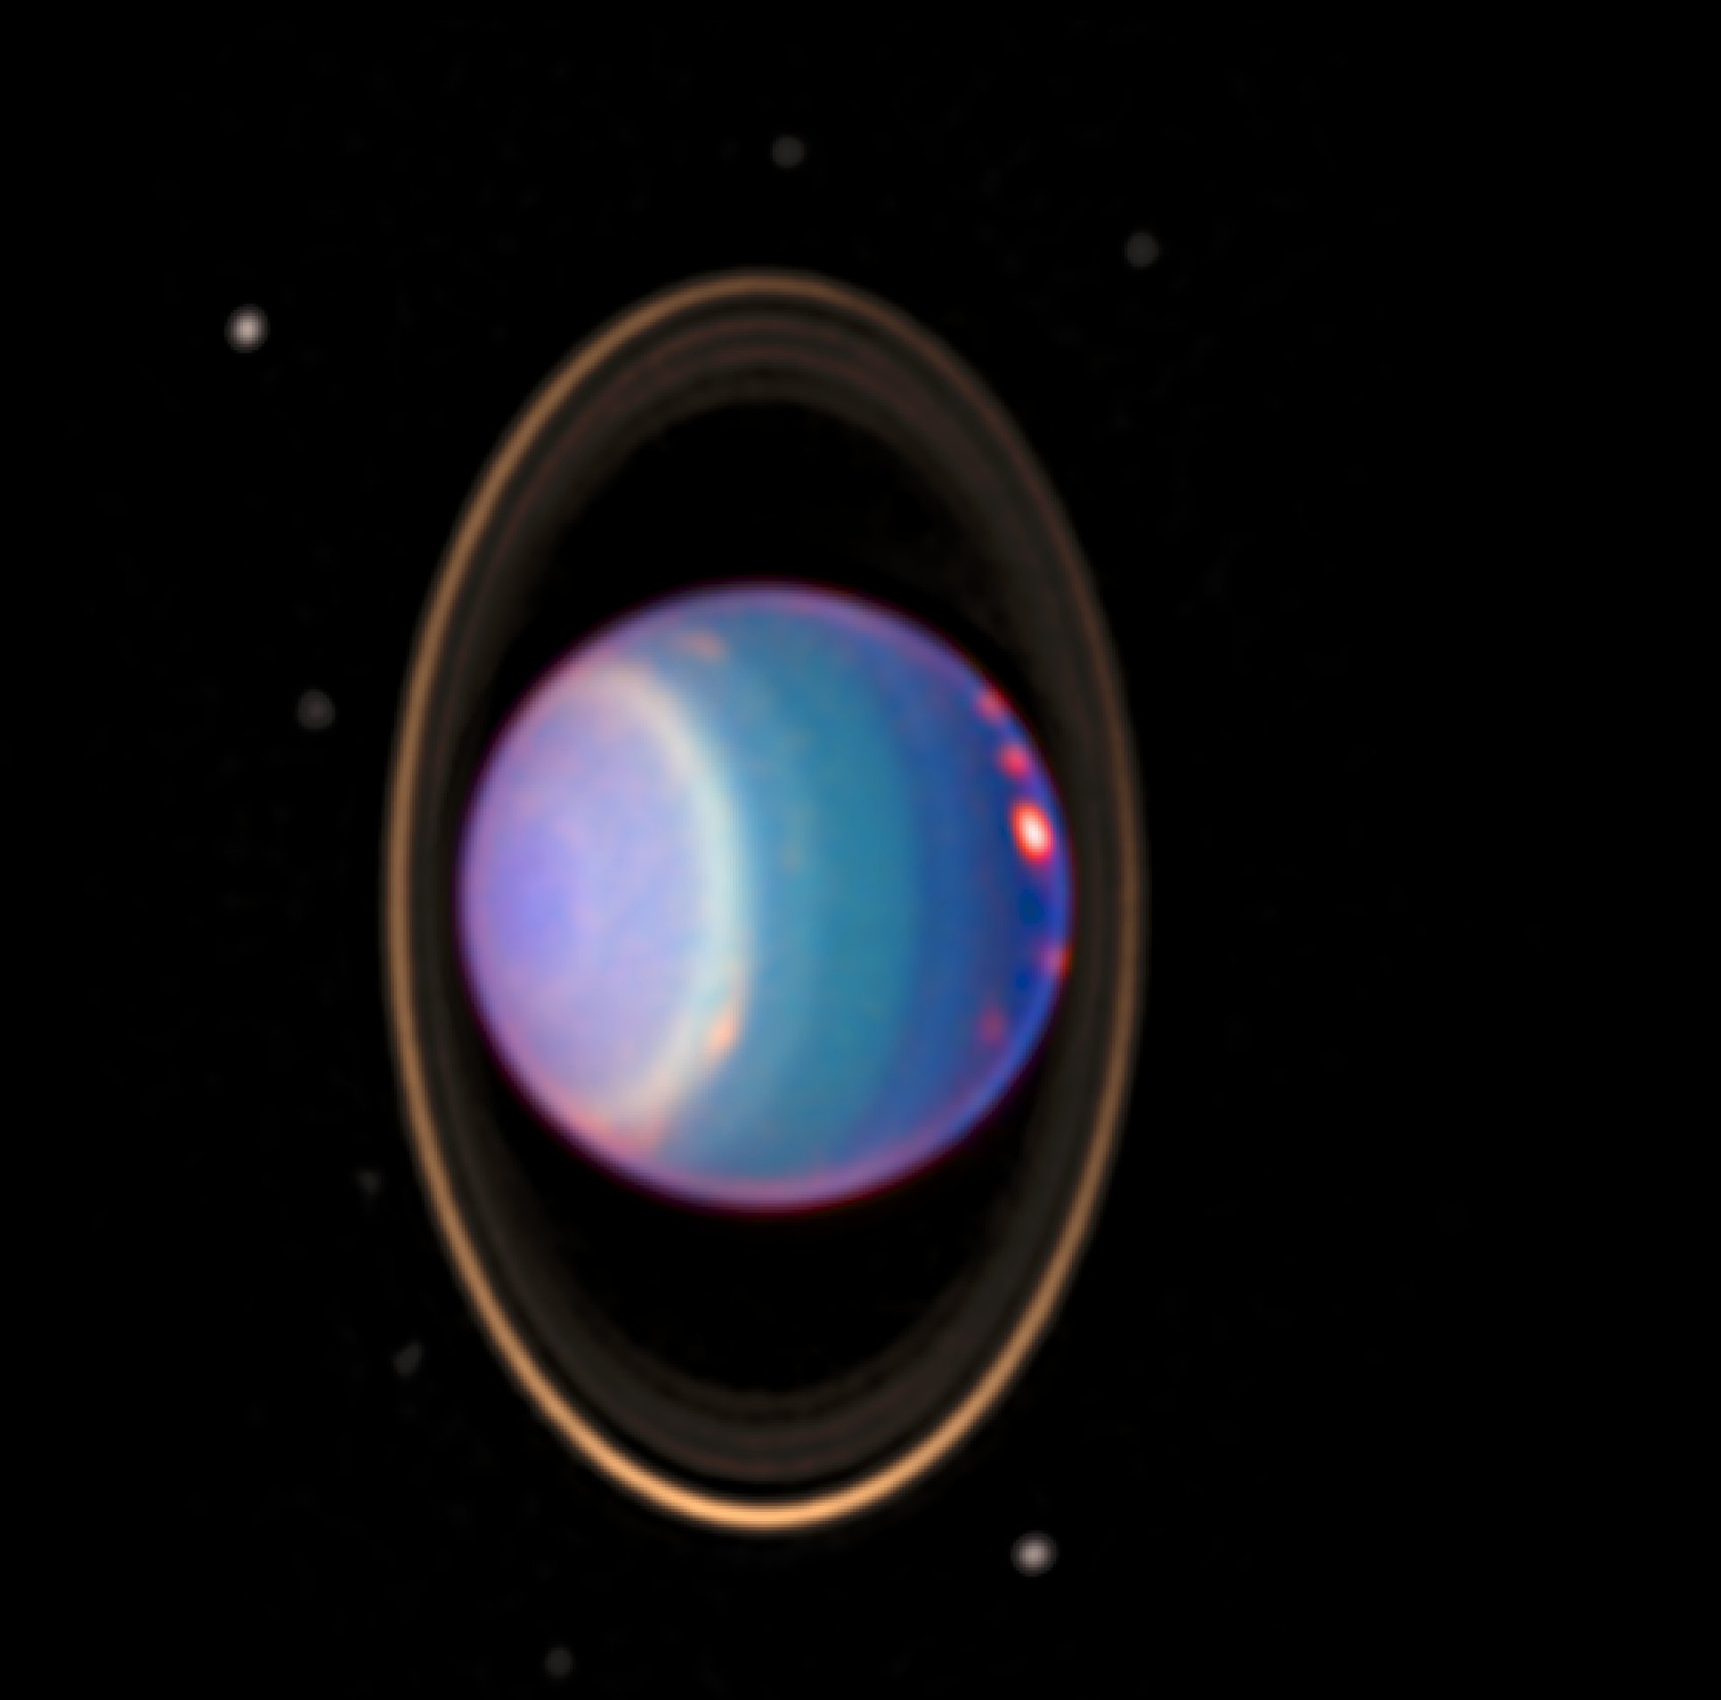
Uranus
But in the IR, we do see storms and bands!

Slide 10
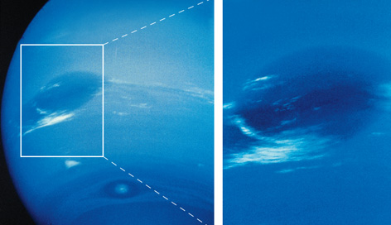
Neptune
Interestingly, the Great Dark Spot has disappeared!
Notes:
Neptune’s winds go the wrong way around – opposite its rotation!
They’re also really fast, at 2,000km/h!
Neptune also emits more light than it receives… we don’t know why, as it does not appear to be contracting still. Maybe the methane insulates it?

Slide 11
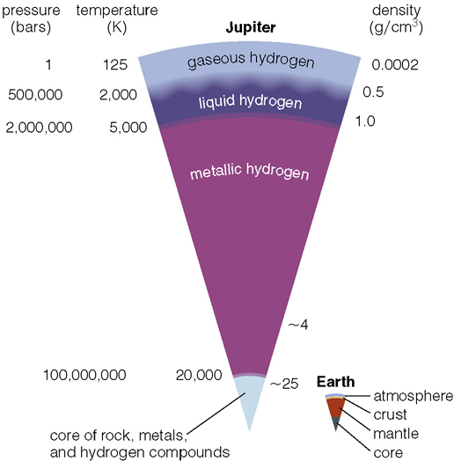
Jupiter’s Interior
No real ‘surface’
Gaseous atmosphere
Liquid and metallic hydrogen interior
Earth sized core
Notes:
Temperature, density, and pressure all increase with depth
Jupiter’s core is slightly larger than the Earth, but 10 times as massive and 5 times as dense due to the intense pressure from the material stacked on top of it
Metallic Hydrogen
Hydrogen molecules share the same electrons

Slide 12
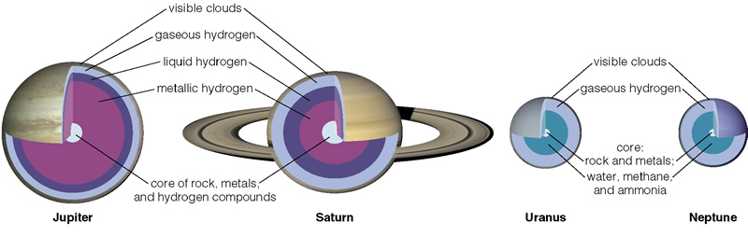
Other Interiors
Jupiter and Saturn are very similar
Uranus and Neptune are similar
Notes:
The cores of all Jovian planets appear roughly the same
Composition: rock, metal, hydrogen compounds
Small rocky cores were probably the seeds of accretion (~10 times as massive as Earth)
Uranus and Neptune captured less matter from the solar nebula than Jupiter and Saturn
Accretion of planetesimals took longer
Had less time before material was cleared out by the solar wind
Only Jupiter and Saturn have metallic hydrogen
Jupiter, Saturn, and Neptune emit more light than they receive from the sun: Jupiter is still contracting; Saturn is still differentiating (see next slide); not sure what’s going on with Neptune and Uranus.

Slide 13

Other Interiors
Saturn is different in that it:
Has thicker clouds
Has a thicker liquid hydrogen layer
Has a smaller metallic hydrogen layer
Has a larger core (but not more massive)
because it has less gravity
Saturn also has hydrogen “rain” → still differentiating
Notes:
Jupiter, Saturn, and Neptune emit more light than they receive from the sun.
Jupiter is still contracting; Saturn is still differentiating (see next slide); not sure what’s going on with Neptune and Uranus.

Slide 14
Other Interiors
Uranus and Neptune
No liquid hydrogen
Differentiated cores
Much smaller than Jupiter & Saturn
Why? Slower accretion → captures less H
Cores about the same size as Jupiter & Saturn
Notes:
The cores of all Jovian planets appear roughly the same
Composition: rock, metal, hydrogen compounds
Small rocky cores were probably the seeds of accretion (~10 times as massive as Earth)
Uranus and Neptune captured less matter from the solar nebula than Jupiter and Saturn
Accretion of planetesimals took longer
Had less time before material was cleared out by the solar wind
Only Jupiter and Saturn have metallic hydrogen
Jupiter, Saturn, and Neptune emit more light than they receive from the sun.

Slide 15
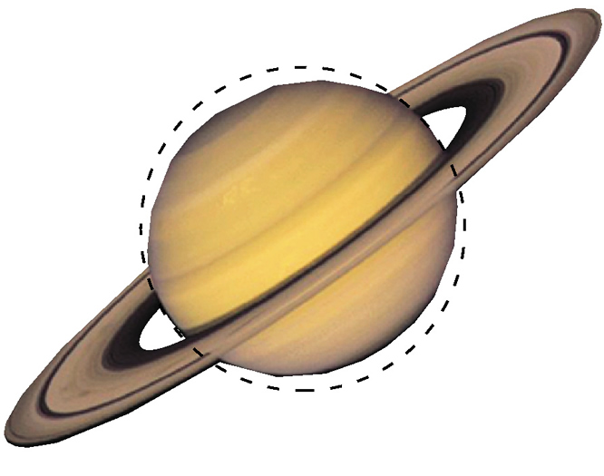
Rotation
Jupiter: 9h 50m Uranus: 16h 34m Saturn: 10h 19m Neptune: 17h 17m
High rotation rates cause them to be oblate
Notes:
Just like pre-solar nebula spin into a disk… rapidly rotating planets spin (slightly) into a disk
Jupiter completes one rotation in 9.8 hours. Saturn 10.23 hours

Slide 16
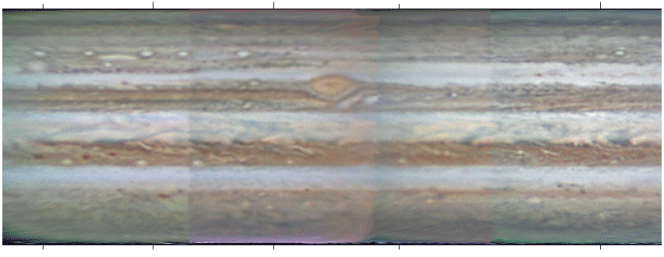
Rotation
Differential Rotation
Means different parts rotate slower/faster
Notes:
Jupiter has some pretty fast winds

Slide 17
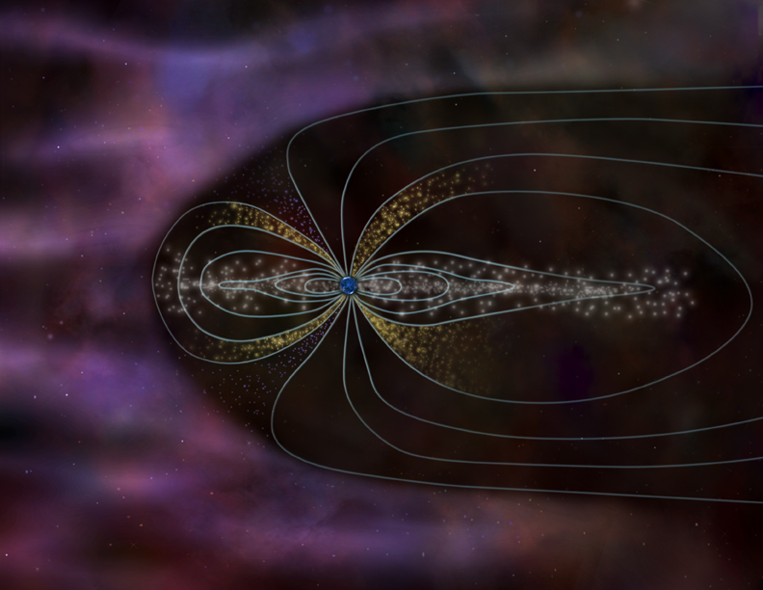
Jupiter’s Magnetic Field
Magnetic Fields
Notes:
Plasma sheet in the plane of Jupiter’s orbit, due to ions that are trapped by the magnetic field. Io (and Europa a little) put out atoms into the Jovian environment. Neutral ones get trapped in a torus around the moon; ions often make it to Jupiter causing the aurora.
Jupiter’s magnetic field is VERY strong, due to the spinning metallic hydrogen at its center.

Slide 18
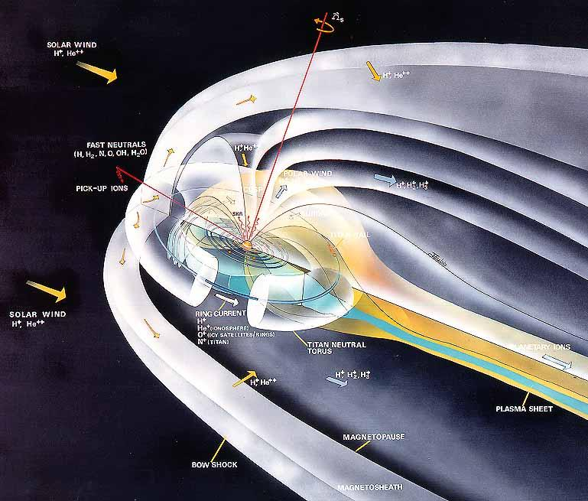
Saturn’s Magnetic Field
Notes:
Saturn’s magnetic field is similar to Jupiter’s. There is a neutral torus around Titan, a plasma sheet, etc.
It was expected that a large amount of neutral Nitrogen would escape from Titan’s atmosphere; we don’t see that though. So is less Nitrogen escaping than expected, or is it somehow being removed? We don’t know yet, but we’re trying to find out!
Uranus and Neptune have smaller magnetic fields.

Slide 19
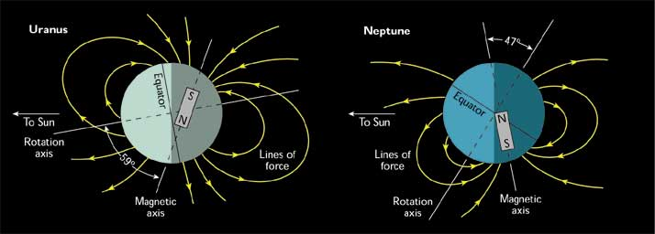
Uranus & Neptune
Notes:
Uranus and Neptune have weird magnetic fields. Neither are aligned with the spin axis. With Uranus, the extreme tilt and strange seasons likely come into play. Neither of the magnetic field axes pass through the center of the planet. Since there is not a metallic hydrogen core, the process of generating the magnetic fields is poorly understood; it’s entirely possible that it’s generated at higher altitudes, such as in the water-ammonia ocean at the center.

Slide 20
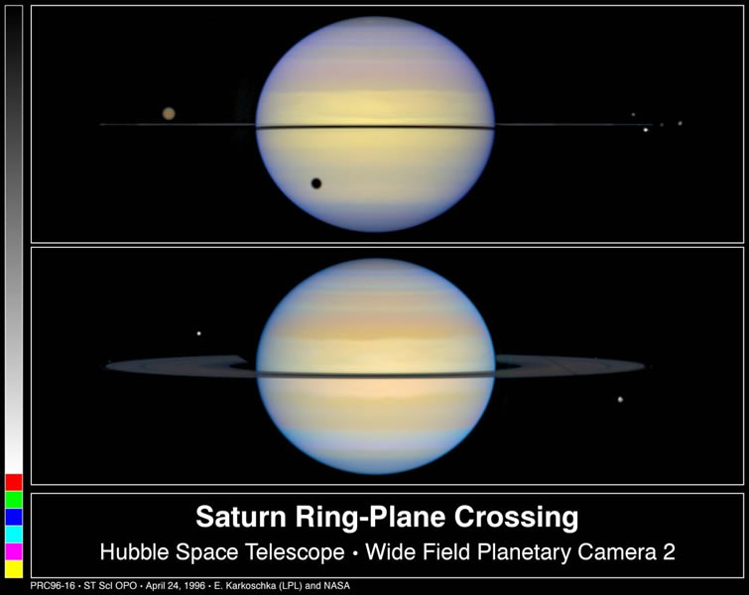
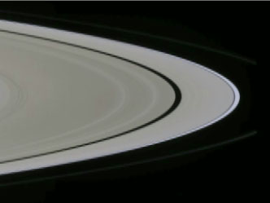
Saturn’s Rings
Saturn’s rings are made of small particles
From large rocks to grains of dust
Notes:
Easily visible through a telescope
Consist of many small particles
From large rocks to tiny dust grains
Mostly made of water ice
The brighter rings consist of more material, so they reflect more light. Darker rings have less material
Very thin due to constant collisions
A few meters thick, 270,000 km in dia.
Invisible when viewed edge on
Your book notes that the rings are pretty young and so must be replentished. In fact, we DO see moons being ground apart, and even reforming, in the rings.

Slide 21
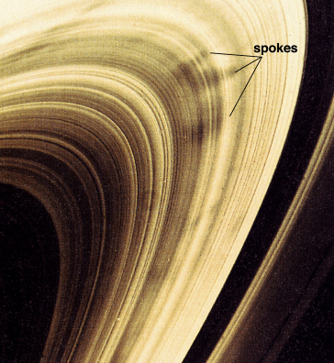
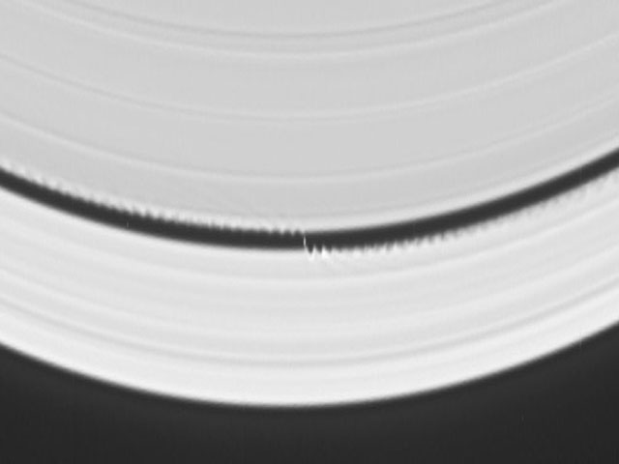
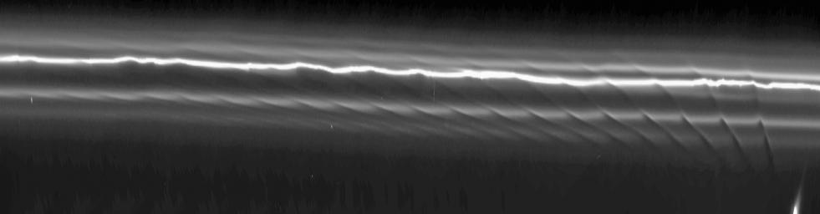
Saturn’s Rings
Notes:
Aside from the rings, we see gaps and ripples
Gravitational interaction with moons inside the rings push particles into specific orbits
clear gaps
Interaction with larger, distant moons can clear gaps and form ripples.
Dark patches called ‘spokes’ appear and disappear but origin is unknown
Perhaps they might be particles of dust drawn out by Saturn’s magnetic field
Origin of rings is probably a moon destroyed by tidal forces

Slide 22
Clicker: Planetary Atmospheres
Jovian planets have HUGE hydrogen atmospheres because
A. they have massive cores and are cold
B. they have massive cores and are warm
C. they have no cores and are cold
D. they have no cores and are warm
Notes:
A
It’s cold where Jupiter forms. And, the jovian cores are BIG.
So, hydrogen isn’t moving very fast. It doesn’t exceed the escape velocity.

Slide 23
Clicker: Planetary Atmospheres
Terrestrial planets have no hydrogen in their atmospheres because
A. Hydrogen is light and terrestrial planets are warm.
B. The Sun blows the hydrogen away.
C. There was very little hydrogen in the disk when the Earth formed.
D. All of the hydrogen got fused inside the Sun.
Notes:
A.
It’s too warm here, and terrestrial planets aren’t very massive.
So, hydrogen exceeds the escape velocity.

Slide 24
Clicker: Jovian Interiors
Jupiter and the other jovian planets are sometimes called "gas giants." In what sense is this term misleading?
A. They are not in any sense "giants."
B. They actually contain relatively little material in a gaseous state.
C. The materials they are made of are not the kinds of thing we usually think of as gases.
D. Actually, it's a great description, because these worlds are big and gaseous throughout.
Notes:
A.
It’s too warm here, and terrestrial planets aren’t very massive.
So, hydrogen exceeds the escape velocity.

Slide 25
Clicker: Jovian Interiors
Uranus and Neptune are smaller than Jupiter and Saturn because:
A. Colder gas has less gravity and could not form such large balls
B. The size differences are random coincidence.
C. Particles were more spread out so accretion took longer & couldn’t form before the solar wind started
D. Only rock and metal could condense at the distances of Uranus and Neptune.
Notes:
A.
It’s too warm here, and terrestrial planets aren’t very massive.
So, hydrogen exceeds the escape velocity.

Slide 26
Clicker: Planetary Atmospheres
Mercury’s atmosphere is likely extremely thin because
A. of its large mass
B. of its slow rotation
C. it’s very close to the sun
D. of large impacts in the past
Notes:
C.
HOT!

Slide 27
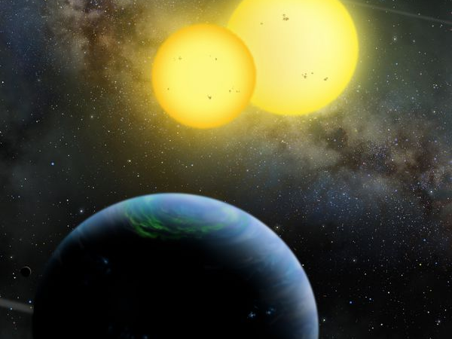
Exoplanets
One of NASA’s goals is to investigate the possibility of life on other worlds
The question is… will it be obvious?
Notes:
What are the things that life needs to exist?
Are each of these necessary, or can we get around them somehow?
If we want to find life, where should we look?

Slide 28
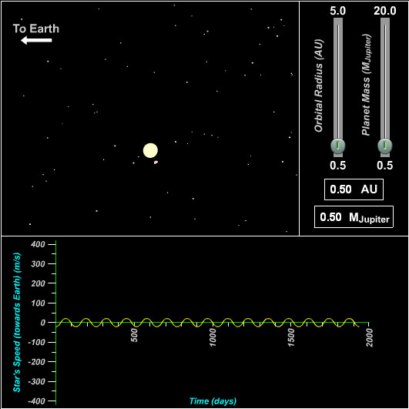
Detecting Exoplanets
Exoplanets are planets that orbit a star that is not the Sun
Methods of detecting:
Stellar “wobble” (astrometry)*
Direct detection*
Doppler shift
Transits
Notes:
Mostly, we can only see the effect that they have on their parent stars.
Really big planets (Like the size of Jupiter) can cause a significant wobble in the star… but this can be hard because it’s best if they are far from their star, which makes the wobble take a long time. Best for nearby stars, and only works in rare cases. The GAIA mission that the European Space Agency (ESA) is running is currently working on doing this accurately.

Slide 29
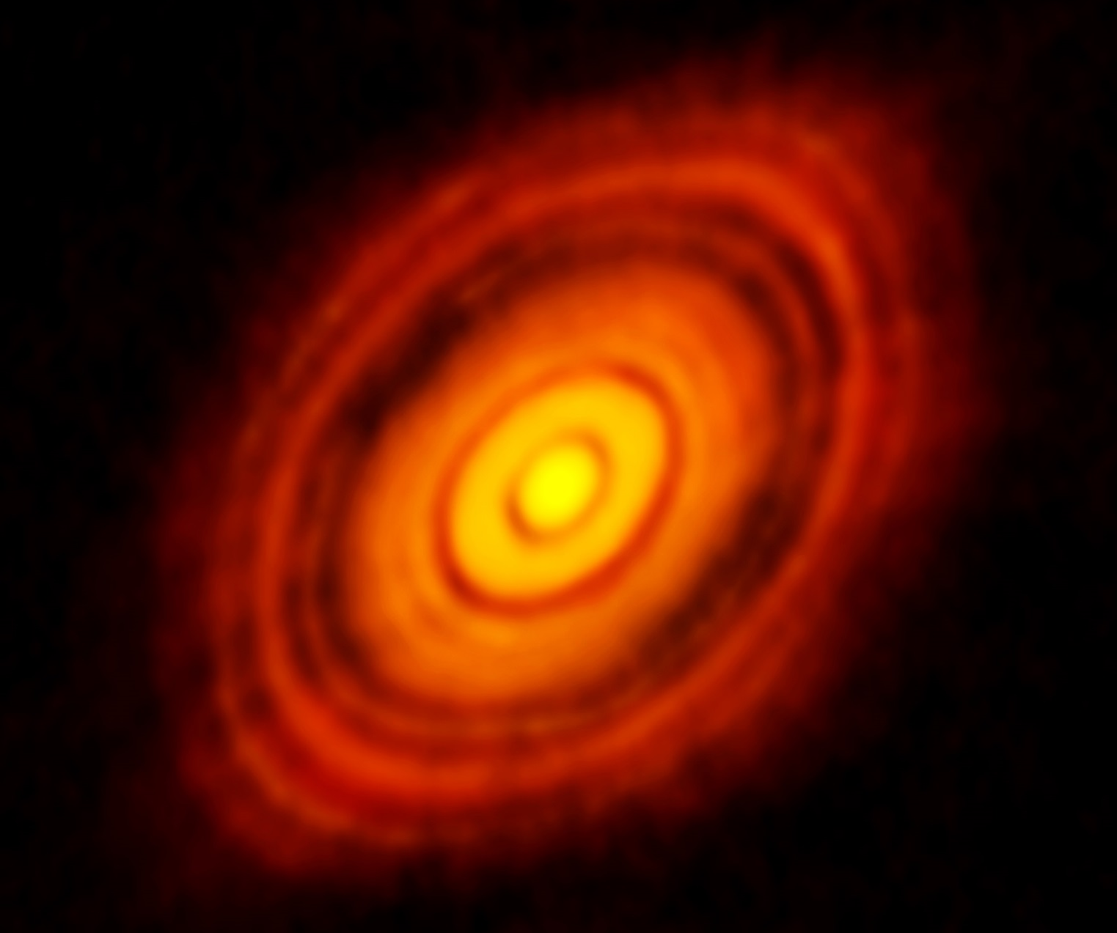
Direct Detection
Only a few found… but maybe more soon!
Notes:
It’s VERY HARD to detect extra solar planets directly. Rare cases only….
As the Alma telescope comes online this will become easier – but most likely will focus on the planetary systems already detected. This is a protoplanetary disk, one of the first ones imaged! Look at those gaps! Just like we predicted!

Slide 30
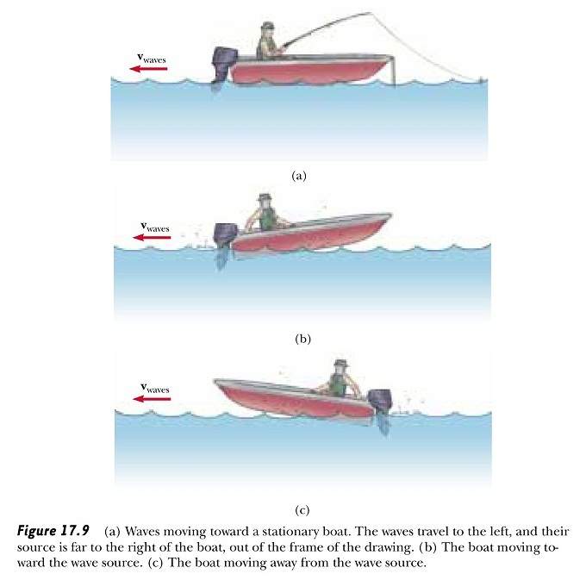
Light: Doppler shift
Notes:
30
We can detect that wobble through the Doppler Effect.
The absorption lines in the star shift back and forth as the star wobbles first away from us and then towards us.
So let’s talk about Doppler shift (we will need it for other things as well).
If you think about waves on a lake, the water waves move at a constant rate
When you move TOWARDS the waves, the frequency with which you get hit in the head INCREASES
When you move AWAY from the waves, the frequency with which you get hit in the head DECREASES
Another analogy:
A baseball machine shoots baseballs at a constant rate…
When you run TOWARDS the machine, the frequency with which you get hit in the head INCREASES
When you run AWAY from the machine, the frequency with which you get hit in the head DECREASES
It doesn’t matter if it’s the machine moving (the thing generating the waves) or if you’re moving; it’s the RELATIVE velocity that matters.

Slide 31
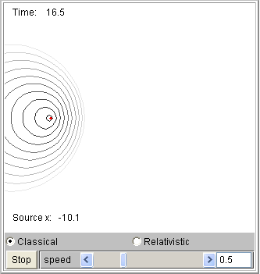
Light: Doppler shift
Notes:
31
Notice in this example the people are stationary and the wave source is moving, as opposed to the boat/baseball examples.
Either one could be the case, the end result is the same.
(In fact, Newton says that you can’t really tell which is moving unless one is accelerating. If velocities are constant than each one can claim it is stationary and the other is moving.)
http://www.fisica.uniud.it/~deangeli/applets/Multimedia/Waves_java/Doppler/doppler.htm

Slide 32
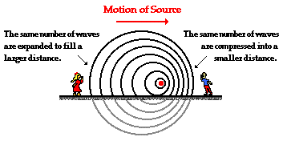
Light: Doppler shift
Notes:
32
The person on the left sees a longer wavelength (redder light)
The person on the right sees a shorter wavelength (bluer light)
Redder/bluer are relative to the source’s emitted light (the source sees itself at rest/not in motion so emits like it were stationary).
Image from The Physics Classroom: http://www.physicsclassroom.com/class/sound/Lesson-3/The-Doppler-Effect-and-Shock-Waves

Slide 33
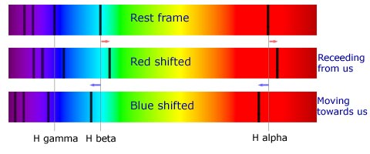
Light: Doppler shift
Notes:
33
In terms of spectra, this is what we see.
Image from http://www.atnf.csiro.au/outreach/education/senior/astrophysics/spectra_info.html

Slide 34
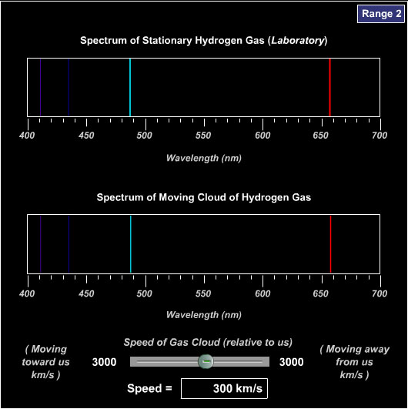
Measuring Velocity
If we know the REST wavelength of an emission line…
Notes:
34
if we know the REST (not moving toward or away from us) wavelength we can calculate the VELOCITY…
file:///U:/Astro/Powerpoints/CP_InteractiveFigs/IF_5.22_doppler_shift_emission_line.html
file:///U:/Astro/Powerpoints/CP_InteractiveFigs/IF_5.23_star_motion_doppler_effect.html

Slide 35
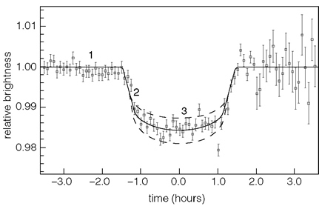
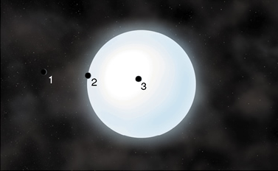
Detecting Exoplanets
Transits can be detected by the light curve
The transiting planet blocks some of the starlight
Notes:
We can also, if we are very lucky and happen to see a planetary system aligned juuuust right, see the starlight dim slightly as the planet passes in front of it.
This method favors big planets close to the star.
Show: file:///U:/Astro/Powerpoints/CP_InteractiveFigs/IF_13.5_planetary_transits.html

Slide 36
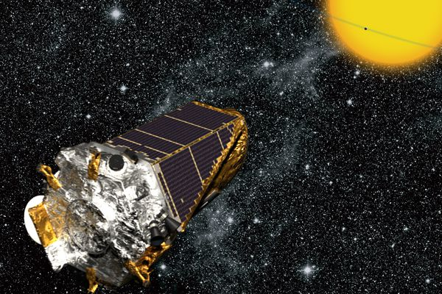
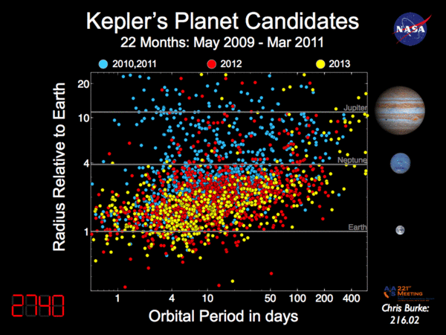
Detecting Exoplanets
Kepler Space Telescope
Confirmed: 1030
Candidates: 4696
Notes:
These are only the ones that have more than one transit seen, and only from Kepler data. There are others detected as well (not just with Kepler) as well.

Slide 37
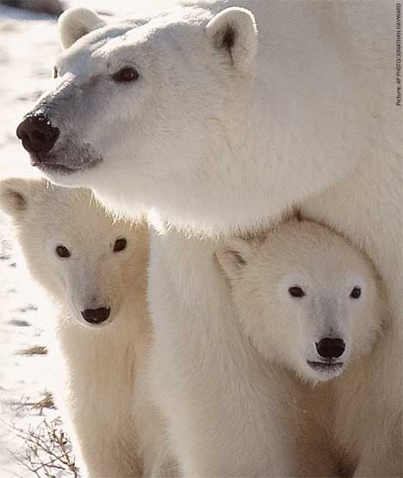
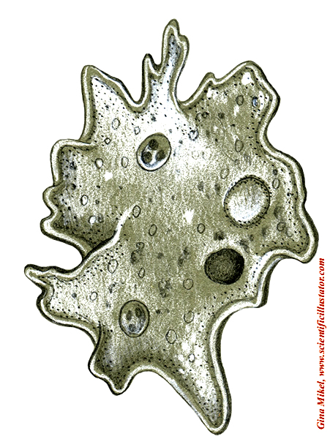
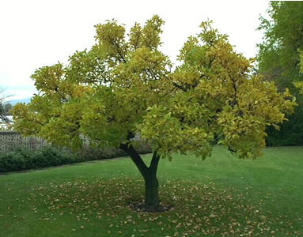
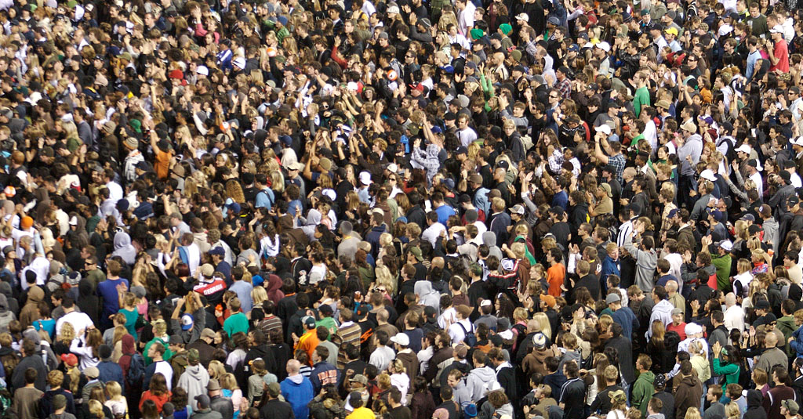
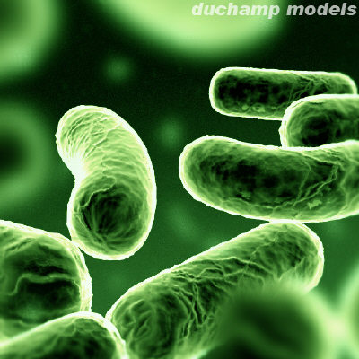
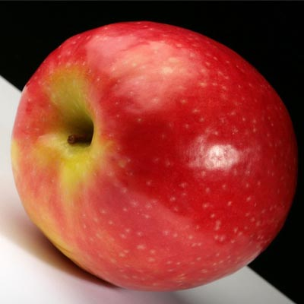
Life…

Slide 38
Lab: Extra-Terrestrial Life
One of NASA’s goals is to investigate the possibility of life on other worlds
The question is… will it be obvious?
Notes:
What are the things that life needs to exist?
Are each of these necessary, or can we get around them somehow?
If we want to find life, where should we look?

