Slide 1
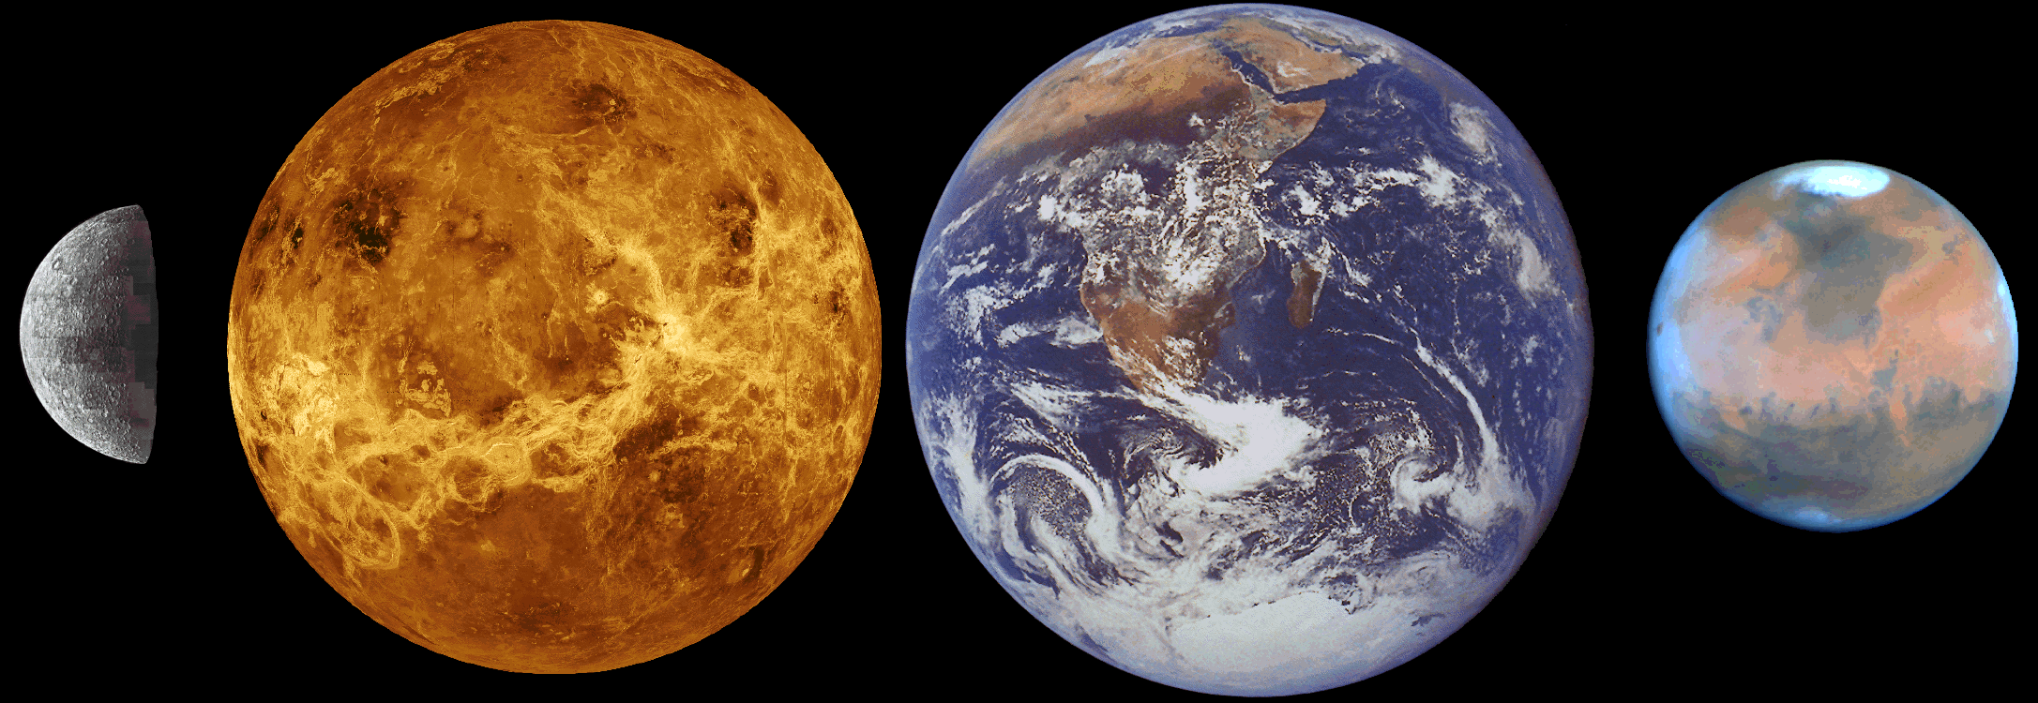
Comparative Planetology
The study of the solar system by examining and understanding the similarities and differences among worlds
Notes:
We’ll start with the terrestrial planets

Slide 2
Comparative Planetology
Interiors
Magnetic fields
Geologic activity & processes
Surfaces
Atmospheres
Notes:
These are the things we need to look at to understand how (terrestrial) planets form. We’ll start with the Earth, and compare from there.

Slide 3
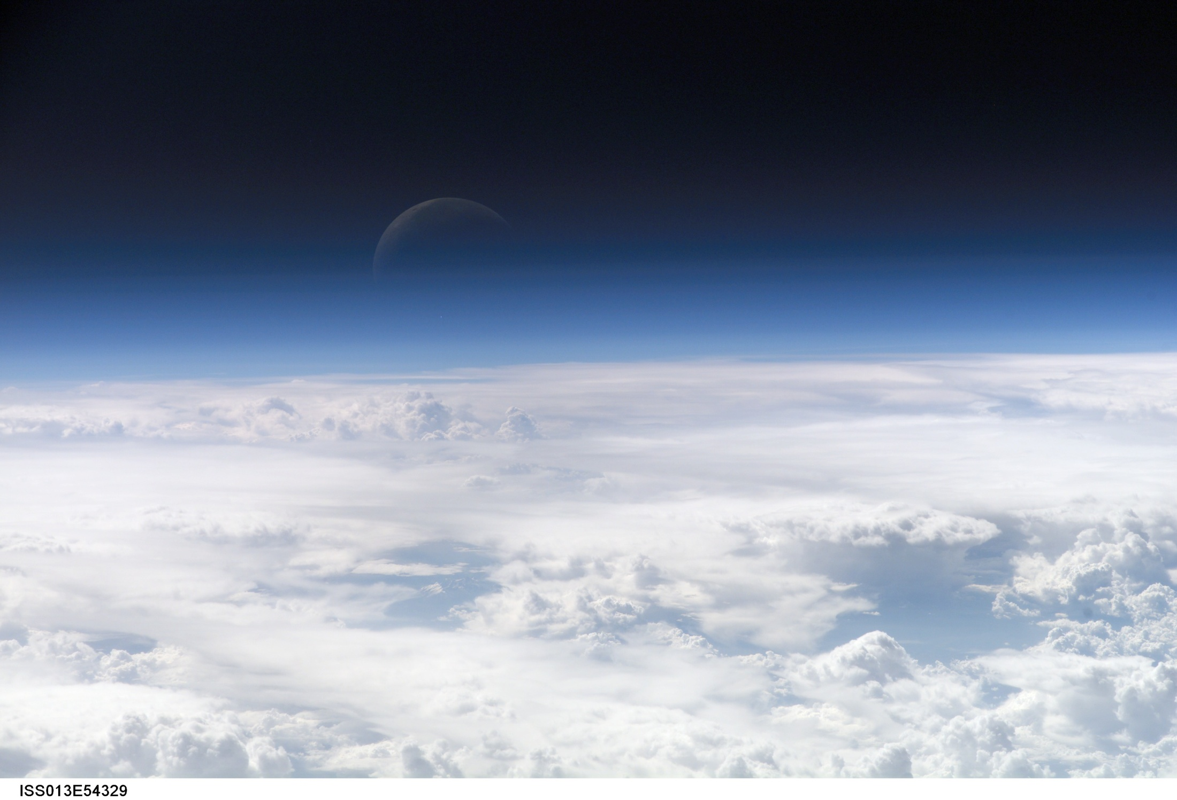
Atmospheres
Notes:
A picture of the moon through Earth’s atmosphere (from the shuttle)

Slide 4
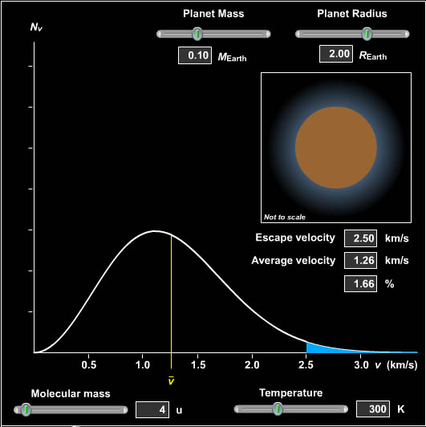
Holding an Atmosphere
Depends on:
Temperature
Molecular mass
Planetary mass
Planetary radius
Notes:
Mercury is small and hot. It can’t hold an atmosphere
Venus has a LOT of carbon dioxide.
Earth has a nitrogen/oxygen atmosphere
Mars has a very thin carbon dioxide atmosphere

Slide 5
Atmospheric pressure
Pressure: Force per unit area
Atmospheric pressure holds the atmosphere up against the force of gravity
Collisions between atoms and molecules create pressure
Notes:
Air has mass.
Massive things in a gravitational field have weight, so the air presses down on us with some amount of force.
Something must be holding it up, or it would all collapse. That something is Pressure.
Pressure comes from the molecules in the air knocking into each other.
If I cool a balloon down, the internal pressure decreases and the balloon deflates.
The atmospheric pressure decreases with increasing altitude.

Slide 6
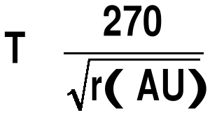
Planetary Temperature
Without an atmosphere:
250
≈
Planets must be in thermal balance
Energy In
=
Energy Out
Notes:
Incident solar radiation is absorbed (some is reflected)
The planet gets warm.
Hot Dense Objects emit radiation. They emit radiation like a … Say it!
Total incoming radiation must equal total outgoing radiation. Hotter objects emit more than cold objects.
The blackbody curve of terrestrial planets peaks in the infrared.
Earth should be about -1 degree Fahrenheit
But it’s not because…

Slide 7
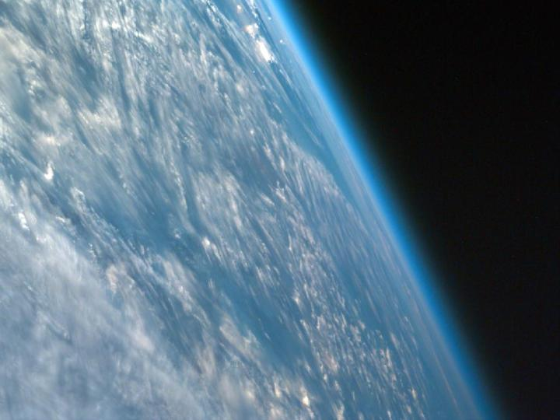
Earth Temperature
Without an atmosphere:
250
≈
250K (-23°C or -10°F)
With our atmosphere: 287K (14°C or 57°F)
Notes:
This is the temperature at the surface! In general it gets cooler as you go to higher altitudes.

Slide 8
Earth Atmosphere
78% N₂
20% O₂
1% H₂O
(and some other stuff)

Slide 9
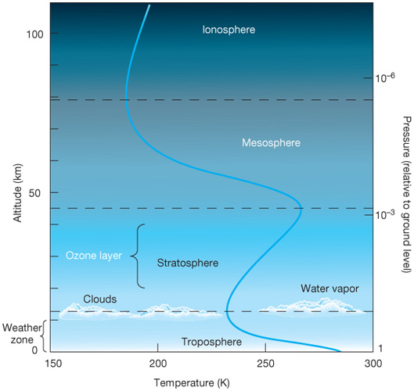
Atmospheric Temperature
Notes:
Troposphere: convection occurs here. Ground is heated and in turn heats the atmosphere right above it. Temperature cools as you go upwards.
Stratosphere: ozone layer lies here; in this layer we’re absorbing high energy radiation, and more of it is absorbed at the top than the bottom so that at the top it’s hotter than at the bottom.
Mesosphere: Here again we have cooling, but the air is too thin for convection to be important
Ionosphere: This is where the air is very thin. Again the temperature rises (slightly) as you go higher in altitude, in part just because things aren’t held all that well by gravity, and in part because of the high energy radiation hitting the molecules.

Slide 10
Greenhouse Effect
Lecture Tutorial (p. 105)
The greenhouse effect keeps a planet warm
Notes:
Visible light passes through the atmosphere warming the planet.
The planet emits primarily in the infrared.
Greenhouse gasses absorb infrared radiation which contributes to their kinetic energy, and therefore the temperature.
Since the atmosphere causes the planet to radiate less efficiently, the planet has to get hotter to stay in thermal balance.
The Greenhouse effect on Venus is whacky out of control. The surface temperature is nearly 900 degrees fahrenheit.
LECTURE TUTORIAL p. 105
We will talk more in depth about this later.

Slide 11
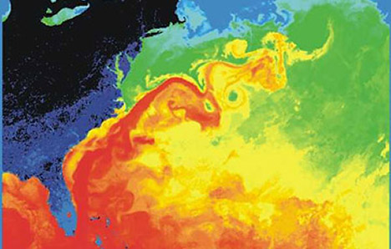
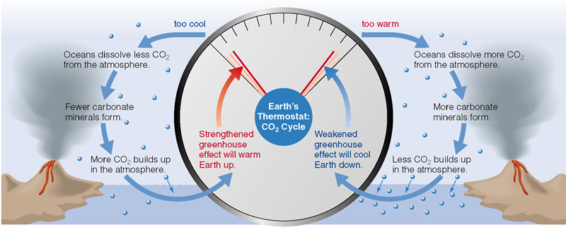
Atmosphere and Ocean
Only on the Earth!
Oceans and Atmosphere are closely linked
CO₂ Cycle
Notes:
We will come back to this on Friday.
Even without organic matter or life: CO2 -> dissolved in ocean. Silicates also in ocean. CO2 + silicates -> carbonates (e.g. limestone). These are then subducted taking CO2 out of the way. Temp – if hot more CO2 gets dissolved and taken out. If cold, it builds up in the atmosphere, therefore self-regulating.

Slide 12
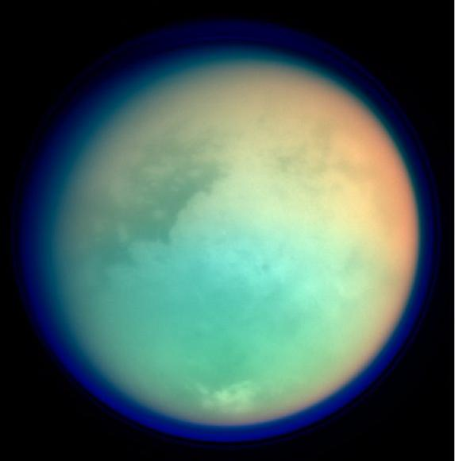
Other Atmospheres

Slide 13
Atmospheric Structure
Notes:
On the left is the diagram we saw earlier of Earth’s atmospheric structure. Notice how much it wiggles back and forth (decreasing temperature, then increasing, then decreasing then increasing again.)
On the right is a comparison with the other two terrestrial planets that have atmospheres. Notice all are warmer at the surface than what their temperatures would be without the greenhouse effect. **How come Venus is cooler than Earth (without greenhouse effect)?**

Slide 14
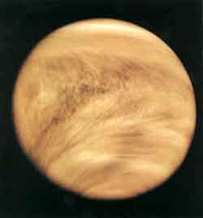
Venus
Completely cloud shrouded
Surface atmospheric pressure 100 times Earth’s
Surface temp:
735K (462ºC)
Notes:
Radius: .95 R_{earth}
T~300K without an atmosphere but with it’s atmosphere it’s much hotter!

Slide 15
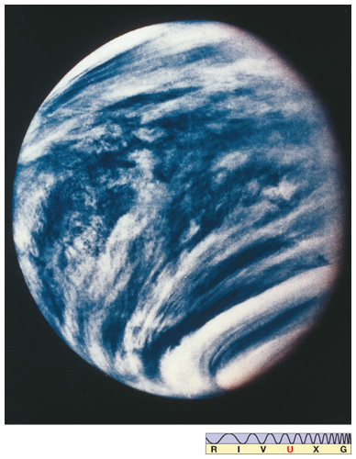
Venus
So what’s the atmosphere like?
High winds at high altitudes (~400km/h)
Hazy below that
Clear and calm near the surface
Notes:
This photo is in Ultraviolet light which shows the contrasts better.

Slide 16
Venus
So what’s the atmosphere like?
The atmosphere is mostly (96.5%) CO2
Even the clouds aren’t water – they’re H2SO4
Notes:
This photo is in Ultraviolet light which shows the contrasts better. H₂SO₄ is sulfuric acid.

Slide 17
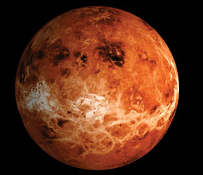
Venus
What happened??
Why does Venus’ atmosphere have such a bizarre composition?
Runaway Greenhouse Effect!
Venus is closer to Sun
Venus has volcanic activity
H2O and CO2 → warmer
H2O evaporates → WARMER!
Notes:
This photo is radar imaging of the surface of Venus.
**What’s different about Venus, compared to Earth, at the beginning of the solar system?**
Remember which gas is the most effective greenhouse gas! Water! Without any atmosphere, Venus is at about 294K… so a lot more water stays in the atmosphere.

Slide 18
Venus
Runaway Greenhouse Effect!
Once all the water is in the atmosphere, it won’t rain out anymore.
H2O at the top of the atmosphere is destroyed by UV light and the H escapes into space – meaning no more water, ever!
Notes:
This photo is radar imaging of the surface of Venus.
Once you don’t have the any possibility for a CO₂ cycle (need oceans), any volcanic activity is just going to make more and more CO₂ in the atmosphere, and it’ll never come out again.

Slide 19
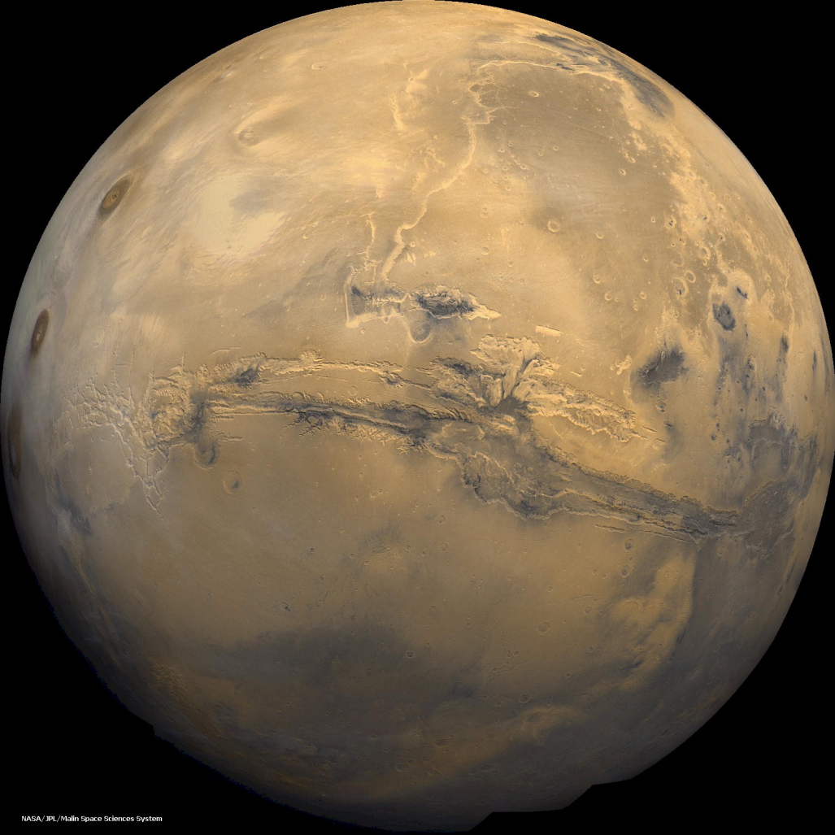
Mars
Extremely thin atmosphere
Surface pressure
.006 times Earth
Surface Temperature about 70K cooler than Earth
Notes:
Mars’ climate varies a lot, depending on the season and the orbit. Unlike most planets, Mars’ orbit has enough eccentricity to matter a little.
Temperature should be about 203K (-70C)

Slide 20
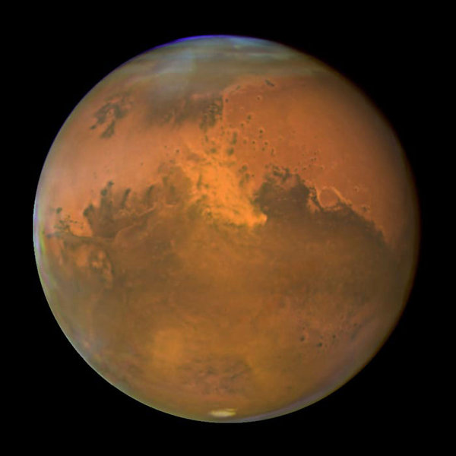
Mars
What’s it made of?
95% CO2…
3% Nitrogen
(hmm, a trend?)
Why so thin?
Surface gravity = 0.376g
Notes:
Even though Mars is somewhat colder than the Earth (due to being farther away), it is not cold enough to make a difference for holding onto that atmosphere. Mars’ gravity is small enough that it has a hard time holding onto its atmosphere.
Where’s the water? Did it escape through dissociation (like Venus)? The UV radiation would be less out this far, but the lack of magnetic field means the atmosphere is bombarded more by particles… a lot of the oxygen is locked up in rusting the surface rocks. On the other hand… we do see evidence of water, just not in the atmosphere.

Slide 21
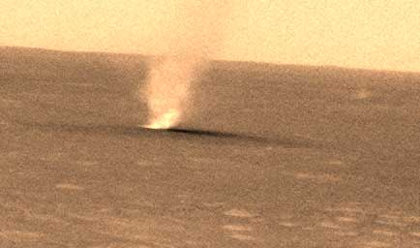
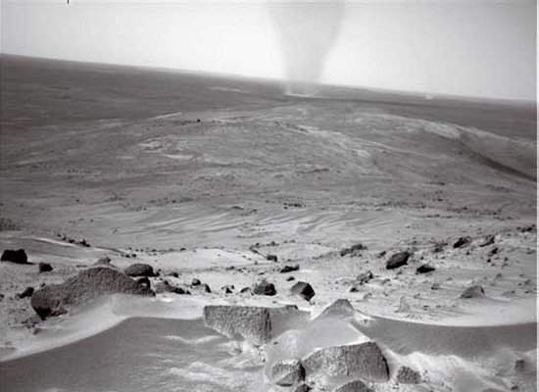
Mars
Despite that, there are some neat things:
Dust devils
Differential Heating
Circulation is very different from Earth’s
Notes:
(Board work for the circulation and heating)

Slide 22
Comparative Planetology
Interiors
Magnetic fields
Geologic activity & processes
Surfaces
Atmospheres
Notes:
These are the things we need to look at to understand how (terrestrial) planets form. We’ll start with the Earth, and compare from there.

Slide 23
Comparison
Property | Mercury | Venus | Earth | Mars
Atmosphere | Minimal temporary H & He | Dense 96% CO₂ Hot H₂SO₄ | Medium density N (77%) O (23%) | Thin 95% CO₂ Some water ice clouds
Interior | Large dense core | Molten core | Molten core | (Mostly) solid core
Geologic activity | None currently (some in the past) | Volcanic No Erosion No plate tectonics | Volcanoes earthquakes Plate tectonics | Volcanic in the past Huge tectonic stresses Erosion
Surfaces | Lots of craters | Few craters | Few craters | Some cratered, some newer
Magnetic field | Surprisingly strong! | None | Strong | Remnant
Notes:
Remember: Our oxygen is only because we have life on this planet!! Plant life, specifically.
Similarly there wouldn’t be Sulfuric Acid on Venus if there weren’t current volcanic activity.

Slide 24
The Earth
The Earth is different in that it:
Has an atmosphere with lots of water
(and oxygen, due to life)
Has oceans
Has plate tectonics
Has a strong magnetic field
Has a large moon compared to its size
Notes:
These are the ways that the Earth is different from the other terrestrial planets. We will see next week how the Earth is similar, and what some of the differences between the other terrestrial planets are. Note that there are more differences with the Earth’s atmosphere as well, such as atmospheric structure and composition – but we’ll get to that next week.

Slide 25
Comparative Planetology
The study of the solar system by examining and understanding the similarities and differences among worlds
Notes:
We could just talk about planets (and one moon with an atmosphere), but there are other objects in the solar system which also undergo some of these processes as well. How do they compare?

Slide 26
Moons of Jovian Planets
Larger moons likely formed like terrestrial planets
Smaller moons could be captured asteroids or comets

Slide 27
Moons of Jovian Planets
Given what you know about solar system & planetary formation, what would you expect the Galilean moons, and Titan to be like?

Slide 28
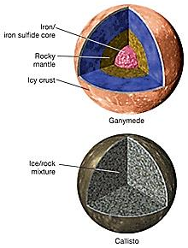
Galilean Moons (Jupiter)
Interiors:
Iron/iron sulfide core
Rocky mantle
Water/icy crusts (2)

Slide 29
Galilean Moons (Jupiter)
Exceptions:
Io: No water, possibly almost completely molten
Callisto: “uniform” ice/rock mixture

Slide 30
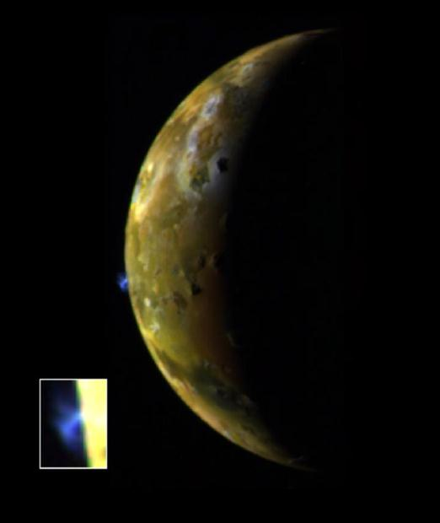
Io (Jupiter)
Volcanically active!!

Slide 31
Io (Jupiter)
Volcanically active: why?
Tidal forces with Jupiter
Resonances with the other moons, especially Europa tugs it back and forth
This tugging causes Io to have lots of heating due to tides

Slide 32
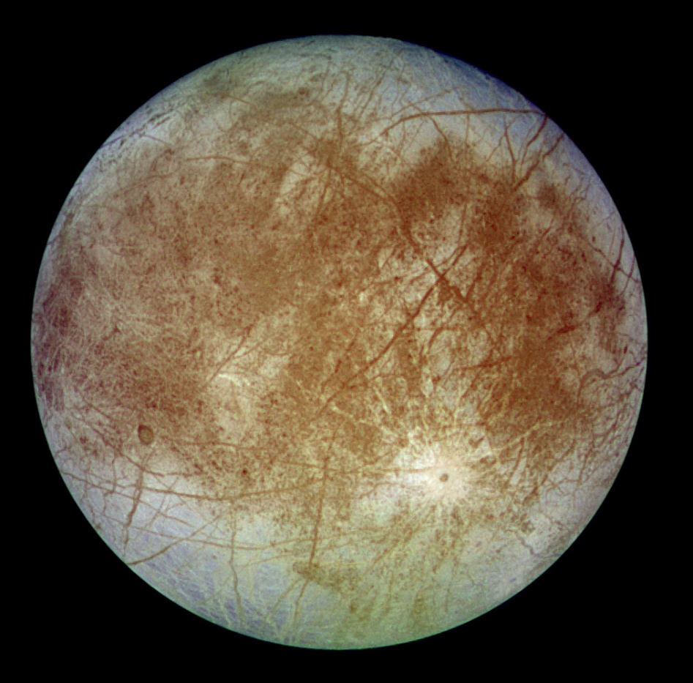
Europa (Jupiter)
Icy crust and evidence of plate tectonics
Notes:
Metallic core, rocky mantle, and a crust made of H₂O ice
Its fractured surface indicates plate tectonics
few impact craters seen
double-ridged cracks
jumbled icebergs
These provide photographic evidence of a subsurface ocean
Europa has a magnetic field
Implies liquid salt water beneath the icy crust
Where liquid water exists, there could be life!
Again, tidal heating!

Slide 33
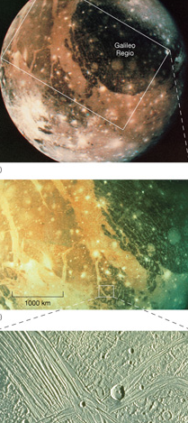
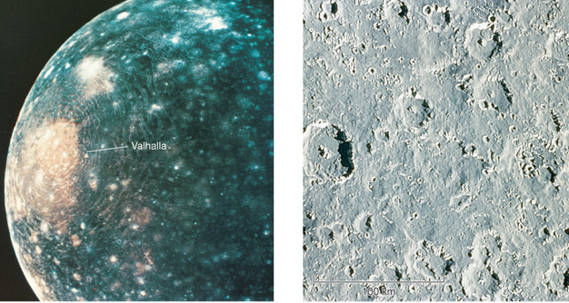
Ganymede & Callisto (Jupiter)
Ganymede: similar to moon’s history except for water
Callisto: similar composition as Ganymede but never differentiated
Notes:
Ganymede: Dark areas are similar to moon’s highlands, heavily cratered and old. Light areas are similar to the moon’s maria, fewer craters and so younger; likely upwelling (more with water though than lava) after impacts similar to how the maria formed on the moon. May have slushy water ice beneath the surface, because it has a very weak magnetic field.
Callisto: More heavily cratered than Ganymede. Froze before any tectonics could start. Large ringed area was probably a very large impact. Why Callisto didn’t differentiate like Ganymede is a mystery.

Slide 34
Titan
Hubble
Cassini
Notes:
Titan is Saturn’s biggest mooon.
Titan has an atmosphere! (Hubble is visible light – what you would see with your eyes; Cassini is infrared, seeing through the smog) Titan’s atmosphere is at the triple point of methane – liquid, gas, and solid methane can exist on Titan… and there’s more methane in its atmosphere than there should be, so something has to be replenishing it.
Titan’s surface temperature without an atmosphere would be 80K (-192C) – so it’s gained ~12 degrees from its atmosphere. Its radius is about 2500km (0.4 Earth’s radius; compare to Mars which is about 0.5 Earth Radii). Its surface gravity is 0.14g (compare to Mars at about .3g). Yet it has a much thicker atmosphere than Mars. Why? Because it’s just so much colder out by Saturn; molecules move much more slowly and therefore it’s harder for them to escape.

Slide 35
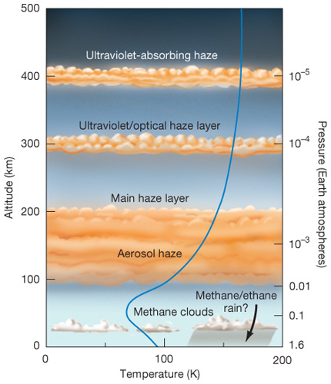
Titan
Thick Nitrogen atmosphere, cloud shrouded
Surface pressure:
1.5 x Earth’s!
Surface temperature:
-180° C (93 K)
90% Nitrogen + Argon, methane & ethane
Notes:
Titan is Saturn’s biggest mooon.
Titan has an atmosphere! (Hubble is visible light – what you would see with your eyes; Cassini is infrared, seeing through the smog) Titan’s atmosphere is at the triple point of methane – liquid, gas, and solid methane can exist on Titan… and there’s more methane in its atmosphere than there should be, so something has to be replenishing it.
Titan’s surface temperature without an atmosphere would be 80K (-192C) – so it’s gained ~12 degrees from its atmosphere. Its radius is about 2500km (0.4 Earth’s radius; compare to Mars which is about 0.5 Earth Radii). Its surface gravity is 0.14g (compare to Mars at about .3g). Yet it has a much thicker atmosphere than Mars. Why? Because it’s just so much colder out by Saturn; molecules move much more slowly and therefore it’s harder for them to escape.

Slide 36
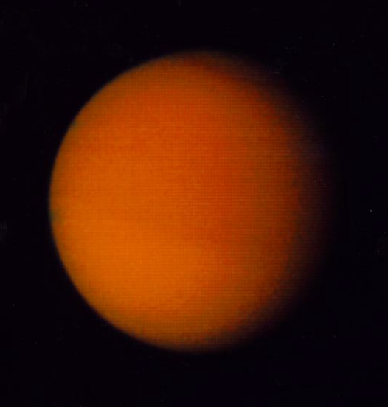
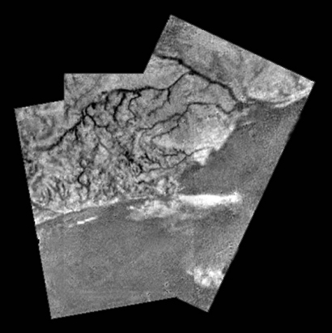
Titan (Saturn)
Thick Nitrogen atmosphere, cloud shrouded with smoggy haze

Slide 37
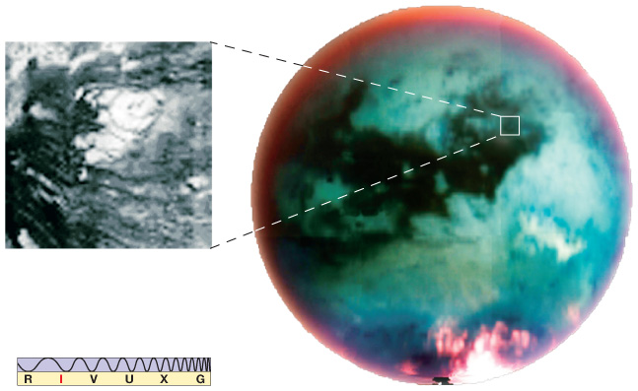
Titan (Saturn)
Surface features
Notes:
Remember: Using radar, smooth things are dark and rough things (like mountains) are bright.
The image on the left shows an active cryovolcano on Titan.
Are there ethane oceans on Titan? Yes! And methane/ethane rain!

Slide 38
Titan (Saturn)
Notes:
Show movie, and surface images

Slide 39
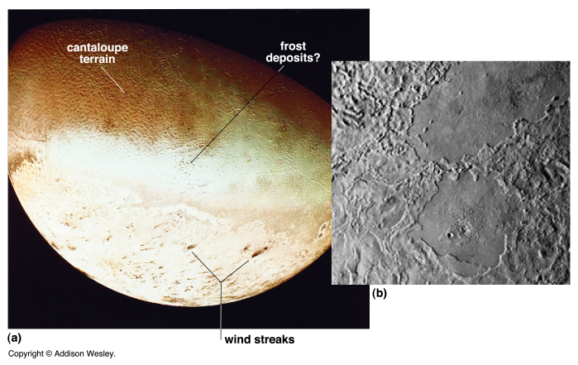
Triton (Saturn)
Triton is colder than Pluto due to reflectivity
Retrograde orbit suggests likely capture by Neptune
Notes:
Coldest moon in the Solar System
Due to higher reflectivity, even colder than Pluto
Orbits in retrograde motion, opposite the motion of the other moons
Highly inclined orbit
Points to a capture
Some volcanic activity
Some internal heating, possibly due to tidal heating

Slide 40
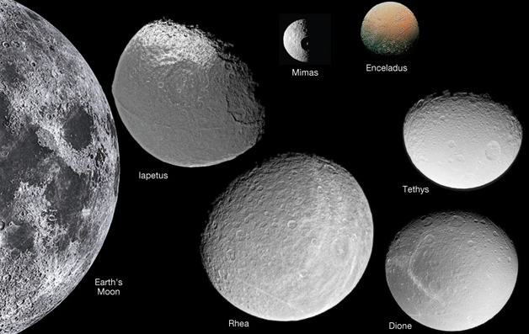
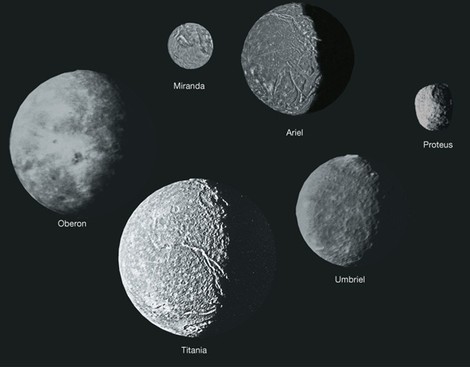
Mid-Sized Moons
~200-800 km
Rock & Water ice
Tidally locked
Mostly not geologically active
Some interesting ones:
Dione
Iapetus
Enceladus
Mimas & Miranda
Notes:
Enceladus is very bright. We see jets, even!!

Slide 41
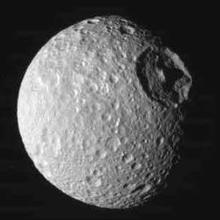
Mid-Sized Moons
Dione:
Faults due to cooling
Mimas & Miranda:
Giant impacts
Notes:
Image of Dione from Cassini. A similar “wispy” terrain can be seen on Rhea, which is also probably due to cooling fracturing the moon’s surface.
Mimas’ giant impact probably nearly shattered the moon
Miranda (Uranus) has weird features, which might be due to repeated large impacts… but until we send a probe actually there, it will be hard to be sure.

Slide 42
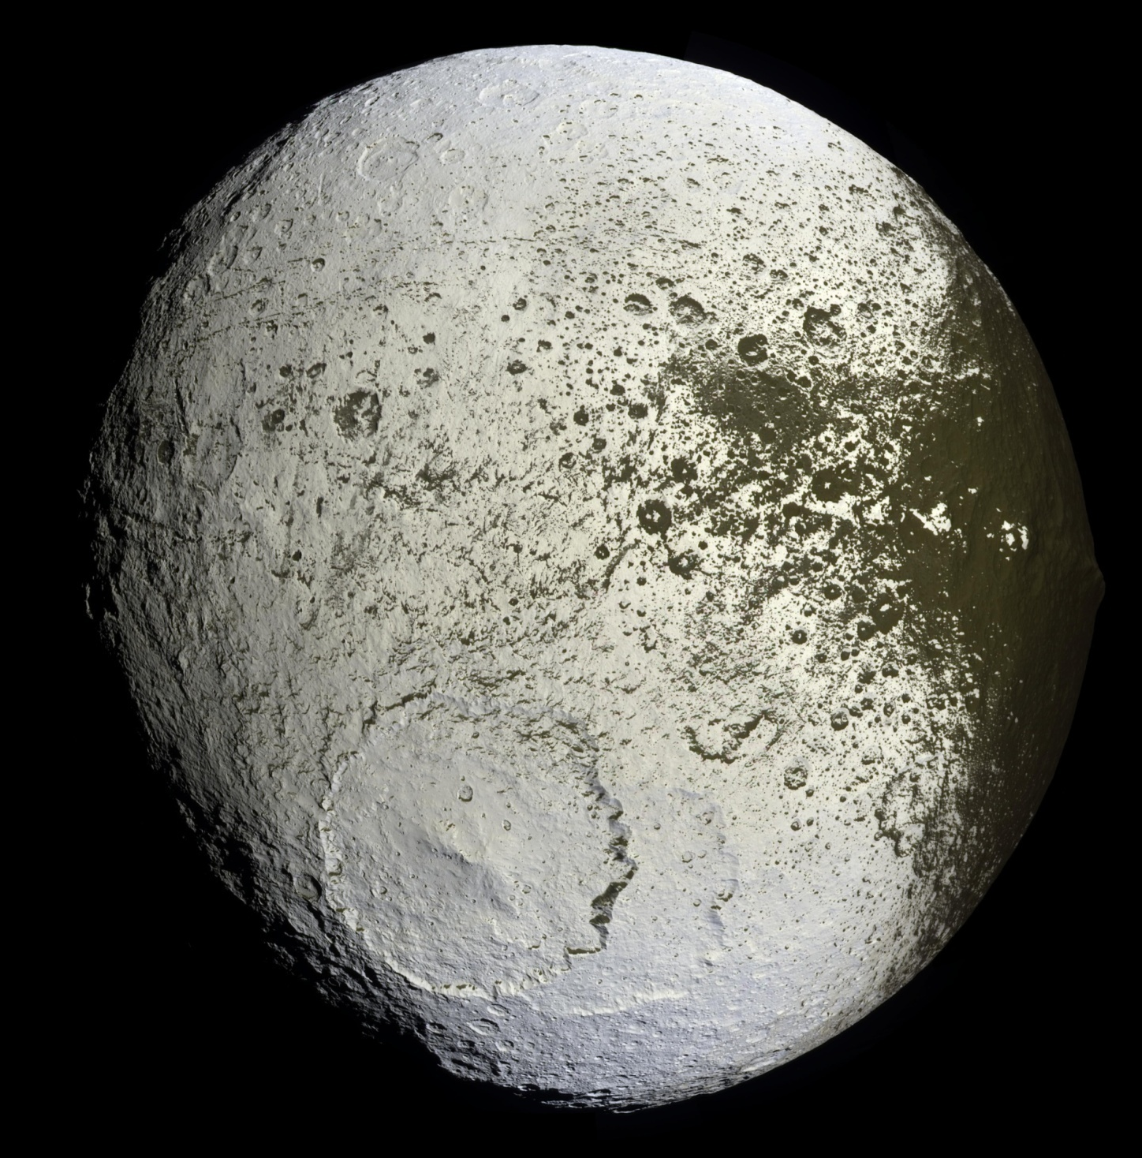
Iapetus (Saturn)
One side is bright
The other side is very dark
Also has a large equatorial ridge
Notes:
The dark stuff is probably leftovers from sublimation (going straight from solid to gas) of ice on the leading side, which then recondenses on the trailing side, which makes that side bright. The dark stuff is only 10s of centimeters thick (or about a foot), which we can tell because smaller more recent craters have punched through to the ice below. Something must have started this dichotomy in the first place, though, and it could be due to micrometeorite impacts from dark stuff in the leading edge. Alternately, that’s what could be going on anyway, without the sublimation process. Probably both come into play.

Slide 43
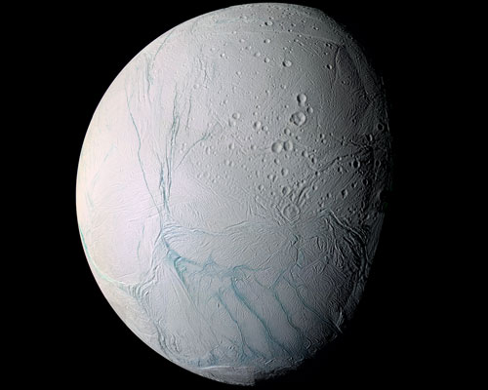
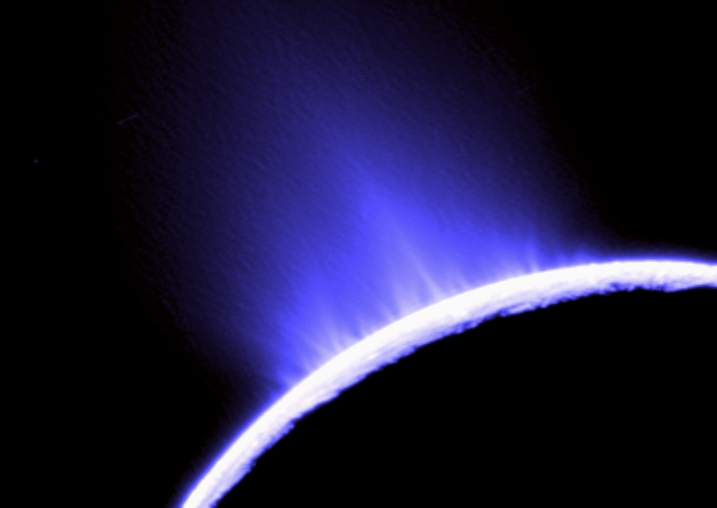
Enceladus (Saturn)
Very bright – if it were older, it’d be darker
And we found jets from a cryovolcano!
Notes:
Enceladus is very bright. Reflects almost 100% of the light that falls on it. We see jets, even!! It is tectonically active. We also see places where – similar to the moon’s maria – plains have been flooded and frozen with ice. Very few craters!

Slide 44
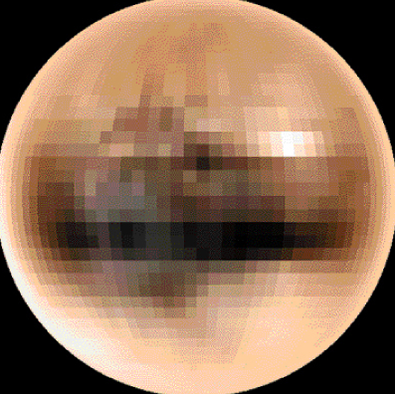
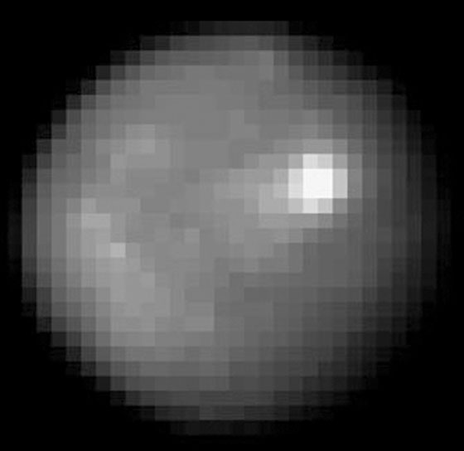
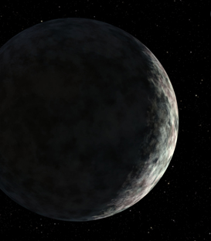
Dwarf Planets
Eris
Pluto
Ceres
Big enough to be round; but haven’t cleared their orbits
Notes:
Pluto has many properties in common with Kuiper belt comets.
Its orbit is very similar to Kuiper belt comets
Its composition of ice and rock is very similar
Pluto has some properties which differ from Kuiper belt comets.
Its surface is much brighter; Nitrogen atmosphere refreezes on the surface rather than escaping
It is much larger than most Kuiper belt comets
Charon moon is believed to have formed in the same way as our Moon
Eris is the largest dwarf planet so far.

Slide 45
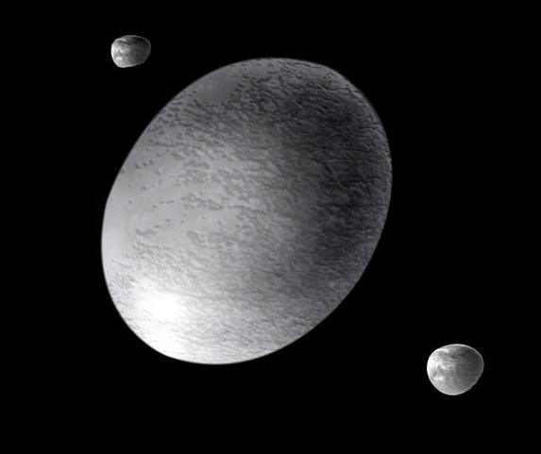
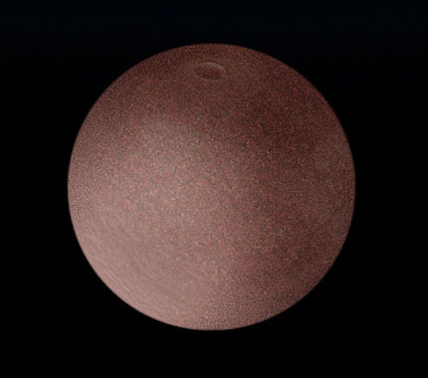
Dwarf Planets
Makemake
Maybe:
Sedna*
Quaoar
Ixian
Varuna
Haumea
Smaller dwarf planets
Notes:
Sedna is a possible Oort cloud object

Slide 46
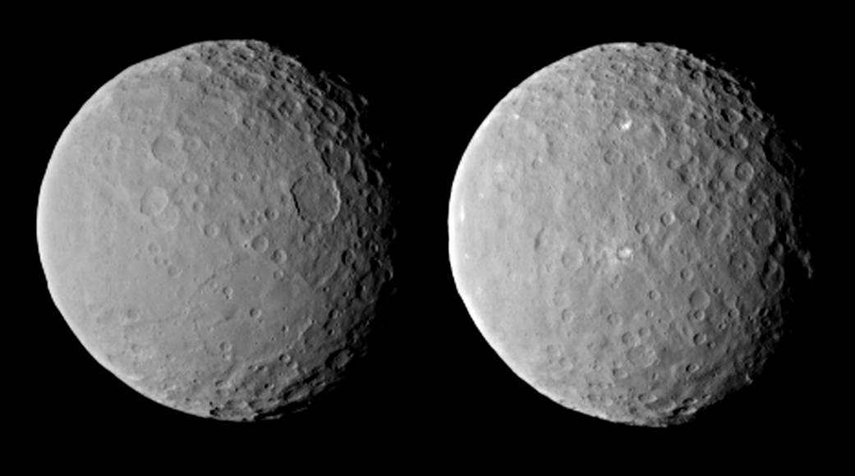
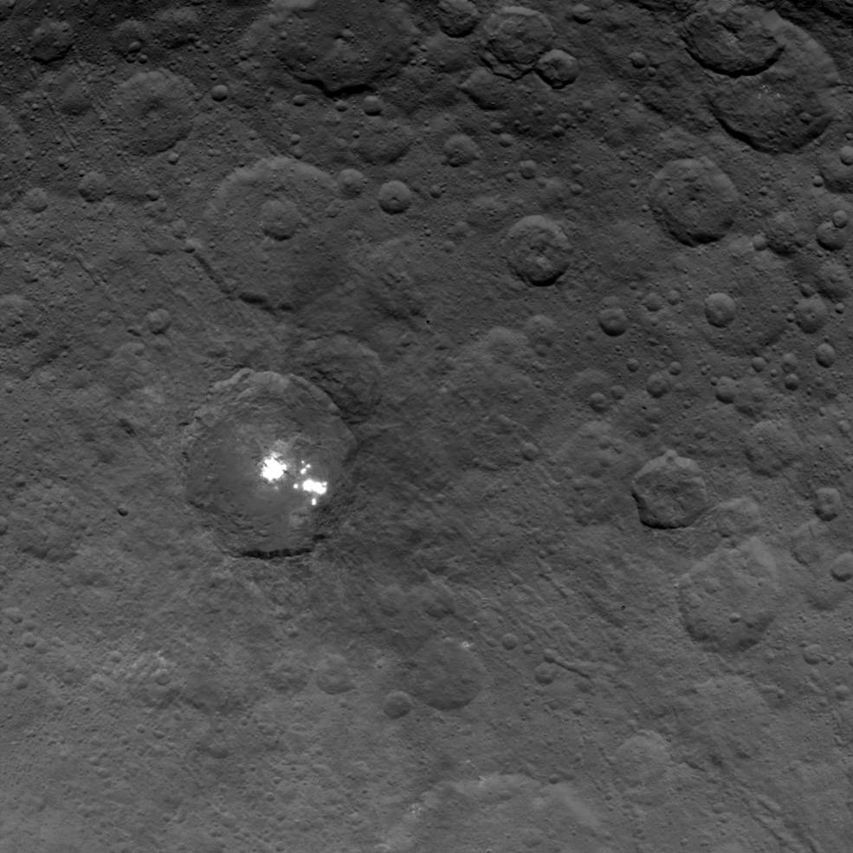
Ceres
Notes:
What are the weird bright spots?
Lots of craters!

Slide 47
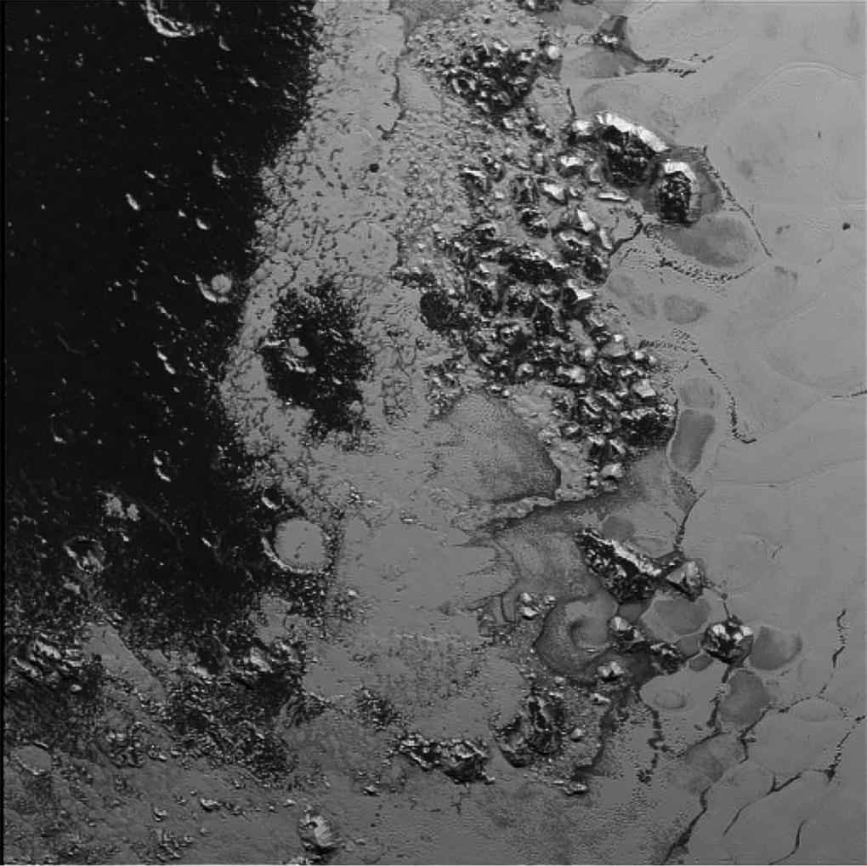
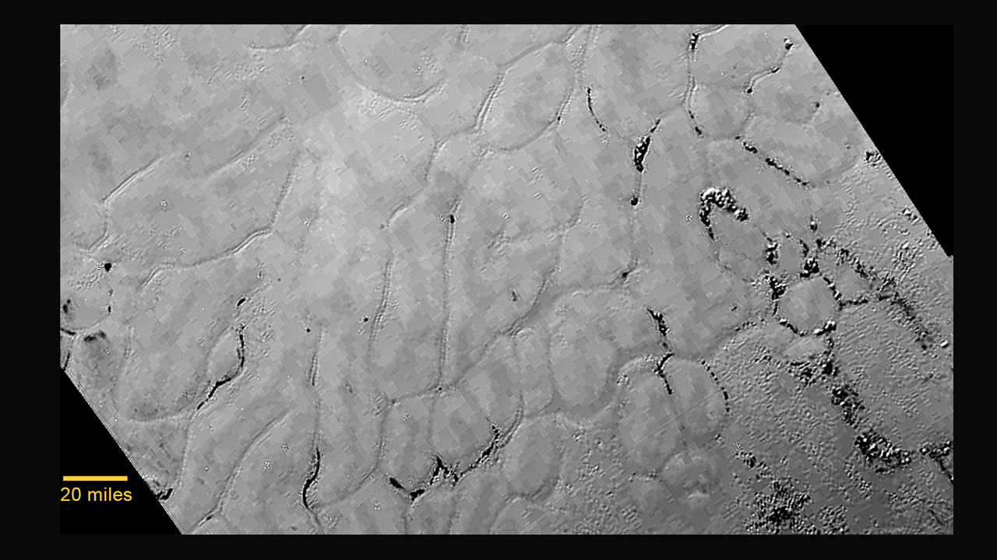
Pluto!
N, CO₂, CH₄ Glaciers!
Complex hydro-carbons!
Features!
Notes:
Glaciers, ice flows, weird smooth planes with shallow troughs and dark hills, dark complex hydrocarbons, weird looking features… where are the craters???

Slide 48
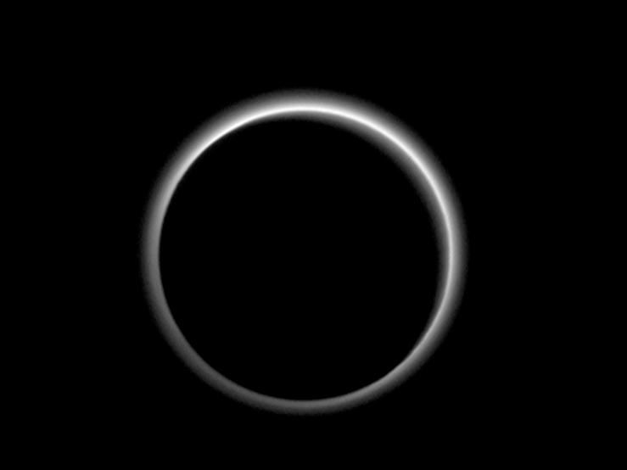
Pluto!
Multi-layer
Atmosphere!
Notes:
At least two levels of haze! Mostly nitrogen

Slide 49
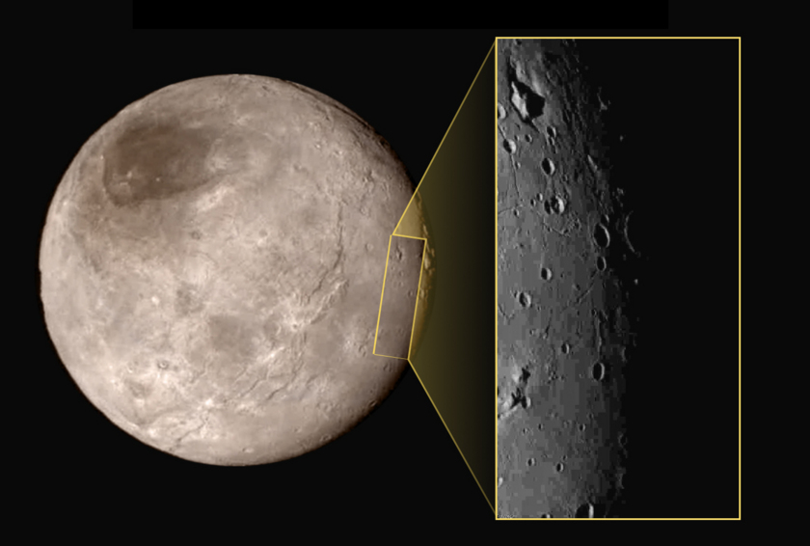
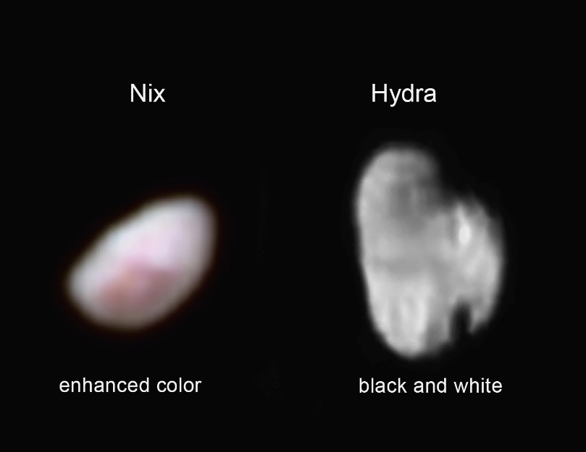
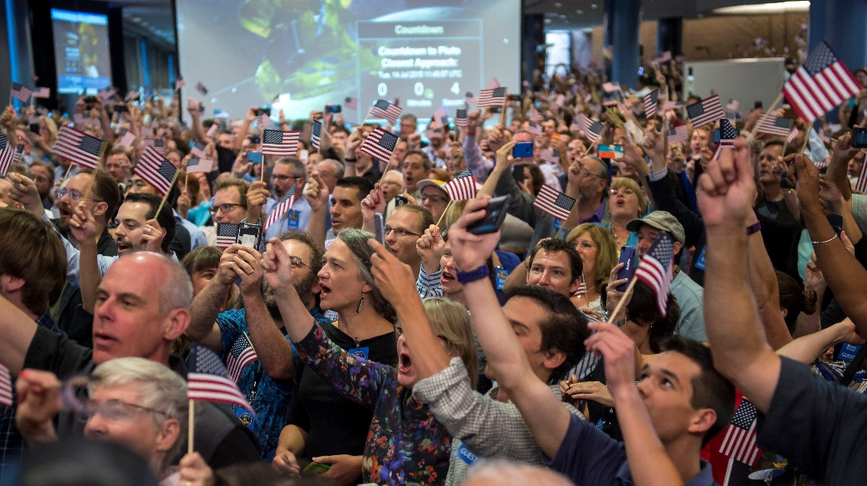
Pluto!
Many Moons!
Charon
And of course
Styx and Kerberos
Notes:
Charon, what’s up with that big crack eh? Is it an extension crack due to cooling? Or something else?

Slide 50
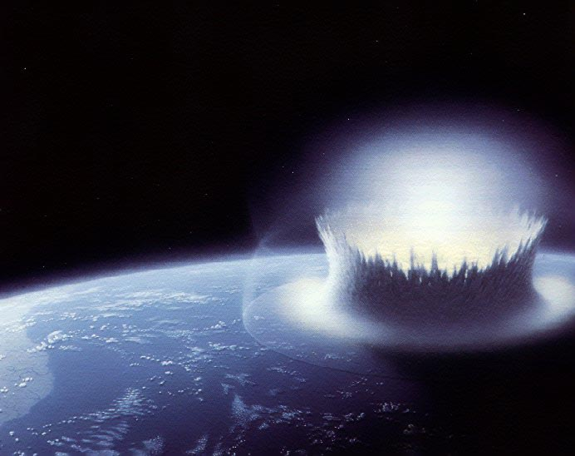
- Lab Time -
Notes:
What kinds of energy can you think of? Name as many as you can within your group. [Make class list]
Next, think about changing energy from one type to another. What types can turn into other types? Are there any kinds of energy that cannot turn into other types? Where does energy come from? What is energy?

Slide 51
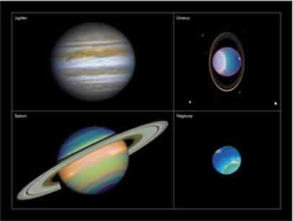
Next up: Gas Giants!
Notes:
Well…. After talking about our atmosphere/global warming ☺

