Slide 1
Solar System Formation

Slide 2
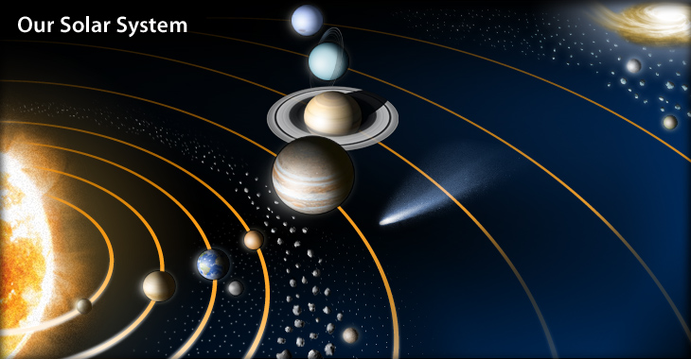
Planetary Formation
What do we need to know?

Slide 3
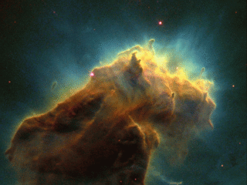
Planetary Formation
Basic characteristics
How does it start forming?
How do I make the planets (& stuff)?

Slide 4
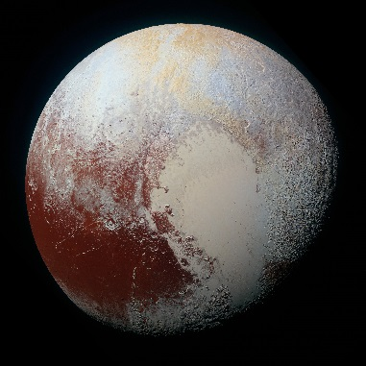
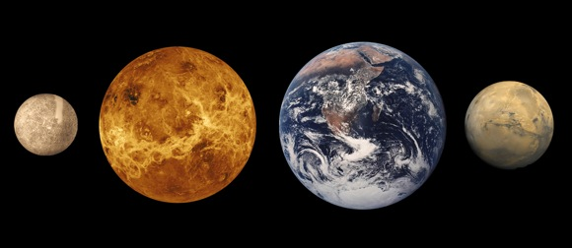
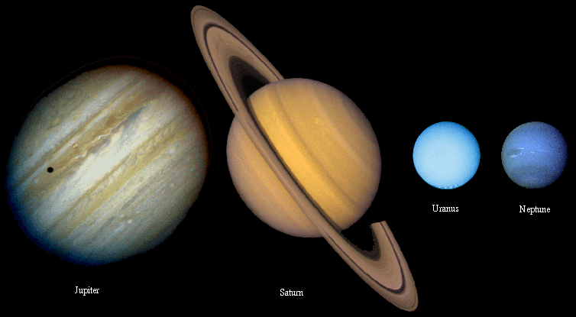
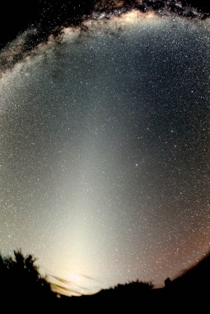
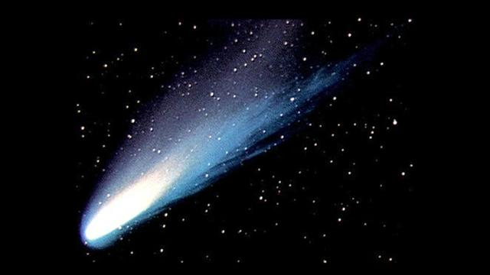
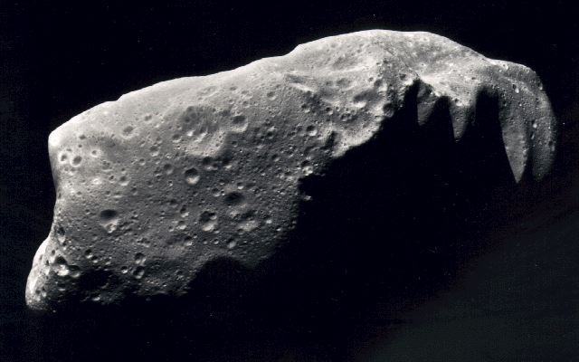
What’s in it?
Terrestrial Planets
Jovian Planets
Dwarf Planets
The Sun
Comets
Asteroids
Dust
Notes:
What are the components of the solar system?
Sun, terrestrial planets, jovian planets, asteroids, comets, moons, dust

Slide 5
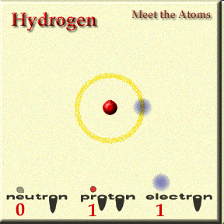
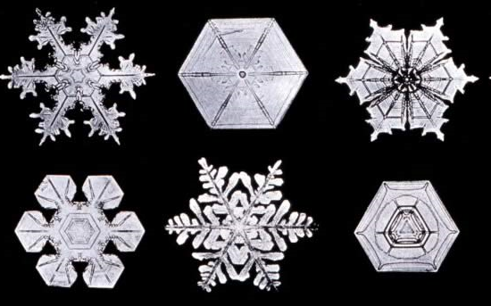
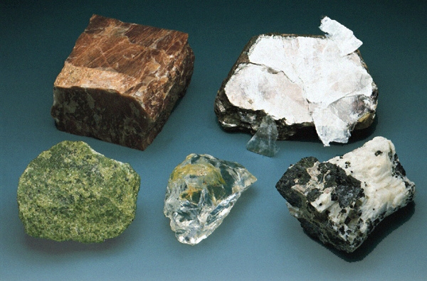
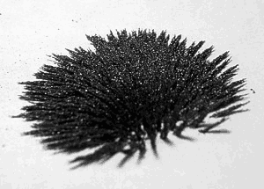
What’s it made of?
Gasses
Ices
Rocks
Iron
Notes:
Terrestrial Planets: Primarily Rocks and Iron
Jovian Planets: Mostly Hydrogen but, in the core, rocks, iron, and ices
The Sun: Gasses (Mostly Hydrogen)
Asteroids: Rocks and Iron
Comets: Rocks, Iron, and Ices
Dust: Rocks, Iron, Ices
Dwarf Planets: Rocks, Iron, Ices.

Slide 6
Where is everything?
Not to scale!
Notes:
From inside out:
Terrestrial planets, asteroid belt, Gas giants, Kuiper Belt objects, Oort cloud
There is a high degree of order in the solar system that must be explained.
The planets all lie in a plane.
They all orbit in the same direction.
Most of them rotate in the same direction.
Most rotation axis are roughly perpendicular to the ecliptic
Rocky planets are in the interior, Gassy planets in the exterior, and icy planets waaay out there.

Slide 7
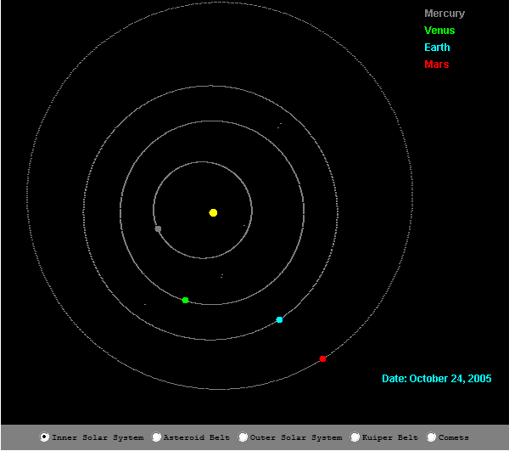
How does it move?
Notes:
We Must Explain:
All orbits are in the same plane (mostly)
Everything orbits in the same direction around the sun
(Almost) Everything spins in the same direction
(Almost) All of the spin axes are approximately aligned
The orbit of objects in the asteroid belt tend to be more elliptical
The orbits of objects in the Kuiper belt tend to be more elliptical and their orbital planes are at greater angles.
These are all due mostly to angular momentum arguments… Everything lines up along the original angular momentum axis
http://janus.astro.umd.edu/javadir/orbits/ssv.html

Slide 8
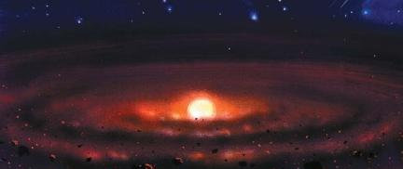
Planetary Formation
A Formation Scenario must answer
Origins of the orderly motion.
Differentiation of material
Rubble
Exceptions
Notes:
How did the solar system form so that the motion was very orderly?
Why are the inner planets (terrestrial planets) different from the outer planets (gas giants)?
What’s the deal with asteroids, the Kuiper belt, and the Oort cloud?
Venus spins backward, Uranus is tipped on its side, the Earth has a ginormous moon….why?

Slide 9
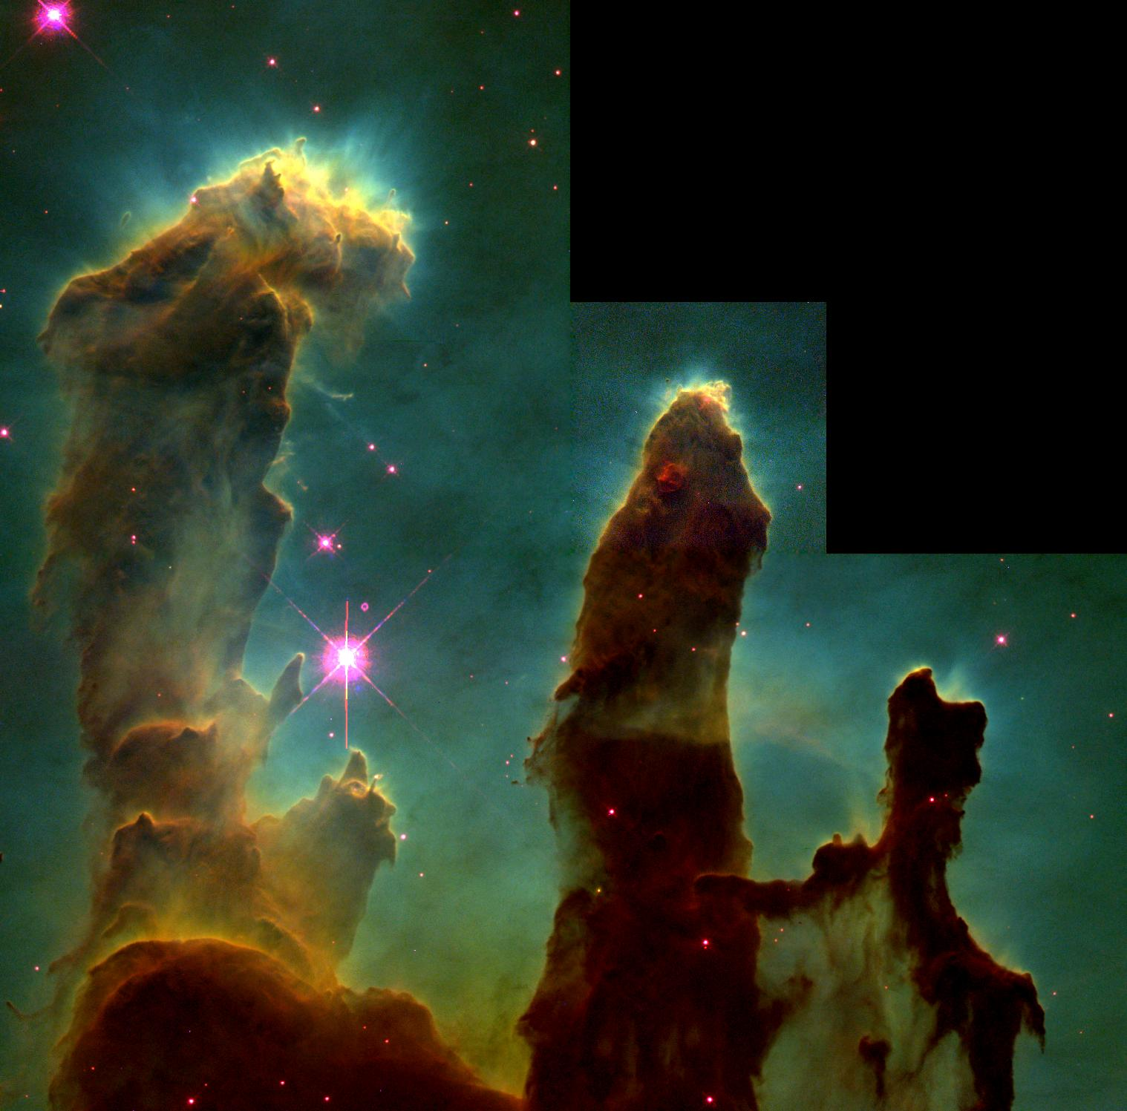
Orderly Motion:
the Nebular Theory
The solar system formed from the collapse of a giant cloud of gas
Notes:
The Nebular Theory:
A cloud of interstellar gas began to collapse due to it’s own gravity.
As it collapses, it conserves angular momentum and spins faster
As it the density increases, collisions between particles cause it to flatten into a disk.

Slide 10
Collapse
Gravity
Pressure
Notes:
The collapse is a battle between GRAVITY and internal PRESSURE
If gravity wins, the cloud collapses.

Slide 11
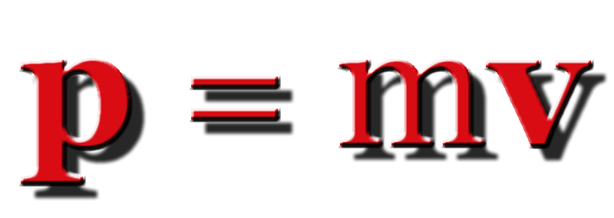
Momentum
Momentum is conserved
Notes:
Our first conservation law.
In a closed system MOMENTUM IS ALWAYS CONSERVED.
This includes situations where the gravitational force is involved.
It also includes situations where energy is transferred such as:
Friction robs kinetic energy
and explosion occurs (potential energy transfers into kinetic energy)
If we add up (M1 X V1) + (M2 X V2) + … and wait for some time
And add them up again, the answer will be the SAME.
As long as no external forces act on the system.

Slide 12
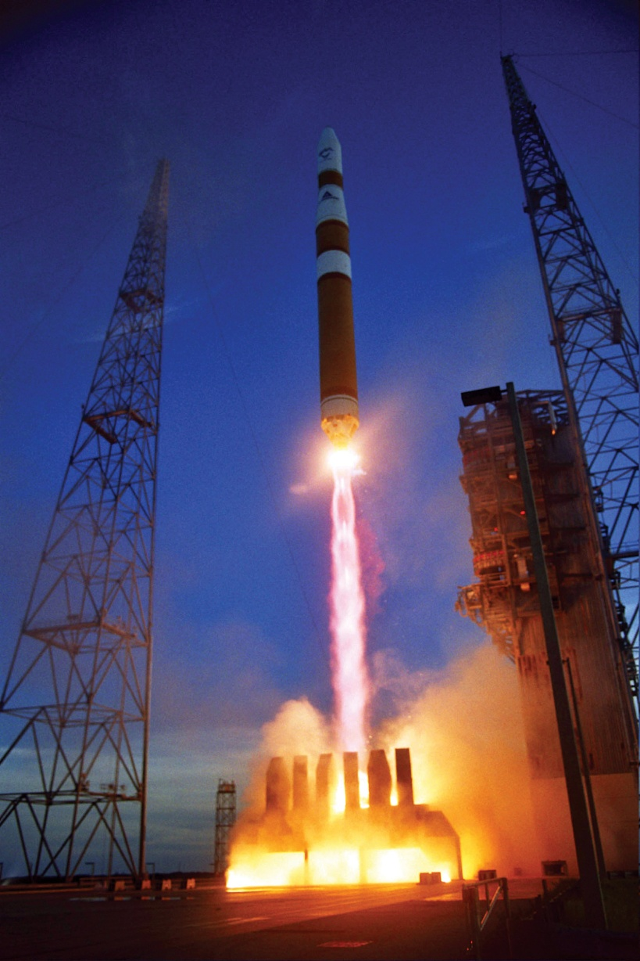
Rockets Conserve Momentum
Notes:
In the rocket, an EXPLOSION occurs that propels exhaust out the back of the rocket and propels the rocket forward.
The system conserves momentum.
If the rocket fuel system has zero momentum initially, the momentum of the rocket plus the momentum of the exhaust will be zero afterward.

Slide 13
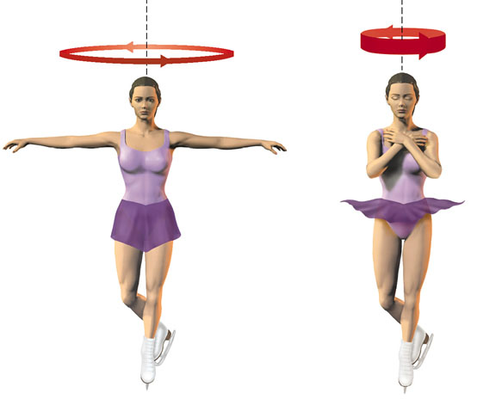
Spinning into a disk
Angular Momentum
L = r m v
Angular Momentum is CONSERVED
Notes:
So everything is going in (roughly) the same direction. Motions vertical cancel out (same number of ups as down; collisions → neutral).
As it collapses what happens to the speed?

Slide 14
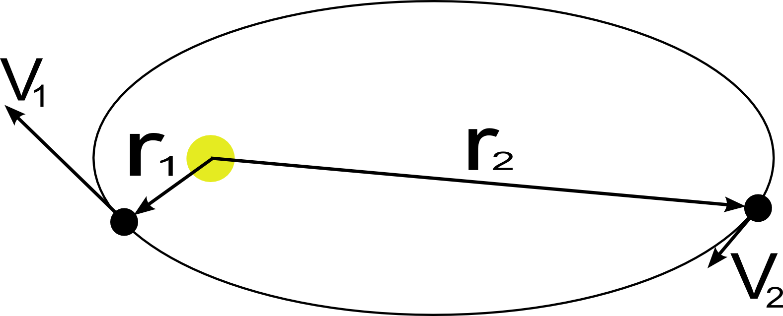
Orbital Angular Momentum
B
A
Which point has greater angular momentum?
Notes:
SAME! L = rmv. So when r goes up, v goes down proportionally

Slide 15
Orbital Angular Momentum
How does conservation of angular momentum explain Kepler’s Second Law?

Slide 16
Collapsing Nebula
A cloud of gas collapses under its own gravity
It maintains its angular momentum and spins faster
The spinning cloud flattens and forms a disk
Notes:
Disks form all the time. Galaxies, disks around black holes, forming stars…
(L = angular momentum = m v r)

Slide 17
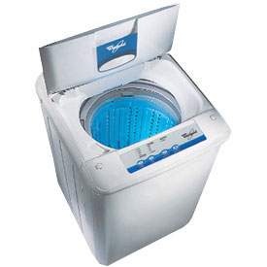
Spinning into a disk
Toss a ball in at a random direction. What happens?
Notes:
Imagine filling a washing machine with balls and putting it on the spin cycle.
All the balls are whizzing around in a circle.
Now… throw a ball into the machine in any random direction.
Collisions between balls will drag the “oddball” along with the rest and soon it will be going in the preferential direction.

Slide 18
Planetary Formation
A Formation Scenario must answer
Origins of the orderly motion.
Differentiation of material
Rubble
Exceptions
Notes:
Close Encounter Theory:
The Sun encountered another star at some point in the distant past and great blobs of gas were ripped off.
Those blobs eventually formed the planets.
Problems with this scenario the “Close encounter Theory”
Encounters are rare.
It’s hard to get stable orbits when we model this in the computer.
It’s nearly impossible to get a well ordered and differentiated solar system.

Slide 19
Differentiation
Notes:
Why are the planets differentiated by composition?
Inner terrestrial planets are primarily rock and iron. They are small and dense. They have few moons and no rings.
Jovian planets, at middle distances, are primarily hydrogen (plus helium) gas with icy/rocky/iron cores. Low density but very large. They have lots of moons and all have rings.
Dwarfs, on the outskirts of the solar system, are an even mixture of rocks and ice. (except Ceres in the asteroid belt, which is more rock and not icy…probably)
Let’s look at the proto-Planetary disk and see if we can figure out the answer.

Slide 20
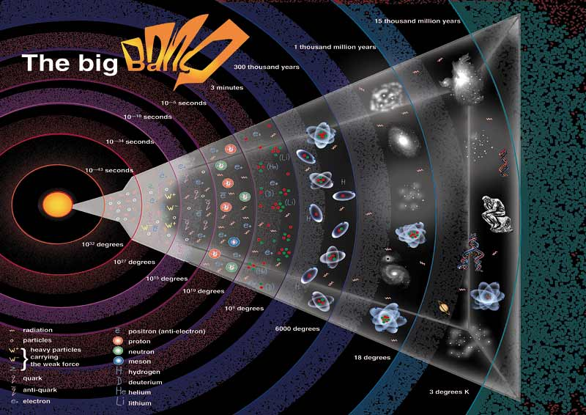
History of Matter I
Only H and He in the BB
No heavier elements
Notes:
What elements are in the proto-solar system are another piece of what we need to figure out how the planets were formed. So where does the “stuff” come from?
The big bang created Hydrogen and Helium. 75% Hydrogen, 25% Helium
Stuff is made of more than Hydrogen and Helium.
Where does Iron come from? Silicon? Krypton? All the stuff on the periodic table…

Slide 21
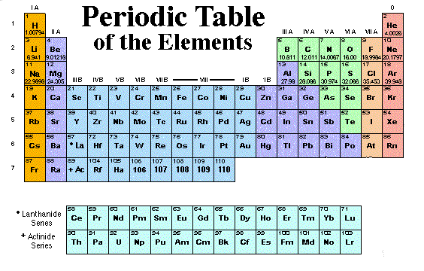
History of Matter I
H
He
Li
Notes:
Stuff is made of more than Hydrogen and Helium.
Where does Iron come from? Silicon? Krypton? All the stuff on the periodic table… There are a lot of other elements (and most Lithium was not created in the Big Bang)

Slide 22
History of Matter II
Heavier elements are made by stars.
Notes:
Fusion creates everything up to Iron (Fe)
The rest are created by processes when a very massive star dies. This stuff gets mixed into clouds in the interstellar medium (ISM), and can be used to make new stars (and after several generations, planets). We will talk about this process more in the future, but at least we know where the elements came from.

Slide 23
Differentiation: Why?
Notes:
Why are the planets differentiated by composition?
Inner terrestrial planets are primarily rock and iron. They are small and dense. They have few moons and no rings.
Jovian planets, at middle distances, are primarily hydrogen (plus helium) gas with icy/rocky/iron cores. Low density but very large. They have lots of moons and all have rings.
Dwarfs, outskirts of the solar system, are an even mixture of rocks and ice.
Let’s look at the proto-Planetary disk and see if we can figure out the answer.

Slide 24
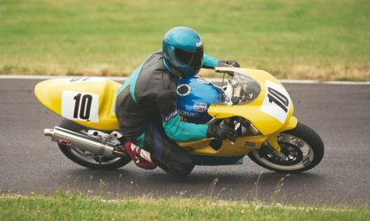
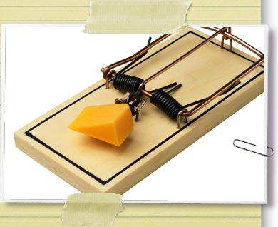
Types of Energy
Kinetic
Motion
Thermal
Potential
Gravitational
Chemical
Springs/Rubber Bands
Radiative
Light
Notes:
All of the energy forms that you can think of fit into one of these three types.

Slide 25
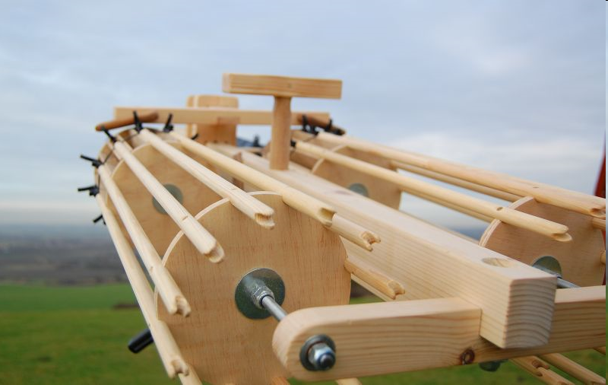
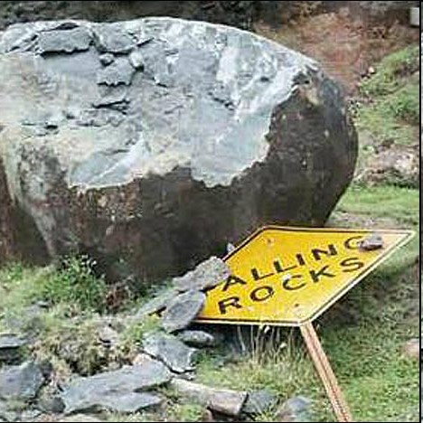
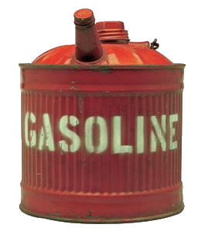
Potential (stored) Energy
Notes:
Energy that is stored. Potential energy can be converted into either kinetic or radiative (light) energy.
Sources of Potential Energy:
Chemical-
Gasoline, Hydrogen (both are forms of combustion, or combining with oxygen)
Gravitational-
Water flowing down a mountain.
A space rock falling towards the earth
Molecular bonds
Springs and rubber bands

Slide 26
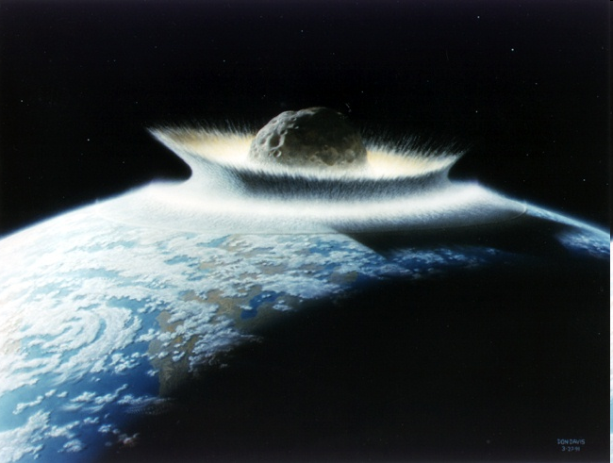
Kinetic Energy
K = ½ mv²
Notes:
Kinetic energy depends on
mass
A truck moving at 10 miles an hour has more energy than a bicycle moving at moving at 10 miles per hour
And the SQUARE of the velocity.
You saw this in the Impact lab.
2 times the velocity is 4 times the energy
4 times the velocity is 16 times the energy
Fast moving asteroids carry ENORMOUS kinetic energy.

Slide 27
Energy is CONSERVED
Energy can be transformed but not created or destroyed
Notes:
Can’t always go backward though!
Where does the energy in the gasoline come from?

Slide 28
Orbital Energy
B
A
Which point has greater energy?
Notes:
Same! Conserved quanitity!

Slide 29
Collapsing Nebula
Energy:
Start with Potential Energy
Collapse → Kinetic Energy
→ Thermal Energy
Hotter in the center and cooler further out
Notes:
Energy (and therefore temperature) will help us figure out why the planets formed the way they did. It’s one piece of the puzzle we will need.

Slide 30
Differentiation: Composition
1.4%
98%
0.4%
0.2%
Assume that the disk was WELL MIXED
Notes:
Why are the planets differentiated by composition?
Let’s start here: What are the various components?
The disk is made up of lots of different stuff. Some stuff is more abundant
In order of abundance:
Hydrogen (gas), There is a LOT of hydrogen Most of the mass of the solar system.
Ices (hydrogen compounds like water or methane) way more than the iron or rocks
Rocks (silicate compounds) Not much, but more than Iron
Iron (and other trace heavy metals) Very little

Slide 31
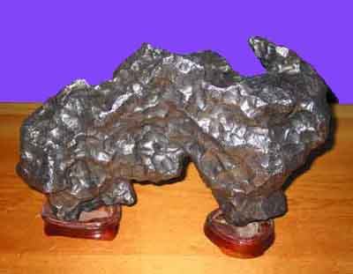
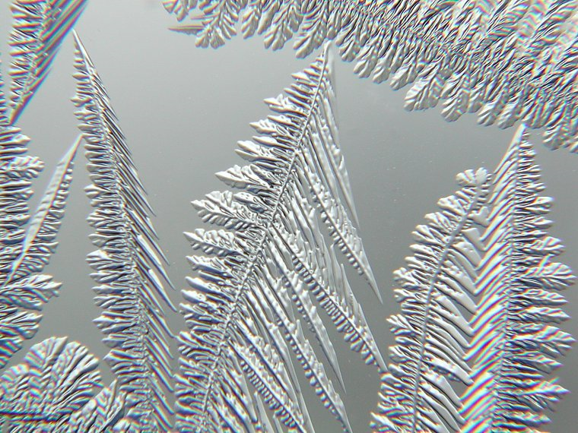
Differentiation: Condensation
HEAVY compounds can condense at HIGH temperatures
LIGHT compounds require LOW temperatures.
Notes:
Condensation is changing from the gaseous state to the solid state.
In the summer, water from the air condenses on your glass of ice water.
In a proto-planetary disk, the gaseous compounds condense to form solids.
Hydrogen compounds (NOT to be confused with hydrogen GAS)
Require LOW temperatures to condense at low temperatures to form ices.
Rocks and Metals are able to condense at HIGH temperatures.

Slide 32
Disk Temperatures
The disk temperature decreases with radius (larger r, smaller T)
Notes:
So let’s go back to our proto-planetary disk. How do we make planets in this disk? Well, first let’s talk about what elements we find where… and how that changes what planets will form.
Closer to the proto-sun (it hasn’t started fusing yet!) it is hotter because it has given up more Potential Energy. Further out, it’s colder. Moving out from the sun, it is too hot for things like water ice (or other ices like ammonia). So any water that’s there is vapor and moving fast. As you move further from the sun, though, it gets colder and colder, until eventually you can form ice. Those ice particles don’t zip around like a gas zips around, and can condense onto rocks and dust. This makes the rocks and dust particles *bigger* than the ones on the inner solar system.
The dividing line between where it’s too hot and where it is cold enough to have ice is what we call the Frost Line

Slide 33
Differentiation of the disk
Lecture Tutorial: p. 111
Frost Line: The radius where the temperature drops below the freezing point
Notes:
Metals and rocks (silicon based stuff) condenses at higher temperatures than hydrogen compounds (in other words, you can form rocks at a higher temperature than you can form ices)
So… Inside the frost line, you get rocks and metals. Beyond the frost line, you get rocks, metals AND hydrogen compounds condense. Things like hydrogen (by itself) and helium don’t ever condense to form solids.
So what does that mean?

Slide 34
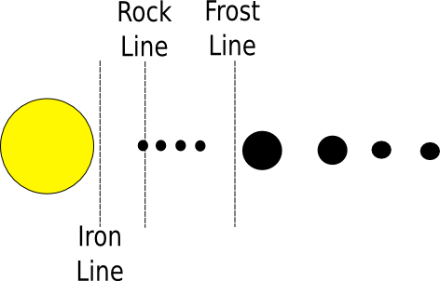
Condensation Temperature
Notes:
Inside the frost line, ices do not condense, so only rocks and iron are available for construction of planets.
So, near the sun, planets made of rocks and iron form. These are called Terrestrial planets.
The terrestrial planets are small because the abundance of rocks and heavy metals is small
Compared to the compounds that form ices.
They are too small and hot to capture a hydrogen atmosphere.

Slide 35
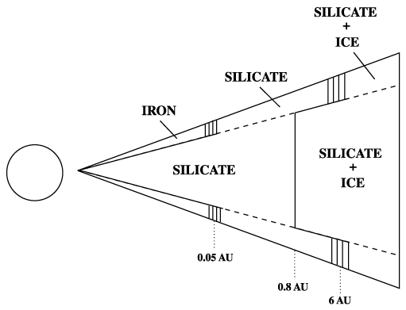
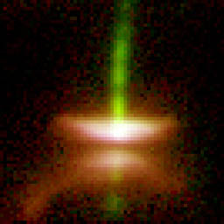
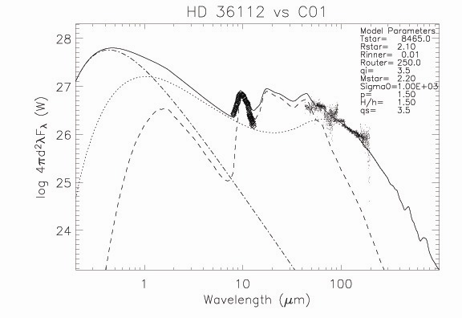
Does it work?
Hubble image
We generate a synthetic spectrum & compare to observations
Notes:
Modeling: You think of what the disk looks like (shape, temperature, energy) and what it’s made out of (H, He, rock, metals, ices) and use a computer to generate the spectrum.
Compare the output spectrum with real observations to see if the beast in the computer looks like what we see in space.
Why? This way we try to answer the questions on the next slide.

Slide 36
Protoplanetary Disk Puzzles
Crystalline silicates found in outer solar system.
Dust grain growth
Disk Geometries
Disk Composition
Notes:
Certain crystals require high temperatures to form, yet we find them in comets which come from the outer solar system. How did they get there?
We don’t completely understand grain formation and growth in a proto planetary disk
The geometry of the disk is a matter being hotly debated.
The composition of the disk is not completely characterized.

Slide 37
Building Terrestrial Planets
The rocks bash together and stick to form planets
Why no hydrogen?
Notes:
The components of rocky stuff are less abundant than the components of icy stuff.
Inner planets are therefore too small (and hot) to capture hydrogen (hydrogen is light and reaches escape velocity if the temperature is even slightly warm)
Things are violent in the early solar system… smaller planetesimals are easily shattered… only the largest ones survive the impacts so a few planets get the mass.

Slide 38
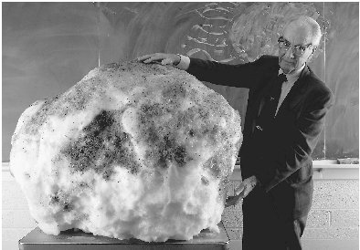
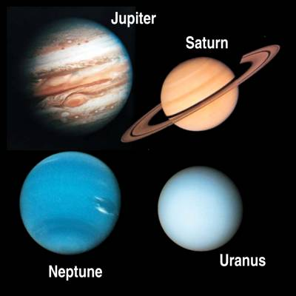
Building Jovian Planets
A BIIIIG dirty snowball
A dirty snowball
Notes:
In the outer solar system, it’s cold enough to form ices.
There is a LOT more icy stuff than rocky stuff so BIG dirty snowballs are built.
Ices as well as rocks can condense beyond the frost line so there is more stuff available to accrete
Hydrogen is moving slow AND the planetary cores are BIG so hydrogen does not achieve escape velocity.
Jovian planets capture an ENORMOUS hydrogen atmosphere
So, the jovian planets are very large compared to the terrestrial planets. Jupiter is 318 Earth masses.

Slide 39
Building Jovian Planets
Jovian planets were able to capture hydrogen.
They are more massive
The hydrogen isn’t moving as fast
Notes:
Jovian planets could capture hydrogen because it’s cold out there.
Ices as well as rocks can condense beyond the frost line so there is more stuff available to accrete
Lower temperatures mean lower thermal velocity of hydrogen and helium atoms.
These two facts combined mean that hydrogen doesn’t achieve escape velocity

Slide 40
Planetary Formation
A Formation Scenario must answer
Origins of the orderly motion.
Differentiation of material
Rubble
Exceptions

Slide 41
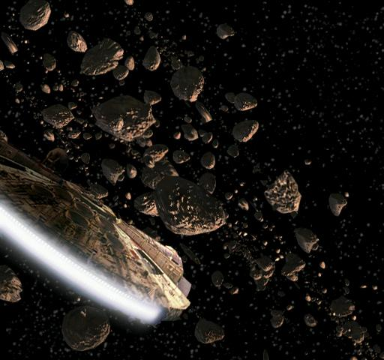
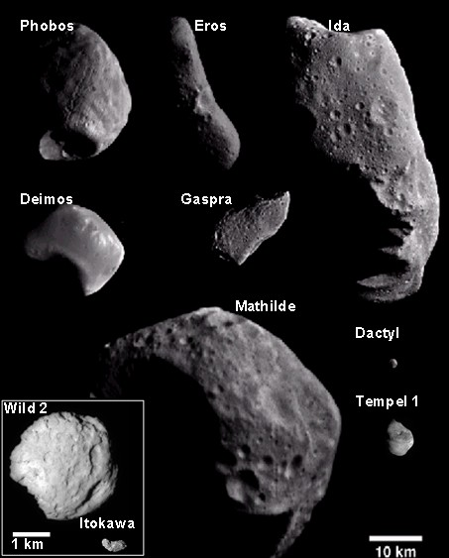
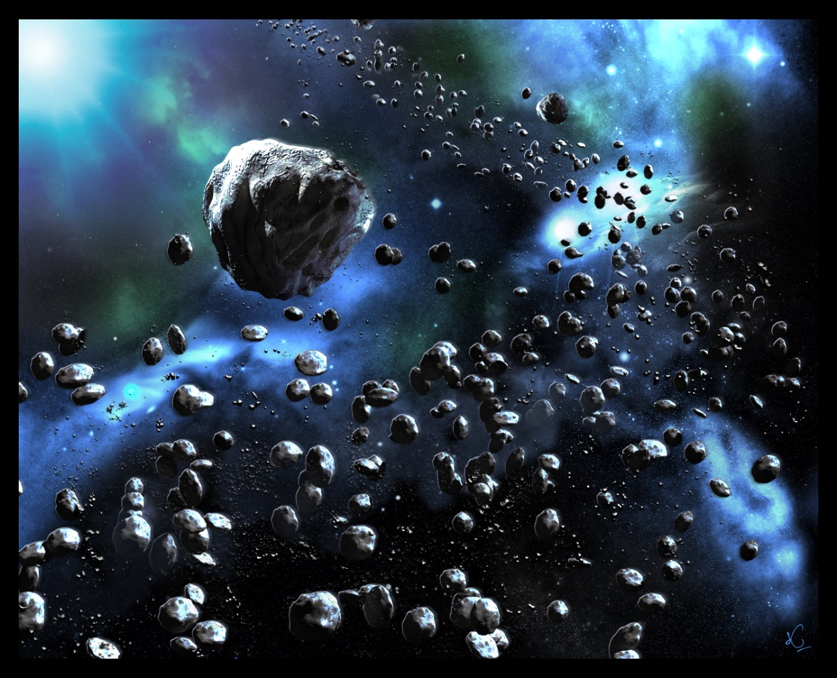
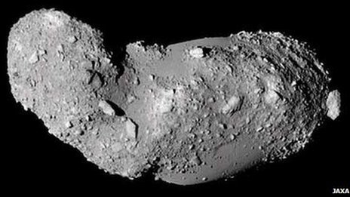
Rubble
Notes:
This is not what the asteroid belt looks like.

Slide 42
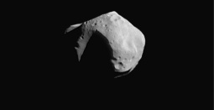
Rubble
50 km
Notes:
This is more like it…. Lots of empty space

Slide 43
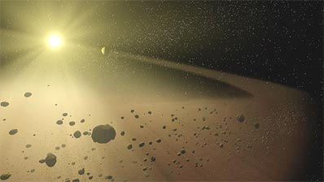
Leftover Rocks and Ice
The asteroid belt is likely a failed terrestrial planet. Jupiter didn’t let it form – gravity kept messing things up
Notes:
The asteroid belt appears to be a terrestrial planet that didn’t form… lots of chunks of rock.
Perhaps a planet tried to form but was too close to Jupiter’s gravitational influence.
The asteroid belt is not very dense, and has a mass of ~one thousandth of a terrestrial planet

Slide 44
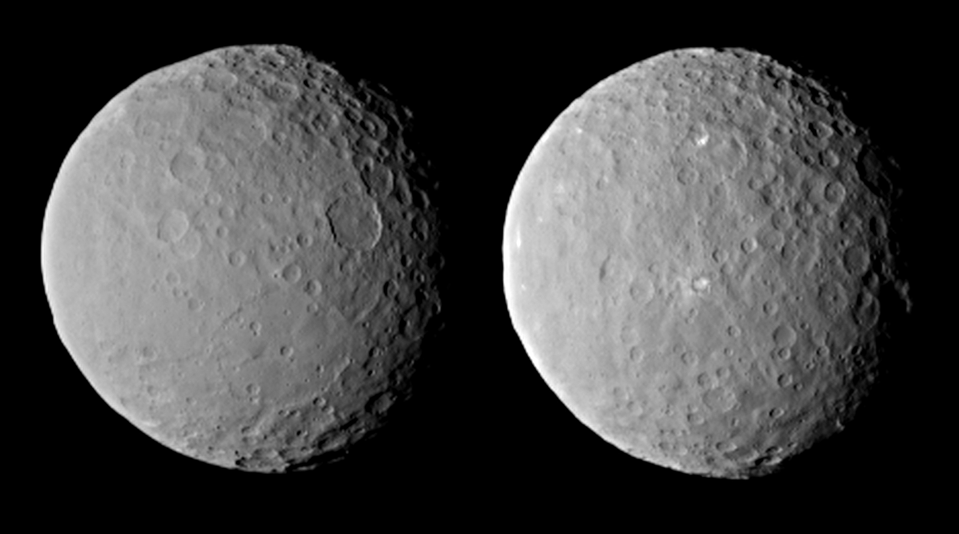
Ceres
The first dwarf planet
Notes:
The asteroid belt appears to be a terrestrial planet that didn’t form… lots of chunks of rock.
Perhaps a planet tried to form but was too close to Jupiter’s gravitational influence.
The asteroid belt is not very dense, on one thousandth of a terrestrial planet
Sweeeet: http://www.nytimes.com/interactive/2015/01/13/science/space/photos-of-ceres-from-nasa-dawn.html?smid=pl-share

Slide 45
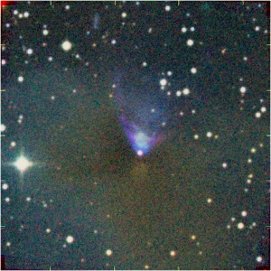
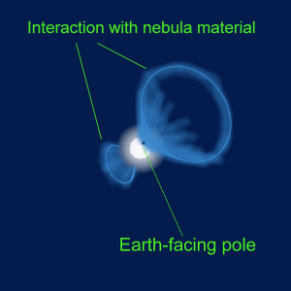
Where’s the Hydrogen?
Young stars have strong winds
The light elements were blown out of the system over time. You have to form planets before this happens!
Notes:
Since things with mass will orbit the sun, and Hydrogen and Helium have mass… Shouldn’t they still be in orbit?

Slide 46
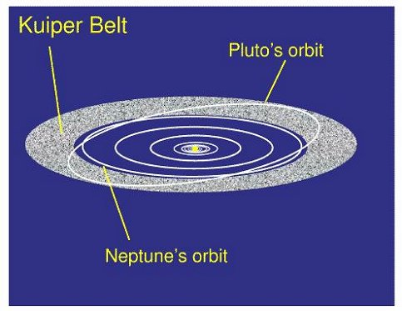
Leftover Rocks and Ice
The Kuiper belt is leftover debris from jovian planet formation
There just wasn’t enough stuff to make another planet
Notes:
This is where most of our dwarf planets live (Pluto, Eris, Sedna, others which haven’t been confirmed yet).

Slide 47
Leftover Rocks and Ice
Notes:
This is where most of our dwarf planets live (Pluto, Eris, Makemake, Haumea. The others haven’t been confirmed as dwarf planets yet). Remember Ceres is also a dwarf planet!! So we have five.

Slide 48
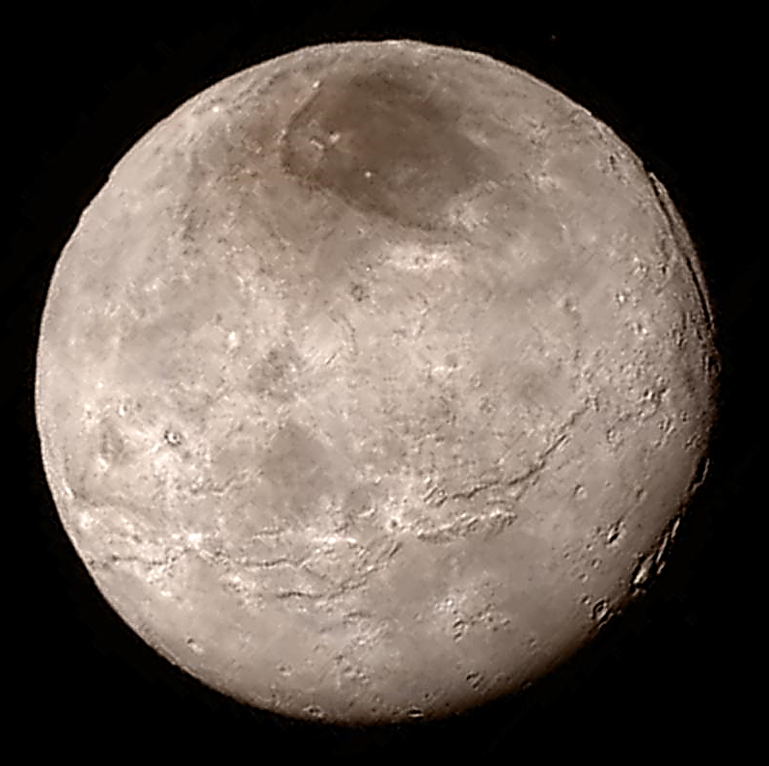
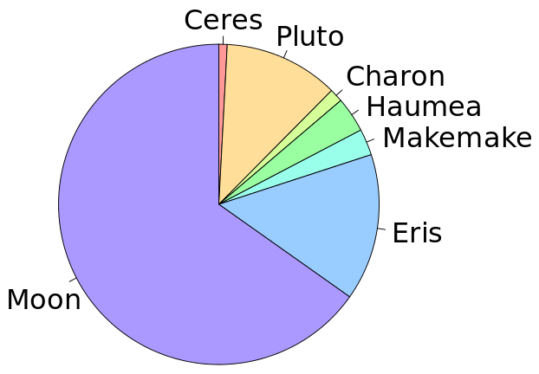
Leftover Rocks and Ice
Charon
masses
Dwarf planets:
Weird orbits
Did not clear orbit
Still spherical!
Pluto
Notes:
This is where most of our dwarf planets live (Pluto, Eris, Makemake, Haumea, Sedna, Quaoar, others which haven’t been confirmed yet).
http://www.slate.com/blogs/bad_astronomy/2015/10/02/charon_new_closeup_color_photos.html

Slide 49
Planetary Formation
A Formation Scenario must answer
Origins of the orderly motion.
Differentiation of material
Rubble
Exceptions

Slide 50
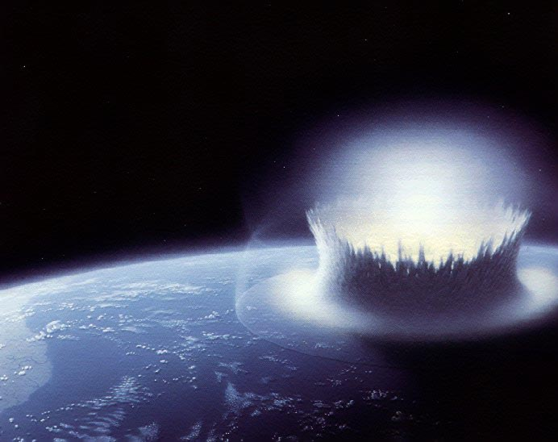
Exceptions
Notes:
KABOOM!

Slide 51
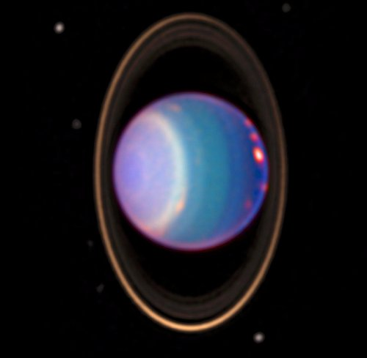
Uranus’ Tilt
A big collision is the leading hypothesis

Slide 52
Venus’ Spin
A big collision is the leading hypothesis

Slide 53
Origin of the Moon
A big collision is the leading hypothesis

Slide 54
Captured Moons
Deimos
Phobos
Notes:
Mostly angular momentum arguments… Everything lines up along the original angular momentum axis

Slide 55
Heavy Bombardment
There were lots of big rocks flying around the early solar system!
Some of them hit things! BOOM!
until about 3.8 billion years ago

Slide 56
Why?
Notes:
Jupiter is the one throwing its mass around the most, but the other Jovian planets got into the act as well. Even now, (mostly) Jupiter perturbs things out even in the Kuiper belt or further out in the Oort cloud, which is how we get new comets…

Slide 57
Solar System Age
Radiometric dating of rocks
Stellar evolution theory
about 4.5 billion years old
Notes:
1) Things decay at a fixed rate. Some of the decay products are gases.
By looking at the ratio of the radioactive element to the decay product, the formation date can be calculated.
2) We understand how stars work and can date the sun based on our knowledge
They agree to within 100 million years.

Slide 58
What can impacts explain?
Venus’ spin
Captured moons
Axis tilts
Mercury’s high density*
AND our moon!
*bonus!

Slide 59
Planetary Formation
A Formation Scenario must answer
Origins of the orderly motion.
Differentiation of material
Rubble
Exceptions

