Slide 1
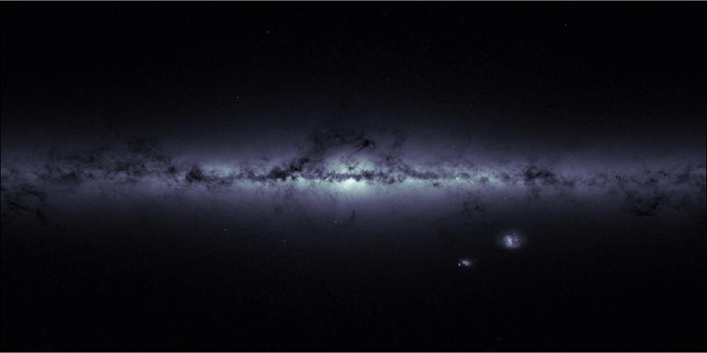
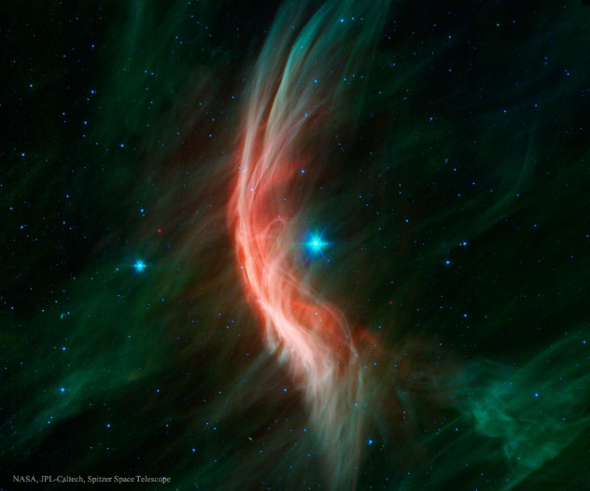
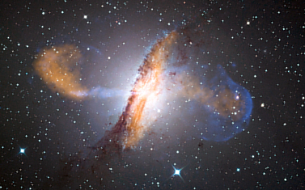
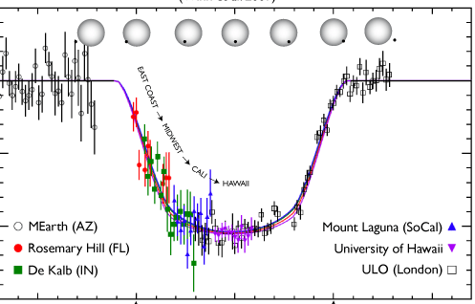
What do we want to know?
What stuff is out there?
What’s it made of?
Underlying physics?
Is it changing over time?
Notes:
How do we answer these questions?
Images:
Milky way: http://www.cosmos.esa.int/web/gaia/iow_20150703 ESA/Gaia-CC
Zeta Oph: http://apod.nasa.gov/apod/ap150705.html (NASA/JPL/Spitzer)
Centaurus A: ESO/WFI (Optical); MPIfR/ESO/APEX/A.Weiss et al. (Submillimetre); NASA/CXC/CfA/R.Kraft et al. (X-ray) https://en.wikipedia.org/wiki/File:ESO_Centaurus_A_LABOCA.jpg
Exoplanet timing: http://www.personal.psu.edu/ebf11/mystuff/press.html (Eric Ford, journal article: http://iopscience.iop.org/0004-637X/703/2/2091/pdf/0004-637X_703_2_2091.pdf)

Slide 2
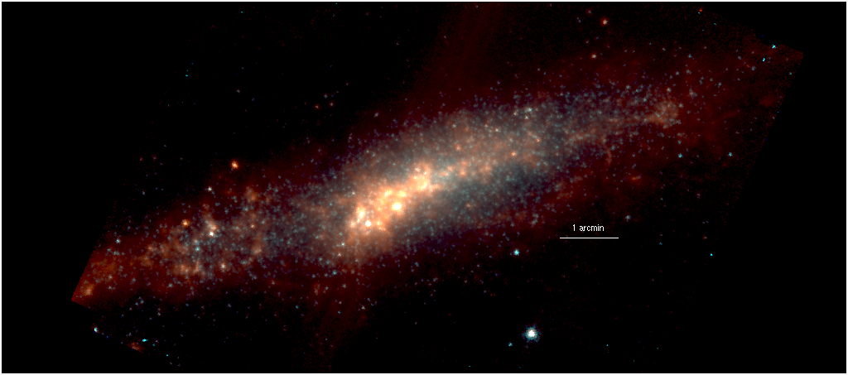
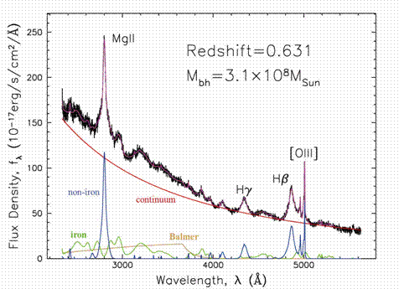
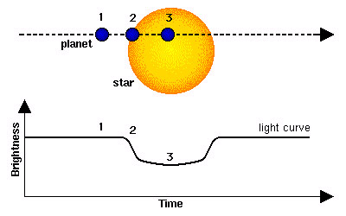
Types of Observations
Imaging
Spectroscopy
Time
Notes:
When we make observations, what are the things we can find out? What are we trying to do?
Imaging can tell us a lot about the object we are looking at
Components (stars, gas, dust, etc.)
Morphology (size and shape)
Brightness
Rough colors from different filters
Spectra tell us more about the physics that is taking place
Composition
Temperature
Radial motion
Rotation
Timing tells us how an object is changing over time
This can be done with either imaging or spectroscopy
How an object’s brightness changes over time
How temperature changes over time
Useful for detecting extra-solar planets, variable stars, etc.

Slide 3
Challenges
Things are really DIM
Need even more light to do this
Things are really small too
Notes:
When we make observations, what are the things we can find out? What are we trying to do?
Imaging can tell us a lot about the object we are looking at
Components (stars, gas, dust, etc.)
Morphology (size and shape)
Brightness
Rough colors from different filters
Spectra tell us more about the physics that is taking place
Composition
Temperature
Radial motion
Rotation
Timing tells us how an object is changing over time
This can be done with either imaging or spectroscopy
How an object’s brightness changes over time
How temperature changes over time
Useful for detecting extra-solar planets, variable stars, etc.

Slide 4
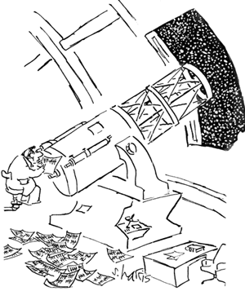
Telescopes

Slide 5
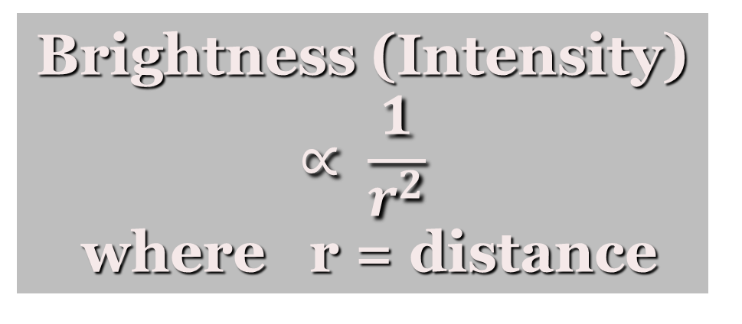
Light: Why so dim?
Brightness (Intensity)
$$∝ \frac{1}{r^{2}}$$
where r = distance
Further away = Dimmer

Slide 6
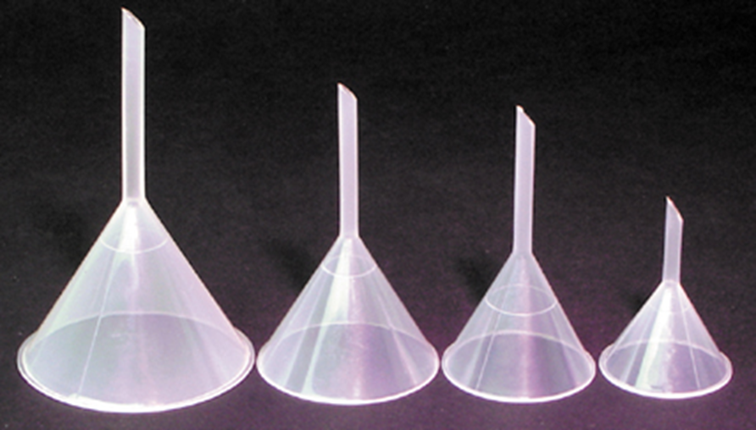
Dim things: Gathering Light
=
π
r
2
A
Telescopes are photon funnels
Notes:
If I want to catch more rain… I should use a bigger funnel.
If I want to catch more photons, I should use a bigger mirror. This lets us see really faint things, like far away galaxies or very small dim planets.
If I double the telescope diameter, I quadruple the collection area.
[Note this is a different area than for a star! Stars are spheres, light collecting area is a flat circle]

Slide 7
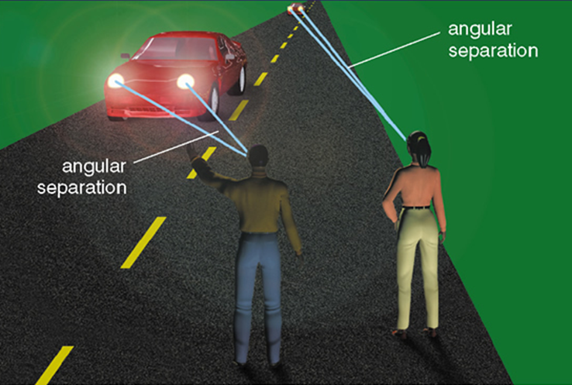
Small things: Angular Separation
The apparent angle between two distant points
1° = 60’
=3600”
1’= 60”
Notes:
Imagine two long lines extending from your eye, one to each distant point.
The angle between the lines is the angular separation.
Objects appear smaller (have a smaller angular separation) as they are moved further away
Angles are measured in degrees. There are 360 degrees in a circle.
For small angles, we subdivide a degree into 60 arc minutes and each minute into 60 arc seconds.
So… There are 3600 arc seconds per degree

Slide 8
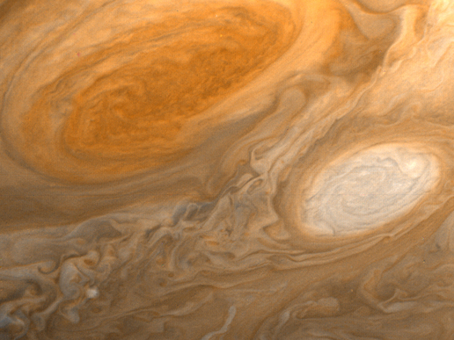
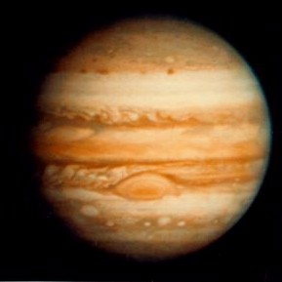


Angular Resolution
Rayleigh Criterion
λ
The quality of the image depends on this… not magnification
θ
∝
D
Notes:
Less fuzziness! You see things bigger AND better!
Our ability to distinguish one point from another depends on the angular resolution which in turn depends on the size of the telescope mirror or lens.

Slide 9
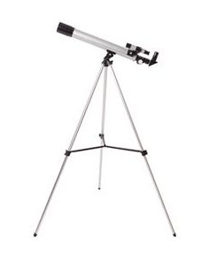
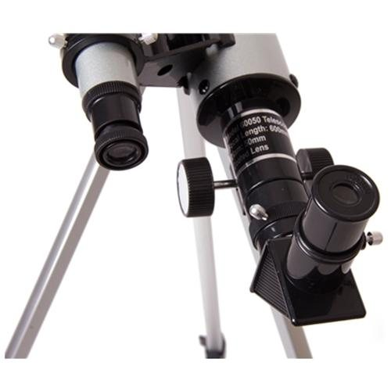

Small things: Magnification
So Magnify !!!!
Much Excite!
Three
Eyepiece!!!!
wow
Notes:
Magnification: don’t buy any telescope where this is the selling point. You can change magnification by changing eyepieces.

Slide 10
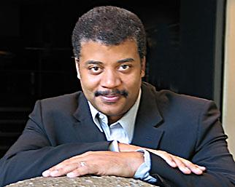
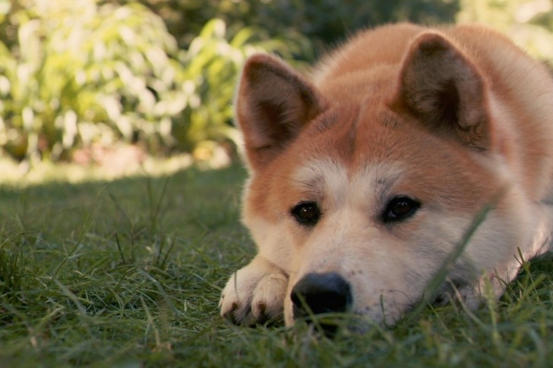
Small things: Magnification
No, Doge, this is not what you need
Such sad
Many cry

Slide 11
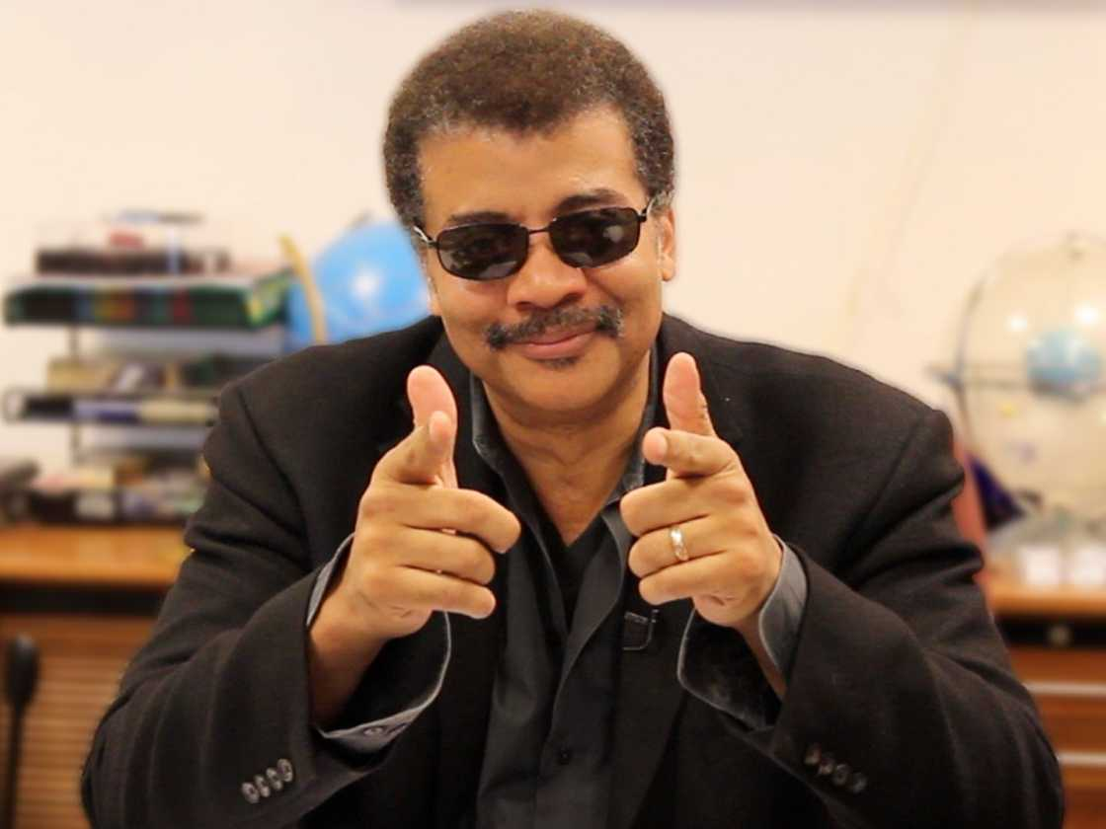
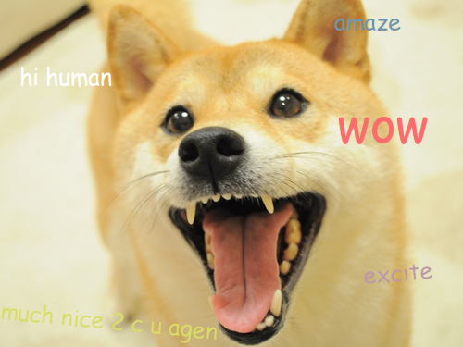
Small things: Magnification
You need a bigger telescope!
Notes:
With a BIG telescope you get magnification for free -- AND….

Slide 12
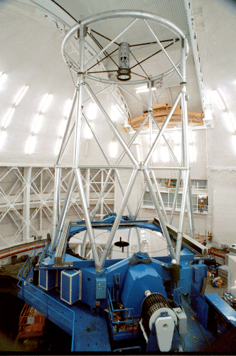
Why Big Telescopes?
We can gather more light
We can see finer detail
Incredible magnification
Notes:
You do get magnification for free, with larger telescopes, but that’s not the reason to do it

Slide 13
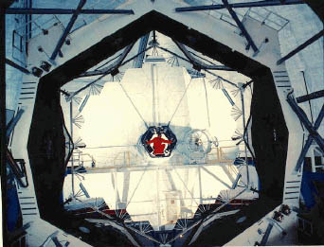
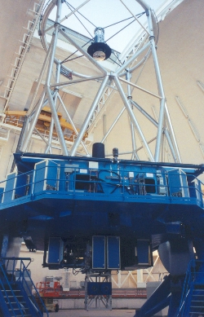
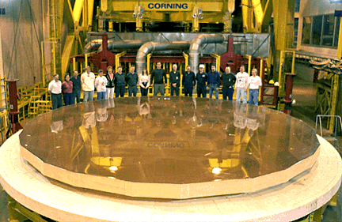
Mirrors = Big!
Notes:
Most modern telescopes use mirrors.
The top left mirror is from one of the twin Keck telescopes on Mauna Kea in Hawaii.
At 10 meters, it is currently the largest optical telescope in the world (approximately 845 square feet of glass)
It is not a single piece of glass, it is made up of 36 hexagonal segments.
The bottom left picture is the solid 8 meter Gemini telescope primary mirror.
The There are hexagonal pockets on the back of the mirror to make it lighter.
The picture on the right is the fully assembled Gemini telescope. Notice that it doesn’t have a tube.

Slide 14
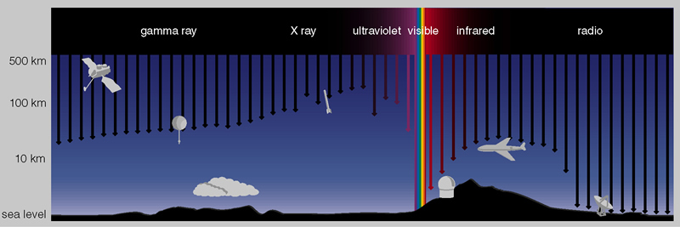
Challenges: Atmosphere
The opacity of the atmosphere depends on the wavelength
Opacity: The amount of light that passes through a given material.
Notes:
The atmosphere happens to be transparent at optical wavelengths.
This is not so at other wavelengths.
If we can’t catch photons of a particular wavelength on the ground, we have to get above the atmosphere.
Lecture tutorial: Telescopes & Atmosphere, pg. 51

Slide 15
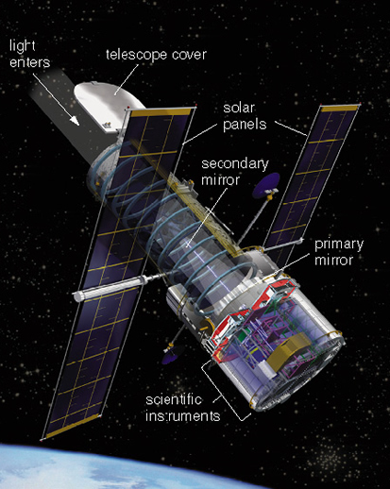
Solutions
Space!
Advantages
  Takes care of opacity.
  Takes care of seeing
Disadvantages
  Expensive
  Really Really Expensive
Notes:
We are also still limited by the telescope diffraction limit
The Hubble mirror is only 2.4 meters. Compare this to Keck’s 10 meter mirror.

Slide 16
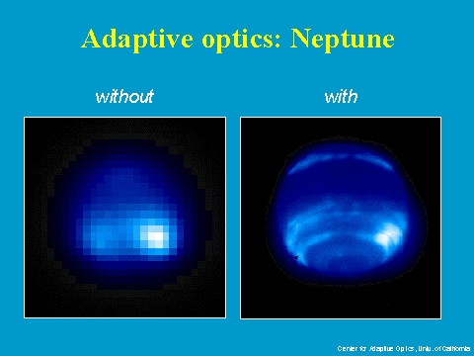
Solutions: Adaptive Optics
Fixing atmospheric distortions.
Does not fix atmospheric opacity
Notes:
Adaptive optics systems actively measure and correct for atmospheric turbulence in real time.
There are mid-level solutions as well, such as balloon observatories and observatories on airplanes.
For some wavelengths, these are valid solutions to the absorption problem.

Slide 17
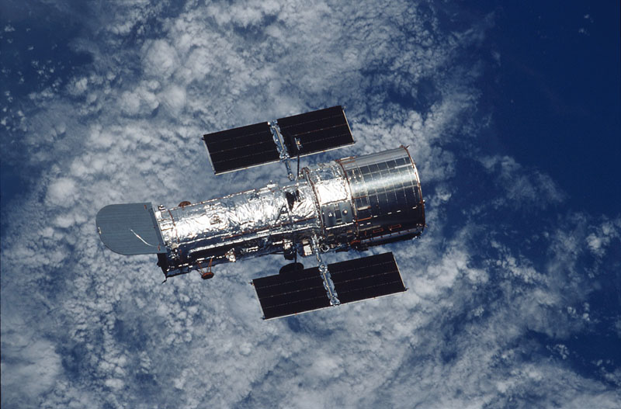
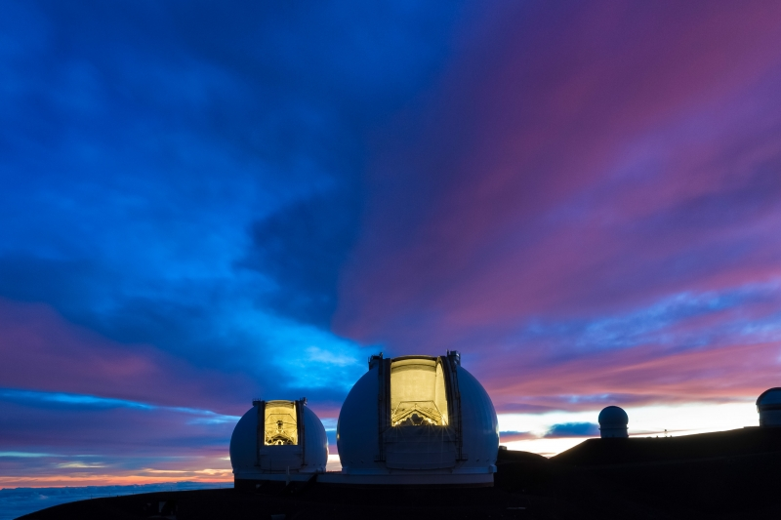
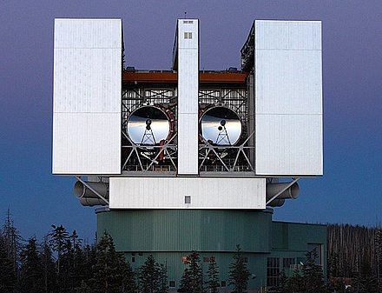
Visible/IR Energy Telescopes
Notes:
Actually we can use more than one telescope in other wavelengths too – both the large binocular telescope and Keck observe at visible wavelengths. Keck also observes in the infared. LBT has an effective diameter of meters, and Keck has an effective diameter of .
Hubble operates on its own, above the atmosphere, observing primarily in the optical and near infrared. Hubble’s diameter is 2.4 meters.

Slide 18
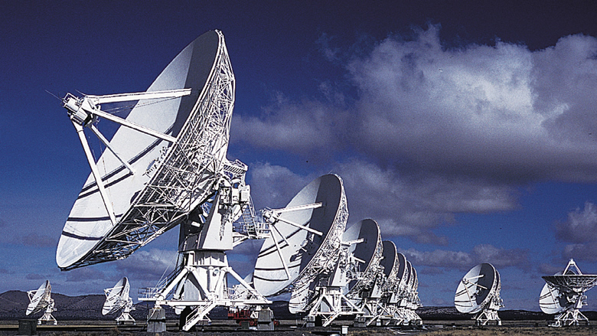
Low Energy Telescopes
Glass mirrors are transparent at radio frequencies
So we make them out of something else
Notes:
Loooong radio waves require huge dishes (apertures) to overcome the diffraction limits.
We can cheat a little bit by placing two dishes a long way away.
Then (in terms of diffraction anyway) it’s like having one really big dish.

Slide 19
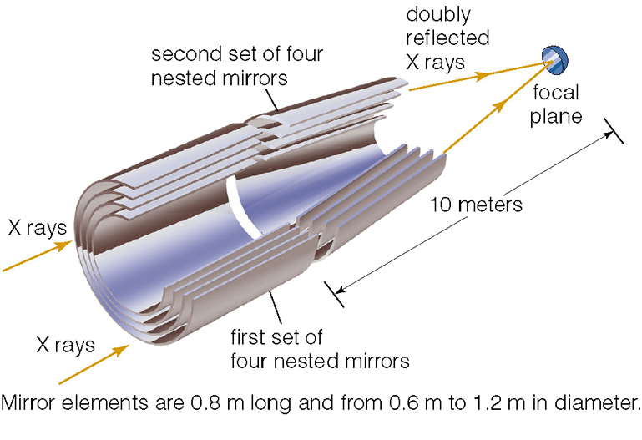
High Energy Telescopes
Glass is opaque at X-ray frequencies
Notes:
And it’s hard get big reflection angles with x-rays
So we build our mirrors with grazing reflection angles.

