Slide 1
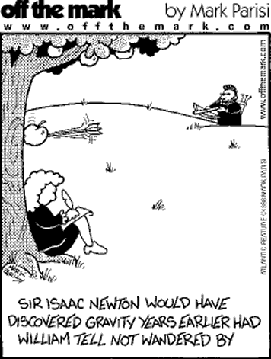
Modern Physics
Isaac Newton
Three laws of motion
Universal Gravitation
Calculus (kind of, Leibniz did too)
Simple central principals from which all motion, either on Earth or in the heavens, can be derived.
Notes:
Gottfried Leibniz also invented calculus.
India had a long history of trigonometry as witnessed by the 8th century BCE treatise Sulba Sutras, or rules of the chord, where the sine, cosine, and tangent were conceived. Indian mathematicians gave a semi-rigorous method of differentiation of some trigonometric functions. In the Middle East, Alhazen derived a formula for the sum of fourth powers. He used the results to carry out what would now be called an integration, where the formulas for the sums of integral squares and fourth powers allowed him to calculate the volume of a paraboloid.^{[7]} In the 14th century, Indian mathematician Madhava of Sangamagrama and the Kerala school of astronomy and mathematics stated components of calculus such as the Taylor series and infinite series approximations
In the 17th century, European mathematicians Isaac Barrow, René Descartes, Pierre de Fermat, Blaise Pascal, John Wallis and others discussed the idea of a derivative.
On the integral side, Bonaventura Cavalieri developed his method of indivisibles in the 1630s and 1640s. Evangelista Torricelli extended this work to other curves such as the cycloid, and then the formula was generalized to fractional and negative powers by Wallis in 1656. In a 1659 treatise, Fermat is credited with an ingenious trick for evaluating the integral of any power function directly
Importantly, Newton and Leibniz did not create the same Calculus and they did not conceive of modern Calculus.

Slide 2
Newton’s First Law
The Law of Inertia
Galileo already
said this
The NATURAL state of motion is to resist changes.
Notes:
Aristotle says:
The natural state of objects on the Earth is a state of rest.
Newton Says:
The natural state of motion of an object is to keep doing what it’s doing.
Galileo had already said this.
Aristotle divided the universe into “The Heavens” and “The Earth”
The “Heavens” were eternal and unchanging. The natural state of the heavens was perfect motion.
The Earth was temporary and ever changing.
The natural state of motion of Earth bound objects was rest.
Newton (and Galileo) said that the natural state of motion is to not change.

Slide 3
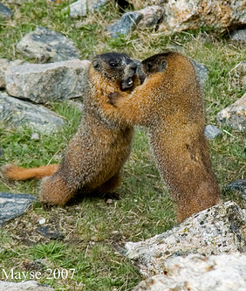
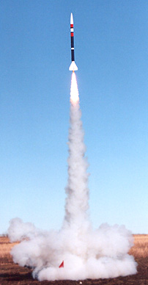
Newton’s Third Law
“For every action, there is an equal and opposite reaction”
If you PUSH on something, it pushes back
Notes:
Forces come in pairs.
If you apply a force to something, it responds by pushing back.
As I push against a baseball to throw it, I can FEEL it pushing back.
This is how rockets work. We push mass out the back of the rocket and the opposing force pushes back, propelling the rocket forward.
A few examples of force pairs:
Standing on the ground (ground pushes on me; I push on the ground)
Pushing on a wall (I push on wall; wall pushes on me)
Bug hitting a windshield
Throwing a baseball
The effects of those forces can be vastly different, but the forces are the same

Slide 4
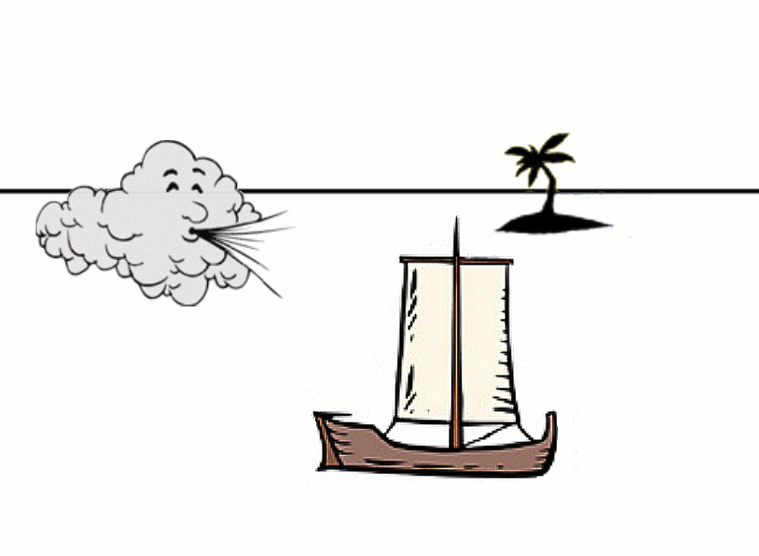
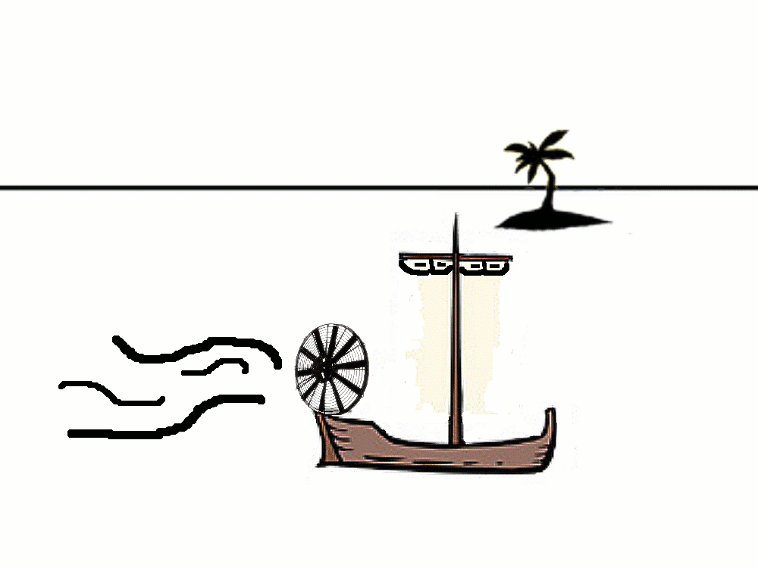
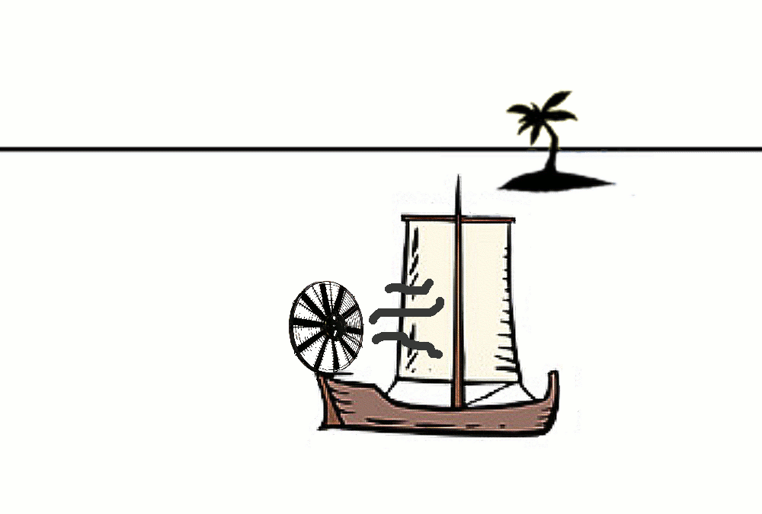
What do you think?
Case 1: Sailboat
Case 2: Fan Boat
Case 3: Sail + Fan
A: Left B: Right C: Neither
Notes:
Which direction will the boat move, and why?
Discuss Case 3 first, then vote. Revote after additional discussion if needed.

Slide 5
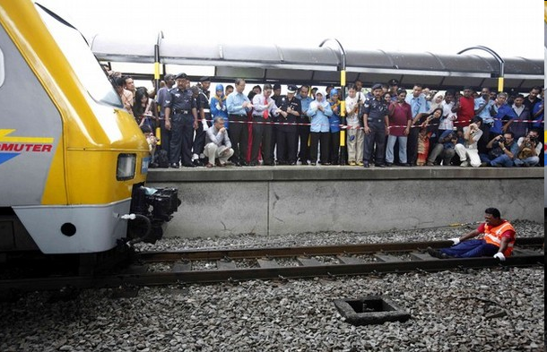
Newton’s Second Law
a = F/m
A change in motion is caused by a FORCE
Notes:
Galileo didn’t say this.
To get an object to change, a force must be applied.
When we push the gas pedal in the car, the engine generates a force causing the car to move.
Why does the car stop if I stop pushing with the engine?

Slide 6
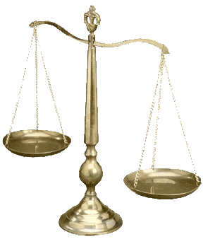
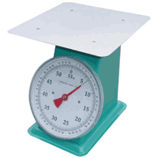
Mass
Measures Mass
Measures Force
Notes:
Balance scale:
Balance test object against a REFERENCE mass
Independent of gravitational force.
You’ll get the same answer on Mars as on Earth
Spring scale.
Measurement is dependent on gravitational force.
Measures how far a spring is stretched or compressed,
which is a measure of FORCE.
You’ll get DIFFERENT answers on Earth versus Mars

Slide 7
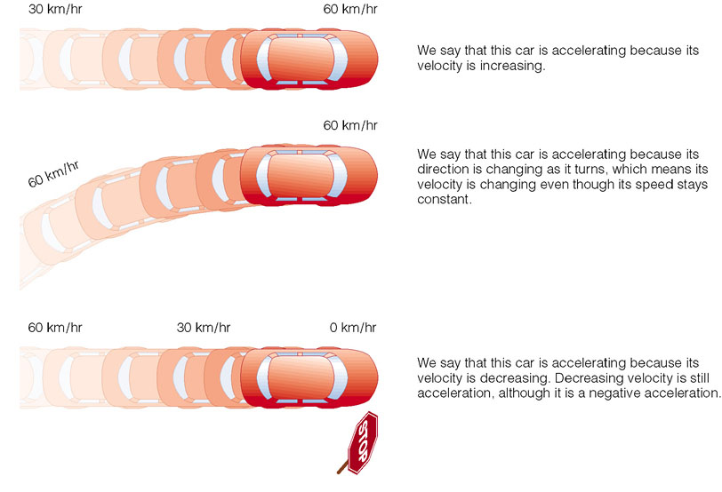
Acceleration
Notes:
So… forces cause changes in velocity… or accelerations.
The acceleration is proportional to the force… and inversely proportional to the mass.

Slide 8
Universal Law of Gravitation
Objects having mass exert an attractive force on one another.
This force is:
Proportional to the product of the masses
Inversely proportional to the square of the distance between them.
Notes:
Phew! What a mouthful! What does it mean?
Give proportional examples: number of apple slices is proportional to the number of apples I start with. Doubling a recipe: I need to double each ingredient (usually). Making skirts – I need twice as much fabric to make twice as many skirts for myself.
Give inverse proportional examples: time needed to dig a hole is inversely proportional to the number of people digging. As temperature increases, sale of sweaters decreases. Etc.

Slide 9
Universal Law of Gravitation
Objects with mass exert an attractive force on one another.
Notes:
But often on Earth we see: F = m g. The “m” is the mass of the object you are dropping.
What is “g”? g = G M_{earth} / r_{earth}²
g is also the acceleration of whatever you’re dropping. Remember F = m a!

Slide 10
Which Falls Faster?
Notes:
Exercise… Reason it out… not just a prediction.
I want the answer to talk about gravitation, mass, and acceleration.

Slide 11
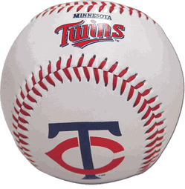
Why do they land at the same time?
A Light object and a Heavy object strike the ground at the same time because:
A. The force of gravity is the same.
B. The Earth is MUCH bigger so the mass difference doesn’t matter.
C. The force of gravity isn’t the same, but the acceleration is the same.
D. Heavy objects fall faster.
Notes:
Fg, bowling ball = m bowling ball * g since the mass is larger than the baseball, the force is larger.
Is the earth much bigger? Yes. But twice the mass still is twice the force.
However the “g” is the same! That only depends on the mass of the Earth and the distance, which is the same for both. This is the accceleration – which means the change in speed, which is what changes position! So they change at the same rate, they must hit at the same time. [What about the acceleration of the Earth? Much smaller!]
Heavy objects, it turns out, do NOT fall faster. Even if you want them to!

Slide 12
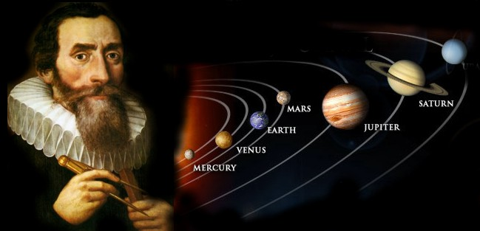
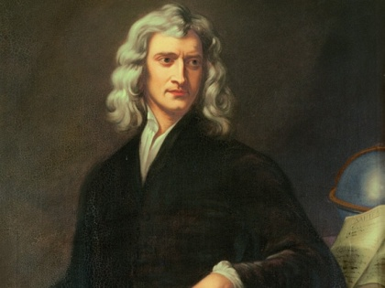
Does it work?
Newtonian mechanics provides extremely accurate predictions.
Kepler’s Laws are a special case.
Notes:
Extremely accurate, that is, until we get near something really REALLY massive, or start moving very VERY fast (~1/3 the speed of light). But that doesn’t happen every day.

Slide 13
Kepler’s Laws
P² = ka³
So what is that constant?
$P^{2}$ = k₂ $\frac{a^{3}}{(M_{1}+M_{2})}$
M₁ and M₂ are the masses of our orbiting objects!
Notes:
Our constant is just the mass of our two bodies orbiting each other! But why do we get the same thing for all the planets? Jupiter has a lot more mass than Earth, so why does this still work?
Even though Jupiter has a lot more mass than Earth, it is still MUCH MUCH smaller than the mass of the Sun! So, we can ignore the M2 in the equation because it’s so much smaller than M1. M1+M2 is the total mass of the system.
NOTE: we are using special units (P in years, a in AU). If we do this, the mass comes out in Solar Masses (our sun is 1 solar mass). But what if we use real units?

Slide 14
Kepler’s Third Law
$P^{2}$ = $\frac{G}{4π}\frac{a^{3}}{(M_{1}+M_{2})}$
Notes:
Now we can use real units! G = 6.67 x 10⁻¹¹ m³/kg/s²

Slide 15
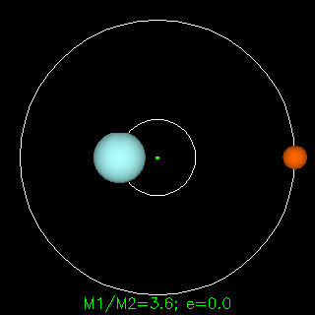
Kepler’s Laws
Binary Stars… it still works!
Notes:
Now I can’t ignore the mass of the secondary object… it’s too big!

Slide 16
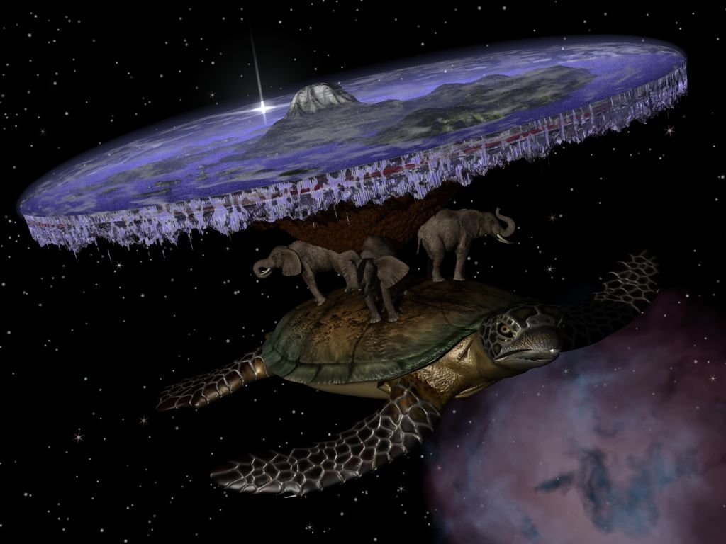
Tutorial: Kepler’s Laws
Pages
25 & 26
Notes:
Class discussion:
Page 21; Kepler’s 2nd Law tutorial
SKIP Page 22
Page 23: Kepler’s 2nd Law tutorial
Page 24: Kepler’s 2nd Law tutorial
Ask: Which one changes the most (percentage-wise)?
Tutorial: Kepler’s 3rd Law pages 25 and 26 only

