Slide 1
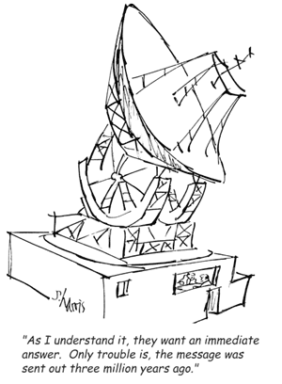
Light

Slide 2
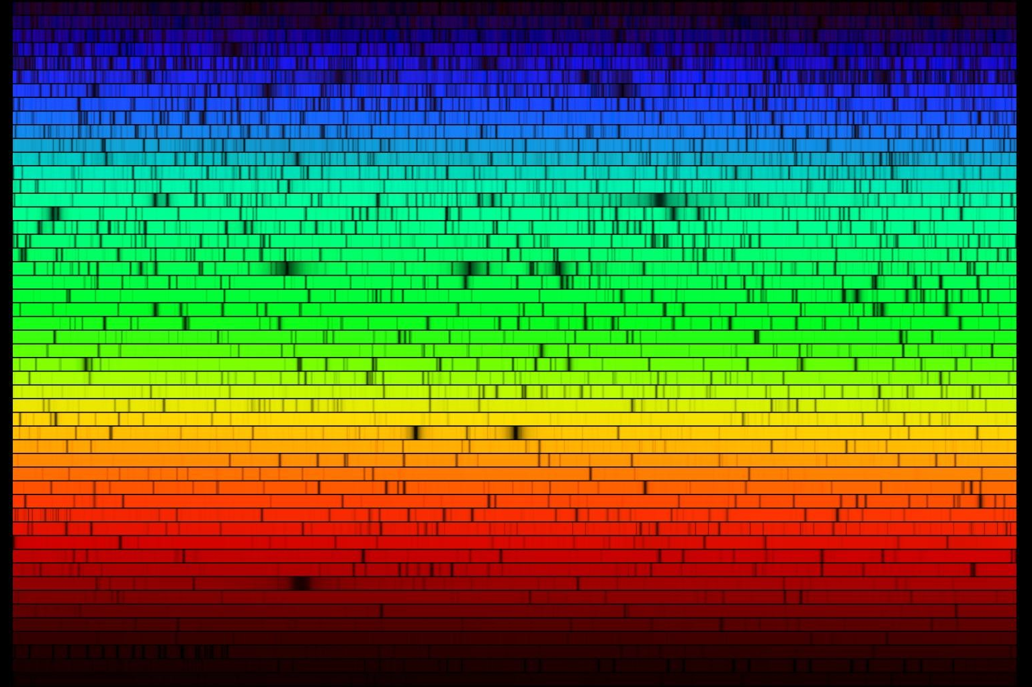
Big Question:
How do we know what we know?

Slide 3
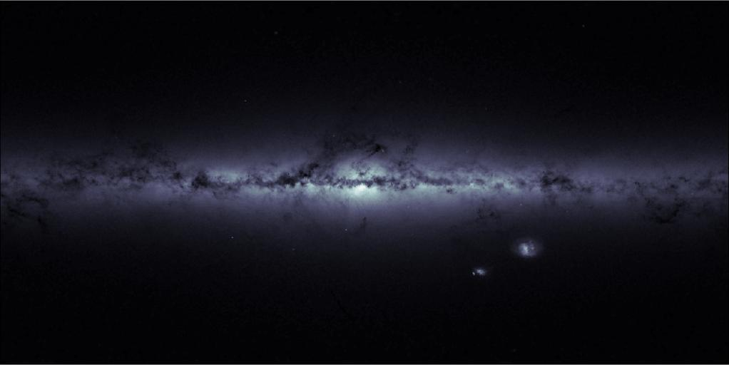
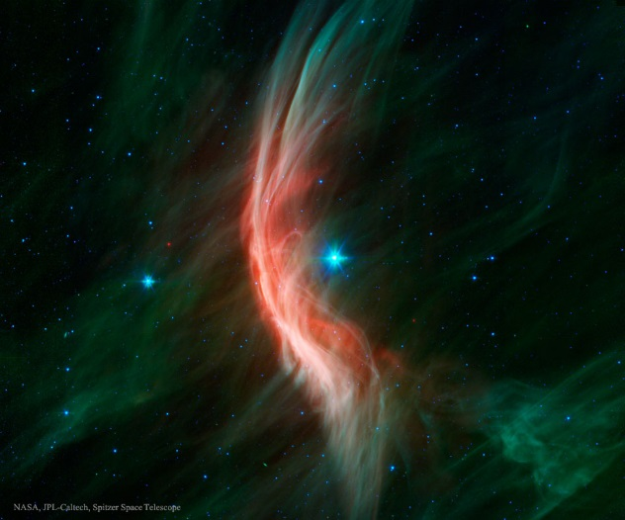
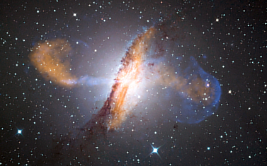
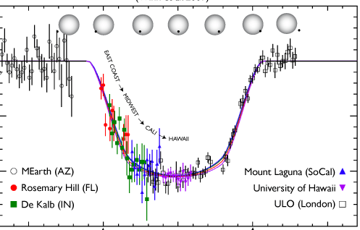
What can Light tell us?
What stuff is out there?
What’s it made of?
Underlying physics?
Is it changing over time?
Notes:
How do we answer these questions?
Images:
Milky way: http://www.cosmos.esa.int/web/gaia/iow_20150703 ESA/Gaia-CC
Zeta Oph: http://apod.nasa.gov/apod/ap150705.html (NASA/JPL/Spitzer)
Centaurus A: ESO/WFI (Optical); MPIfR/ESO/APEX/A.Weiss et al. (Submillimetre); NASA/CXC/CfA/R.Kraft et al. (X-ray) https://en.wikipedia.org/wiki/File:ESO_Centaurus_A_LABOCA.jpg
Exoplanet timing: http://www.personal.psu.edu/ebf11/mystuff/press.html (Eric Ford, journal article: http://iopscience.iop.org/0004-637X/703/2/2091/pdf/0004-637X_703_2_2091.pdf)

Slide 4
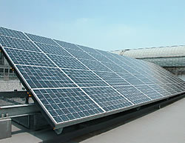
Light Interactions
Emission
Reflection
Absorption
Notes:
We will talk about each of these things in turn… but first let’s take a look at a tool we can use to examine light. We’ve already seen the word “spectrum” but we didn’t really define it….

Slide 5
The Spectrum
The visible part of the spectrum is pretty small
On your own: Lecture tutorial p 47
Notes:
Visible meaning your eye can see it
But it’s ALL light
Radio waves are light with a looong wavelength

Slide 6
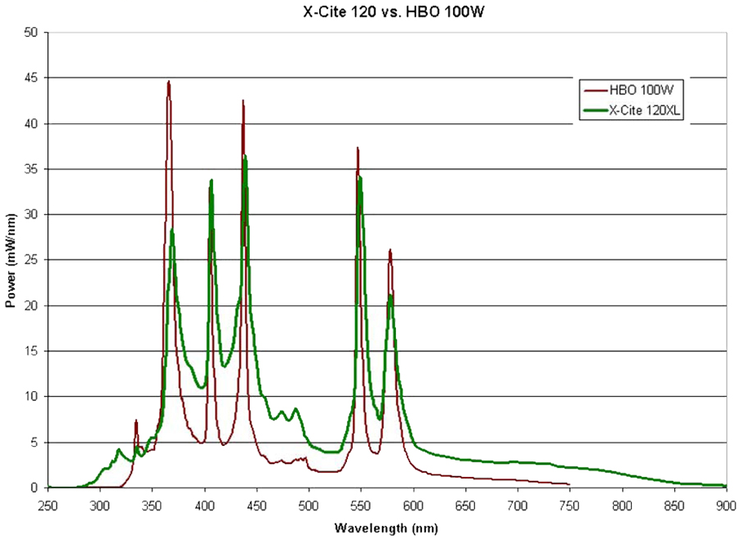
What is a “spectrum?”
A plot of
#Photons per second versus Wavelength
Notes:
# of photos = brightness

Slide 7
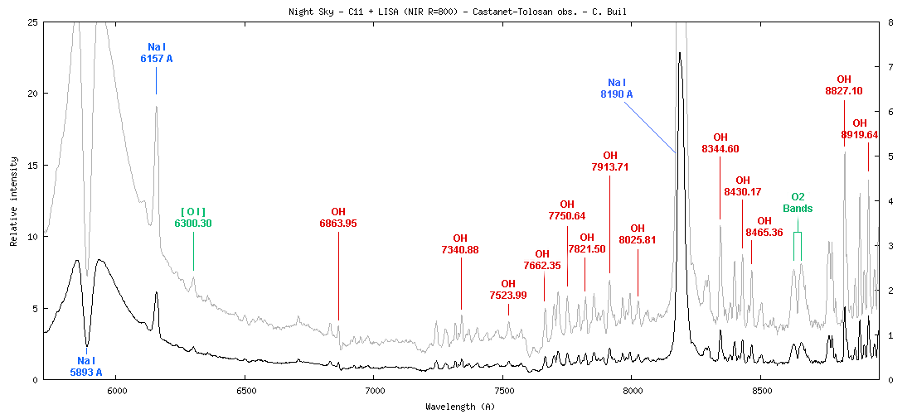
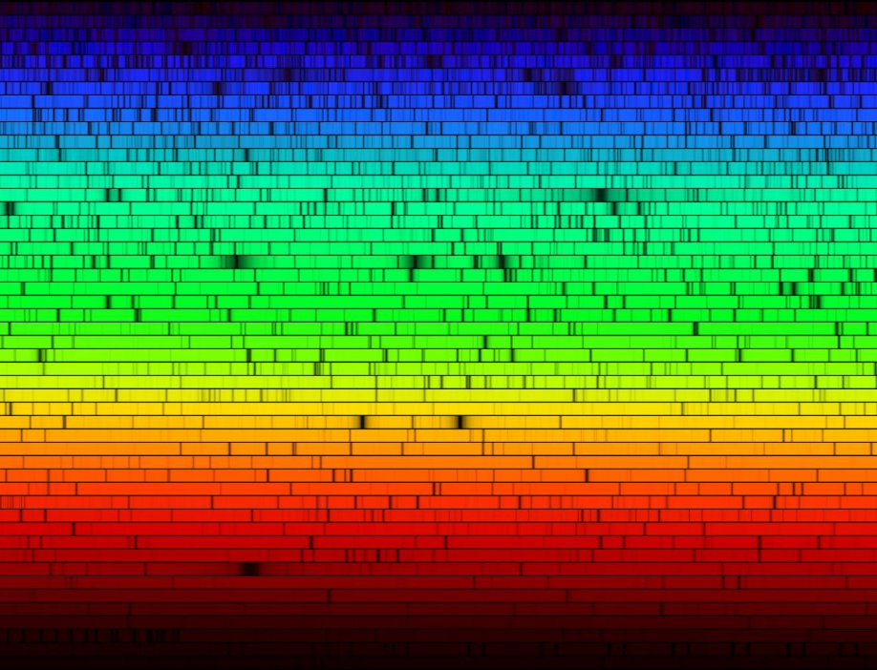
Types of Light:
Thermal Emission
Emission Lines
Absorption Lines
Notes:
Lecture tutorial: Temperature and Luminosty, part 1 through question 5 only (p 55)
Lecture tutorial: Blackbody Radiation.
Everything with a temperature emits light.
Including all of us! We don’t emit at wavelengths that can be seen by our eyes.
But we have special cameras that can see our light…
*** NOTE: Thermal Emission is the same thing as Blackbody Emission or Continuous Emission! ***

Slide 8
Thermal Emission
Everything with a temperature emits light
Lecture tutorial p 55 – Part 1 through # 5 only
Notes:
Lecture tutorial: Temperature and Luminosty, part 1 through question 5 only (p 55)
Lecture tutorial: Blackbody Radiation.
Everything with a temperature emits light.
Including all of us! We don’t emit at wavelengths that can be seen by our eyes.
But we have special cameras that can see our light…
*** NOTE: Thermal Emission is the same thing as Blackbody Emission or Continuous Emission! ***

Slide 9
Why?
Stars emit thermal radiation
Lecture tutorial p 59
Notes:
Discussion: What do we need? What conditions?
Are there other situations that are not the same? That might emit light? What other things might happen to light? (remember earlier!)

Slide 10
Thermal Emission
Intensity
Wavelength
Notes:
Blackbody emission is emission from DENSE objects.
The spectrum that we see is known as a Black Body curve.
The Black Body curve changes as we change the Temperature of an object.
What color does the 15,000 K star appear to our eyes?
What color does the 3000 K star appear to our eyes?

Slide 11
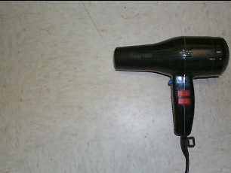
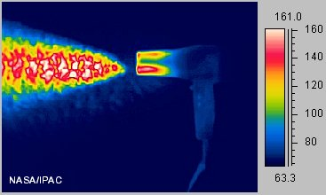
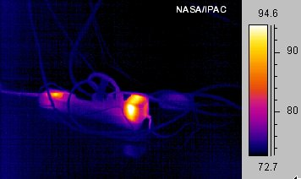

Slide 12
Wien’s Law
λ
T
=
Constant
max
λ
max
Ι
max
So, we can remotely measure Temperature
Notes:
The coordinates of the peak of the blackbody gives us information.
The “x-coordinate” of the blackbody peak is called Lambda Max.
Lambda Max is related to the temperature of the object.
T = Temperature.
The Constant is the same for EVERY blackbody emitter in the Universe.
I can know the Temperature of an object by taking a spectrum and measuring Lambda Max!

Slide 13
Intensity
=
4
Ασ
Itotal
T
So, we can remotely estimate SIZE
Notes:
The coordinates of the peak of the blackbody gives us information.
The “y-coordinate” of the blackbody peak is called Maximum Intensity
Maximum Intensity is related to the temperature AND the Surface Area of the object.
A = Surface Area
T = Temperature
I can know the Size of an object by measuring the Maximum intensity and the Temperature!

Slide 14
Stars In Space
=
4
Ασ
λ
=
Itotal
T
T
Constant
max
 | λmax | Imax
R
T
If I Increase R, what happens to I_{max} and λ_{max}?
If I Increase T, what happens to I_{max} and λ_{max}?
Notes:
Given our two relationships for Blackbody emitters, let’s think about Stars In Space!
Increasing R increases the SIZE of the star. That makes Imax go up, but leaves Lambda max unchanged.
Increasing T increases BOTH lambda max AND Imax.
The blackbody spectrum helps us with temperature (first) and size (second). But to get a real size we need to know something about distance, or some other property (e.g. this is a main sequence star: fusing H to He in its core).

Slide 15
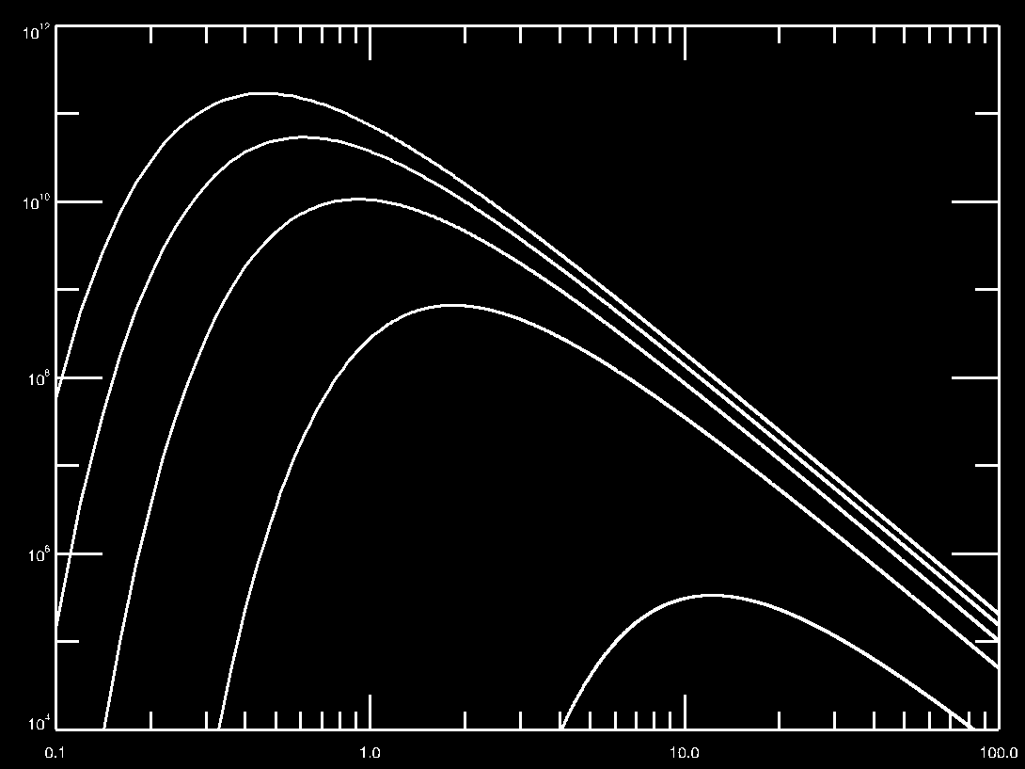
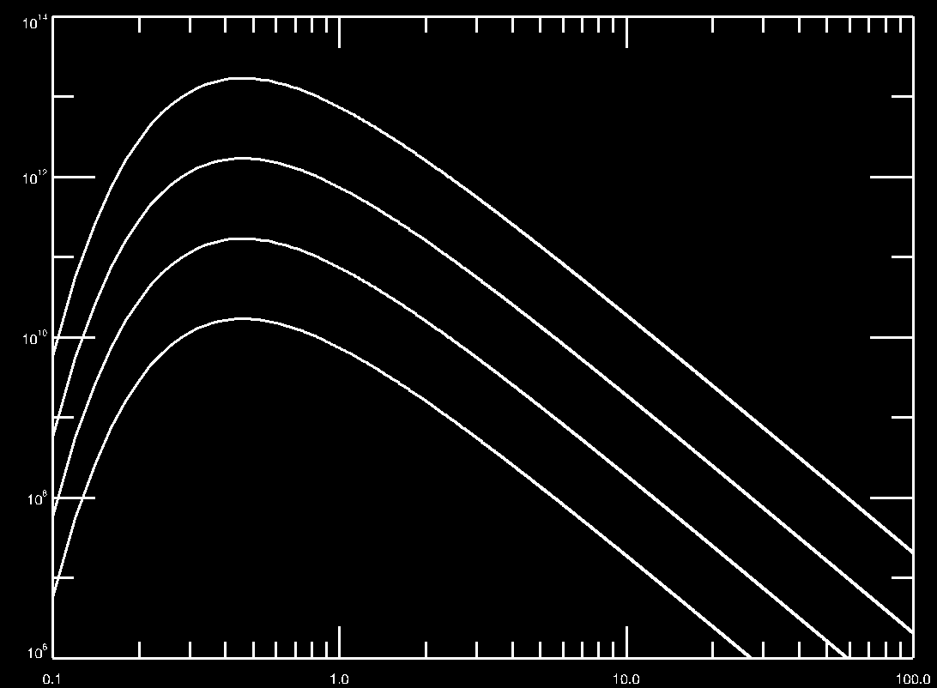
Looking at Stars
A
B
Which panel represents adjusting Temperature?
Which panel represents adjusting Radius?
Notes:
Blackbody spectrum: hot, dense (by dense, I mean opaque) objects

Slide 16
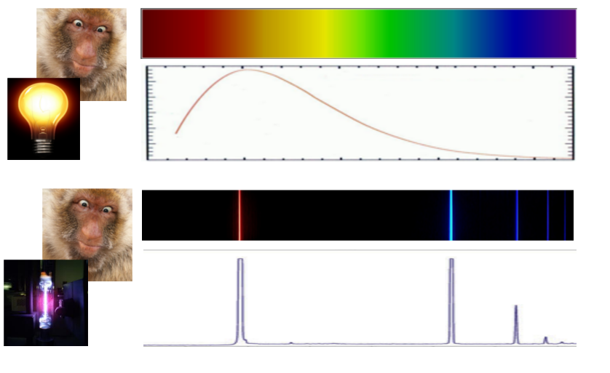
Emission Lines
Thermal spectrum
Emission spectrum
Notes:
Top: continuous, blackbody spectrum
Bottom: Emission lines
So… if we excite some atoms, we’ll see the fingerprint as emission lines.
A line is a very narrow emission feature of a very specific color

Slide 17
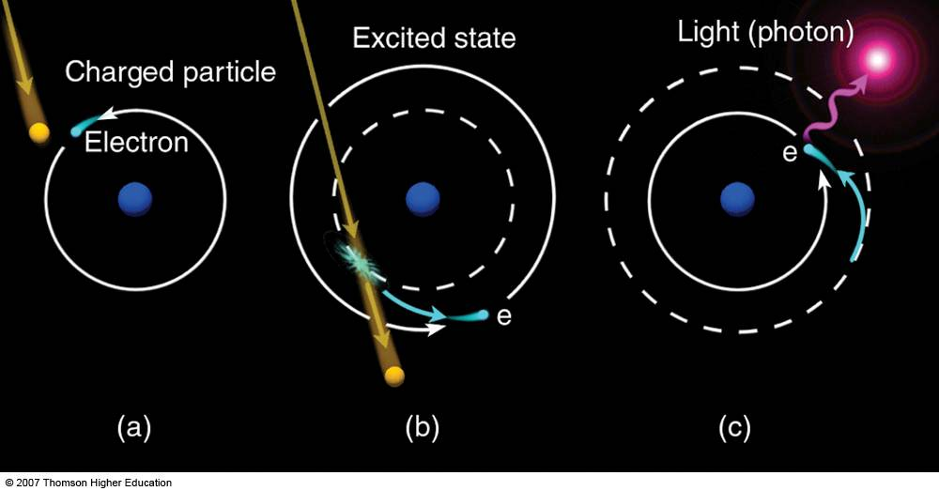
Where do emission lines come from?
Atoms: Classical View
Electrons are in orbits about the nucleus
We will talk about this in lab later
Notes:
Electrons in an atom can gain or lose energy (like the potential energy in a planetary orbit)
When they undergo a collision, the bound electron gains energy and bounces up.
It doesn’t LIKE being up, so it drops back down, losing energy and emitting a photon.
But, they can ONLY occupy discrete orbits, there are no in betweens.
Every element has its own unique set of orbital levels, and thus A fingerprint in light.
(Analogy: Pac-kid atom only likes blue and red m&ms!)

Slide 18
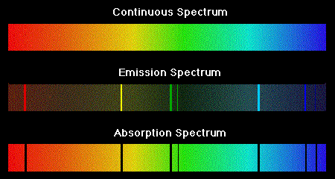
Absorption Lines
Every substance has its own spectral fingerprint
Red
Low Energy
Blue
High Energy
Notes:
The absorption spectrum is the same as the emission spectrum for a given element. Only instead of emitting light, the atom is taking light out of a background continuum (or rainbow).
Lecture Tutorial: Types of Spectra (p 63)

Slide 19
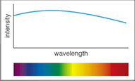
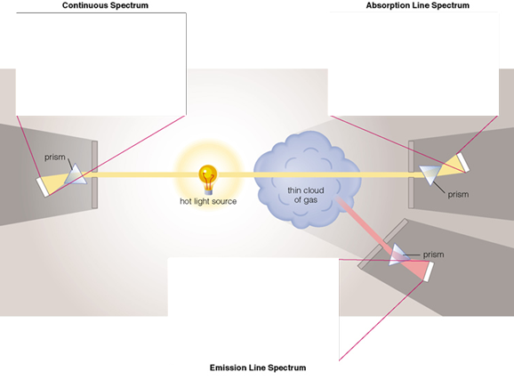
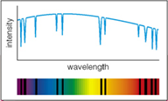
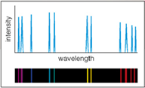
Where do these go?
Notes:
Each blue box is a different observer. What goes where?

Slide 20
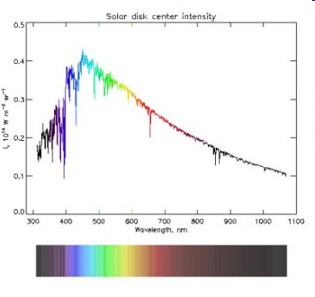
The Solar Spectrum
Notes:
What can we tell about the sun based on its spectrum?
Notice we have: underlying thermal spectrum, absorption lines, and a few emission lines. What do each of these tell us?

Slide 21
Reflection and Scattering
Notes:
We tend to think of reflection in terms of mirrors.
But reflection is how we see most objects.
Already existing photons bounce off of a surface to your eye.
Some surfaces are lumpy and scatter the light

Slide 22
Why is the Sky Blue?
For the same reason that sunsets are red.
Notes:
Wavelength dependant scattering.
Blue is scattered more strongly than red.
At sunset, the light must go through a lot of atmosphere so all of the blue is scattered out.

Slide 23
Putting it All Together
Spectroscopy!
Notes:
When we look at spectra, we generally look at a plot of intensity versus frequency or wavelength instead of the color bar.
The color bar is like looking down at the earth from a satellite. The plot is like turning the satellite view sideways so that you can see the height of the landscape.
This spectrum contains all of the things that we’ve talked about… atomic emission and absorption, scattering, reflection, thermal emission…
The job of a spectroscopist is to figure out what sort of physical configuration would give rise to such a spectrum.

Slide 24
Light Equations:
c = λ f
(special case v = c)
E_{λ} = h c / λ = h f
λ_{max} T = constant
I_{total} = A σ T⁴

Slide 25
Lab: Spectroscopy
Notes:
Three categories of spectra: Thermal (blackbody), Emission, Absorption

Slide 26
What is a “spectrum?”
The X-Axis of a spectrum could also be labeled:
A. Frequency, Color, or Speed
B. Intensity or Number of Photons
C. Frequency, Color, or Number of Photons.
D. Frequency, Color, or Wavelength
Notes:
D.
Frequency, Color, and Wavelength all refer to the properties of INDIVIDUAL photons.
Each photon has a specific Frequency, Color, and Wavelength.

Slide 27
What is a “spectrum?”
The Y-Axis of the spectrum could also be labeled:
A. Frequency, Color, or Speed
B. Intensity or Number of Photons
C. Frequency, Color, or Number of Photons.
D. Frequency, Color, or Wavelength
Notes:
B.
The Y-axis refers to the number of photons that HAVE a particular Wavelength, Color, or Frequency.
The number of photons is related to the brightness of the light.

Slide 28
Summary: What can we know?
Temperature
Size (sometimes)
Composition
Radial Velocity*
Notes:
We didn’t talk bout how to get radial velocity (moving toward/away from us) but will talk about it later.

Slide 29
What is Light?
A wave (Electromagnetic radiation)
A particle (photon)
A form of energy

Slide 30
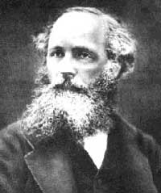
A Bit of History
Maxwell says:
Light is a wave.
Waves require a medium in which to propagate.
Except: There IS no Ether!
Notes:
The velocity of propagation of the wave depends on MY velocity through the medium (called Ether for light). Except that Michelson and Morley’s experiment found there is no difference in the speed of light no matter what direction we’re moving. Uh oh….

Slide 31
Einstein:
Light does NOT need a medium to propagate through!!
Light is made of an Electric field + a Magnetic field (weird!)
Light is a particle as well as a wave! (extra weird!)
The speed of light is a constant in a vacuum c = 3.0 x 10⁵ km/
Notes:
Why not? Light is a particle as well as a wave! Also, it is a wave made up of an electric and a magnetic field combined, unlike other waves (such as water or sound). Electric and magnetic fields can exist without a medium to be in… so if they wiggle, you will get light!

Slide 32
Waves and Wavey Words
Amplitude
Wavelength
Frequency
v = λ f
(special case v = c)
E_{λ} = h c / λ = h f
Notes:
Because light is a wave, we need to use wavey words to describe it.
Wavelength: The distance between wave crests.
Frequency: The number of wave crests per second crossing a point.
Frequency and wavelength are related through the velocity:
For light: c = Frequency*Wavelength, where c is the speed of light.
So if I give you the frequency of light, you can calculate the wavelength.
if I give you the wavelength of light, you can calculate the frequency.
What we perceive as color is really our eyes responding differently to different wavelengths (or frequencies) of light.

Slide 33
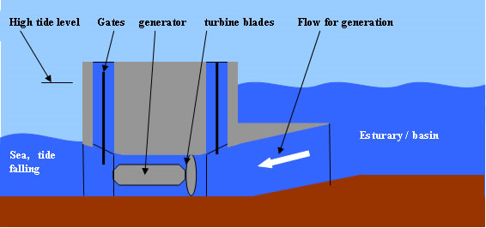
ALL Waves Carry Energy
Capturing Tidal Energy

Slide 34
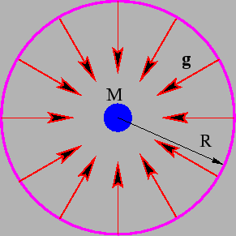
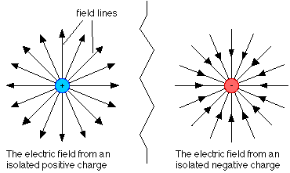
Electric Fields
Force Fields! Just like on Star Trek!
Sort of…
Gravitational
Electric
Notes:
Imagine gravity as “Lines of Force” emanating outward from the center of a massive object.
The Electric force is similar… The “field lines” are also radially directed.
The electric field of a charged particle permeates ALL space.
If another charged particle is placed some distance way, even if it is very very far, they feel each others presence.
DEMO: vandegraff wand

Slide 35
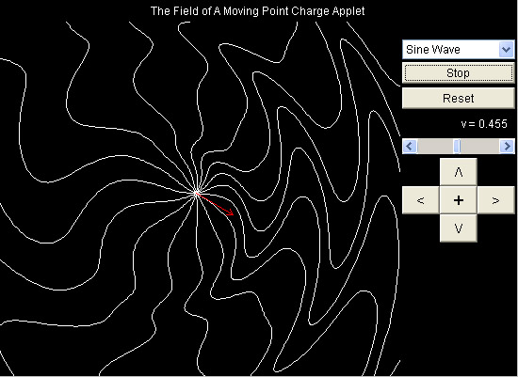
Radiation
A Disturbance in the Electric Field
Notes:
The electric field of a charged particle permeates ALL space.
If the particle moves, the electric field changes.
This change in the electric field propagates outward from the particle at the speed of light.
Some time later, a distant electron feels this change.
It is this change, the disturbance in the electric field, that we call “light”
This change propagates outward as a wave in the electric field.

Slide 36
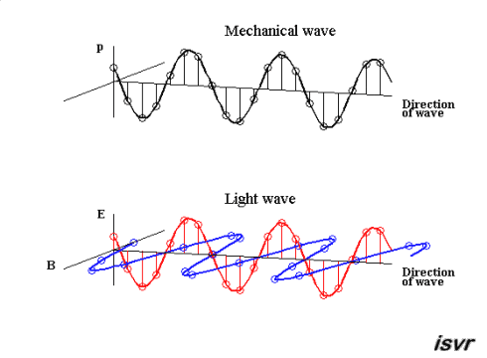
Electro-Magnetic Wave
Side note: not all waves are transverse…. http://www.acs.psu.edu/drussell/Demos/waves/wavemotion.html
Notes:
What kind of wave is light, then?

Slide 37
Light Equations:
c = λ f
(special case v = c)
E_{λ} = h c / λ = h f
λ_{max} T = constant
I_{total} = A σ T⁴

