Slide 1
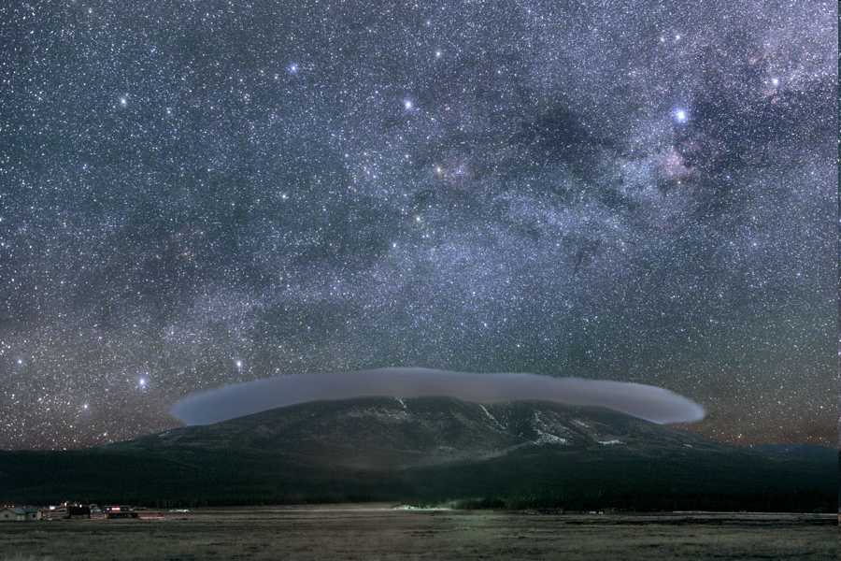
The Sky From Earth
Notes:
WHAT do we see (and experience)?
WHY do we see what we see?
When we walk outside and look into the sky, what do we see?
How does our view change with time?
Why does the night sky change in the way that it does?
Lecture Tutorial: Motions in the Sky
WHAT do we see?
What is the Celestial Sphere?
What are Meridian, the Celestial Equator, and Zenith?
How do the stars move over time?
How does the Sun move over time?
How do the Planets move over time?
How does my view change with position on Earth?
WHY do we see what we see?
Why does the horizon block half the sky?
WHY to questions A4 through A7
Miscellaneous Tidbits
What causes the seasons?
What is a Sidereal Day?
What is a Solar Day?

Slide 2
Lab: Solar Heating
Notes:
What’s the reason for the Seasons?
In class discussion… Take good notes.
Show beam spreading before tutorial

Slide 3
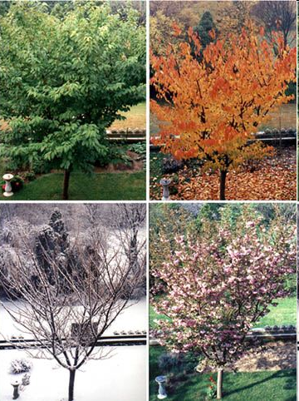
Seasons
What causes differences in temperature?
Notes:
In class discussion… Take good notes.

Slide 4
Seasons
What causes the seasons?
Notes:
Which of these are reasons for the seasons?

Slide 5
Seasons
Hours of Sunlight
Position in orbit
Angle of Sun’s rays
Distance
Tilt
Sun’s Altitude
Ellipticity
Axial Wobble
Notes:
What’s the reason for the Seasons?
In class discussion… Take good notes. Some of these are NOT correct!

Slide 6
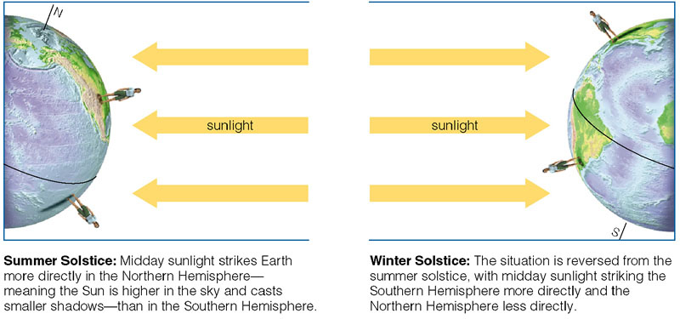
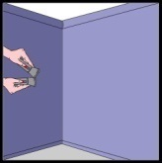
Seasons
Why does the Earth’s tilt matter?
Notes:
What’s the reason for the Seasons?
Tilt causes more “direct” sunlight – in other words, more ENERGY per AREA falling on the surface – in summer, and less energy per area in the winter (this is called “beam spreading”)
Tilt also causes sun to be up LONGER during summer months (so there is more time for heating to occur)
Is it JUST the tilt? No – also the orbit of the Earth around the sun.

Slide 7
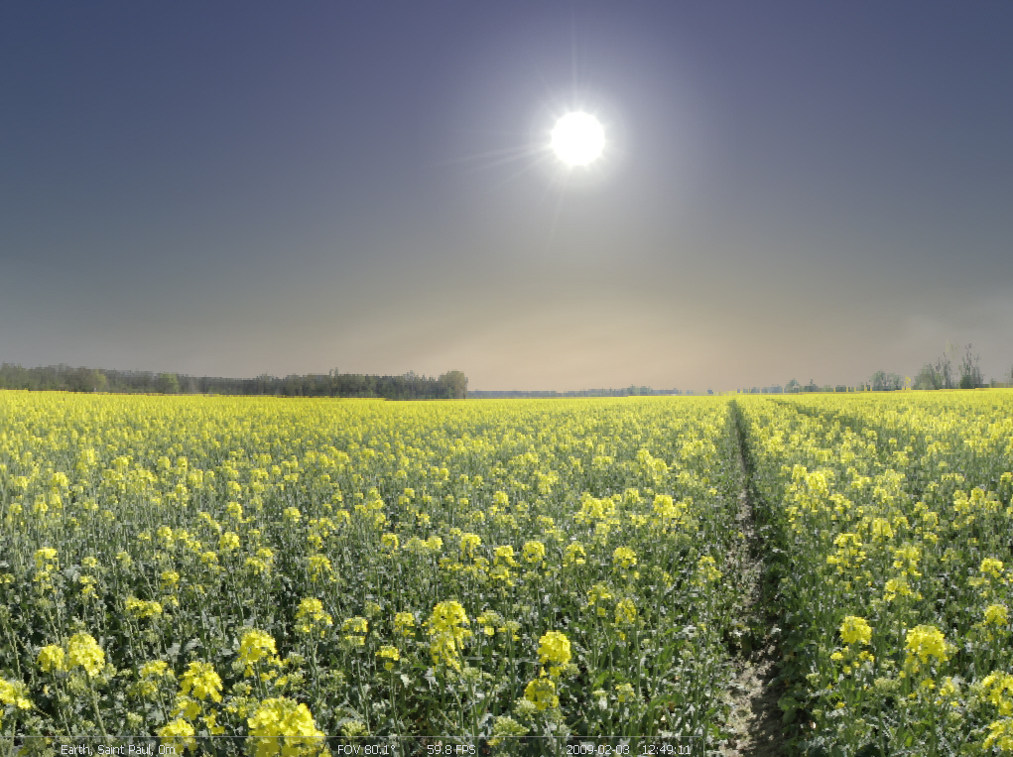
Let’s Step Outside
Lecture Tutorial: Motions in the Sky
Notes:
Using Stellarium, complete the lecture tutorial.

Slide 8
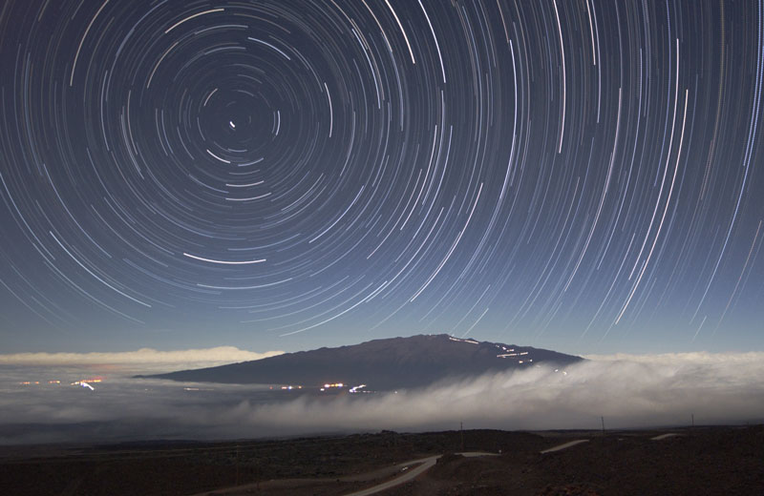
Motions in the Sky: one day
Notes:
The motion of the stars over the course of a day is due to the Earth’s rotation. Because we “feel” stationary, the stars appear to rotate around our north/south axis. Primarily this means stars rise in the east and set in the west, except where they are circumpolar (always above the horizon) and you can see the rotation about the north or south pole.
Image Credit & Copyright: Peter Michaud (Gemini Observatory), AURA, NSF (star trails above Mauna Kea)

Slide 9
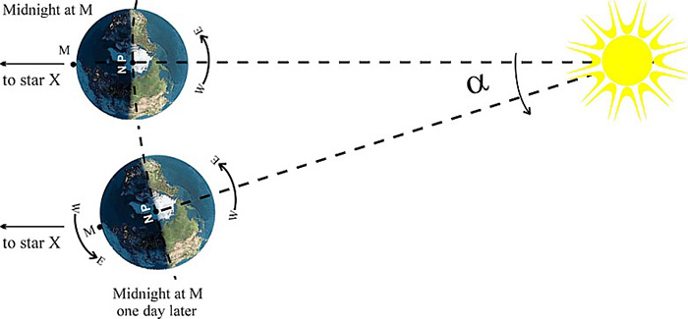
Motions in the Sky: months
Notes:
The motion of the stars over the course of months shows that they moved slowly westward when observed at the same time of day. This is because the Earth orbits the sun in the same direction that it rotates, which makes the sun appear to go the other way (as you saw in the tutorial, the sun moves eastward through the constellations over time).

Slide 10
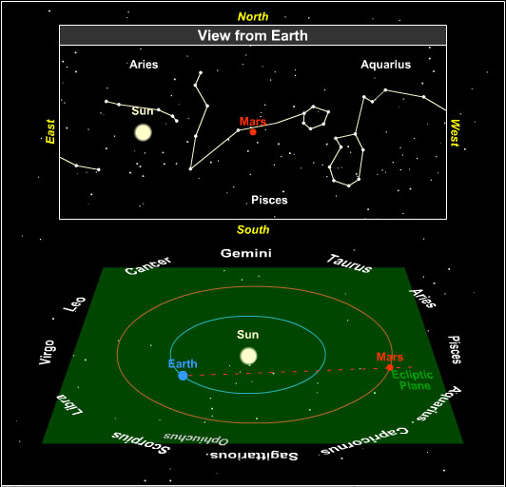
The Planets
Planets migrate eastward along the ecliptic…
Except when they don’t.
Retrograde Motion:
Motion that is ‘backwards’ with respect to what is normal.
Notes:
Remember what happened in Stellarium when you were watching the planets?

Slide 11
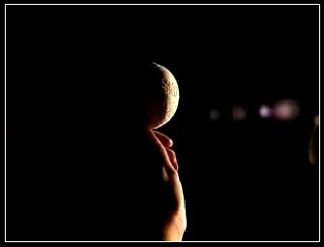
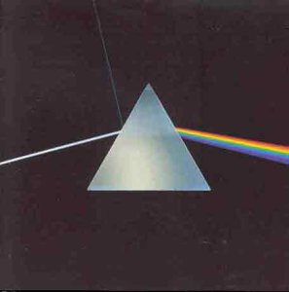
Moon: The Dark Side of the
“There is no dark side of the moon really…”
Notes:
At last there’s no PERMANENTLY dark side of the Moon.
The Moon has day and night just like the Earth.
The odd thing is that it always keeps the same face towards us.
So- there is a FAR side of the Moon.
The far side of the Moon hadn’t been seen by human beings until the Apollo Missions.
The animation shows one complete lunar day as seen from the Earth, called a “Lunation”
Notice that we ALWAYS see roughly the same side.
What’s up with Moon Phases anyway?

Slide 12
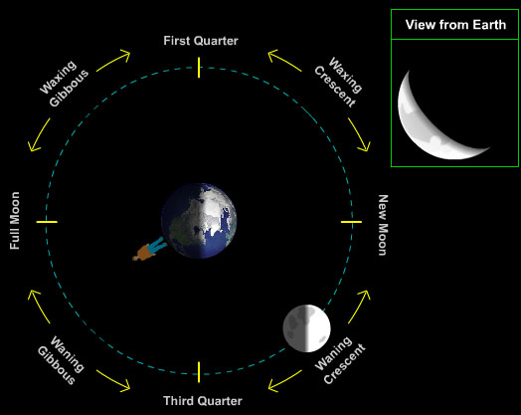
What Causes Moon Phases
Half of the moon is always lit by sunlight.
Notes:
Lecture tutorial: the cause of moon phases

Slide 13
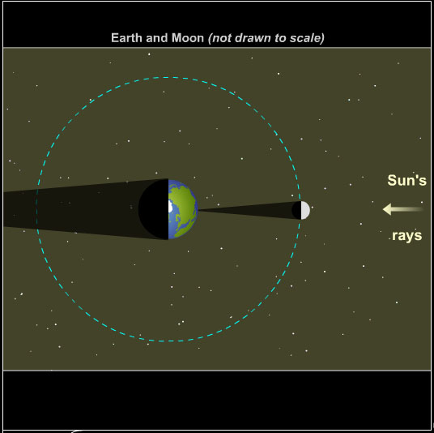
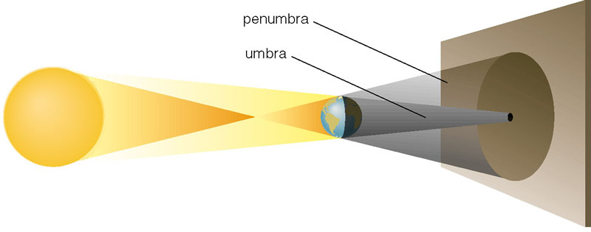
Eclipses
What causes a solar eclipse?
The Moon blocks the Sun.
Notes:
You are in the penumbra when you can see part of the sun around the moon.
You are in the umbra when the entire sun is blocked.

Slide 14
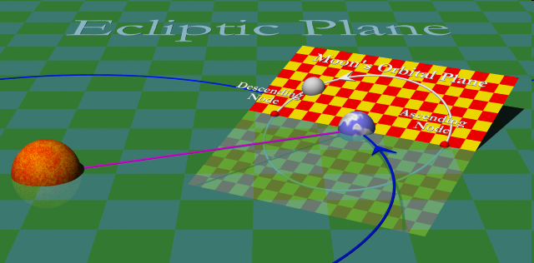
Eclipses
Shouldn’t there be one every month?
The Moon’s orbital plane is tilted 5º with respect to the ecliptic
Notes:
There is a potential for an eclipse twice a year with a sun/node/earth alignment.
There is no guarantee that the moon will actually pass through the node at the right time.
Moon’s radius: 1079mi (1,737.5km) if diam ~ 3.5cm ->
Earth radius: 3,959 miles (6,371 km) then diam ~ 12.7cm ->
Earth-Moon Distance: 238,900 miles (384,400 km) and then -> dist ~ 384cm = 3.84m

Slide 15
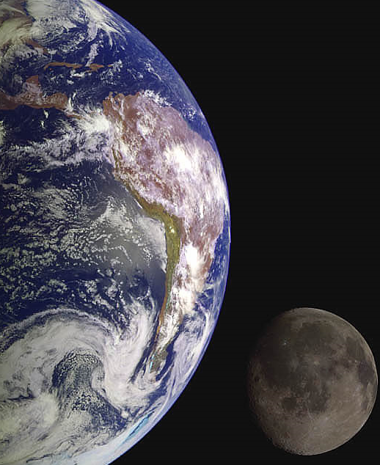
How Far is the Moon?
Notes:
About 30 Earth diameters

Slide 16
How Far is the Moon?
The Earth Moon Distance
235,000 Miles = 0.7 Million NC
Notes:
You can see why they are rarely drawn to scale.
You could walk to the Moon in about 6.7 years at 13 NC/hour
You could imagine a particularly well built car driving 235,000 miles.
Moon’s radius: 1079mi (1,737.5km) if diam ~ 3.5cm ->
Earth radius: 3,959 miles (6,371 km) then diam ~ 12.7cm ->
Earth-Moon Distance: 238,900 miles (384,400 km) and then -> dist ~ 384cm = 3.84m

Slide 17
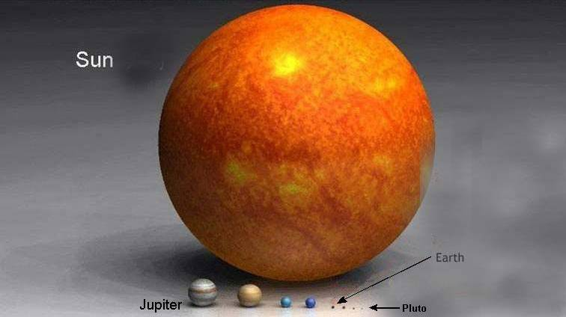
The Solar System
Notes:
The Sun completely dominates the solar system.
The Earth/Moon system fits easily inside the Sun. Twice
The arrows represent the entire DIAMETER of the Moon’s orbit around the Earth.
The Sun has 99.87 percent of the mass of the Solar System.
The Sun is a rather small star though…

Slide 18
Eclipses
Shouldn’t there be one every month?
The Moon’s orbital plane is tilted 5º with respect to the ecliptic
Notes:
There is a potential for an eclipse twice a year with a sun/node/earth alignment.
There is no guarantee that the moon will actually pass through the node at the right time.
Moon’s radius: 1079mi (1,737.5km) if diam ~ 3.5cm ->
Earth radius: 3,959 miles (6,371 km) then diam ~ 12.7cm ->
Earth-Moon Distance: 238,900 miles (384,400 km) and then -> dist ~ 384cm = 3.84m

Slide 19
Demo
Notes:
Moon’s radius: 1079mi (1,737.5km) if diam ~ 3.5cm -> ping pong ball
Earth radius: 3,959 miles (6,371 km) then diam ~ 12.7cm -> big Styrofoam ball
Earth-Moon Distance: 238,900 miles (384,400 km) and then -> dist ~ 384cm = 3.84m
SUN: Need a light!

Slide 20
Summary
Science involves
Hypothesis
Observations
Testing & Revision
Creativity!!!
Motions in the sky
Seasons
Moon Phases & Eclipses
Retrograde Motion
Scale of the Universe
Planets,
solar/stellar systems
galaxies
galaxy groups
observable universe
The Universe

