Slide 1
Astronomy
Exploring The Universe
Summer 2016
Instructor: Kisha Delain

Slide 2
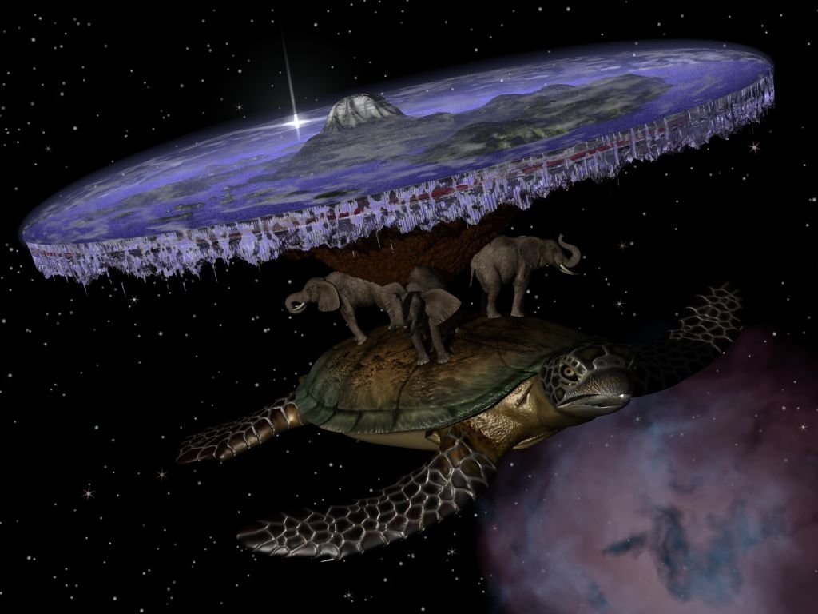
Flat Earth Society
Hi! I’m a member of the Flat Earth Society.
The Earth is flat, you know that, right?
You don’t think so?
Prove me wrong…

Slide 3
You convinced me…
Ok so you were right… the Earth IS a sphere!!

Slide 4
Course Goals
Science vs. Pseudo-science
What do we know about the Universe and our place in it?
How can we apply this to our everyday lives?

Slide 5
This Week’s Class
The Nature of Science
Motions in the sky (stars, planets, the Moon)
Seasons
Astronomical scales

Slide 6
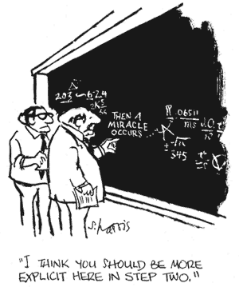
What is Science?
Class Answers:
Scientific method
-exploring, finding clues
-prove/disprove current beliefs (hypotheses)
-conducting experiments
-discover results
Reproducible (process)
Study of earth/nature/elements/natural world
A HUMAN endeavor
Notes:
Here ask students to answer this question in groups – brainstorm. Then put all on board, add to slides later
Observations
Hypothesis
Experiment
Observe again
Test hypothesis
Creativity!!!
Studying nature
Using empirical data to understand everything!!!!
Empirical = observed, measurable
Predictable
Move to theory (why)

Slide 7
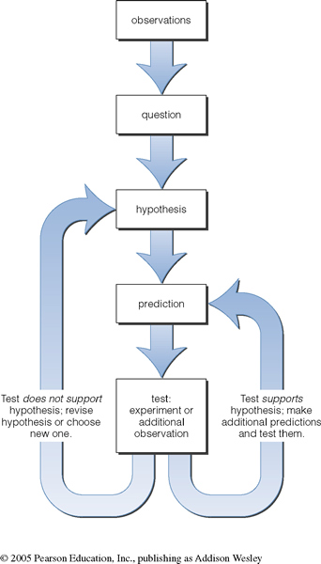
The Scientific Method
Key Features:
Hypotheses are based on observations.
Hypotheses must be testable.
If the experimental results contradict the hypothesis, the hypothesis must be revised.
Notes:
It’s all much messier than you think….

Slide 8
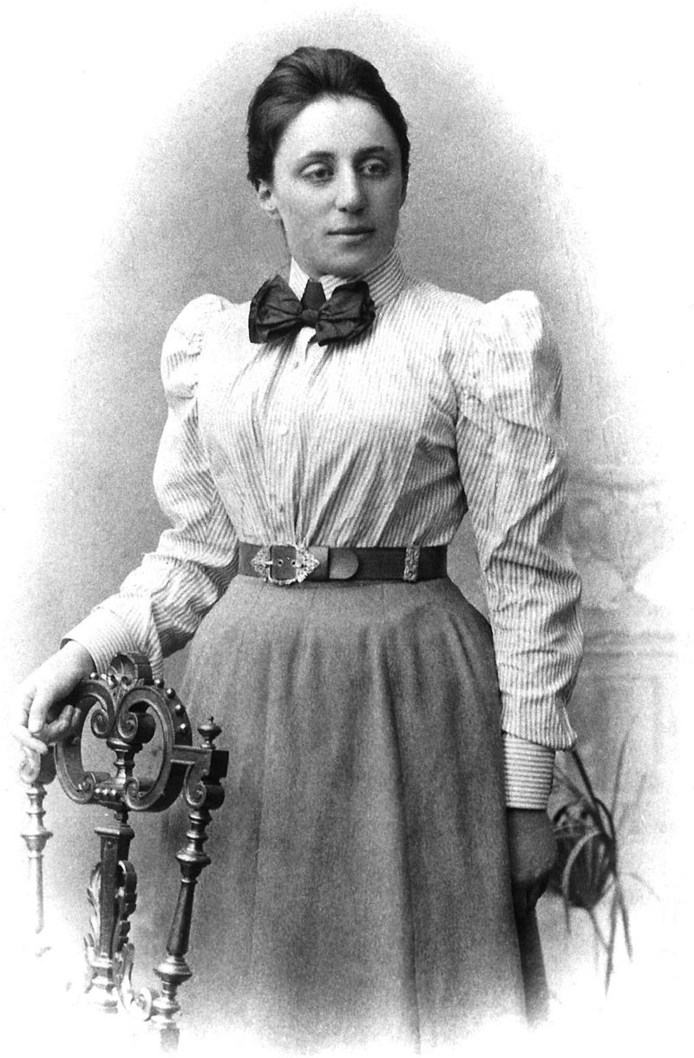
Scientific Theory
It’s just a theory.
Theory:
An explanation of a group of occurrences in nature that has been confirmed by a substantial number of experiments and observations.
Scientific theory is not mere conjecture.
Emmy Noether
Notes:
“The most significant creative mathematical genius thus far produced since the higher education of women began” - Einstein

Slide 9
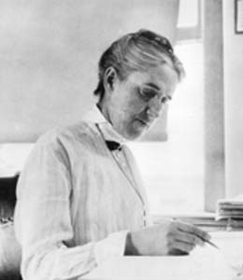
Scientific Law
Law:
A (mathematical) description of a process in nature, without underlying theoretical explanation.
Simple, Empirical description only.
Can a scientific theory become scientific law?
Henrietta Swan Leavitt
Notes:
Simply stated, while a law notes that something happens, a theory explains why and how something happens
Henrietta Swan Leavitt’s work would be followed by Annie Jump Cannon, who explained the why and how.

Slide 10
Hallmarks of Science:
Explanations rely solely on natural causes
Create and test models (hypotheses)
Models explain nature as simply as possible
Must make testable predictions
If test fails, revise or throw it out!

Slide 11
The Scale of the Universe
Notes:
The Sun is MUCH bigger than the Earth.
It’s about 100 Earth diameters across.
The entire Earth/Moon system fits inside the Sun.

Slide 12
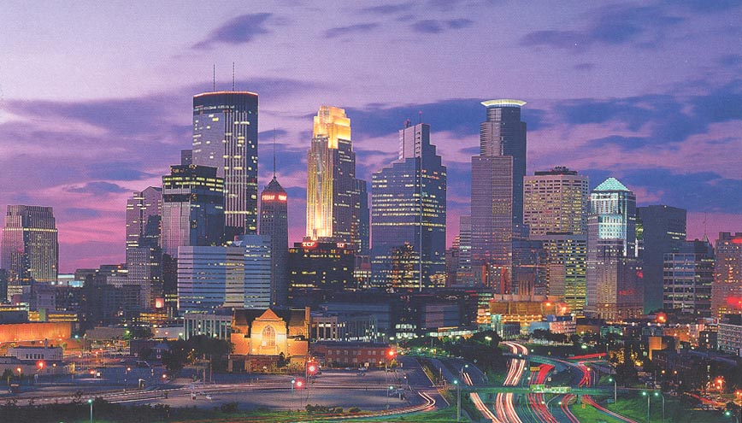
Local Scale
1 mile = 3.3 NC

Slide 13
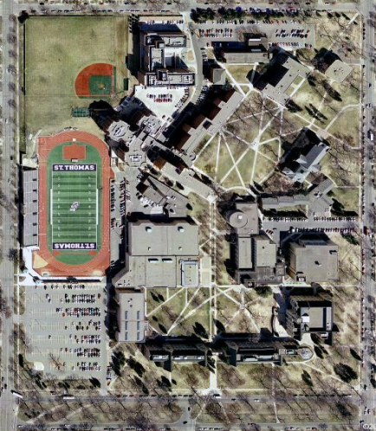
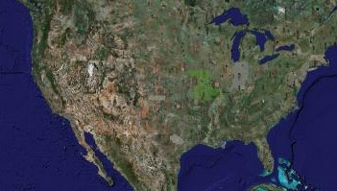
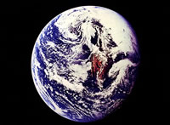
Local Scale
North Campus
0.3 Mile = 1 NC
The United States
2,600 Miles = 8,600 NC
Earth
7,926 Miles = 24,320 NC
Notes:
Units of measure (feet, inches, miles, furlongs, etc.) are defined in a completely arbitrary way.
We generally pick a unit that is matched to the thing that we’re measuring.
Starting with a view of the North Campus of UST, we’ll define a new unit of measure: The North Campus or the NC
One NC = 0.3 miles.
Think about how long it takes you to walk one NC. At 4 mph (13 NCs per hour), it’s about 4.5 minutes
The United States is 8,600 NCs across. At 4 mph, you can walk it in 26 days
The Earth is 24,320 NCs around. At 4 mph, you can walk it in 76 days

Slide 14
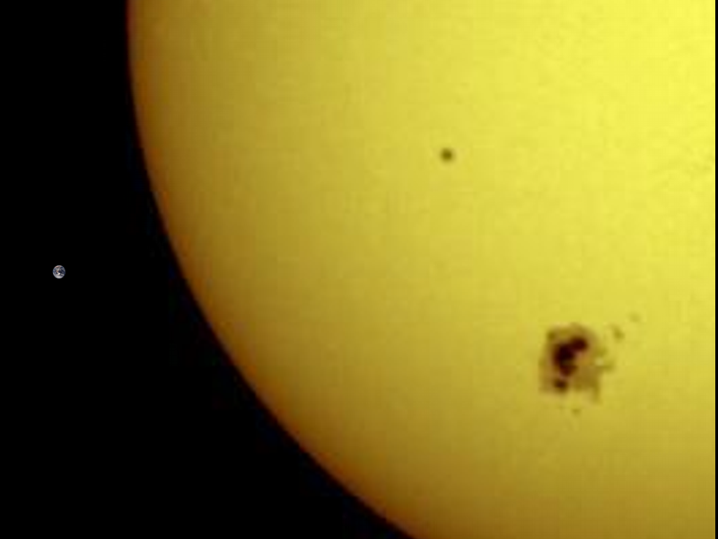
Sun Earth Comparison
Notes:
The Sun is MUCH bigger than the Earth.
It’s about 100 Earth diameters across.
The entire Earth/Moon system fits inside the Sun.

Slide 15
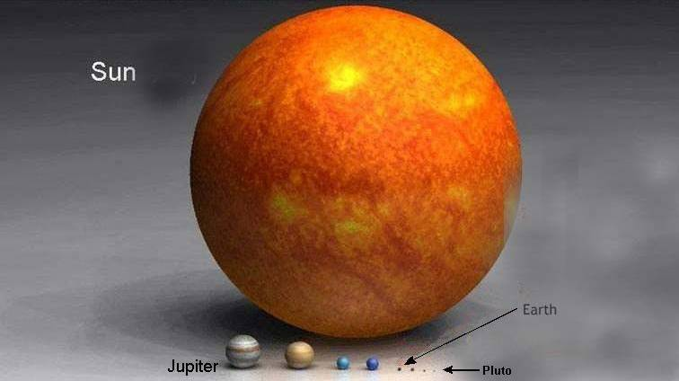
The Solar System
Notes:
The Sun completely dominates the solar system.
The Earth/Moon system fits easily inside the Sun. Twice
The arrows represent the entire DIAMETER of the Moon’s orbit around the Earth.
The Sun has 99.87 percent of the mass of the Solar System.
The Sun is a rather small star though…

Slide 16
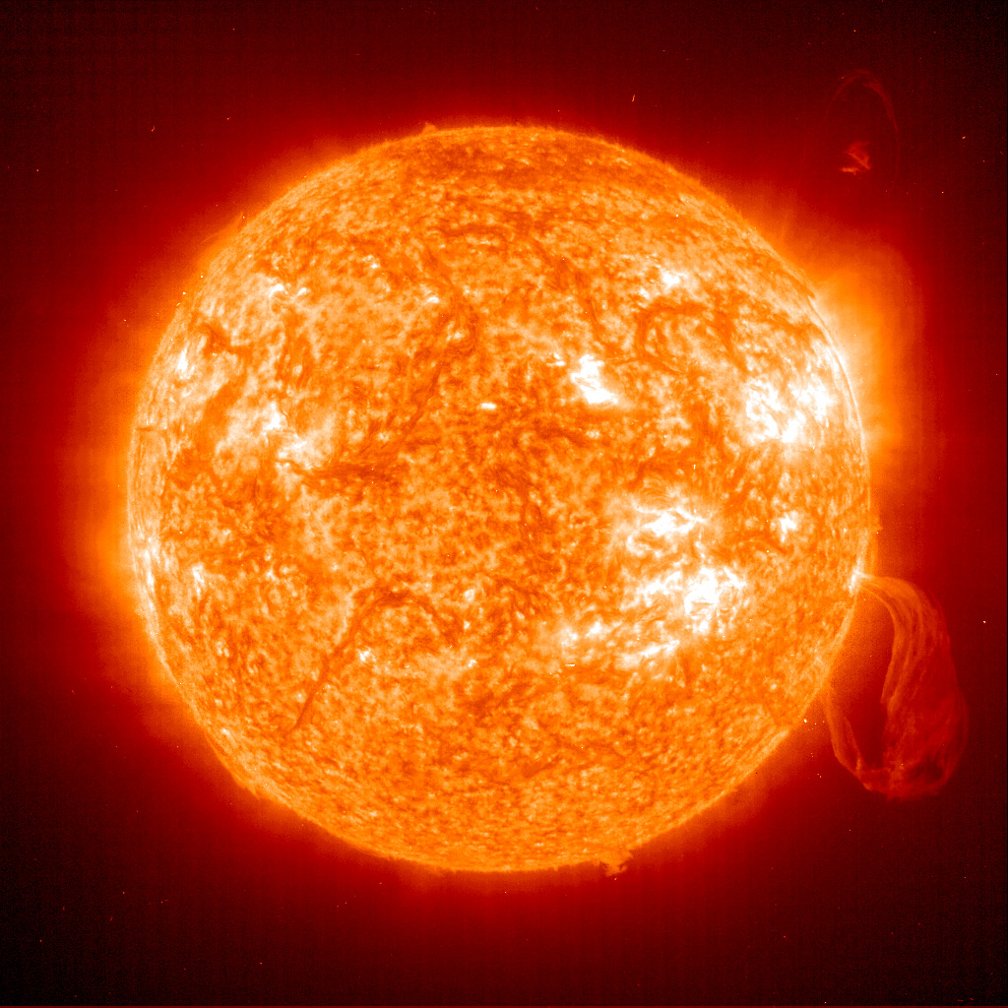
The Sun
Let’s see how big the solar system is!
Notes:
Here ask students to do the exercies with the tapes – break into groups of 4 or 5. Start with them choosing Earth-Sun distance and then guess at the other planets. Then with the other tape go through the next slides with correct distances in AU.

Slide 17
Mercury
0.38 AU
1 AU = distance from Earth to Sun
Notes:
That “bald” spot is where there was no data from Mariner 10 or whatever it was.
Surface gravity – where I have the number in parentheses is how much you would weigh on that planet if you weighed 80 lbs on Earth.

Slide 18
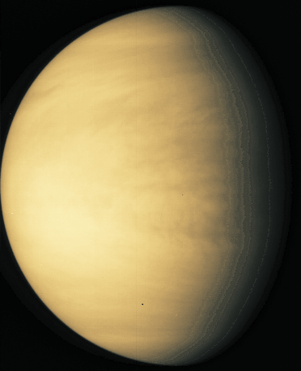
Venus
0.72 AU
Notes:
Bottom left – true color
On right – true color of the surface – thru clouds by radar

Slide 19
Earth at night
1 AU
Notes:
Have them find (or point out) Minneapolis or Japan or something.

Slide 20
Mars
1.52 AU

Slide 21
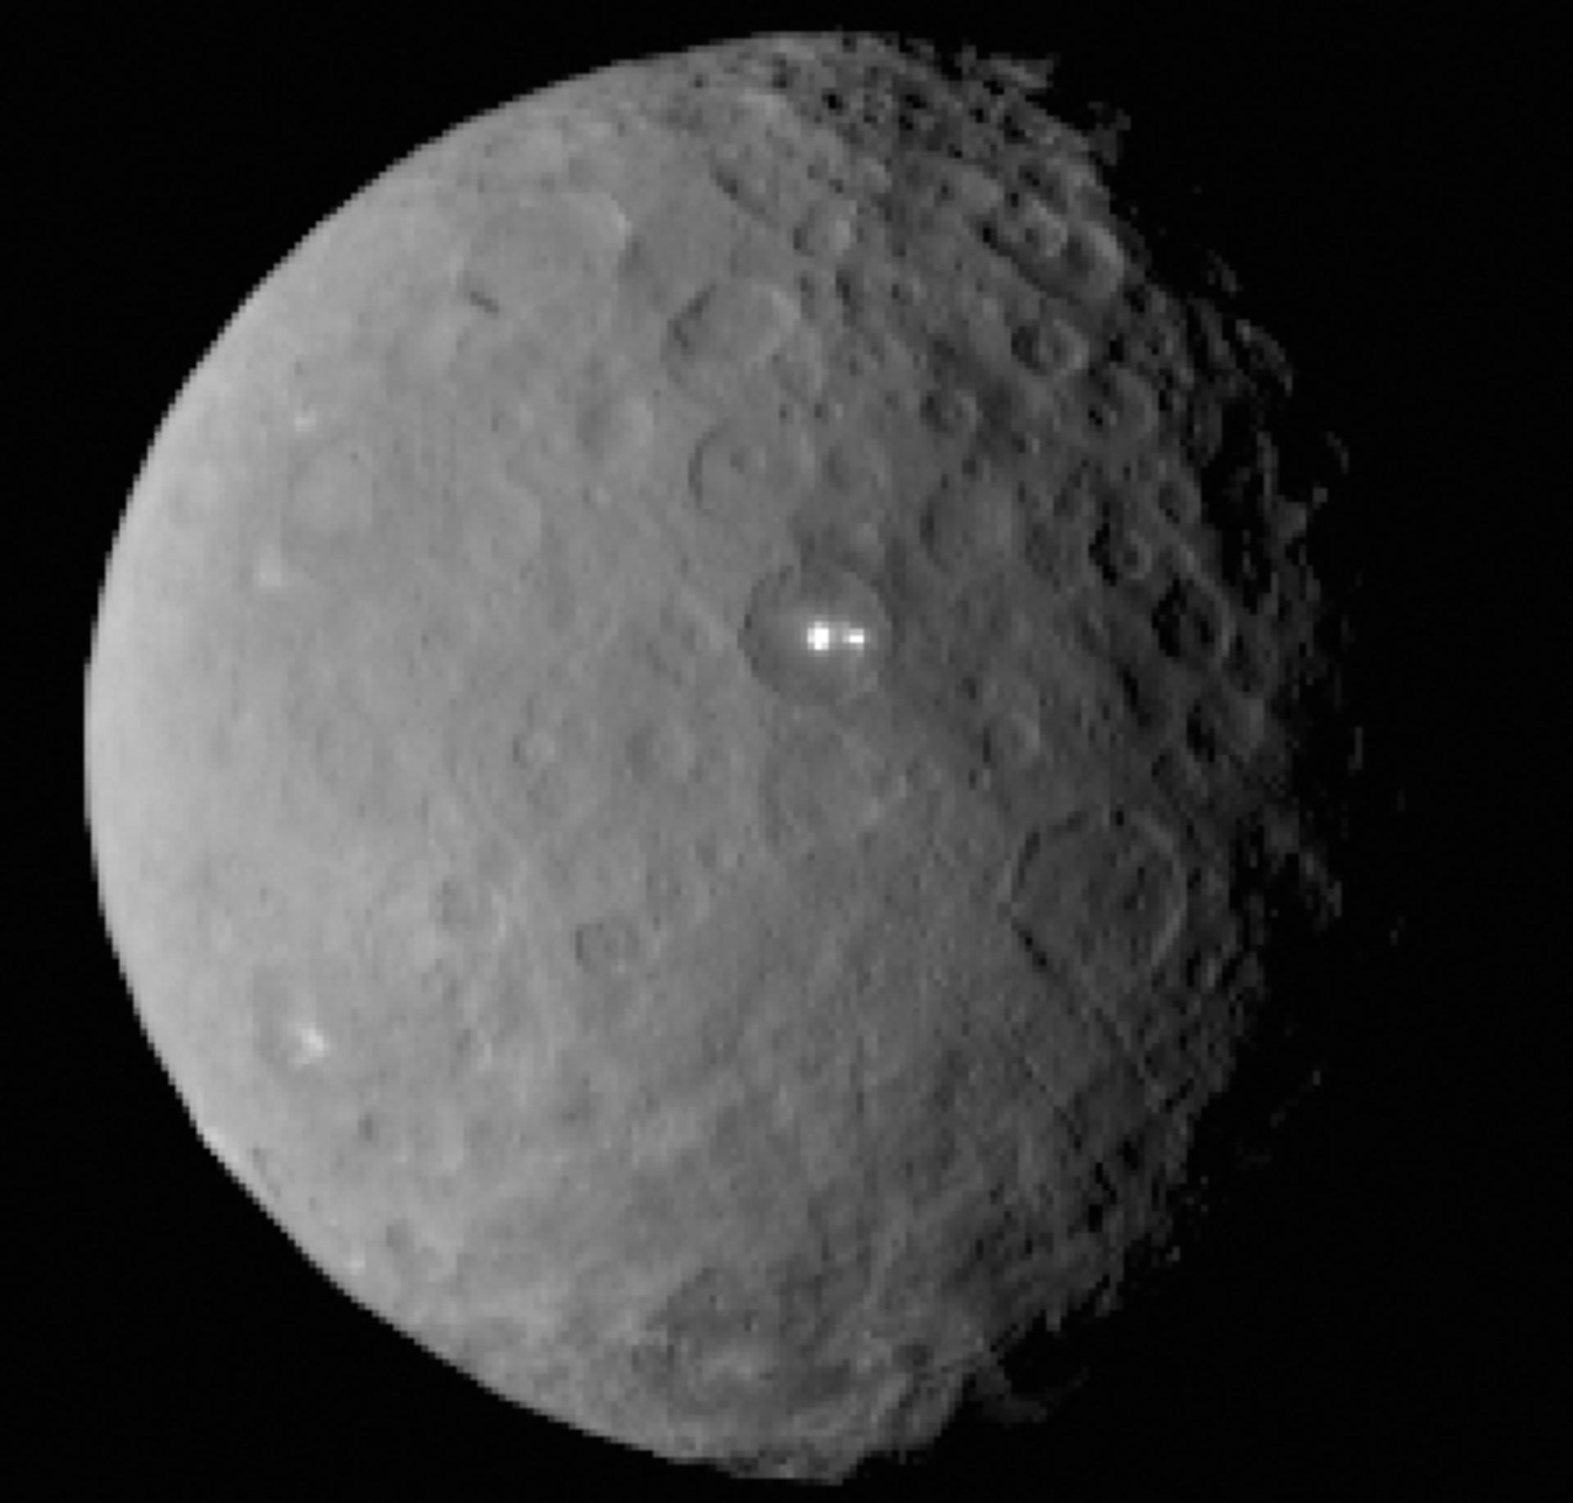
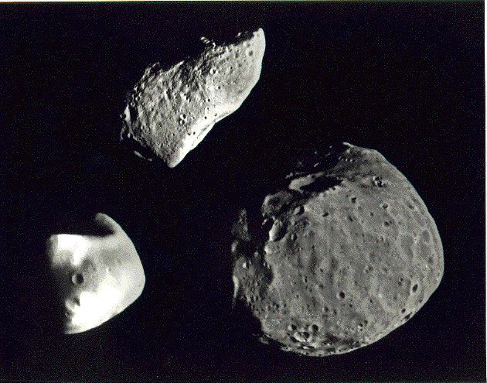
Asteroids!!
2-4 AU
Ceres* (above)
Comparison of Phobos, Deimos, and Gaspra (left)
Notes:
*Ceres is a dwarf planet

Slide 22
Jupiter
5.2 AU

Slide 23
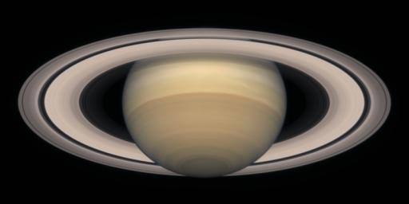
Saturn
9.5 AU

Slide 24
Uranus
19 AU

Slide 25
Neptune
30 AU

Slide 26
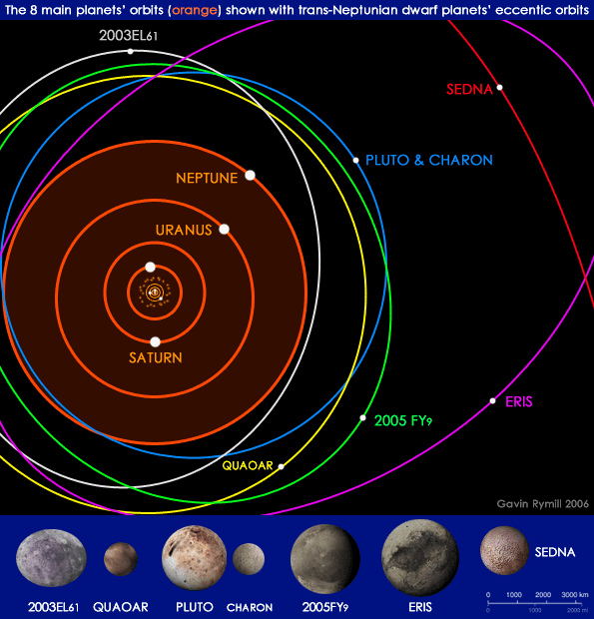
Kuiper
Belt:
30-55 AU
Notes:
Discuss with students their comparisons between their guesses and the real answers

Slide 27
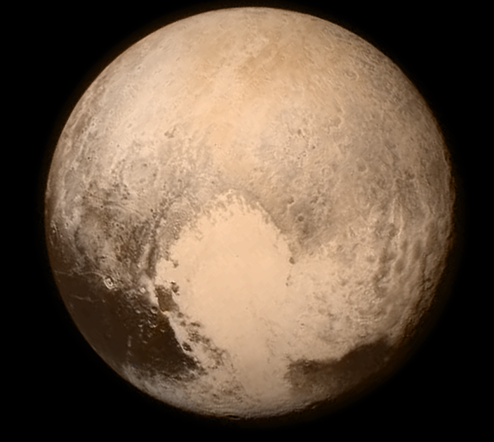
Kuiper
Belt:
Pluto
Notes:
Discuss with students their comparisons between their guesses and the real answers

Slide 28
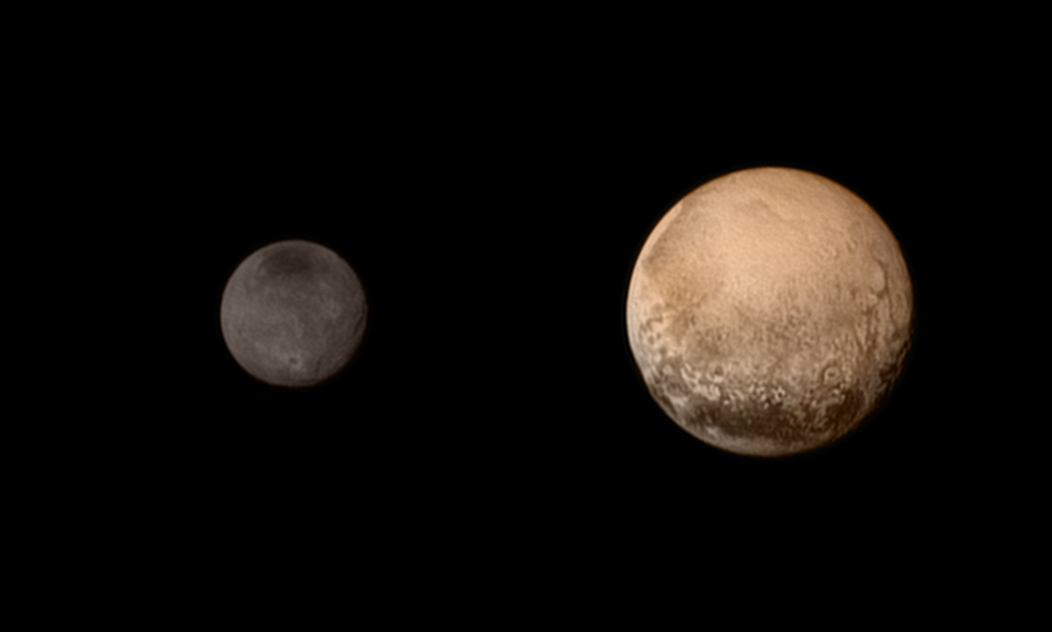
Charon and Pluto
Notes:
Don’t forget Nix, Hydra, Styx and Kerberos

Slide 29
The Solar System
Sun: 1 meter diameter
Mercury
Venus
Earth
Mars
Jupiter
Notes:
Let the Sun have a diameter of 1 meter and place in the end zone of the UST football field.
Mercury ends up on the 45 yard line.
Venus is about 75 yards away
Earth is just beyond the opposing end zone.
Mars is in the Parking lot
Jupiter is… off the map
In the solar system, we use a unit of distance called an Astronomical Unit (AU).
It is the average distance between the Earth and the Sun (about 93 million miles)

Slide 30
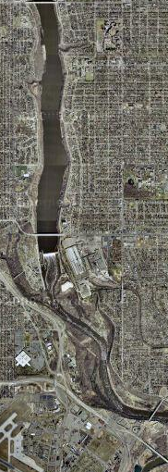
The Solar System
Sun: 1 meter
Jupiter
Saturn
Uranus
Neptune
Pluto
Notes:
The gassy planets are much further away from the Sun than the Earth is.
Jupiter is around South Campus.
5 times further away than the Earth is from the Sun.
We say it’s 5 AU away.
1 AU = the average Earth Sun distance.
And they’re made of gas (mostly). VERY different than the terrestrial planets.

Slide 31
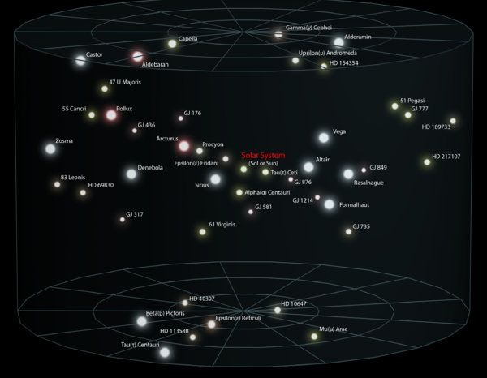
The Solar Neighborhood
Light Year: The distance light travels in 1 year.
1 lyr = 63,240 AU = 5.9x10¹² miles = 2.0x10¹³ NC
Our Nearest Star:
Alpha Centauri
4.4 lyr

Slide 32
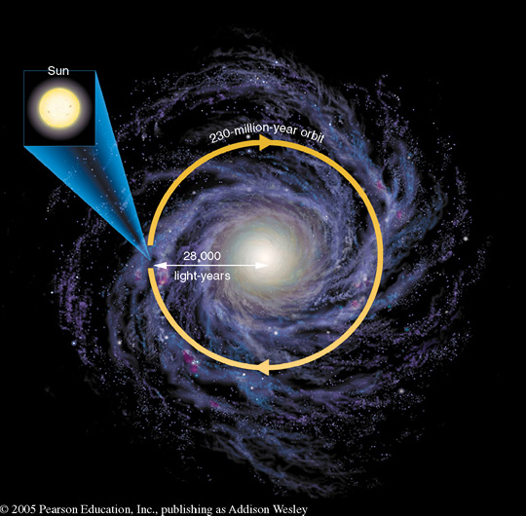
The Milky Way: Our Galaxy
Galaxy: A huge assembly of stars, gas, and dust held together by gravity
More than 100 billion stellar systems
100,000 lyr diameter
If R_{sun} = 1 meter
R_{galaxy} = 4.5 AU

Slide 33
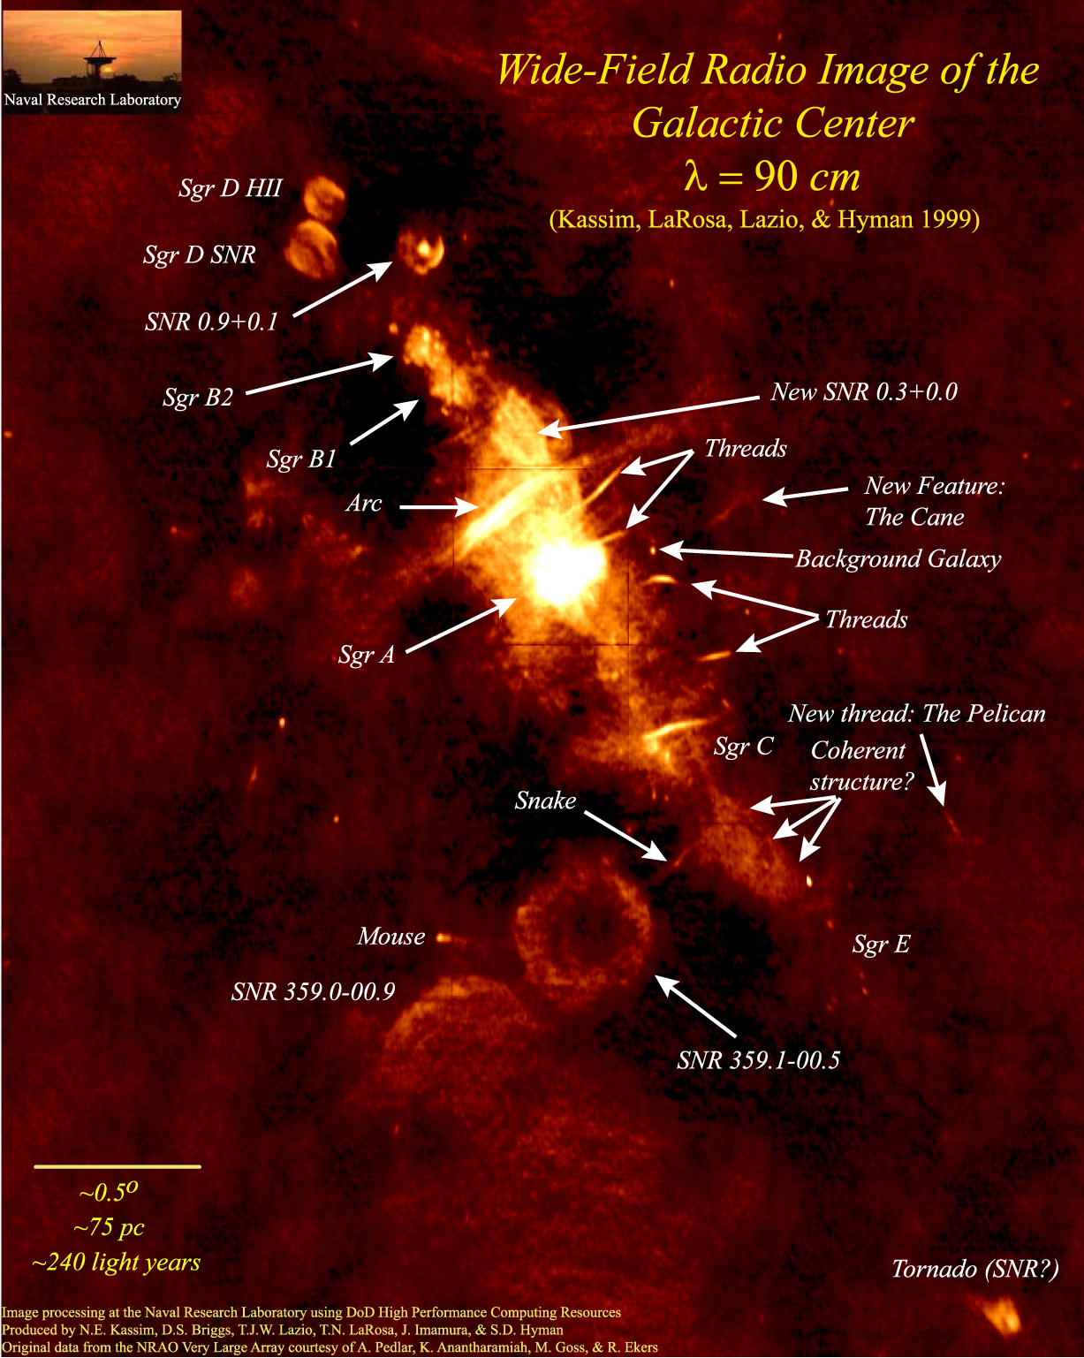
26,000
light years

Slide 34
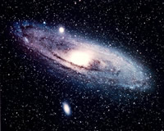
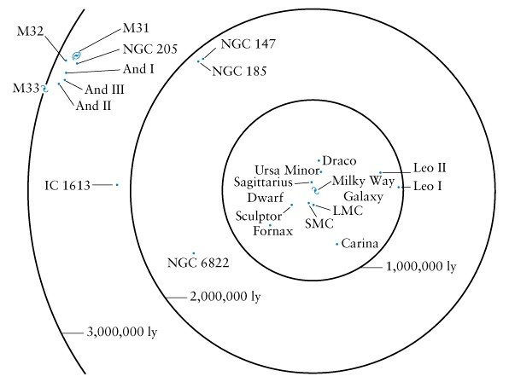
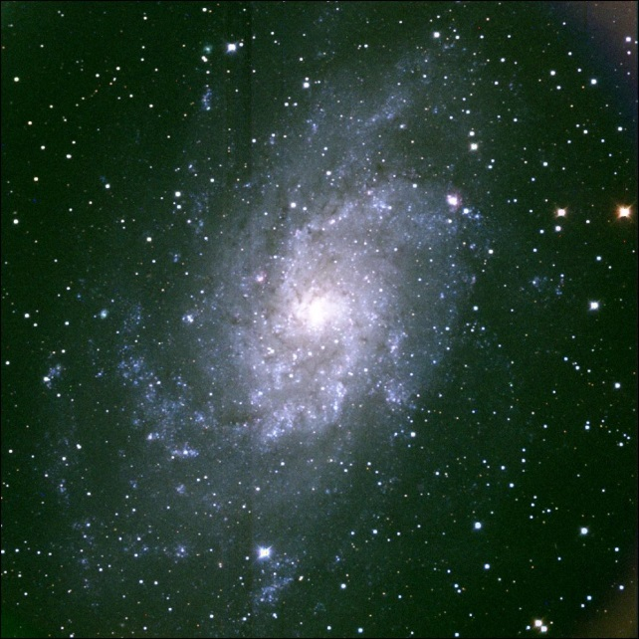
The Galactic Neighborhood
Andromeda: 2.5 million lyr
25 Milky Way diameters
M33: 3 million lyr
30 Milky Way diameters

Slide 35
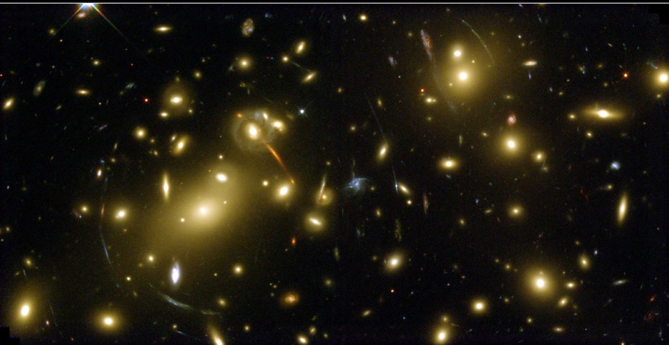
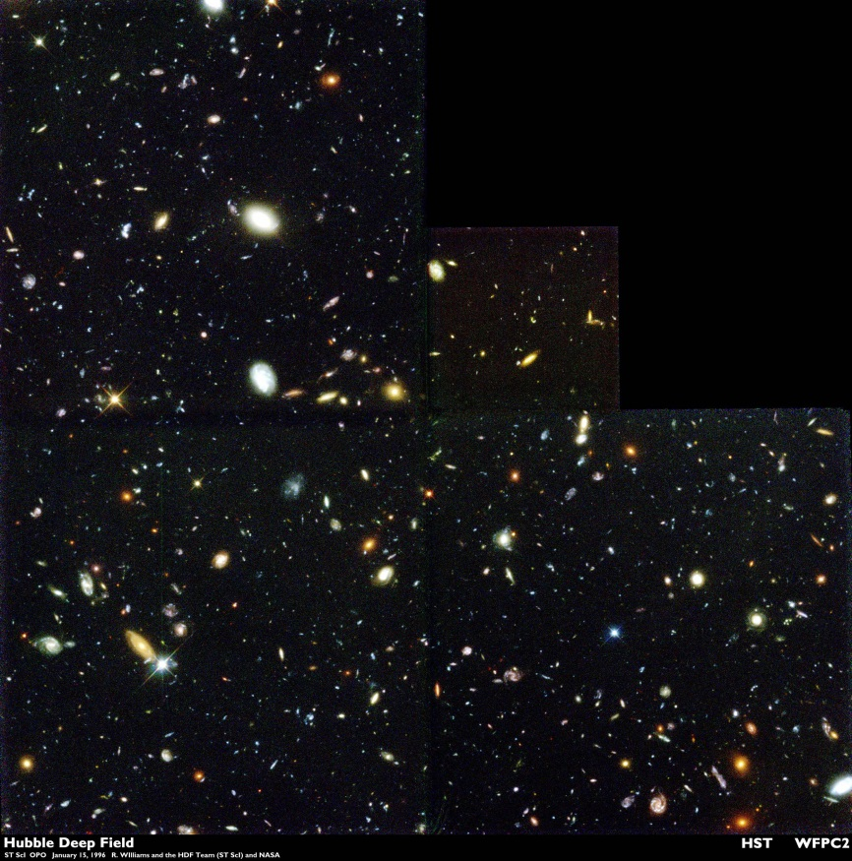
The Universe
The Universe: The collection of EVERYTHING
The Observable Universe:
The collection of everything that we can SEE
The edge of the observable universe is approximately 14 billion light years away.

Slide 36
The Universe is Really Big!!

